Slide 1
LIFE-SAVING AGENCY

Slide 2
HISTORY
Our company was founded in 2012, in Milan, by a group of computer engineers. the name of the company is life-saving agency, because it offers protection services.

Slide 3
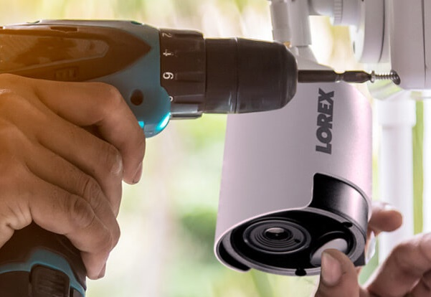
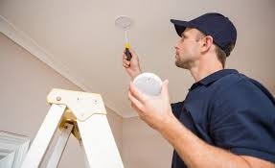
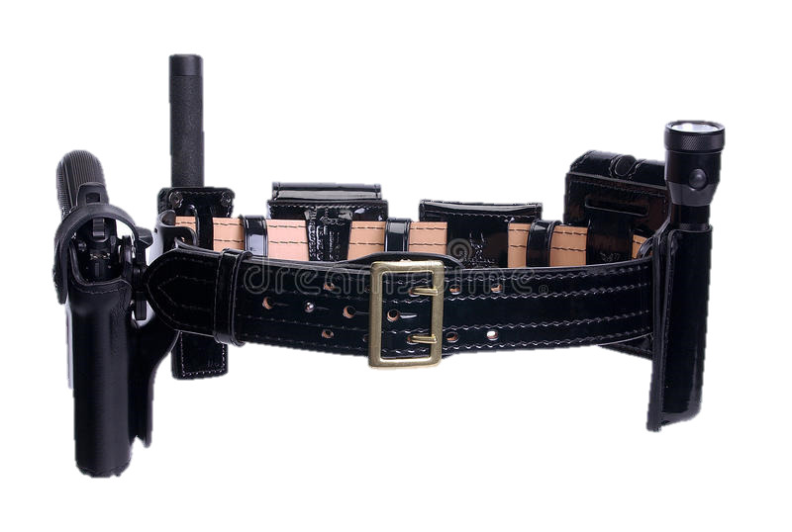
OUR SERVICES
Installation of camera
Installation of burglar alarms
we provide protection services such as:
Installation of fire alarmsi
Some gadgets for police officers

Slide 4
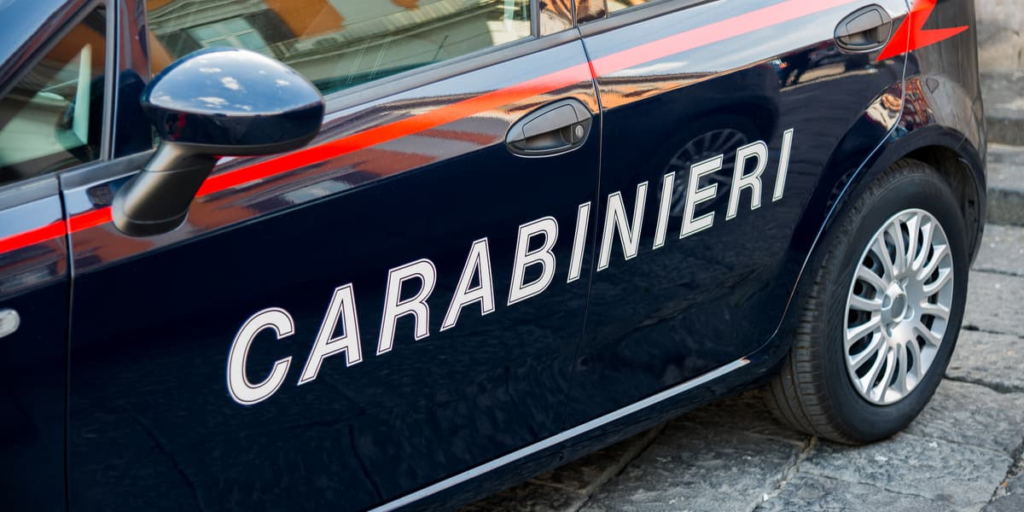
New service
The new service consists in the installation of a device that allows you to press a special button, in cases of emergency and sends a signal to the nearest police station, sending help.

Slide 5
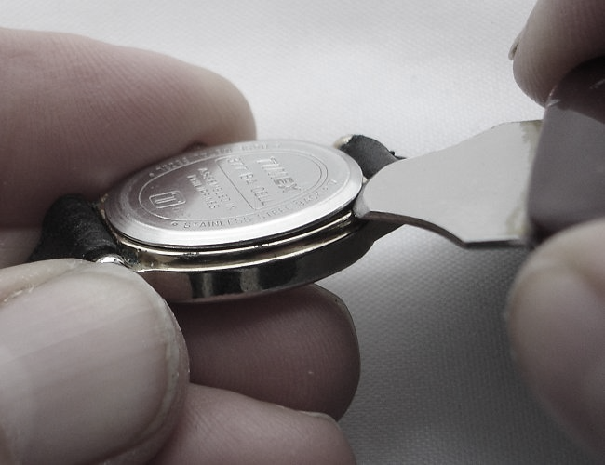
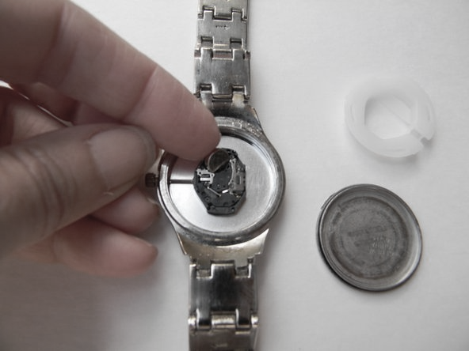
How to do the installation?
First of all you need to bring us your watch, then we remove the back of the watch to install the new special button, the gps and the allarm.
The price changes according to the type of the watch that you own.
The prices range from 45 € to 80 €

Slide 6
How you can contact us?
www.lifesaveragency.com
life.saver.agency@gmail.com
0249170352
you can contact us for other information with our phone number or with our email, while in our website you can see and buy our products or our services.

