Slide 1
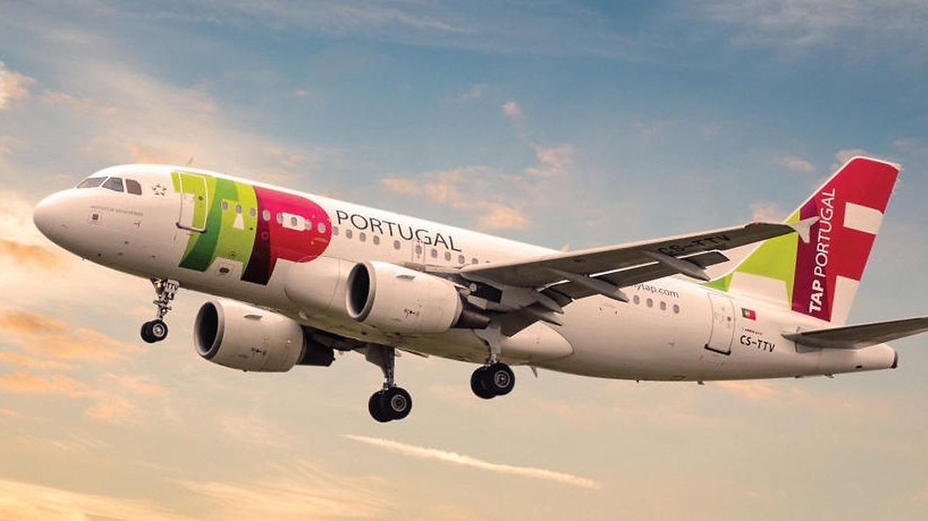
TAP
Francisco Duque
Tárcia Sebastião
Marta Roque
Mariana Santos

Slide 2
Relevant Information
On March 14, 1945 - TAP was created.
The first oficial logotipo of TAP.
The first trip made inside the country was from Lisbon to Oporto in 1947.
In 1948 a few routes were first inaugurated to Sevilla and Paris.

Slide 3
-A new image was adopted in 1948. -In 1948 TAP started travelling to London. -In 1953 TAP became a joint-stock company with limited responsibility. -TAP also started flying to Casablanca and Tanger. -In 2004 TAP payed tribute to a famous football player by naming one of its planes as “Eusébio”.

Slide 4
TAP in 2009 launched 6 new environmentally-friendly airplanes. TAP was the first airline company to launch the CO2 compensation program. TAP has 98 aircrafts.

