Slide 1
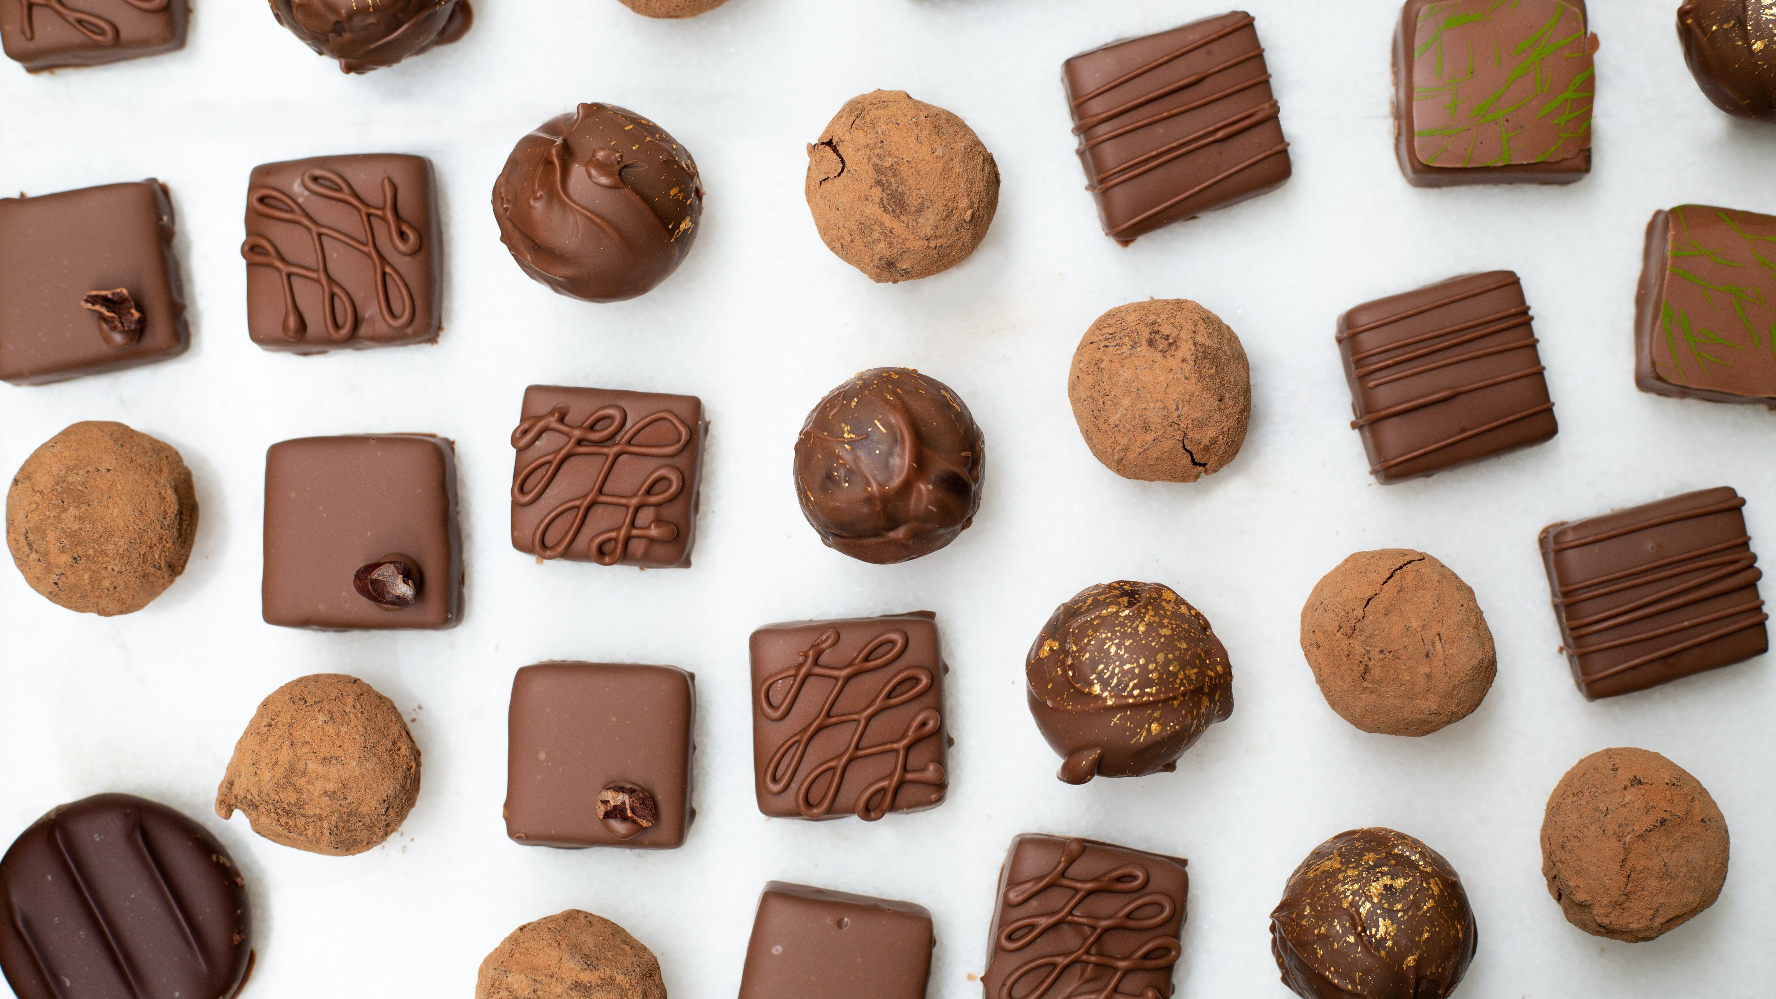
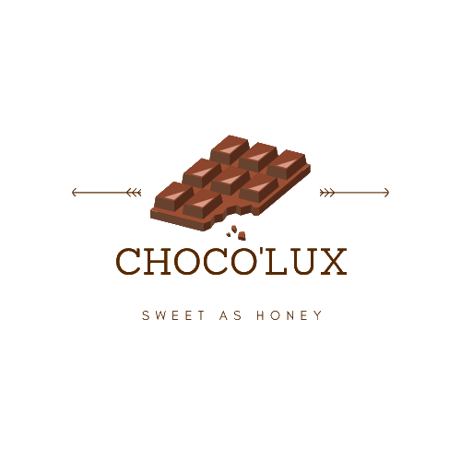

Slide 2
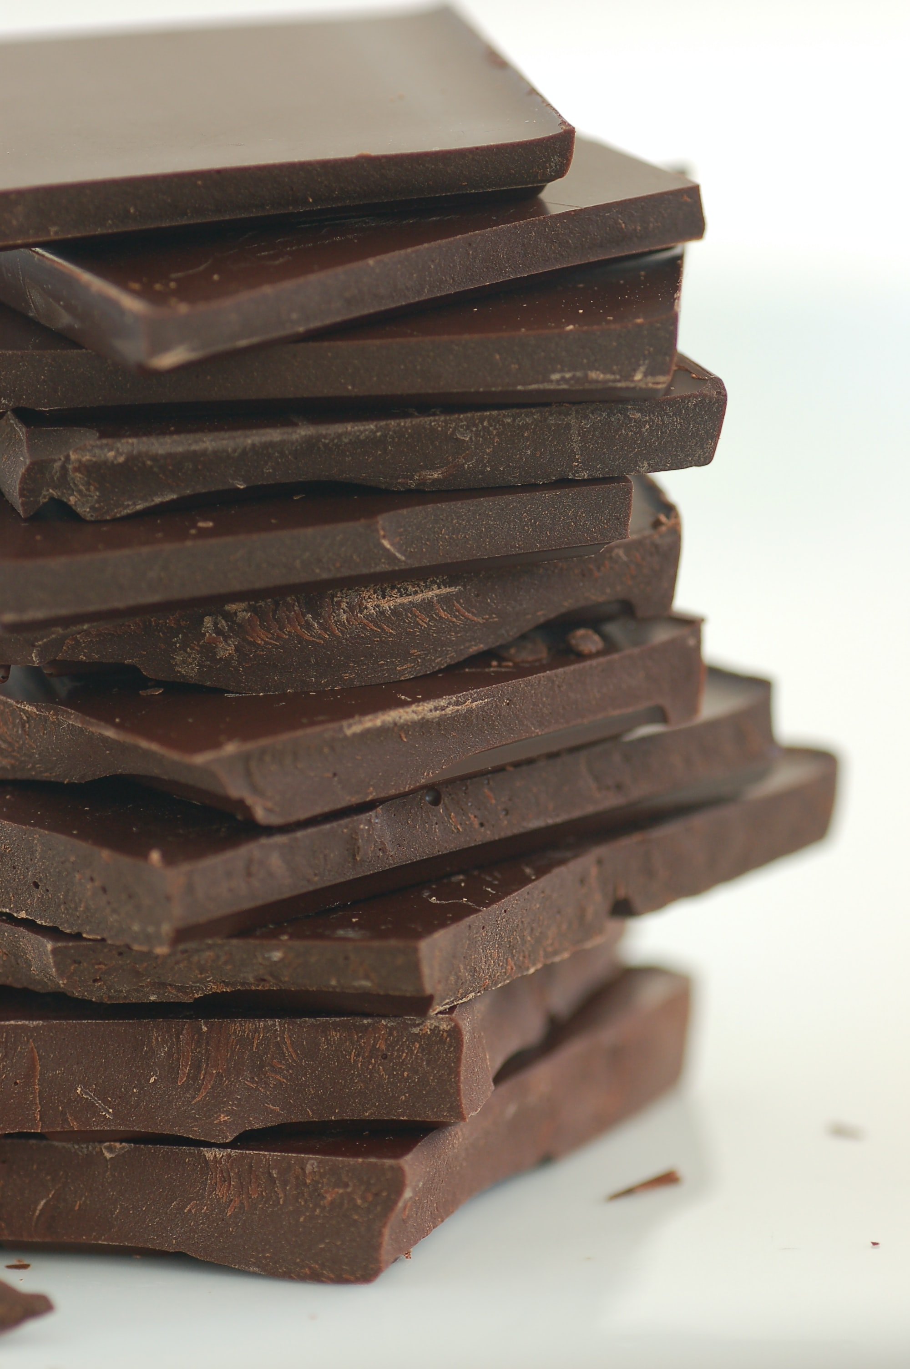
COMPANY DESCRIPTION
Choco'Lux is a company specializing in the preparation of filled chocolate. We have a wide range of products, our products are generally manufactured in large quantities and distributed through our stores located in Réunion. We also own a special production method customized for customers. In addition, we have excellent customer service, available on call and always eager to help each of our customers. You can buy our chocolate on our website.
The company is located in Reunion Island

Slide 3
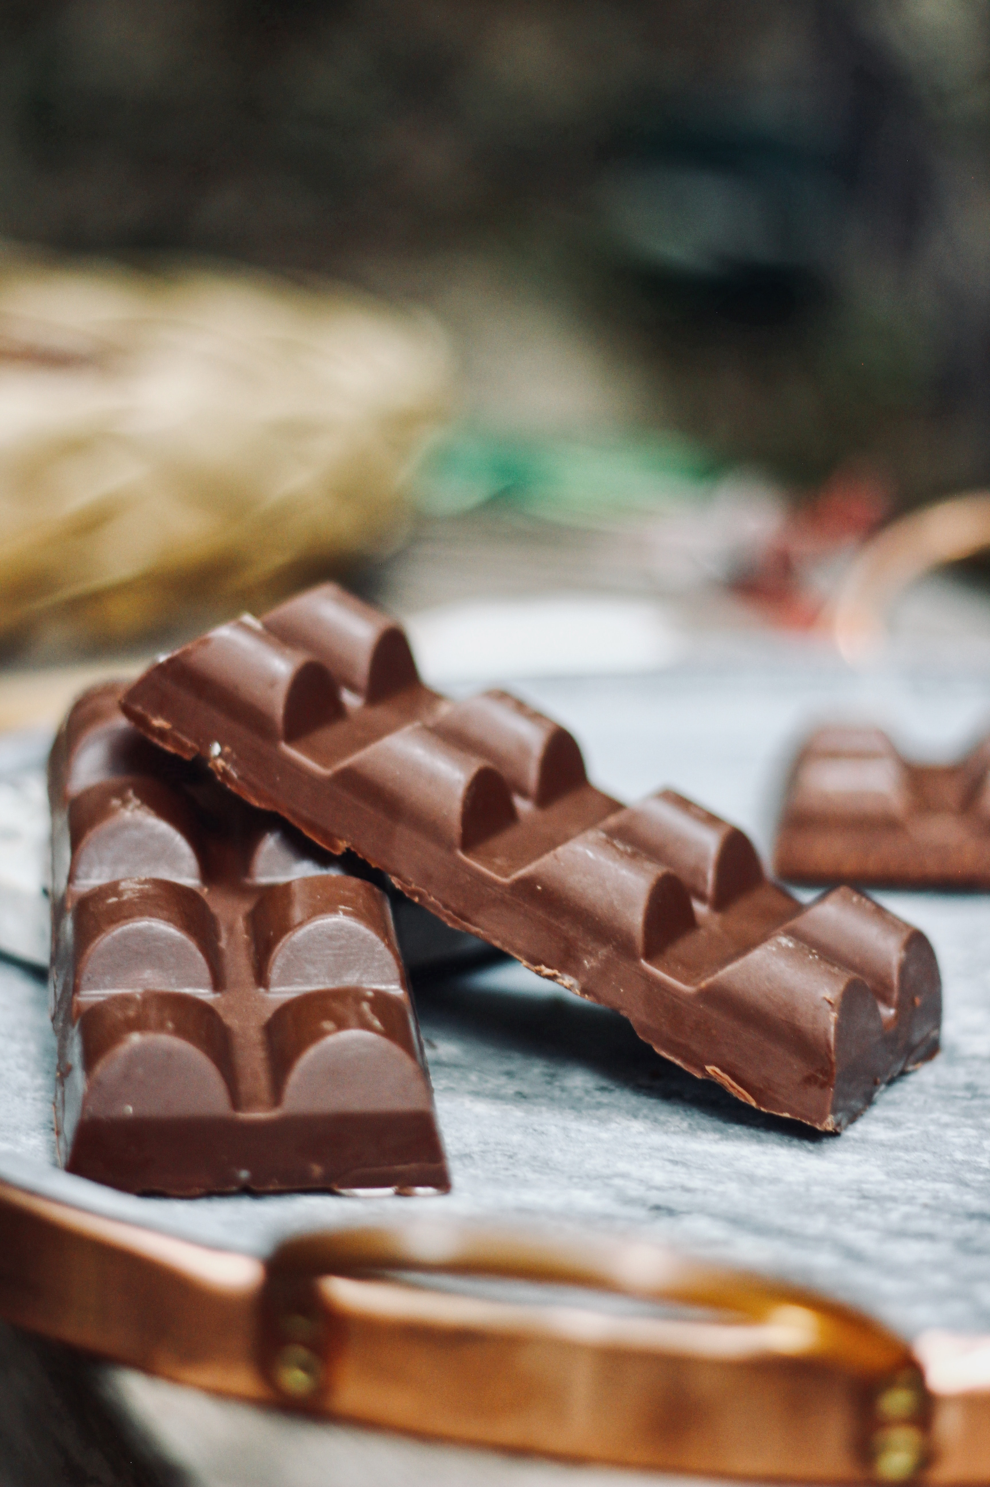
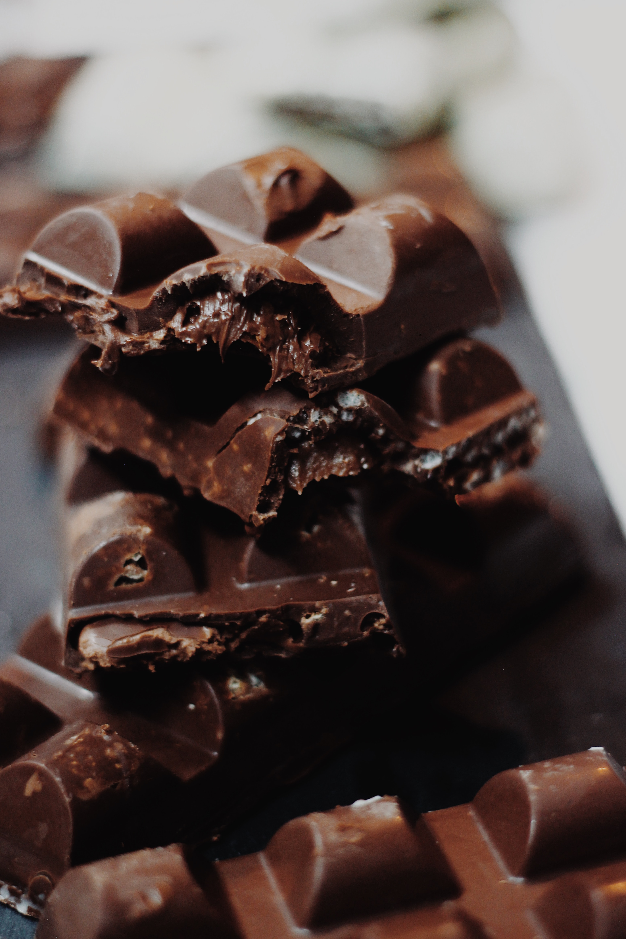
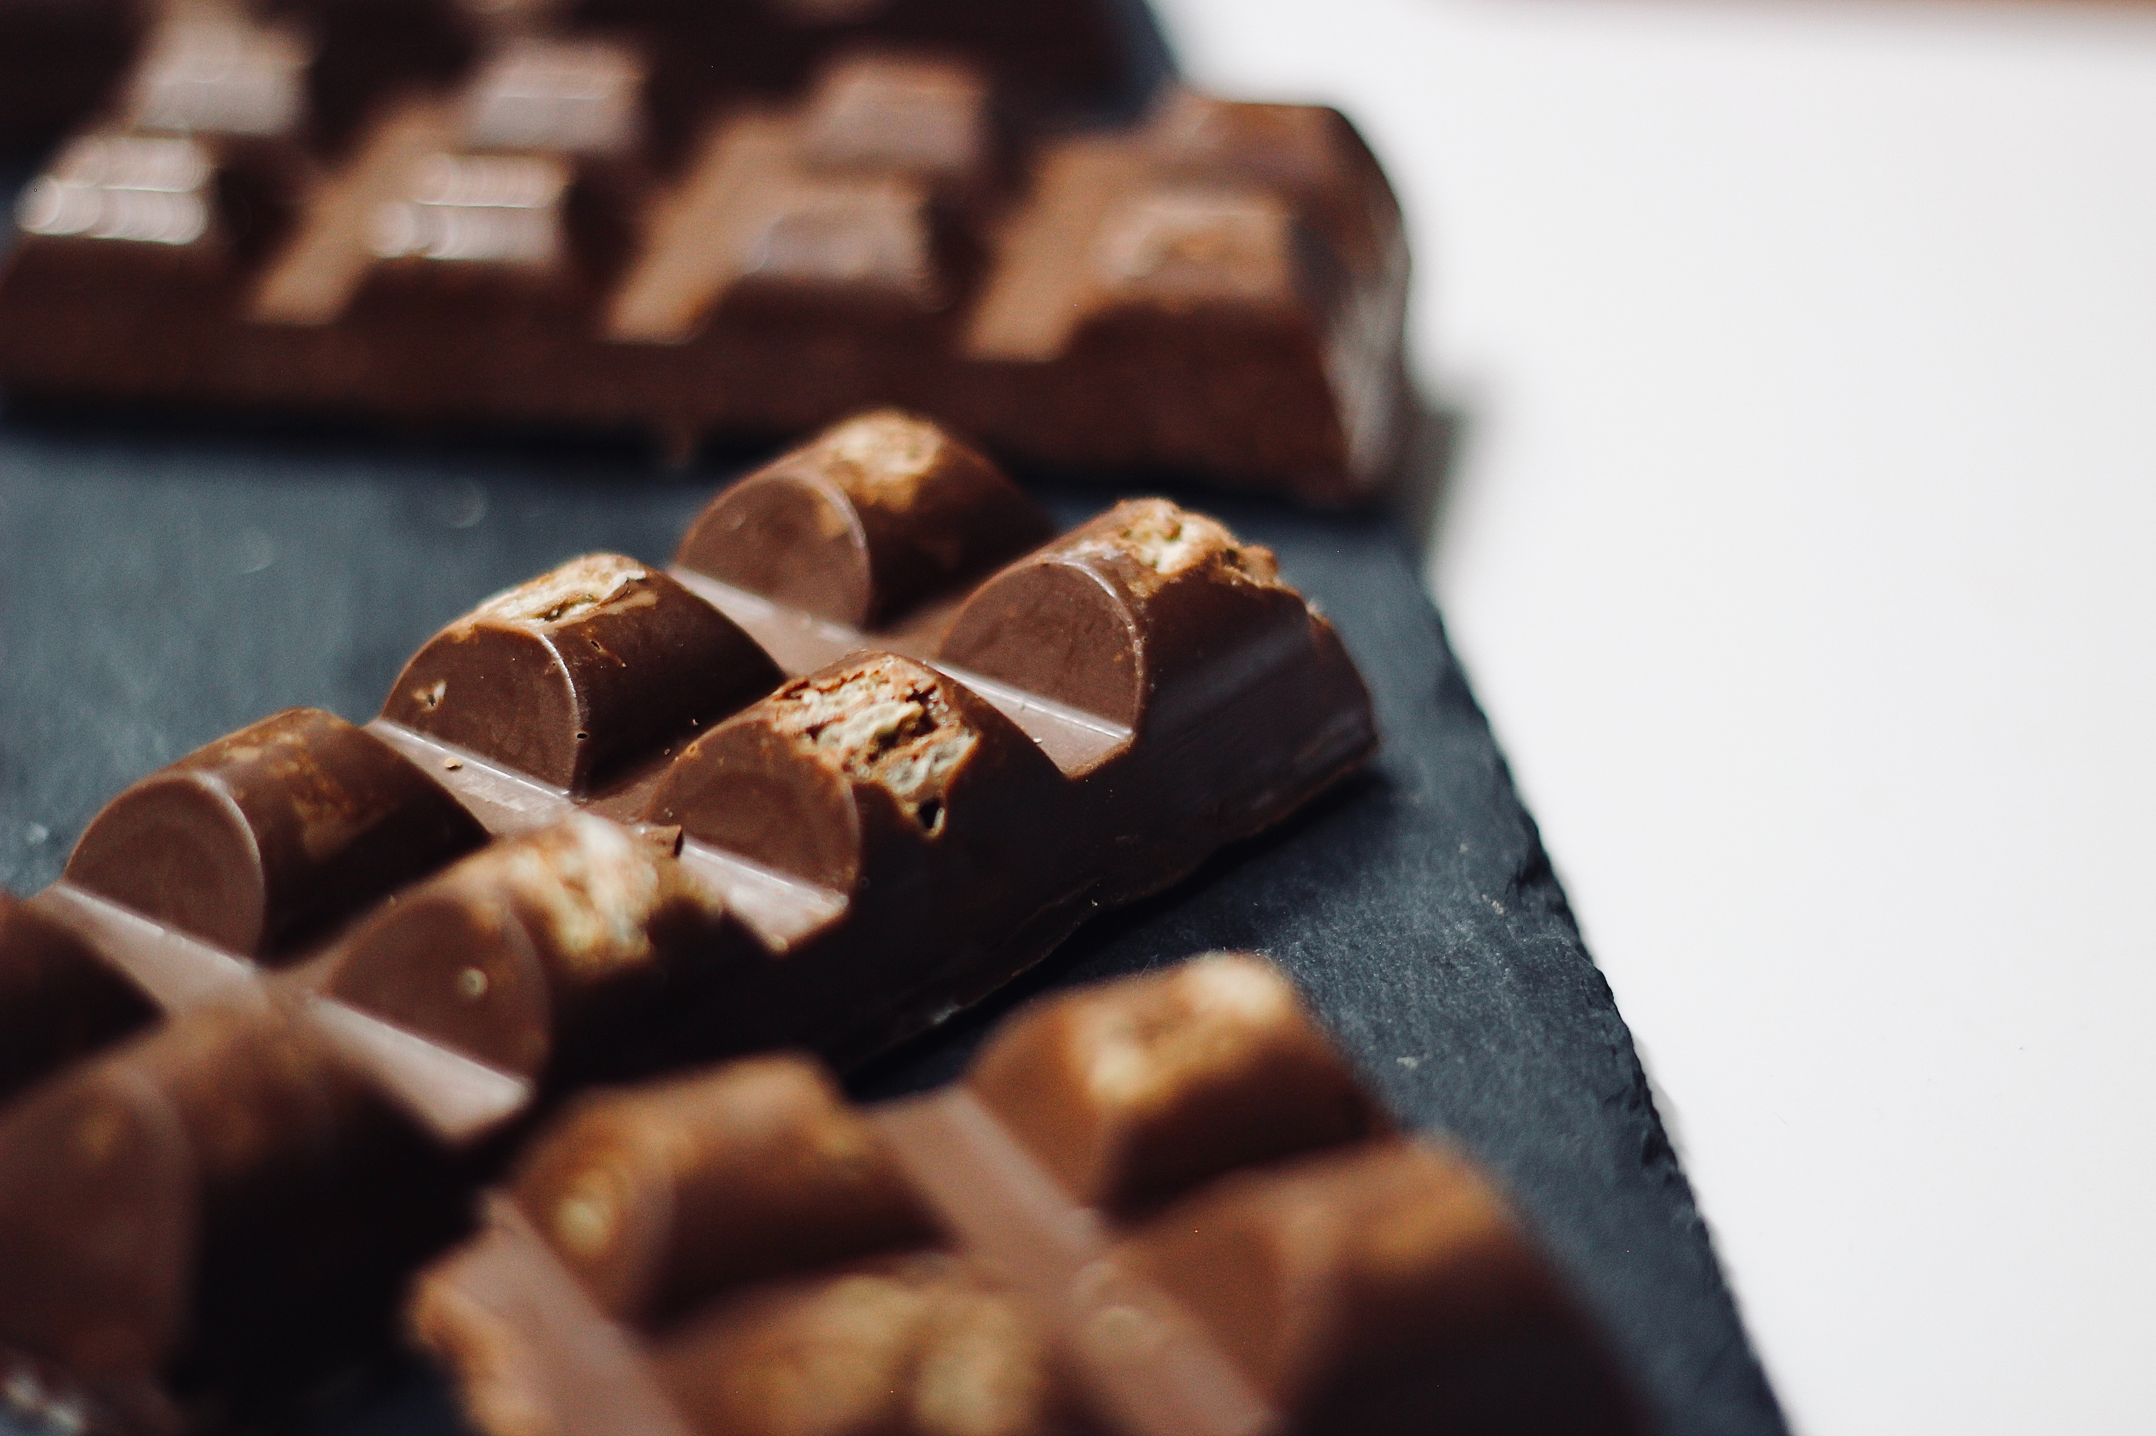
SOME EXAMPLES OF OUR PRODUCTS:
Peanut filled Chocolate
Kinder filled Chocolate
Twix filled Chocolate

Slide 4
PRODUCT PRESENTATION
Flavour : M&M’s, Maltesers, Bounty, Caramel (basic or salt butter), Nutella, Kinder, Snickers, Oreo, Magnum, Cookie, Twix.
Chocolate price : 12€
Filled price : 6€
Guarantee : Made with 100% pure cocoa
Shipping: 10 €
Delivery: 48 hours after order confirmation.

Slide 5
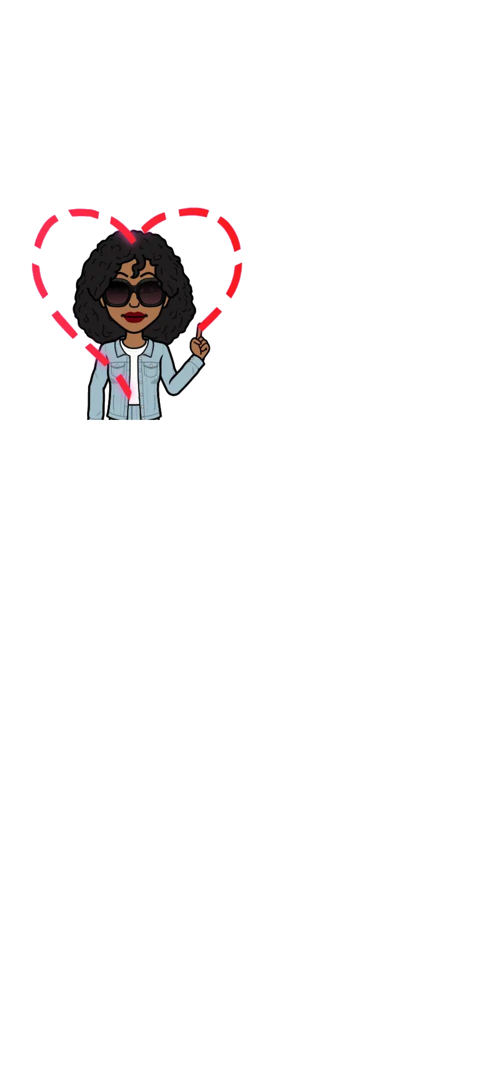
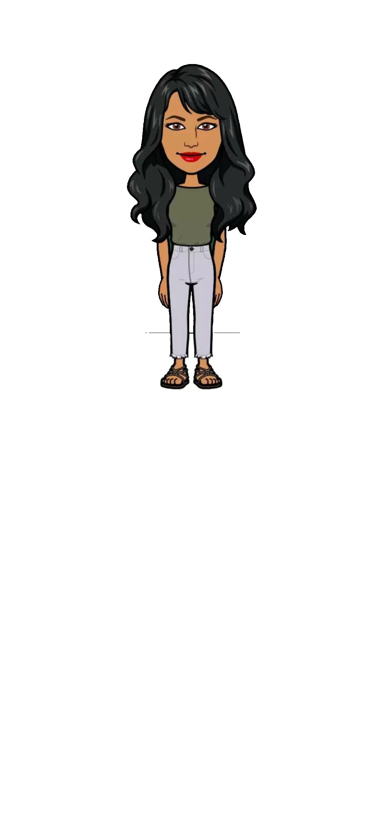
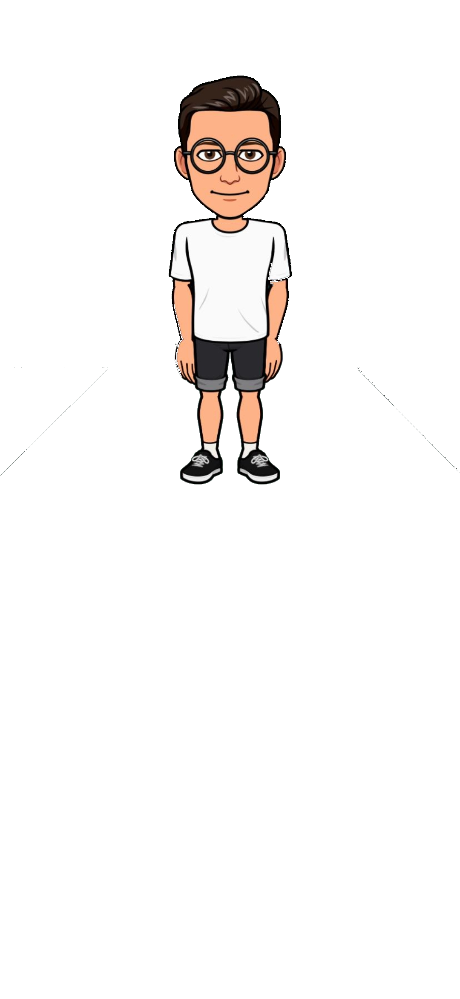
EQUIP
There are 4 of us working in the shop.

Slide 6
COVID-19
Our company was based to boost people’s morale as well as the economy since the COVID-19 pandemic.

Slide 7
Thank You !
112 rue des bonbondouw, 97468 Saint Sucré.
La Réunion

