Slide 1
Magic shop

Slide 2
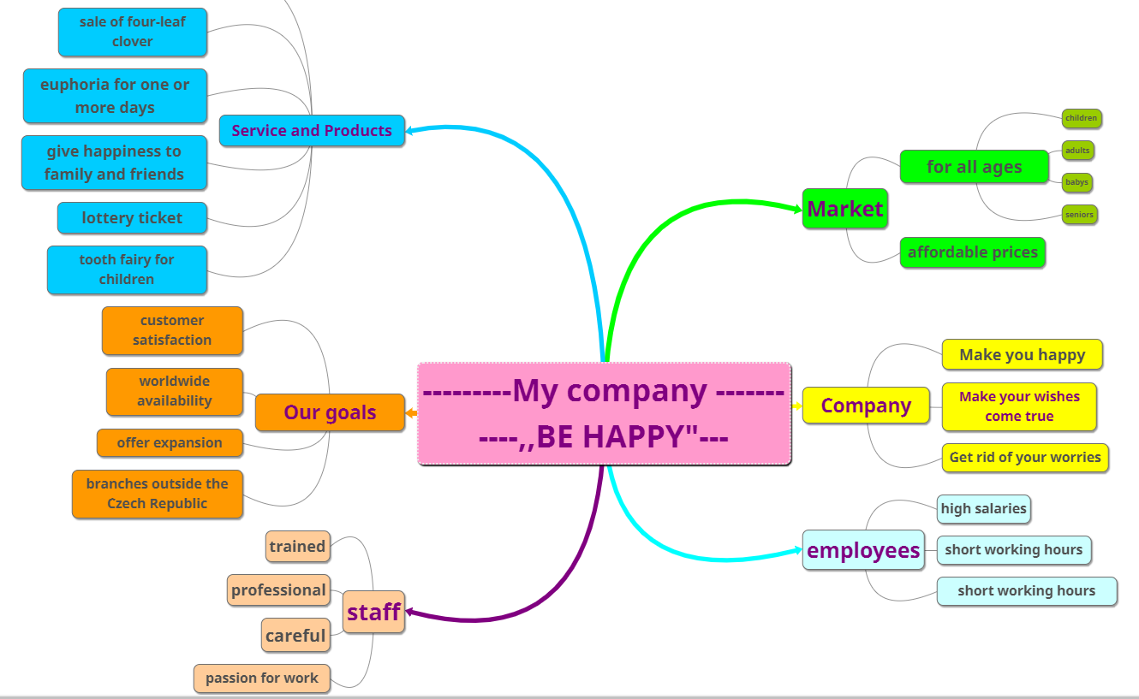
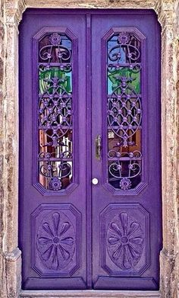
Ginnie in the bottle
Magic Shop

Slide 3
About US
Our small company deals with the happiness of people.
We offer a variety of products and services that will make our customers happy. From four-leaf clover to Ginnie in the bottle.
We understand that for every customer happiness is different. Tthe customers can choose from a many things that will make them happy.
Our company offers not only tangible products but also intangibles. Such as Euphoria or nice dreams.
The customer himself chooses for how long he wants to use it.
Our employees are highly trained and well paid. It forms a very important part of our company
Ourm Company is located in Magic Door
If You Need Us, Magic door will appear for you

Slide 4
Product Representation
Items: Euphoria for one or more days
Single price: 1500$
Quantity discount: 25% on orders of 3 or more units
Price with Quantity discount: 1 125$
Shiping: 90$
Delivery: Within 24 hours of after receiving the order
Guarantee: 7 business days

