Slide 1
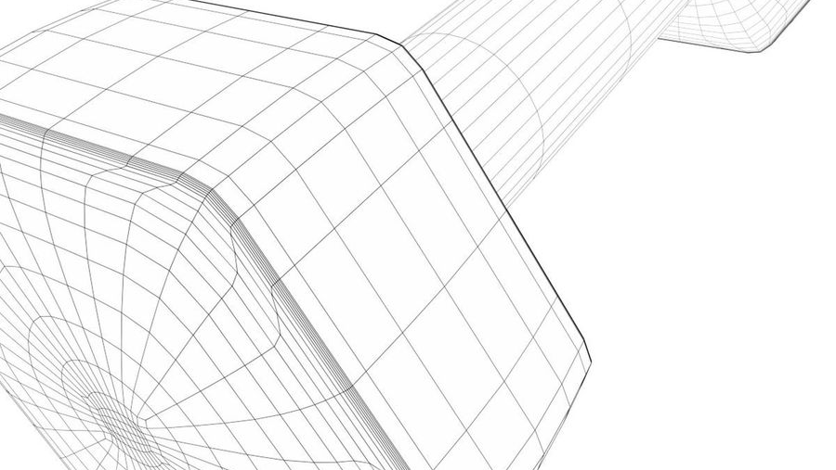
Gyro Dumbell
Eti Social Sciences High School
Eskişehir/Turkey
Yakup Büyükgün - Company presentation of the Turkey Team

Slide 2
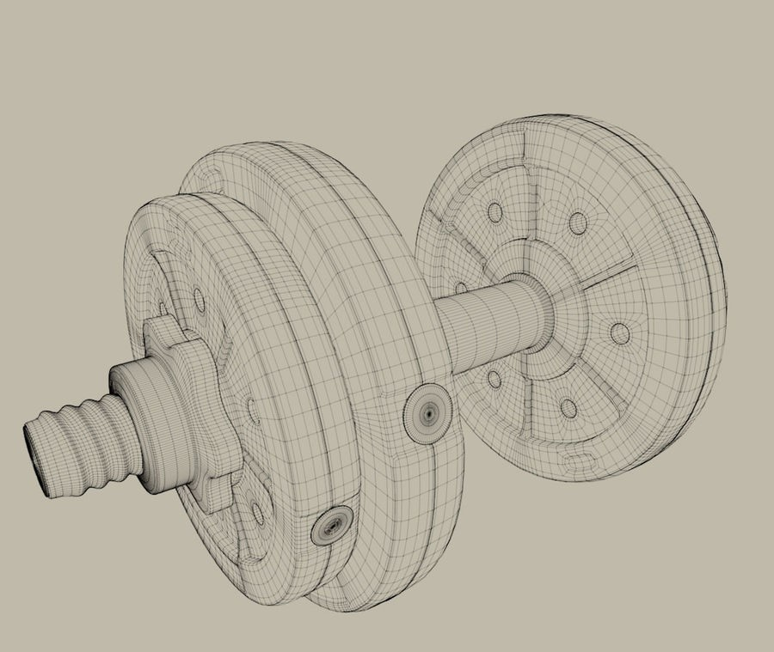
This is a dumbbell, but it has a difference from classical dumbbells.

Slide 3
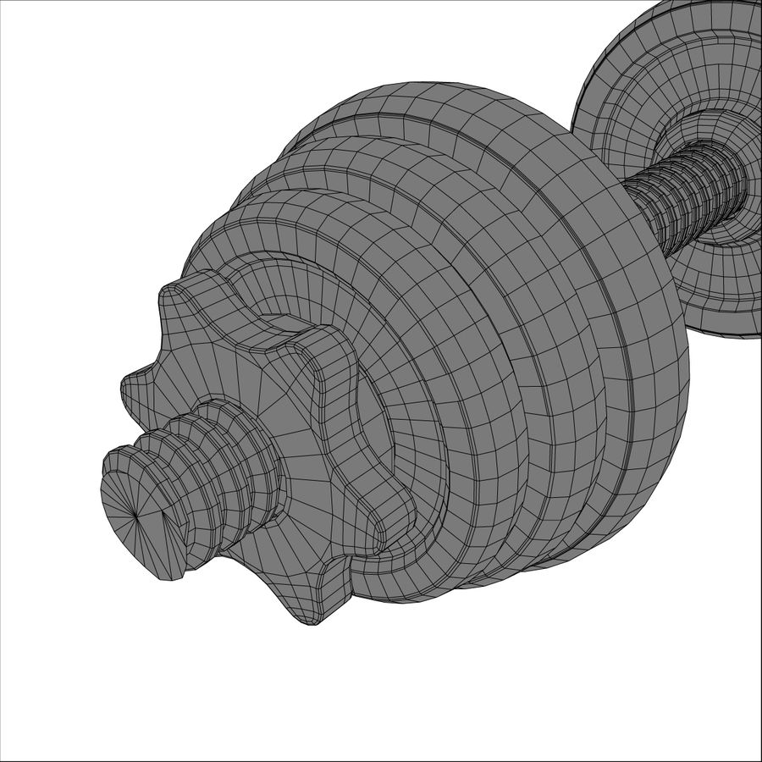
There is a rotating weight in it. This rotating weight on both sides the weights start to rotate thanks to the engine. This whole setup it changes the whole purpose. How fast we spin the discs in a two kilogram dumbbell is turns into very different forces for example 10kg 15kg 20 kg

Slide 4
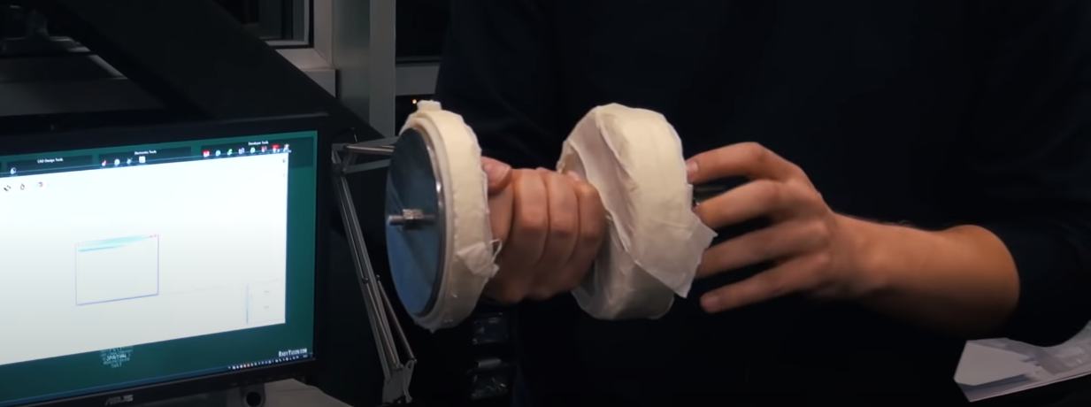
Product Story
Let's imagine a utopian feature in sports equipment. What is the most basic fitness equipment? Of course Dumbbell. What do we want in dumbbells? We wish it was light. What do we want in dumbbells? We wish it was light. We also want it to feel heavy. Instead of struggling with gravity, we are struggling with the dynamics within the mass.

Slide 5
This project is currently fully prototype. In other words, the cost and sale of the project are not yet clear. At the same time, its durability, what happens when it falls to the ground is still unclear. But this project I believe will surely take its place on the shelves one day.

