Slide 1
Zespół Szkół Nr 1
w Starej Wsi
Healthy Herbs Outlook

Slide 2
On Facebook
Polish students are trying
to be in touch with students from Lithuania before meeting in June.

Slide 3
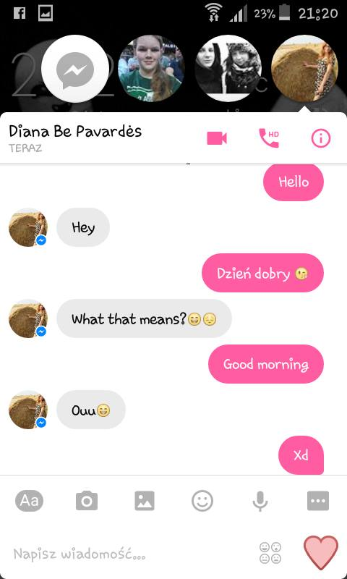
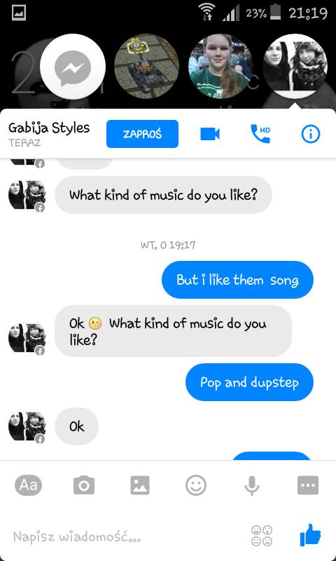
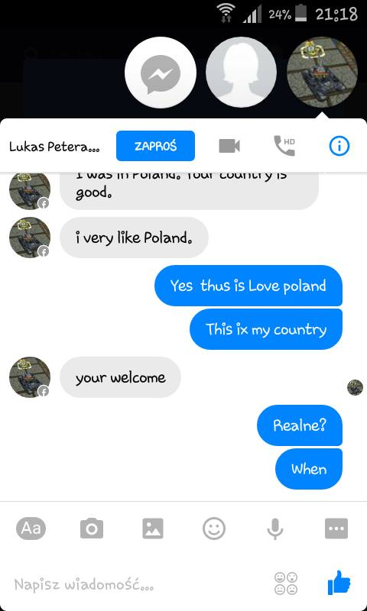

Slide 4
The gifts
Girls from the 3rd class
of Middle High School
prepared some gifts for
the 1st transnational meeting in Romania. That was tea mint very popular in Poland.

Slide 5
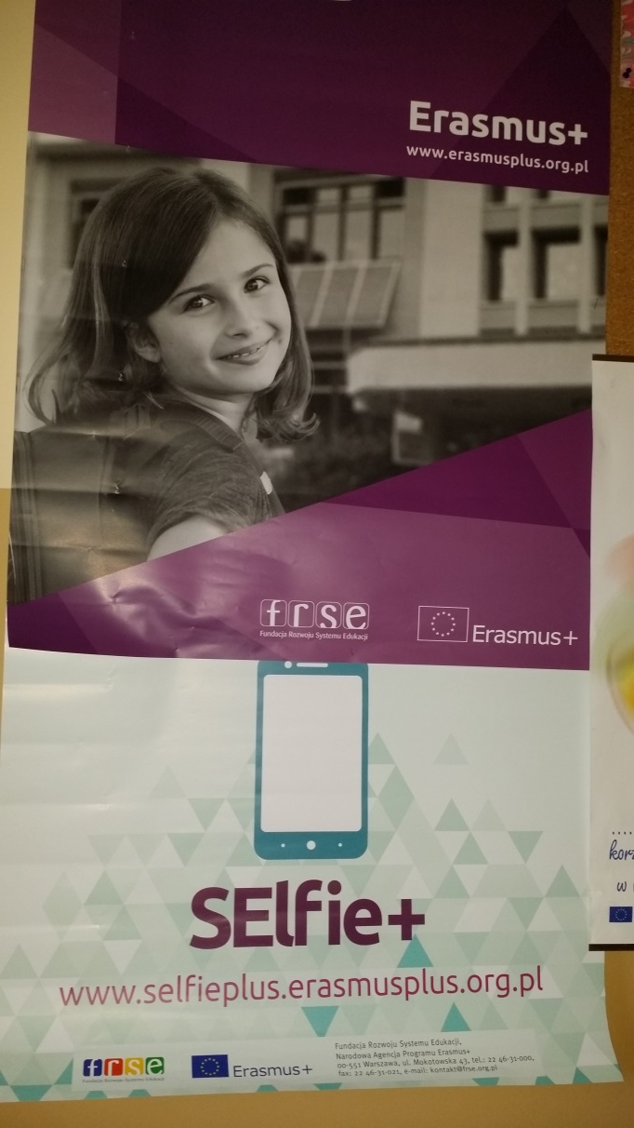
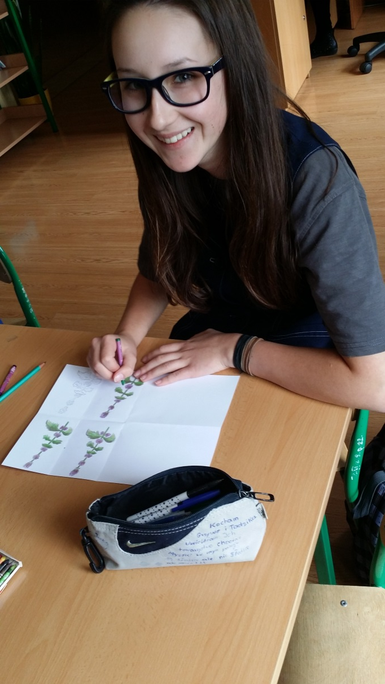
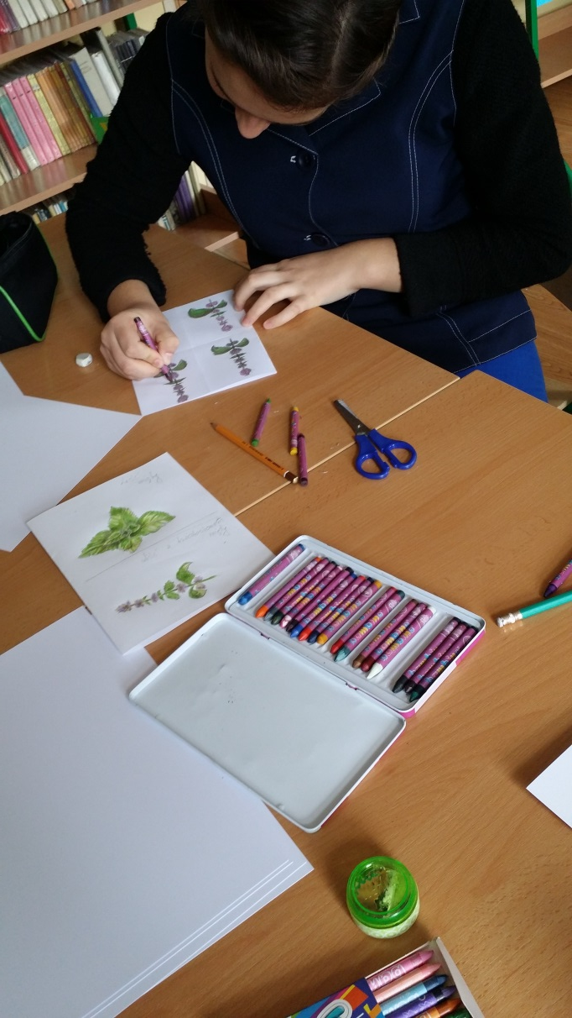

Slide 6
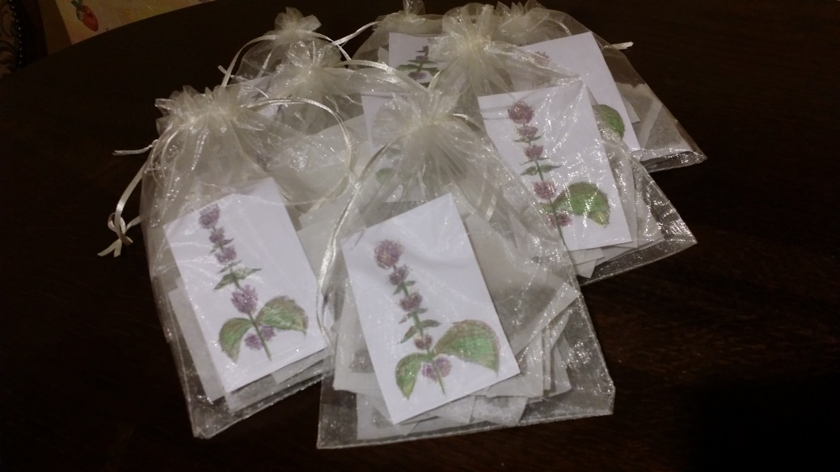
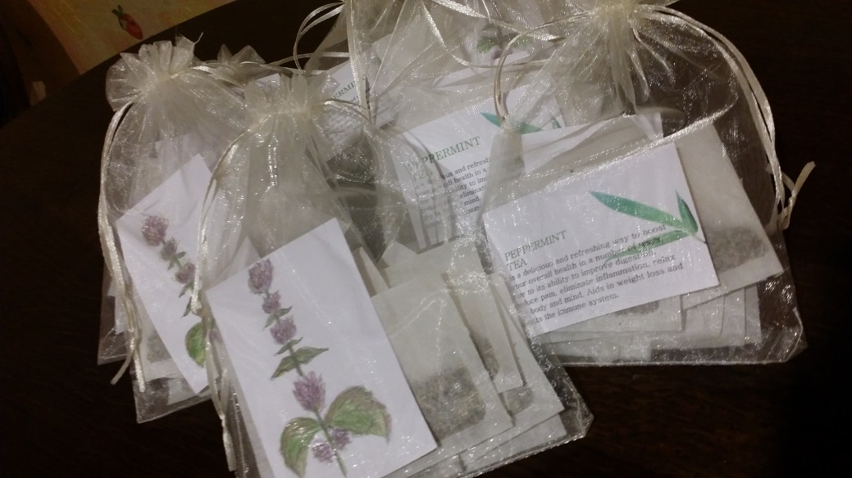
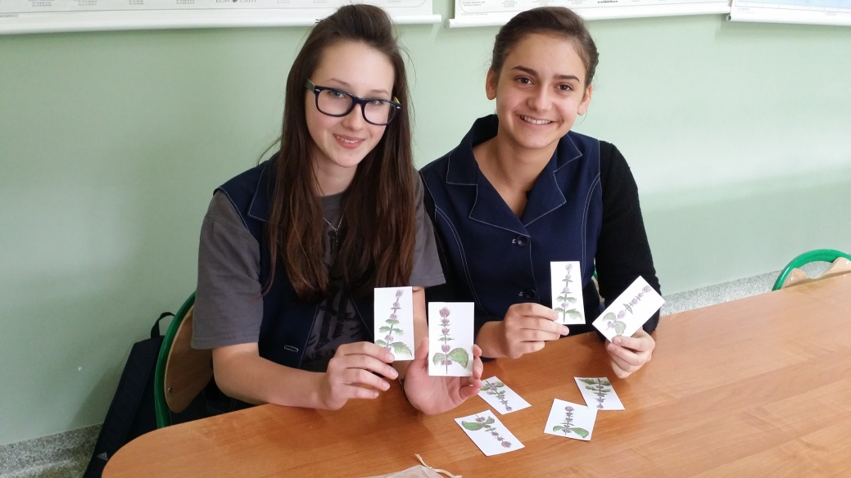

Slide 7
The Logo contest
At school we had a Logo contest .
Students painted the Logo on Art or at home.
The best Logo in Poland was painted by Weronika Kędroń. She is from the 6th grade.

Slide 8
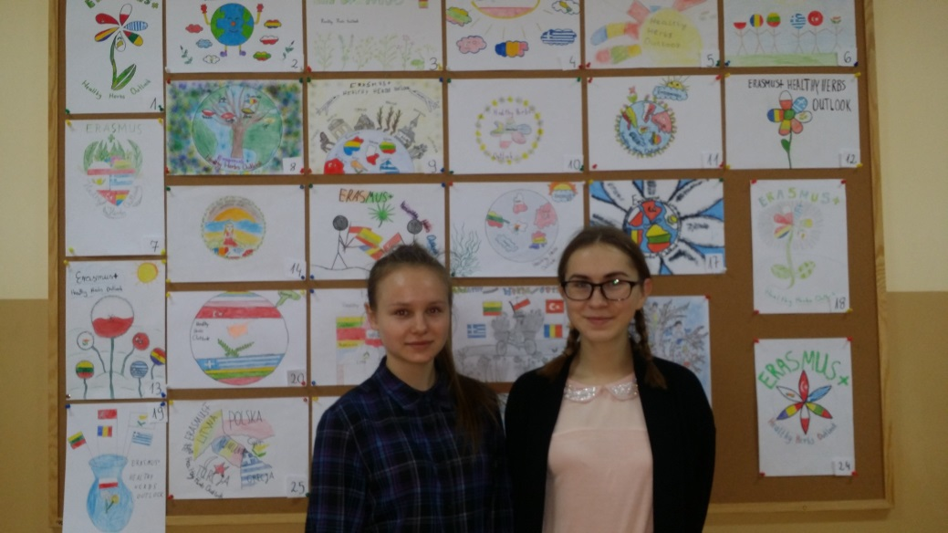
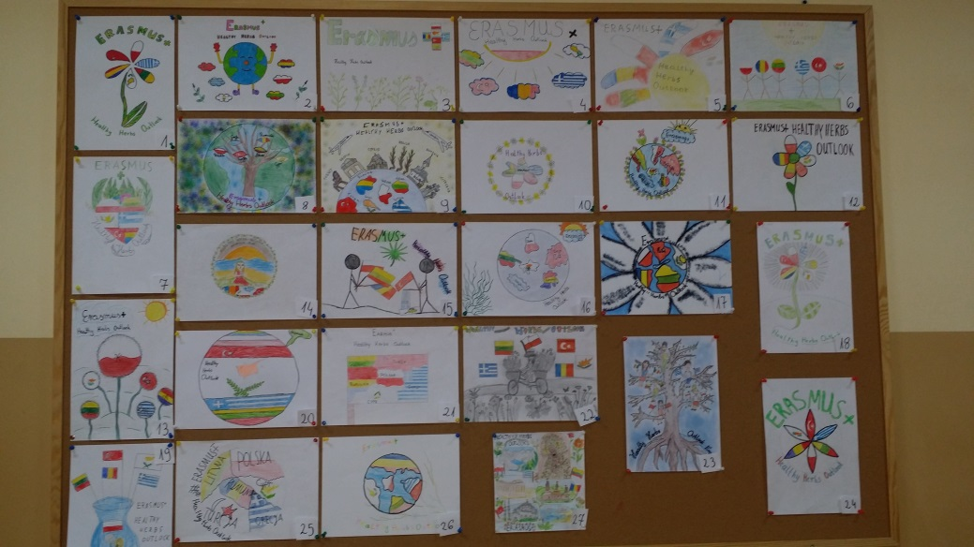
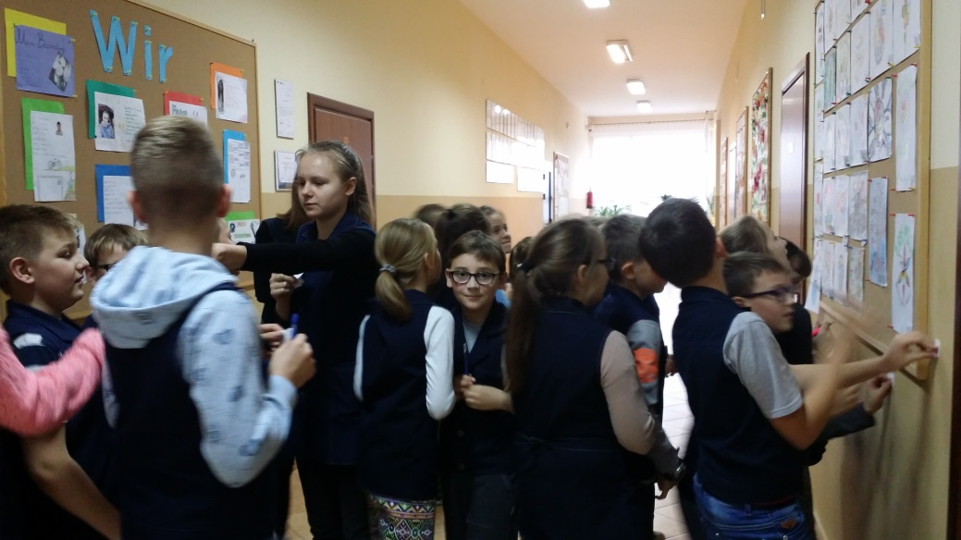
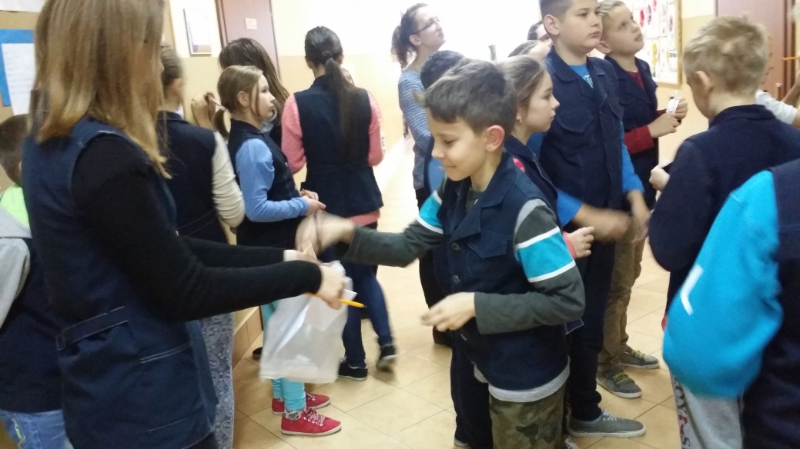

Slide 9
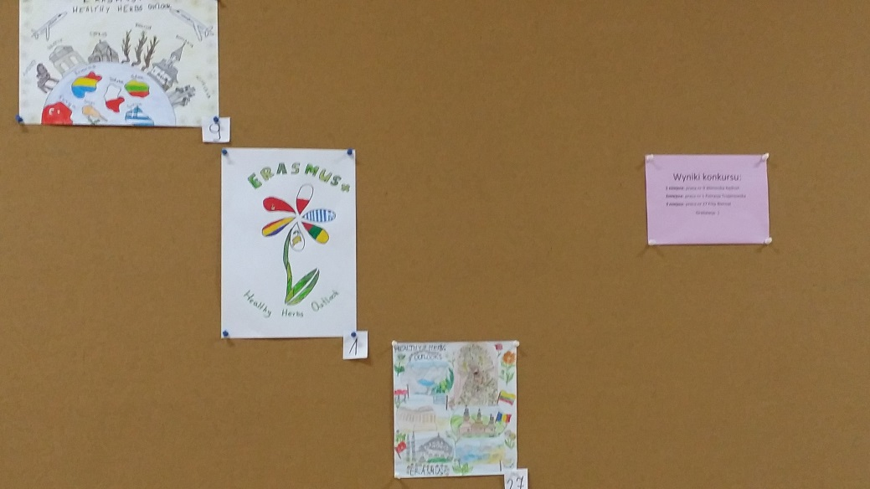
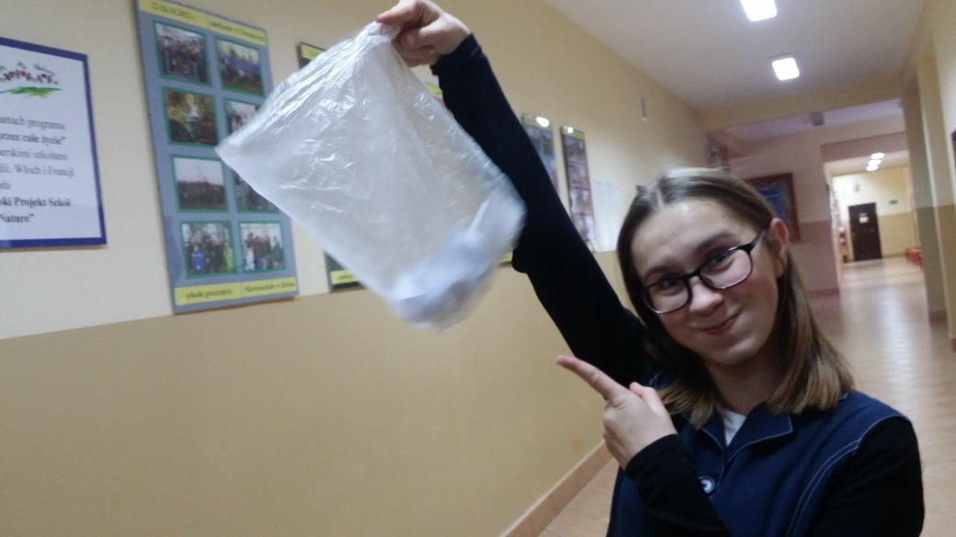
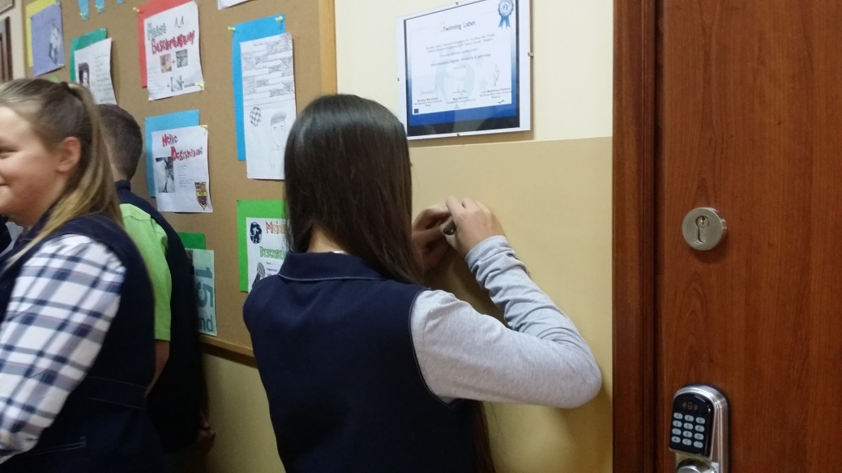
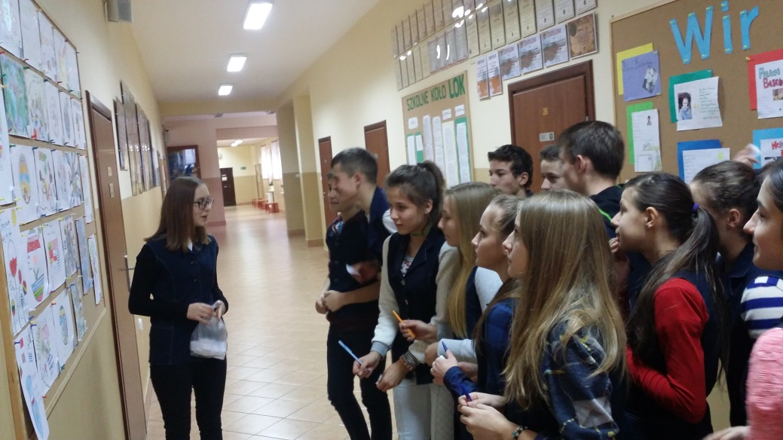

Slide 10
Voting for the project’s Logo
When was the 1st short-term exchange of groups in Turkey in December at the same time in Poland students were voting for the best project’s Logo.
This time won Logo from Romania painted by Iulia Milea.

Slide 11
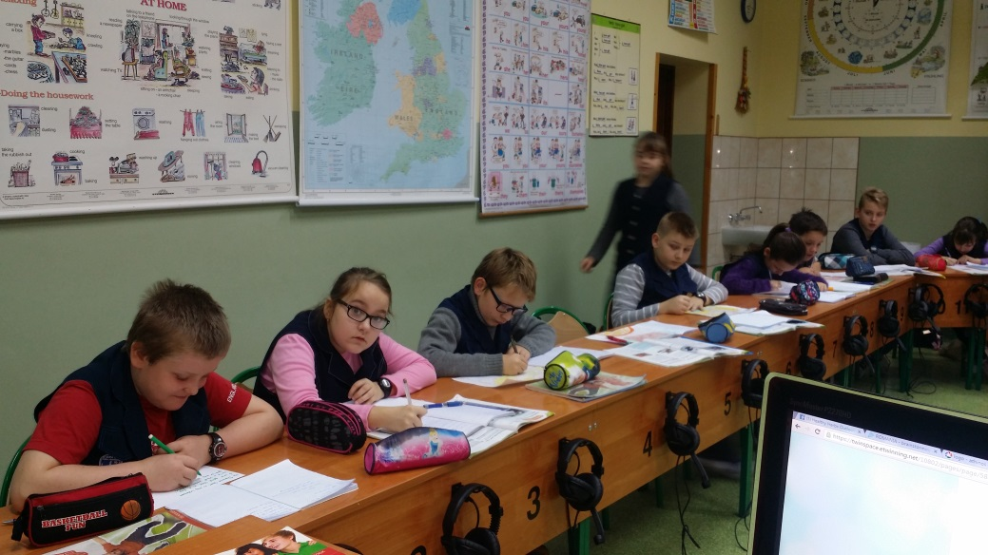
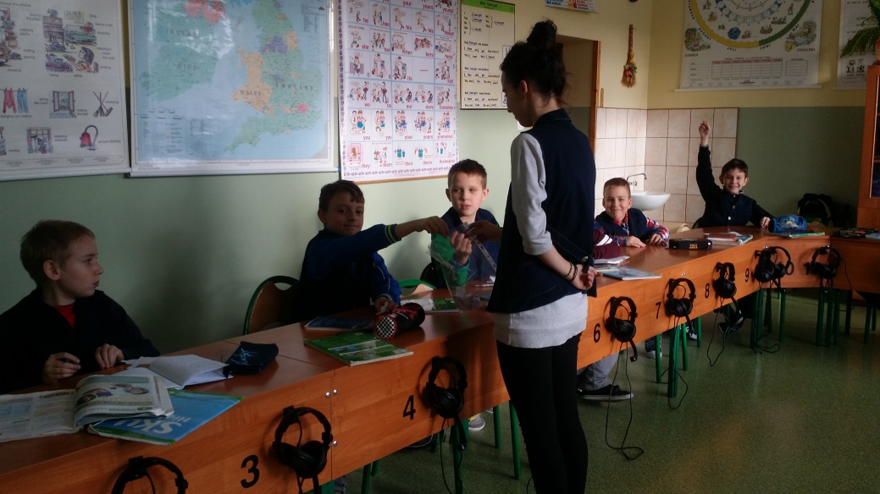
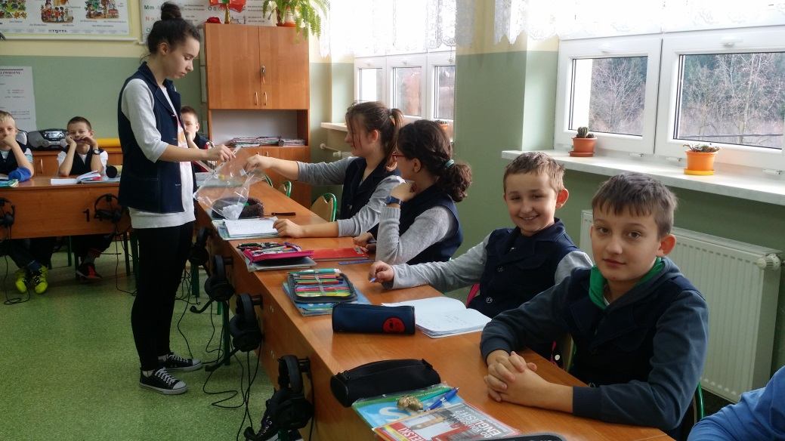

Slide 12
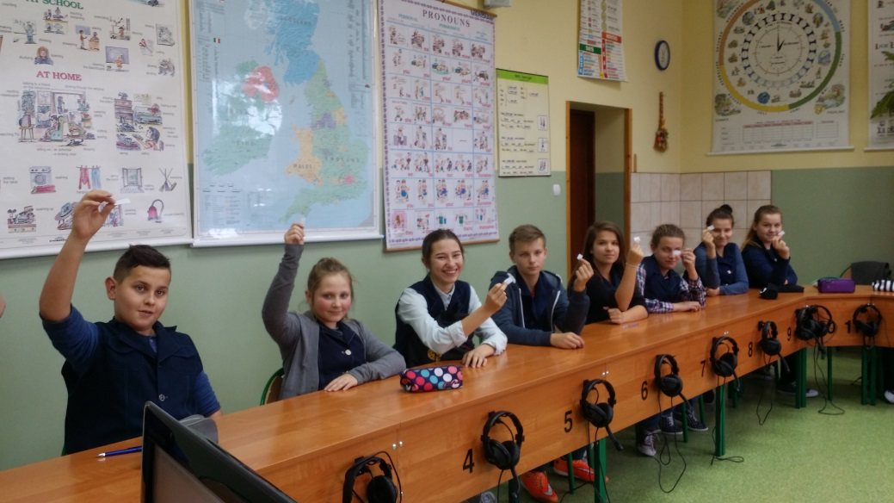
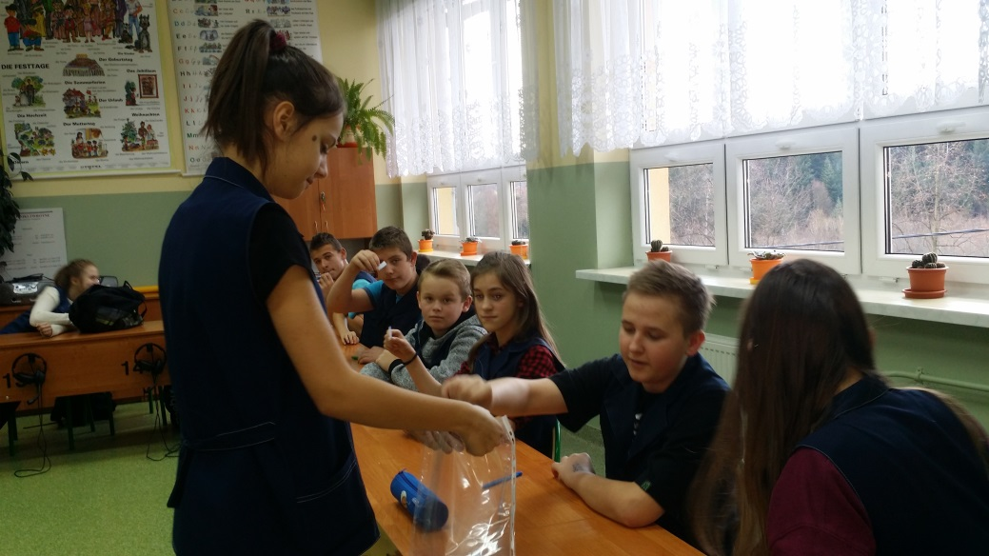
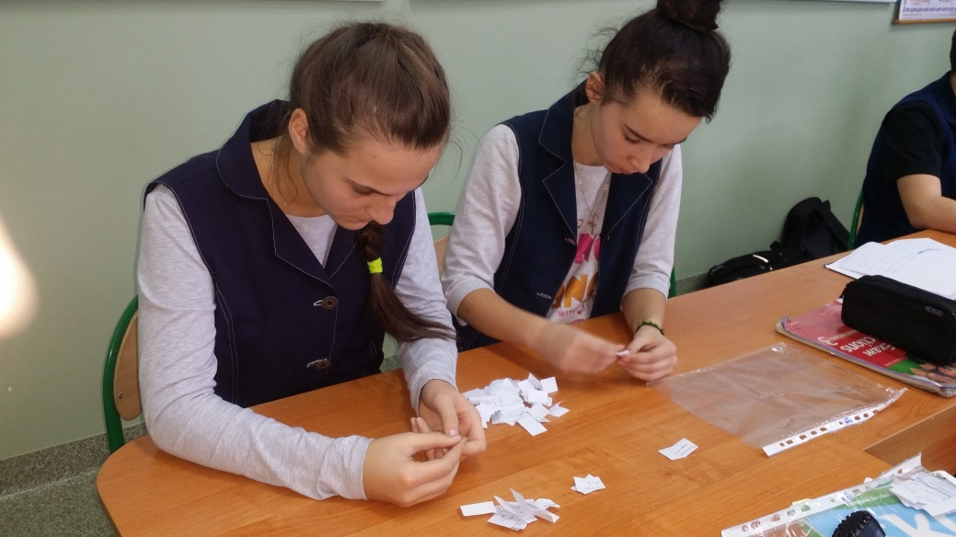
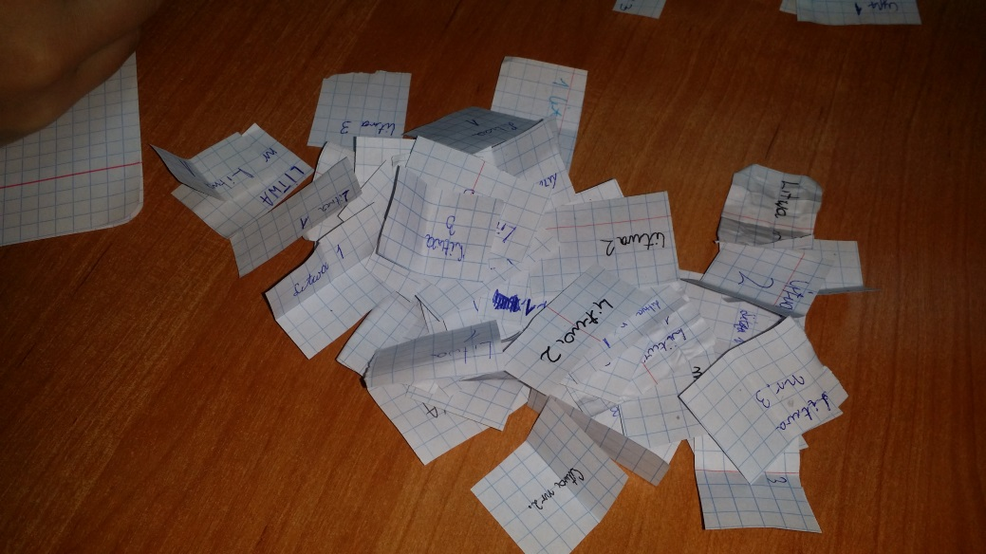

Slide 13
The workshop
One day after school students were drinking herb tea and presenting to others some herbs. They were doing a quiz and a lot of interesting tasks which prepared students from the 2nd class.

Slide 14
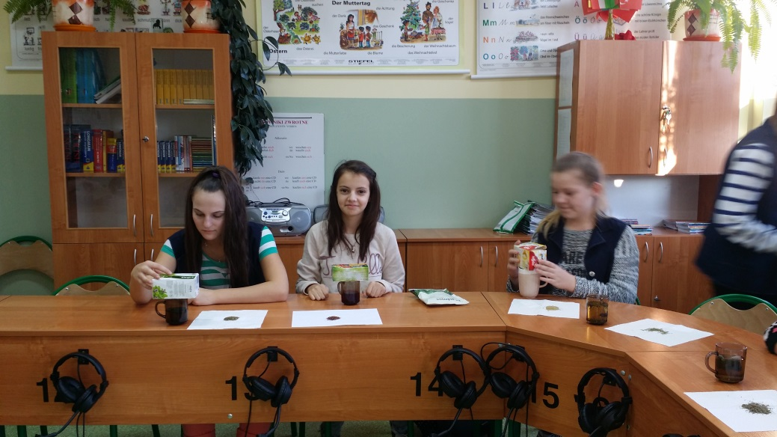
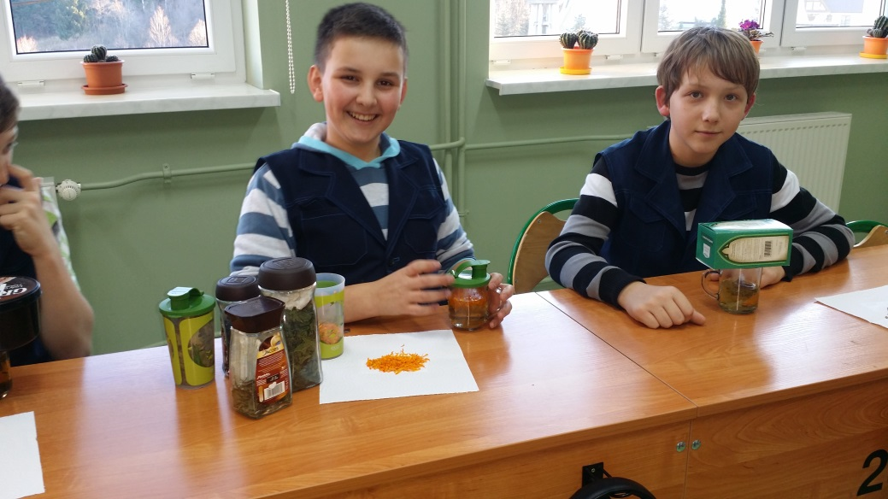
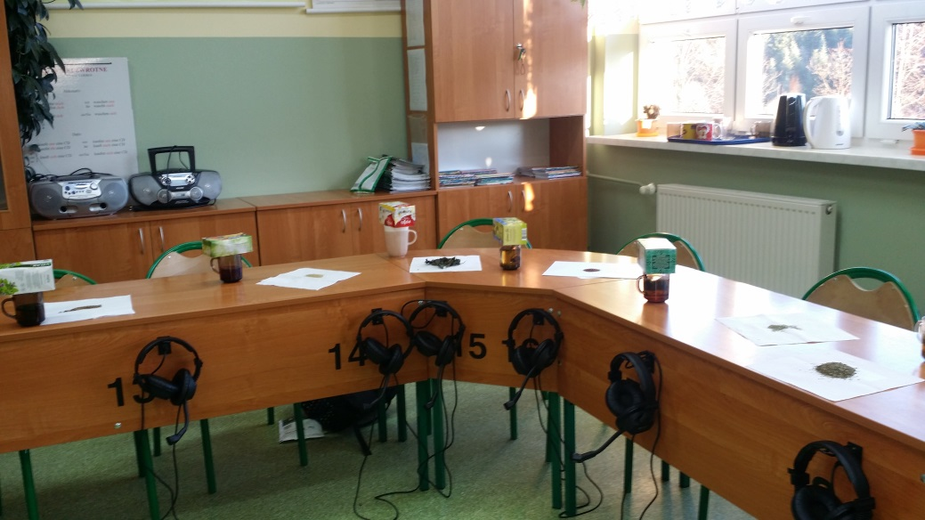
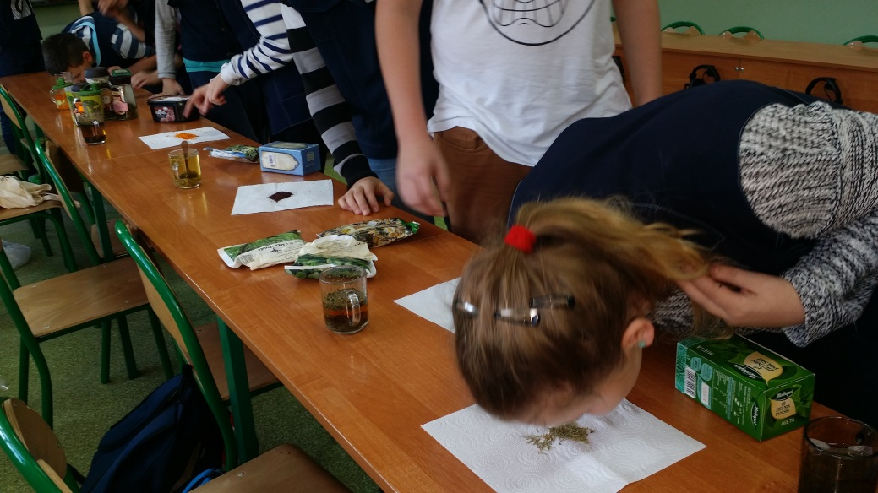

Slide 15
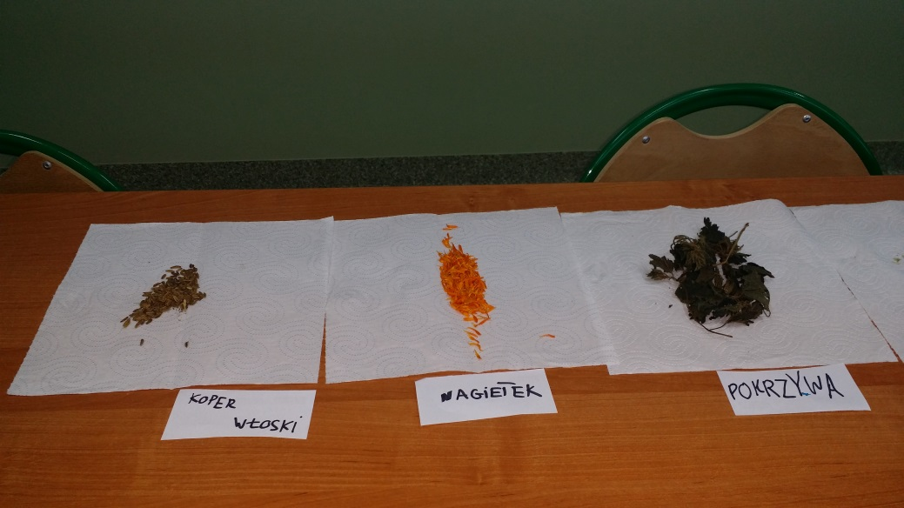
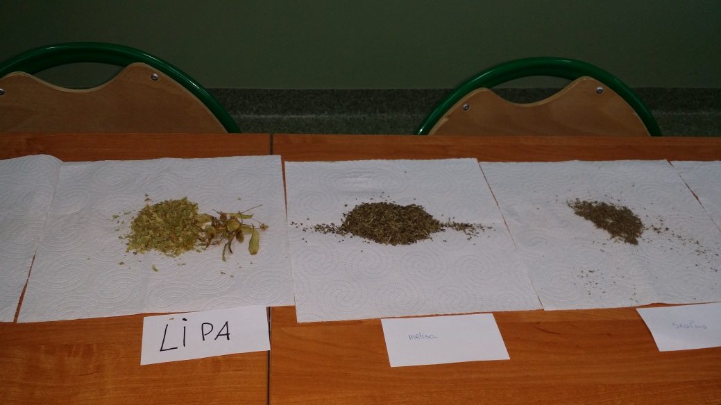
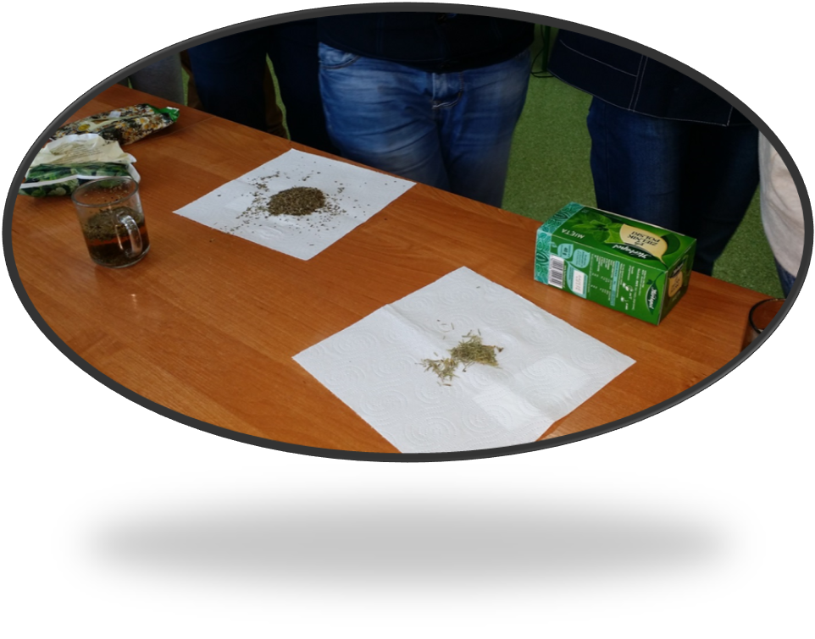
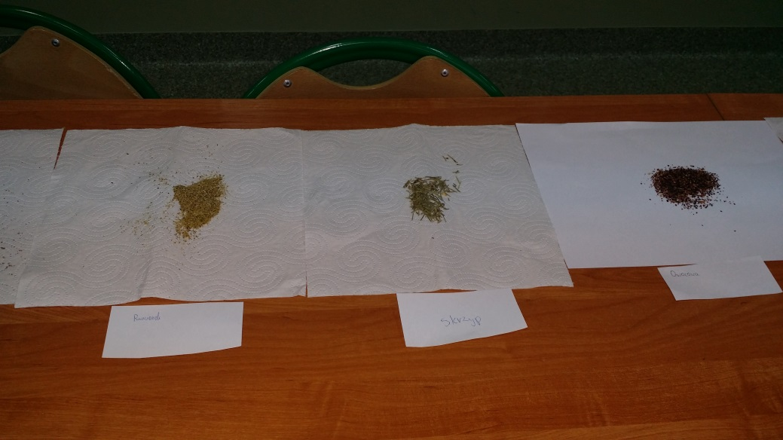
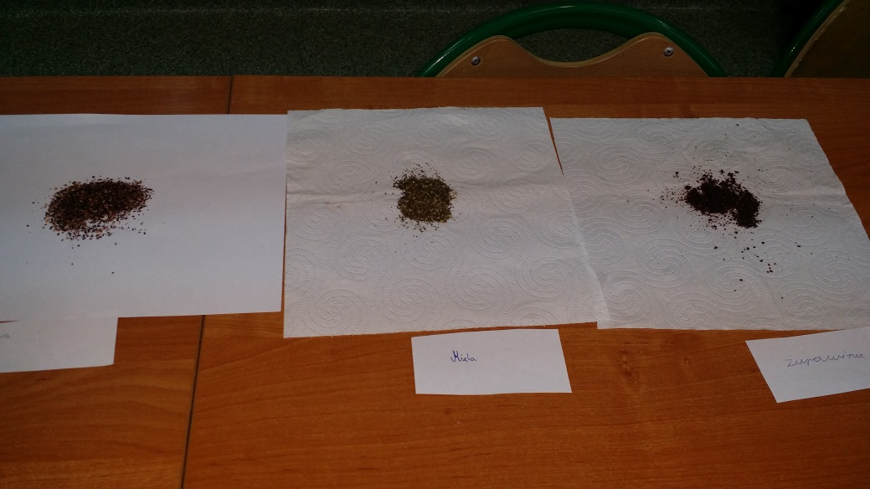

Slide 16
A herbalist at school
Girls from 6th grade wrote an Invitation
for Mrs. Maria. She is an old woman from our village who saved many people’s life because
she knows how to use her knowledge
of herbal medicine

Slide 17
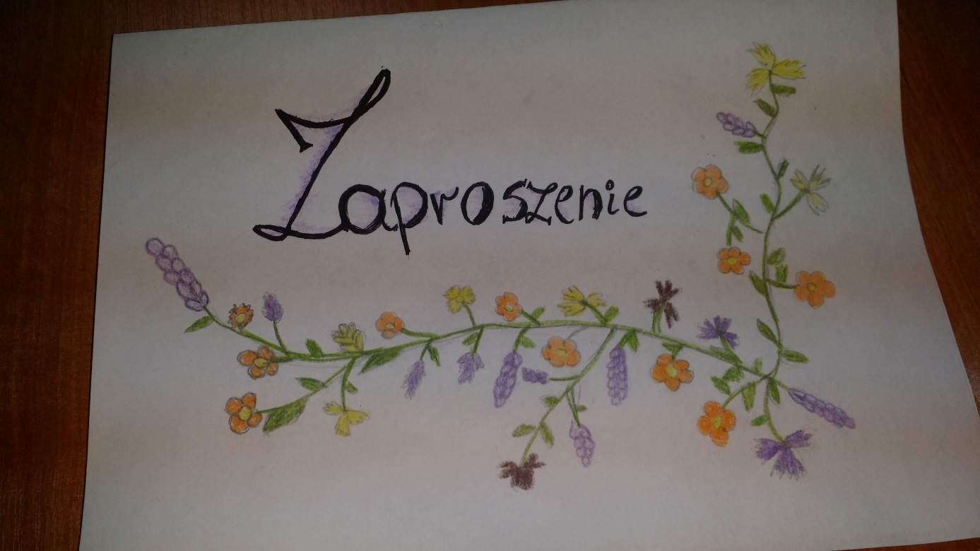
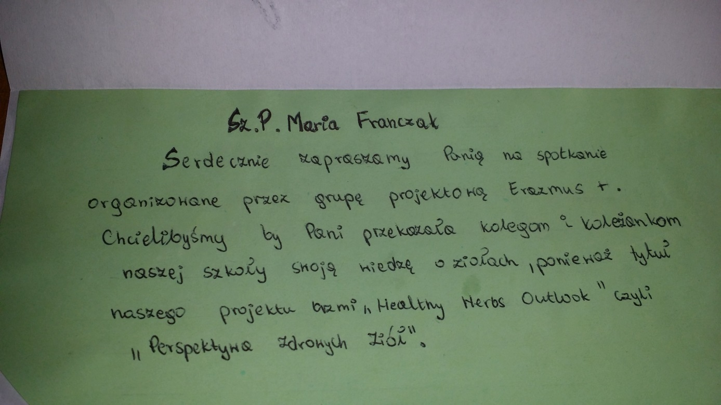

Slide 18
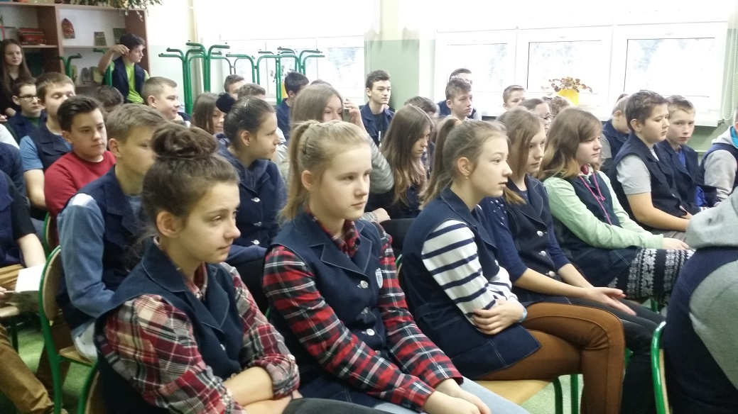
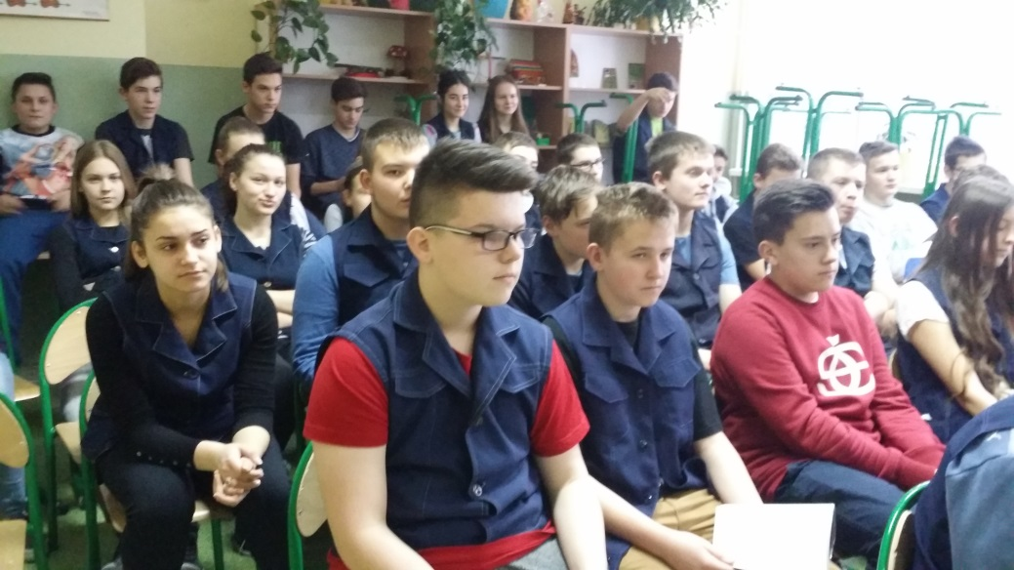
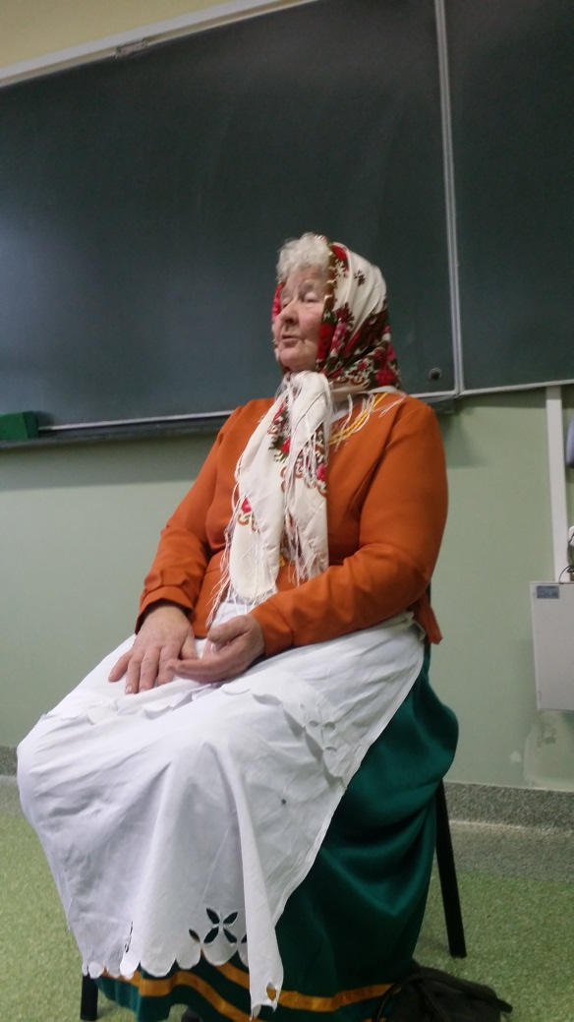
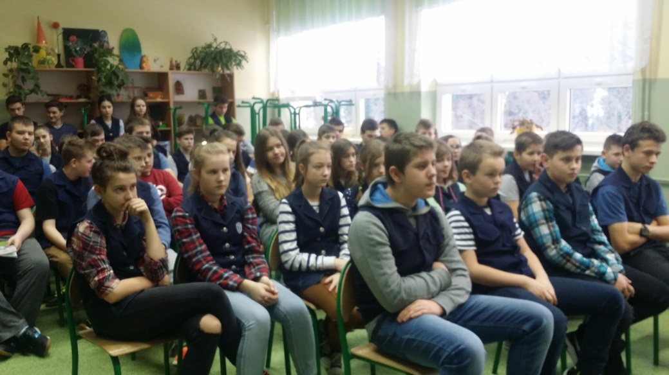
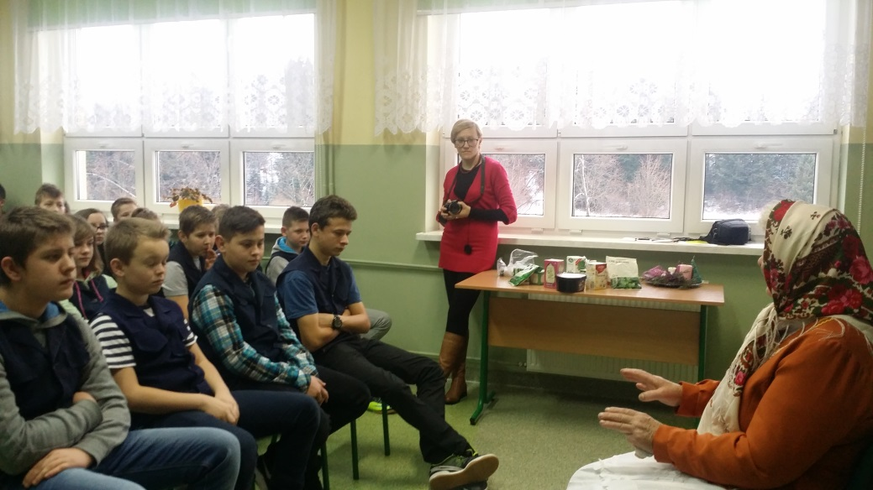

Slide 19
The ICT lesson
Students were looking for some information
on the Internet about herbs.
Next they made a presentation about herbs
for younger pupils.

Slide 20
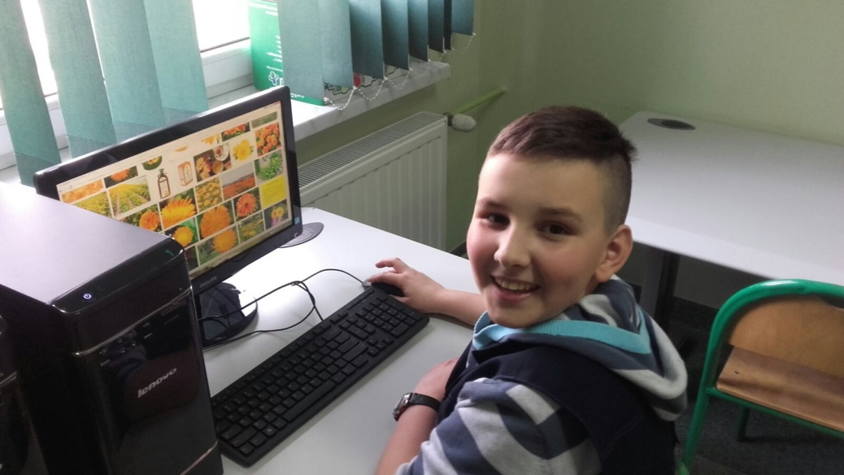
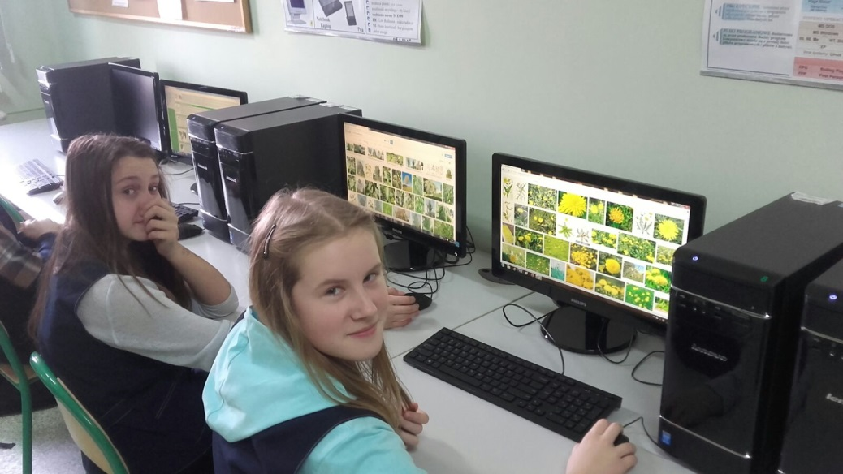
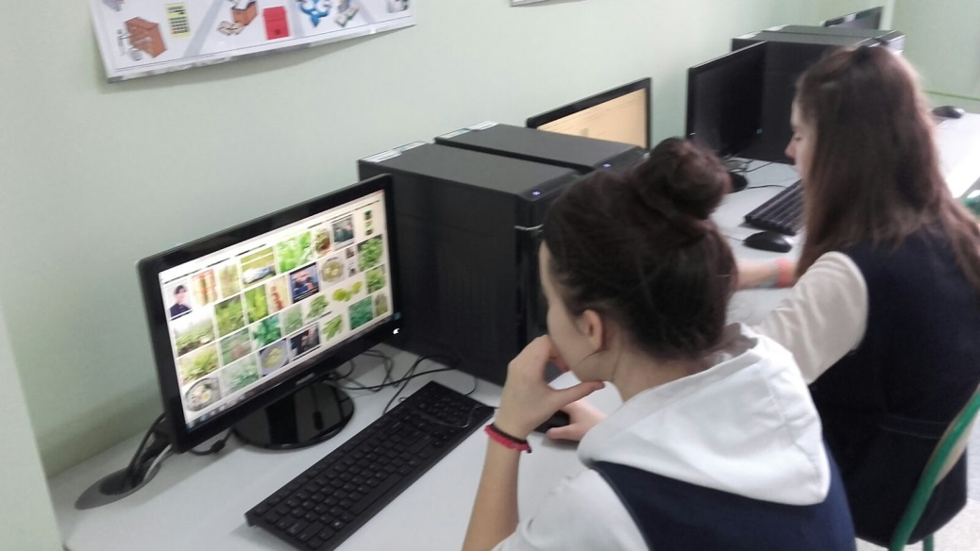
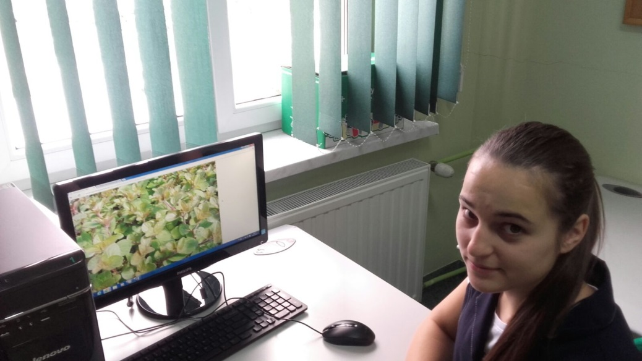

Slide 21
The Art lesson
Students were painting herbs
which they can find on the meadows
next to their houses or in the garden.

Slide 22
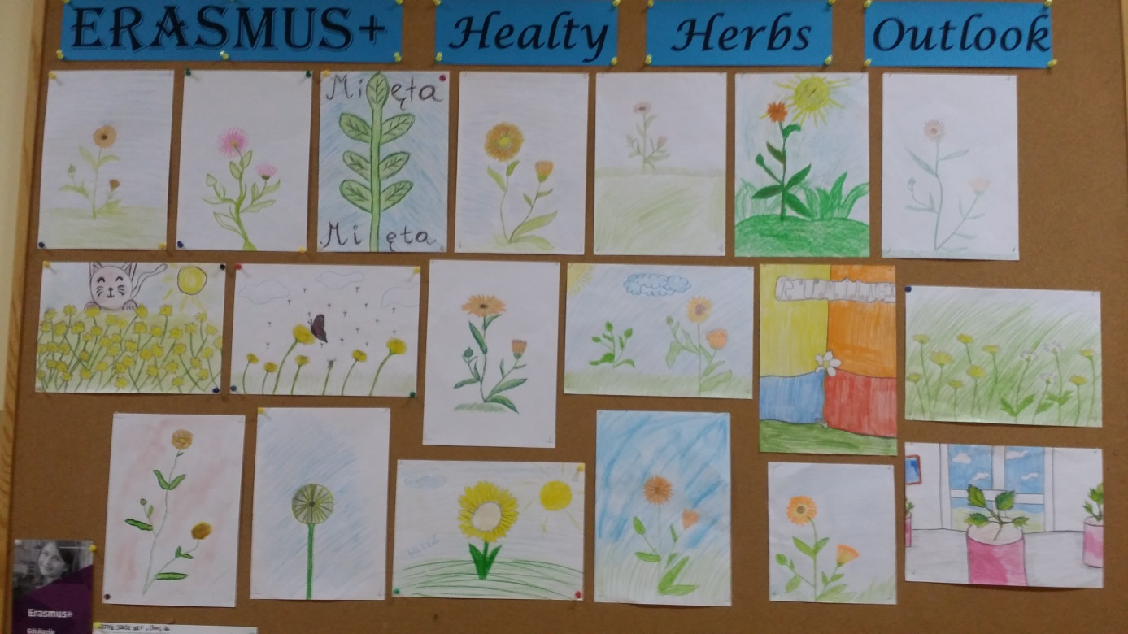

Slide 23
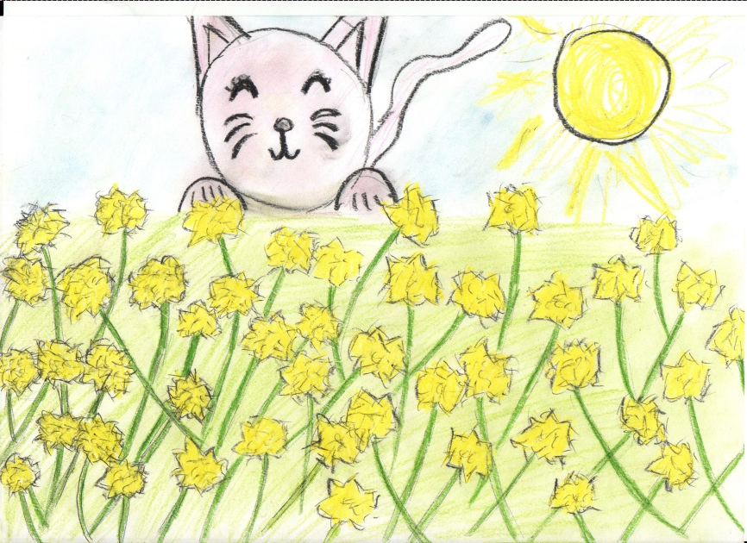
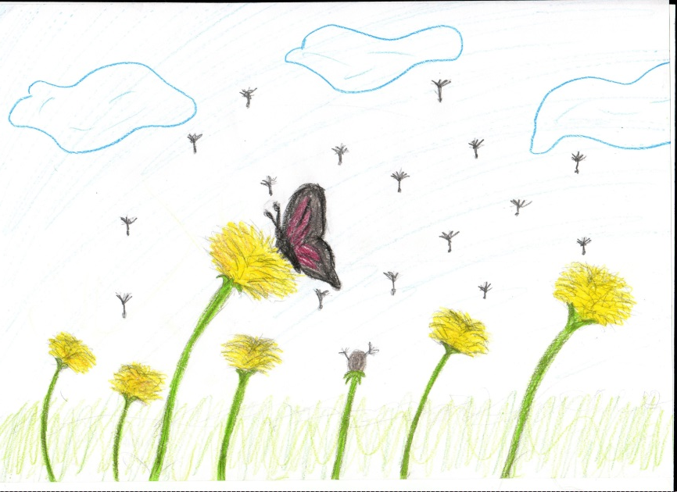
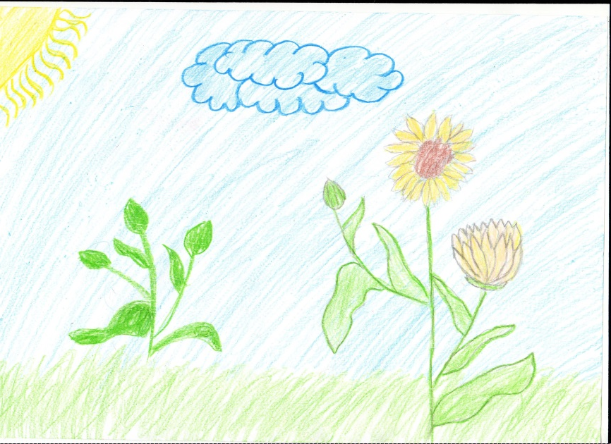
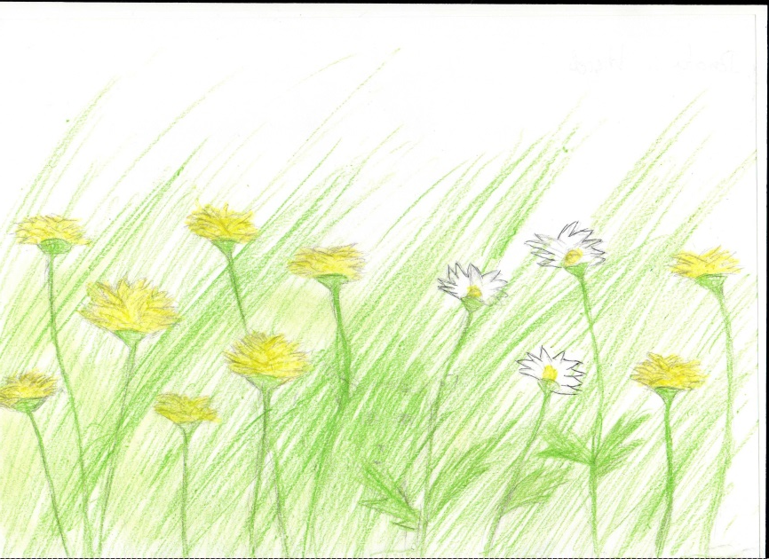

Slide 24
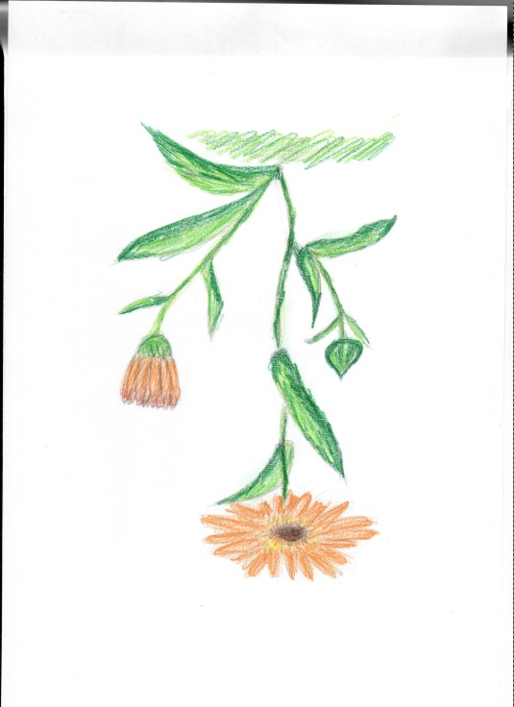

Slide 25
The exhibition of herbs
Karolina and Marta prepared an exhibition
in the school’s library for pupils.
The exhibition is still available
for all school’s students and for parents too.

Slide 33
The Science lesson
After school once a week students have
an extra science lesson.
This time they are watching carefully herbs under microscopes

Slide 35
The extra English lesson
Students who will visit in the future schools in Lithuania, Cyprus and Romania
are trying to prepare before the short-term exchange of groups because they know
how important is English abroad
where no one speaks Polish.

Slide 37
The extra English lesson
Also they are trying to be ready
before June 2017
the last transnational meeting
which will be in Poland.

Slide 39
Our project on the Internet
This time our project is on: http://spstarawies1.edupage.org/text47/?
http://selfieplus.erasmusplus.org.pl
www.etwinning.net
and on Facebook

Slide 41
This presentation was made by:
Paweł Tomaszek
and Dominik Pałka who wrote music.

