Slide 1
Christmas cookies
By Poppy and Ruby

Slide 2
You Will Need
1 ¹/₄ cups sugar
1 cup , butter softened
¹/₄ cup firmly packed brown sugar
2 large eggs,2 teaspoons cream of tartar
2 teaspoons vanilla
3 cups all-purpose flour
1 teaspoon baking soda
¹/₂ teaspoon salt

Slide 3
Cooking them
Heat oven to 375°F.
STEP 2
Beat sugar, butter and brown sugar in bowl at medium speed until well mixed. Add eggs, cream of tartar and vanilla, beating until well mixed. Add flour, baking soda and salt; beat at low speed until well mixed.
STEP 3
Shape dough into 24 balls. Place 2 inches apart onto ungreased cookie sheets.
STEP 4
Bake 10-12 minutes or until edges are lightly browned. Cool 1 minute on cookie sheet; remove to cooling rack. Cool completely.
STEP 5
Melt candy coating according to package directions.
STEP 6
Make 1 snowman at a time, spreading 1 tablespoon melted candy coating in center of cookie to resemble melting snow. Place marshmallow onto cookie for head. Decorate as desired, adding face, scarf, buttons, arms, etc., using candy coating to attach, if necessary. Repeat with remaining cookies and decorations. Reheat candy coating, if necessary.

Slide 4
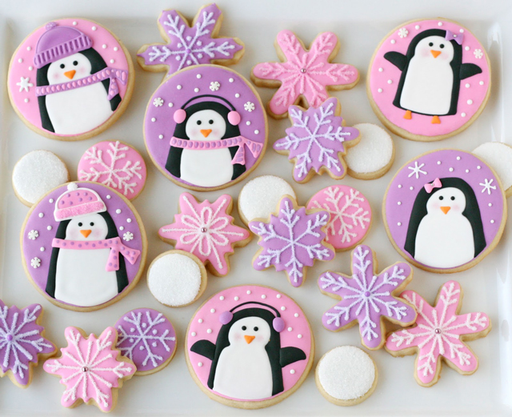
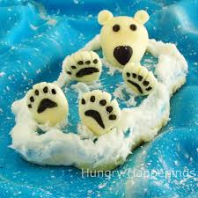
CUTE!

Slide 5
DELICIOUS !!! !!! Yum yum
It is good to eat them at Christmas time because it gives a Christmas spirit and best of all they are DELICIOUS !!!

Slide 6
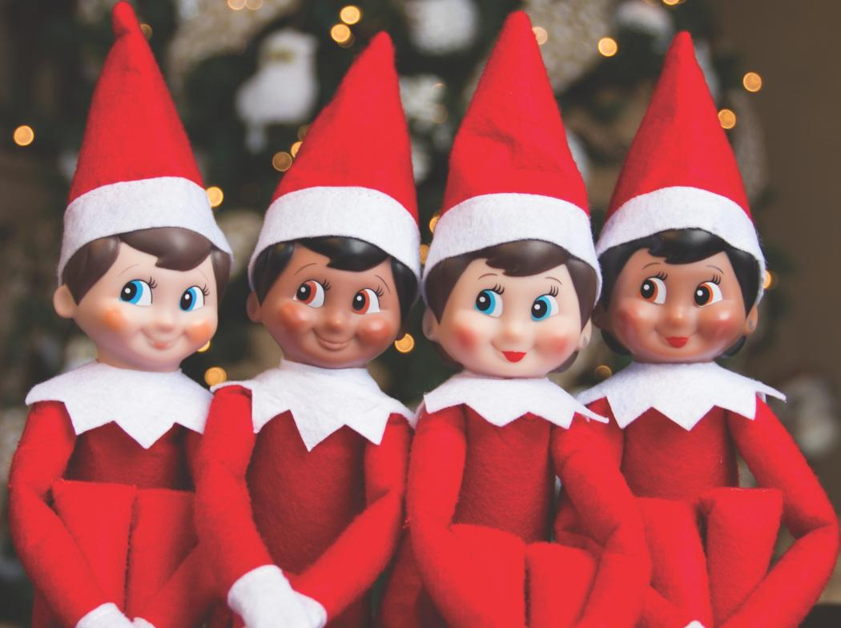
THANK YOU FOR WATCHING
MERY CHRISTMAS

