Slide 1
MINCE PIES

Slide 2
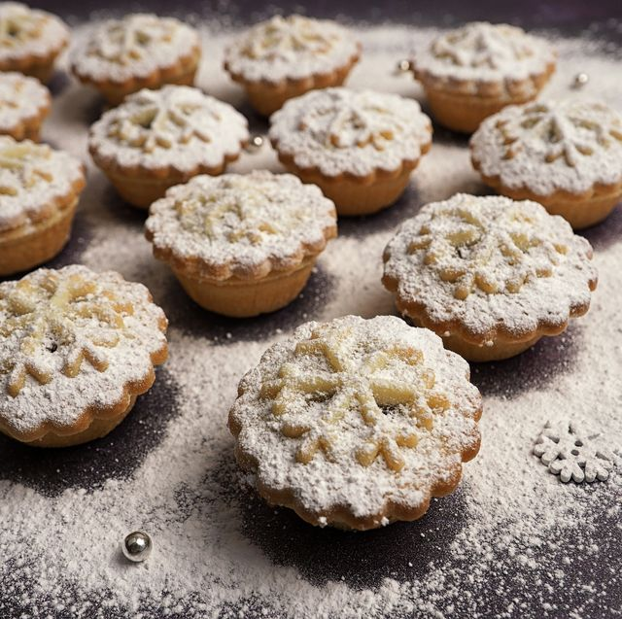
MINCE PIES
Mince pies is a traditional English dish which is eaten at Christmas . In my opinion it is delicious .

Slide 3
HOW TO MAKE MINNCE PIES
1) Place 375g plain flour and 260g softened unsalted butter in a bowl and rub together to a crumb consistency.
2)Add 125g caster sugar and 1 large beaten egg, and mix together.
3)Tip out onto a lightly floured surface and fold until the pastry comes together, be careful not to over mix.
4)Wrap the pastry in cling film and chill for 10 mins.
5)Scoop the large jar of mincemeat into a bowl and add 2 segmented satsumas, 1 finely chopped apple and zest of 1 lemon.
5)Heat oven to 220C/200C fan/gas 7.
7) roll out the pastry to 3mm thick.
8)Using a round cutter (about 10cm), cut out 16 bases and place them into muffin trays. Put 1½ tbsp mincemeat mixture into each. Brush the edge of each pie with a little beaten egg.
9)Re-roll out the pastry to cut 7cm lids and press them on top to seal. Glaze with the beaten egg, sprinkle with the extra caster sugar, then make a small cut in the tops.
10)Bake the mince pies for 15-20 mins until golden brown. Leave to cool before releasing them from the muffin trays and dusting with a little more icing sugar before serving.
I will now tell you how to make some delicious mice pies

