Slide 1
Alice in Wonderland: Discovering our roots.
The project started in September 2018, it has a 24-month duration and focusses on inclusion.
The main goal is to improve school inclusion by providing not only the young immigrants and refugees but all children with the opportunity to find a place in their new communities through active participation in their school.
Inclusion is certainly a wonderful idea. Sadly, it does not happen by itself. Alice in Wonderland is a story that gives pupils opportunities to understand real life issues. It gives children an insight into a world, which they may not have experienced, but it enables them to become citizens with empathy.
The activities planned in first year of the project helped children understand the framework based in 2 thematic topics: ‘Immigration in Europe’, ‘How together we achieve more’.
Through the chapter 1, 2 and 3 of Alice in Wonderland have been promoted diversity and solidarity, an understanding of the multiple facets of social integration, inclusion of different cultures in our classrooms, the inclusion of young immigrants and refugees.
The project actively has involved mobility of management teams to work on project activities, materials and share learning and ideas.

Slide 2
Project takes story "Alice in Wonderland" as a starting point for an extended project in which all children will be able to compare to real life situations and learn about social justice, thus creating a more inclusive school environment. “ Alice in Wonderland: discovering our roots” intends to give children a perspective on thoughts, emotions, and behaviors, that they may otherwise not understand. The activities planned in the project will help children understand the framework based in four thematic topics: Immigration in Europe, Democracy, How together we achieve more and Surrealism and Salvador Dalí as part of European Cultural Heritage. The main goal is to improve school inclusion by providing young immigrants and refugees with the opportunity to find a place in their new communities through active participation in their school.
Il progetto "Alice in Wonderland" è il punto di partenza per un progetto ampio in cui tutti i ragazzi saranno in grado di confrontarsi con situazioni di vita reale e conoscere la giustizia sociale, creando così un ambiente scolastico più inclusivo. "Alice nel Paese delle Meraviglie: alla scoperta delle nostre radici" intende offrire ai bambini una prospettiva su pensieri, emozioni e comportamenti che altrimenti potrebbero non comprendere. Le attività previste nel progetto aiuteranno i bambini a comprendere la struttura basata su quattro punti tematici: -Immigrazione in Europa, -Democrazia, -Come insieme realizziamo di più, -il Surrealismo e Salvador Dalì come parte del patrimonio culturale europeo. L'obiettivo principale è migliorare l'inclusione scolastica offrendo ai giovani immigrati e rifugiati l'opportunità di trovare un posto nelle nuove comunità attraverso la partecipazione attiva nella scuola.

Slide 3
PROJECT MEETINGS DONE
Gran Canaria 25th - 29th November 2018
Northern Ireland 12th - 15th March 2019
Lithuania 20th - 23rd May 2019

Slide 4
During this first year of the project, many topics and activities were carried out:
MURALS - ALL COUNTRIES
LOGOS - videos, photos and albums by all schools
LOGOS - finalists and voting
ABOUT US - ABOUT OUR SCHOOLS
Puglia and IC Parisi DeSanctis school presentations
Our City - Foggia - Italy
Alice's Lapbook
Christmas cards for european friends
VIDEOS Traditional Christmas carols
Our Alice's photo frames handmade by students in the creative Laboratory
Coding Activities with Bee-bot and Alice in Wonderland in 3C ! Handmade pattern!
Alice's carnival
Easter eggs decoupage prepared by students in secondary lower school
Easter sweets and food in Italy
Easter traditions in Italy.
Easter in partner Countries
Easter tree with Alice in our school handmade by pupils
Easter cards for our European friends

Slide 5
ART - IMMIGRATION FLOWS
Emigration and immigration flows
How students see immigration by their creativity!
Charity Event
Students meet NGO SOLIDAUNIA
Celebration of NOT BIRTHADAY for a baby with down syndrome
Students in secondary lower school have reproduced the most representative monuments of the partner Countries. They used recycled materials and polystyrene
ALICE STRIKES ADULT AND CHILDREN HEARTS - A story full of integration and great teaching
A story full of integration and great teaching
Different food in different Countries
Parents, students and teachers Survey

Slide 6
To have feedback on the effectiveness of the activities and on the initiatives proposed, questionnaires were prepared for parents, students and teachers involved in the project. The results obtained were reproduced in the graphs shown below.
Pupils’ Survey: 251

Slide 11
Parents / Governor’s Survey: 125

Slide 15
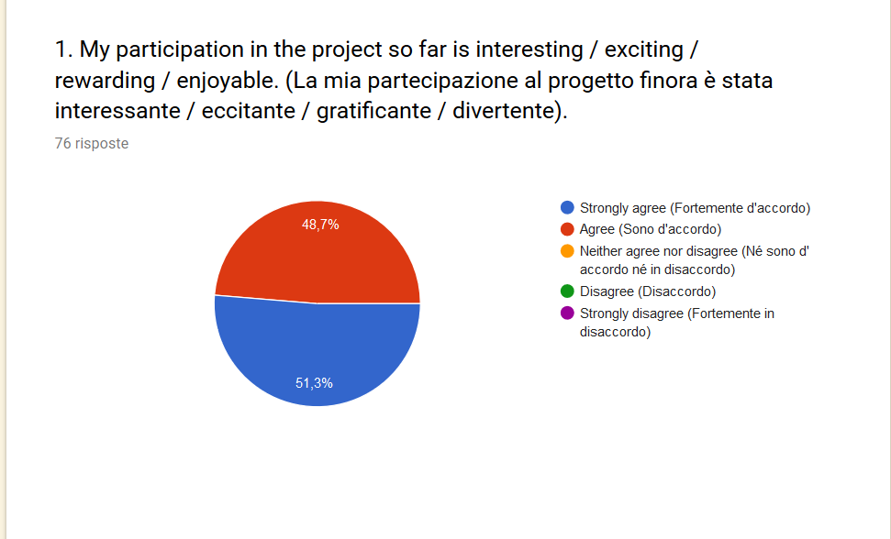
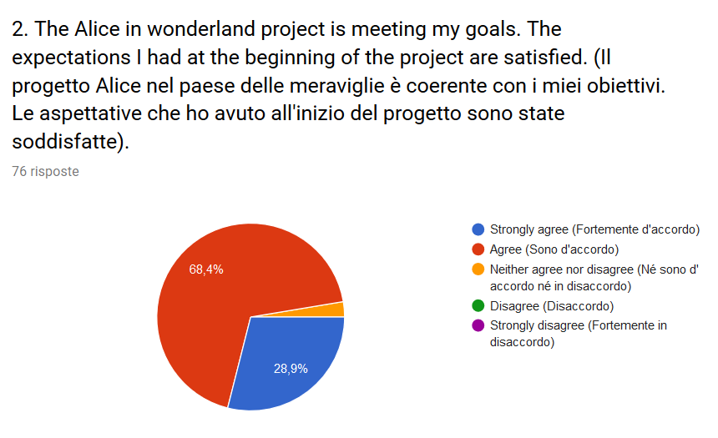
Teachers’ Survey

Slide 16
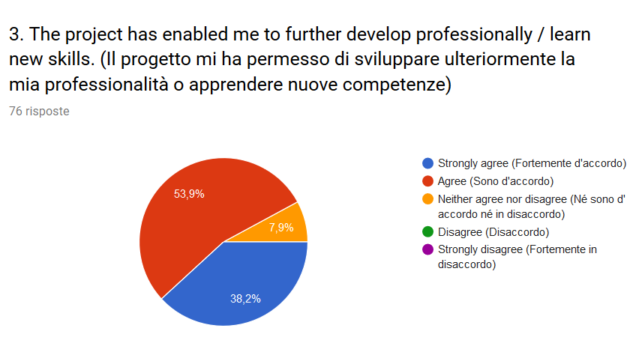
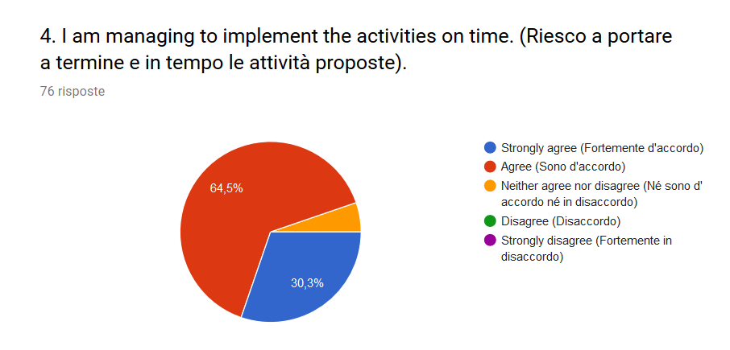

Slide 17
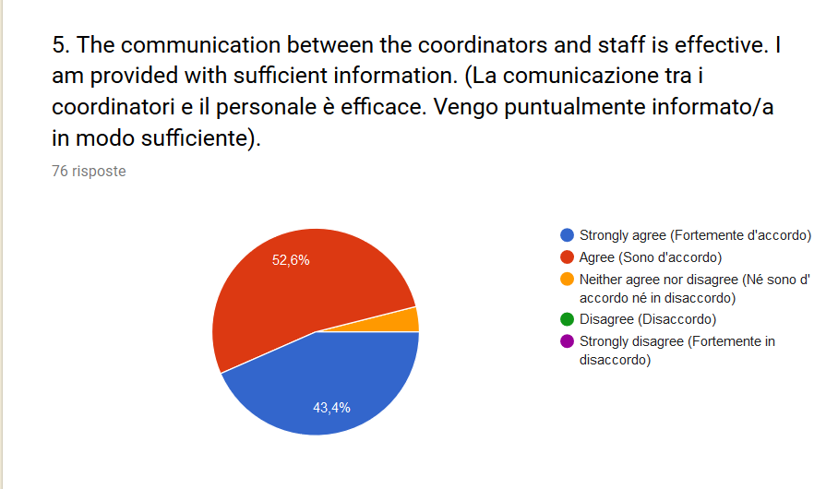
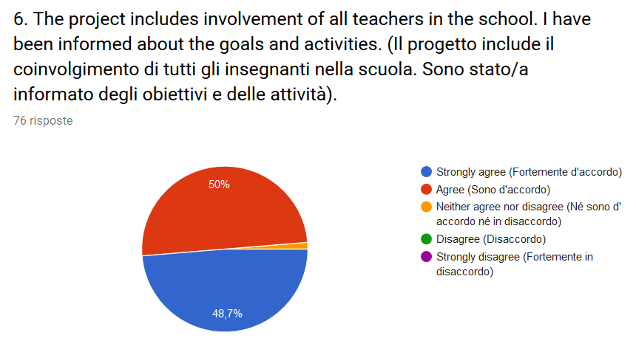

Slide 18
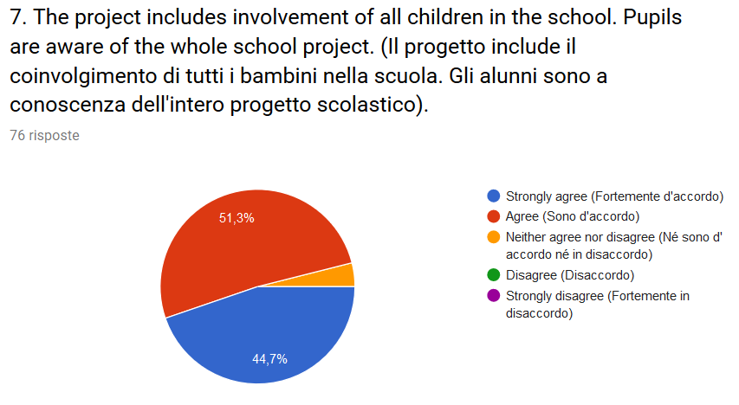
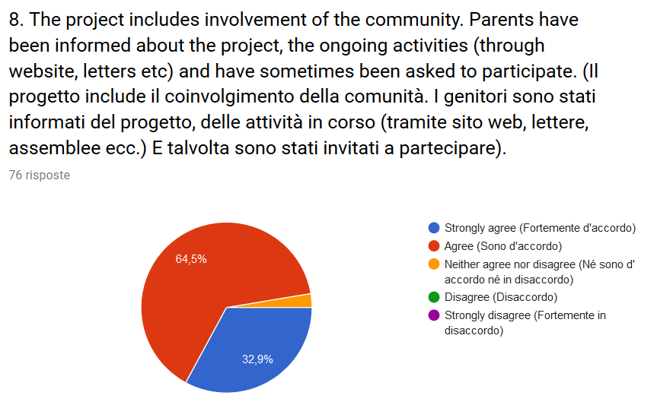

Slide 19
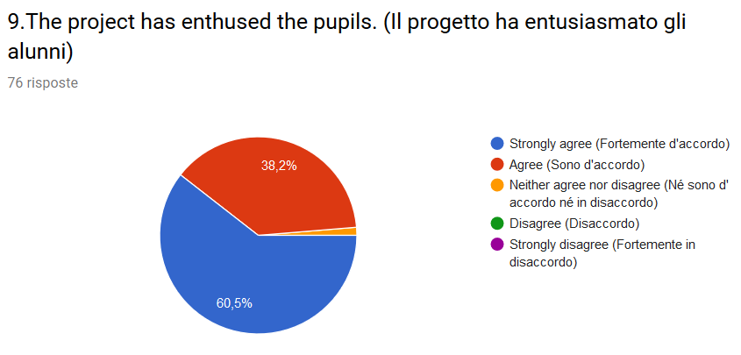
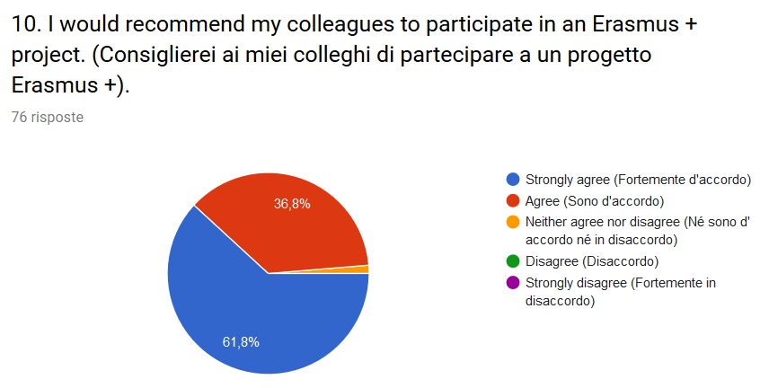

Slide 20
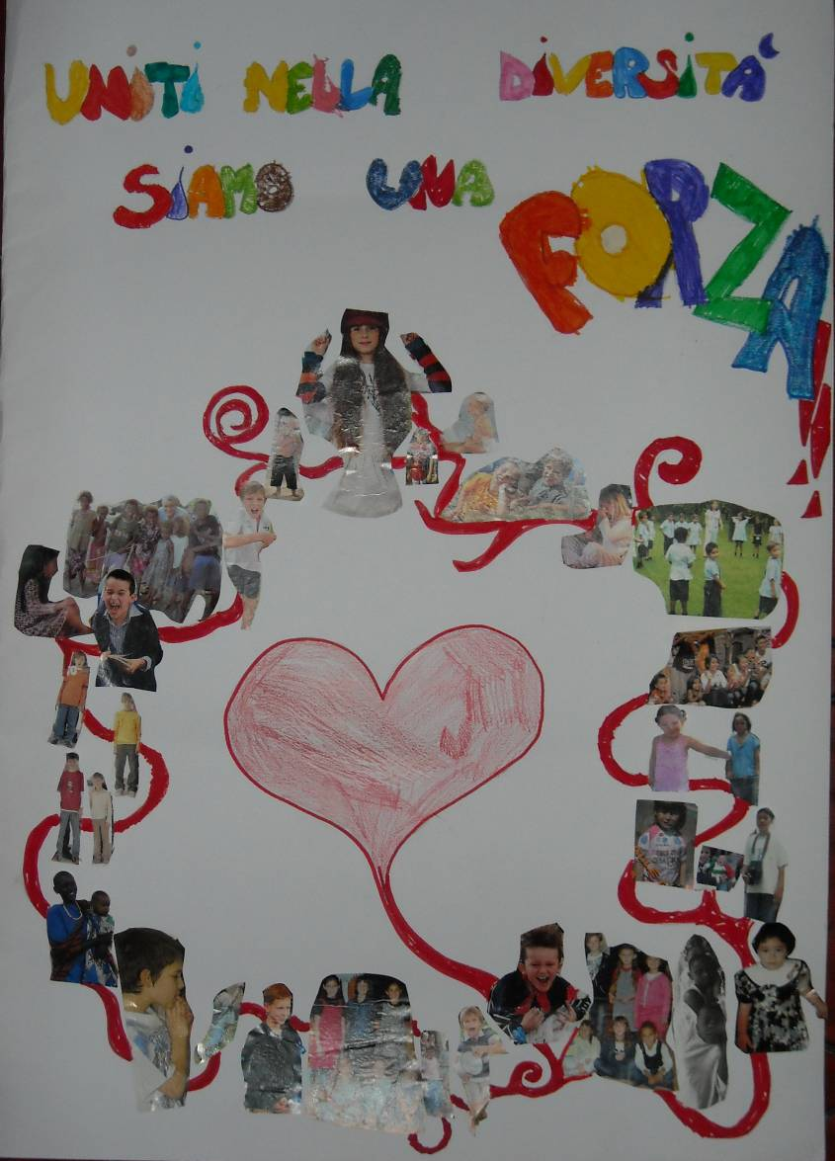
The graphs show that the project has received positive opinions both from parents, students and teachers
The impact was considerable and everyone's involvement meant that the expected results also had a great value.
Parents with their children have adopted the goal of social integration and diversity has been lived as enrichment.
United in our diversity
we are a great strength!!!

