Slide 1
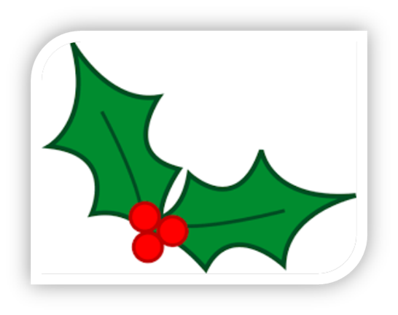
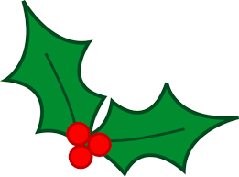
All about Christmas puddings.
Made bye Emma and Sienna.

Slide 2
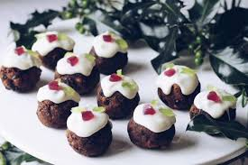
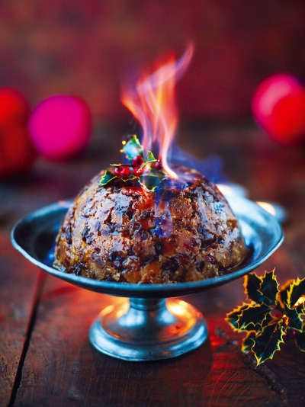
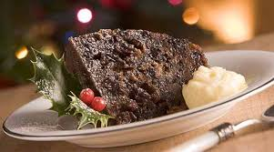
What a Christmas pudding looks like.

Slide 3
Were do Christmas puddings come from?
Christmas puddings originally come from England. Another name for Christmas pudding is plum pudding.

Slide 4
What are Christmas puddings made out of ?
The pudding is traditionally composed of thirteen ingredients, symbolizing Jesus and the Twelve Apostles, including many dried fruits held together by egg and suet, sometimes moistened by treacle or molasses and flavoured with cinnamon, nutmeg, cloves, ginger, and other spices.

Slide 5
THANK YOU FOR LISTENING

