Slide 1
Christmas cookies
By louis and joseph

Slide 2
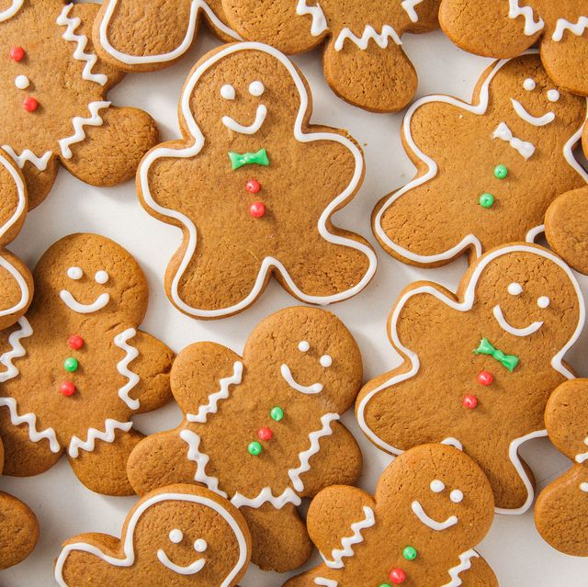
Theses are Christmas cookies

Slide 3
Here are some facts about Christmas cookies
Cookies were originally made to test oven temperature.
Queen Elizabeth I invented gingerbread men.
Santa Claus eats over 300 million cookies on Christmas Eve.

Slide 4
Recipe for Christmas cookies
Put the butter and sugars into a large mixing bowl. Beat together with an electric hand whisk until smooth and light in colour.
Break in the eggs one at a time, mixing as you break in each egg. Once the eggs are combined, add the vanilla extract.
Sift in the flour and baking powder and mix in with a wooden spoon until completely incorporated. Add the chocolate chunks and mix in until thoroughly combined. Divide the dough in half.
Place each half onto a large sheet of cling film. Roll the dough into a wide sausage shape and wrap in the cling film, twisting the ends to seal. Each sausage will make nine large cookies (but you can roll them smaller and make more). The dough sausages can be frozen at this point. However if you wish to bake them straightaway, chill the dough in the fridge for 30 minutes before use.
Once ready to use the cookie dough, remove from the freezer and allow to warm up enough to slice. Preheat the oven to 180C/350F/Gas 4.
Slice the dough sausage into nine discs and place onto a non-stick baking tray or a tray that has been lined with baking parchment.
Sprinkle each cookie with a tiny pinch of salt and bake in the preheated oven for 20 minutes, or until they are golden-brown on the edge and slightly paler in the centre.
Remove from the oven and transfer to a wire rack to cool before serving.

Slide 5
History of Christmas cookies
Cookies have been around a long time (they probably originated as drops of grain paste spilled on hot rocks around a fire), but they became associated with Christmas in Europe in the 1500s. Gingerbread was a similar food, but laws restricted its baking to guildsman, however at the holidays these regulations were relaxed and people were allowed to bake their own at home, making a very special once a year treat.

Slide 6
Thank you for watching

