Slide 1
Mince pies
This is a power point filled with recipes, tips and lots more!

Slide 2
Recipes for lovely mince pies
150g/5½oz raisins
150g/5½oz currants
75g/2½oz chopped mixed peel
150g/5½oz cold butter, grated
125g/4½oz dark brown soft sugar
1 vanilla pod, seeds scraped
1 tsp ground mixed spice
1 Bramley apple, peeled, grated, core discarded
1 orange, juice and zest
1 lemon, juice and zest
Combine all of the ingredients for the mincemeat in a large bowl and mix thoroughly. Cover with cling film and leave for 24 hours.
For the pastry: sieve the flour into a bowl, add the softened butter, icing sugar and orange zest and gently mix with your hands until the mixture resembles rough breadcrumbs. Mix in the egg yolks and then add 2-3 tablespoons of water to help bring it together. Squeeze the pastry together gently until you have a soft ball of pastry. Flatten to a disc, wrap in cling film and refrigerate for 30 minutes.
Preheat the oven to 180C/160C Fan/Gas 4.
Grease a bun tin or muffin tin, depending on how deep you like your mince pies. Unwrap the pastry and roll out on a lightly floured work surface to the thickness of a one pound coin. Cut out 12 discs of pastry with a pastry cutter slightly bigger than the size of the bun tin holes. Press a round of pastry into the bottom of each hole. Fill each pastry case with mincemeat and then cut a further 12 rounds of pastry (this time one size smaller). Brush the rims of the pastry cases with a little beaten egg and press the lids on, pressing the edges with the ends of a fork to seal shut.
Brush the lids with beaten egg and then use a small knife or skewer to make a slit in the top of each pie. Sprinkle with demerara sugar and then transfer the tray to the fridge for 30 minutes.
Bake the mince pies for 20-25 minutes, or until golden-brown and crisp. Transfer to a wire rack to cool and then turn the mince pies out and serve.

Slide 3
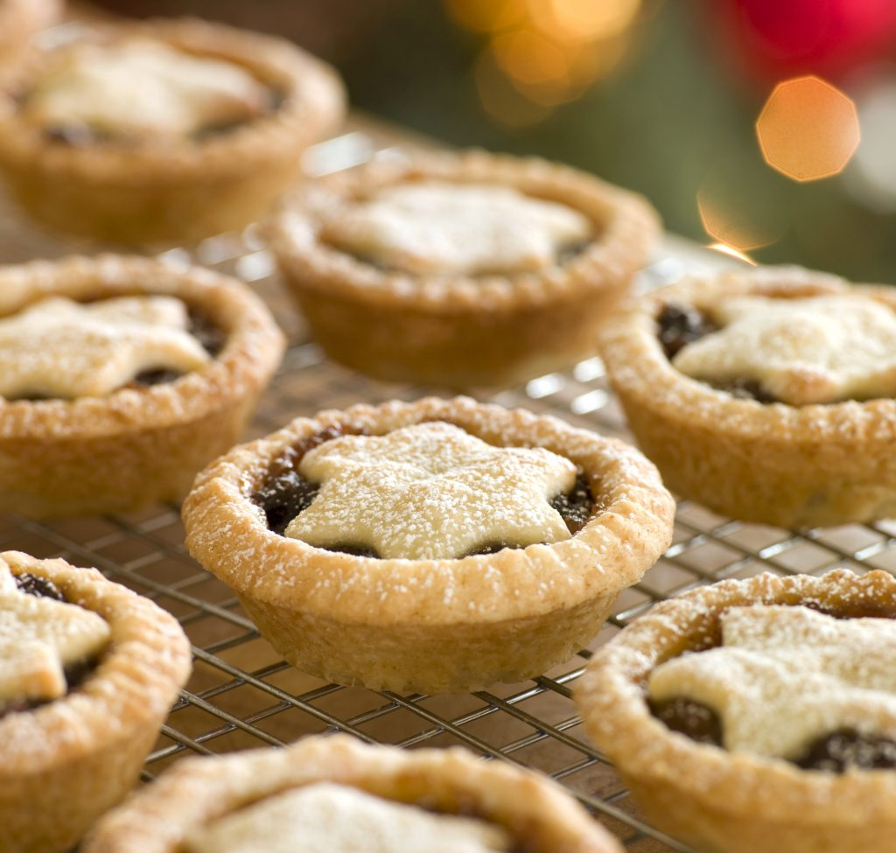
Mince pie tips and tricks
Personally I think mince pies taste amazing with many things.
Cream is very nice with mince pies.
You could have them plain if you would like that’s how I like my mince pies.
Mince pies are very Christmassy foods, but would love them all year round there so good.

Slide 4
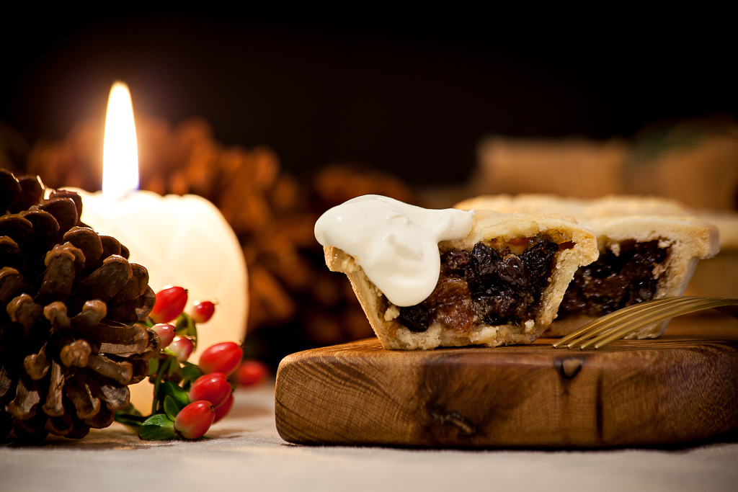
Mince Pie History
Mince Pies were not a British creation. Despite being adopted as a British tradition, the idea actually began in the 13th Century, with European Crusades (albeit some of them British) returning to their homelands from the Middle East.

Slide 5
Mince pies are truly yummy

