Slide 1
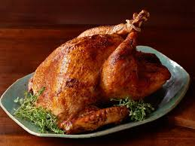
A traditional British Christmas meal.

Slide 2
. The 16th century farmer Thomas Tusser noted that by 1573 turkeys were commonly served at English Christmas dinners. The tradition of turkey at Christmas rapidly spread throughout England in the 17th century, and it also became common to serve goose which remained the predominant roast until the Victorian era.

Slide 3
When did we first start eating turkeys at Christmas? Turkeys were first brought into Britain in the 1520s. At that time, people would eat boar's head, goose or even peacock at Christmas; it has been claimed that Henry VIII was the first person in Britain to eat turkey for his Christmas meal.

Slide 4
So, it has been left to the turkey to keep our stomachs full on Christmas Day - and many days after that. Henry VIII was the first English king to enjoy turkey in the 16th century, although Edward VII made eating turkey fashionable at Christmas.

Slide 5
Small facts about turkey . Three hundred million turkeys are killed in the U.S. each year, many for Thanksgiving and Christmas. . Christmas Stats and Traditions. Last Christmas saw the UK consuming approximately 10 million turkeys.

Slide 6
Ingredients Allow 45 minutes per kilogram, plus 20 minutes, for a turkey under 4.5kg. Allow 40 minutes per kilogram for a turkey that's between 4.5kg and 6.5kg. Allow 35 minutes per kilogram for a turkey of more than 6.5kg.

Slide 7
Thanks for reading and listening I hope you know more about turkeys now.

