Slide 1
Μελετήσαμε τις μεταναστευτικές ροές των Ελλήνων στο χρόνο We have studied the migratory flows of the Greeks in time

Slide 2
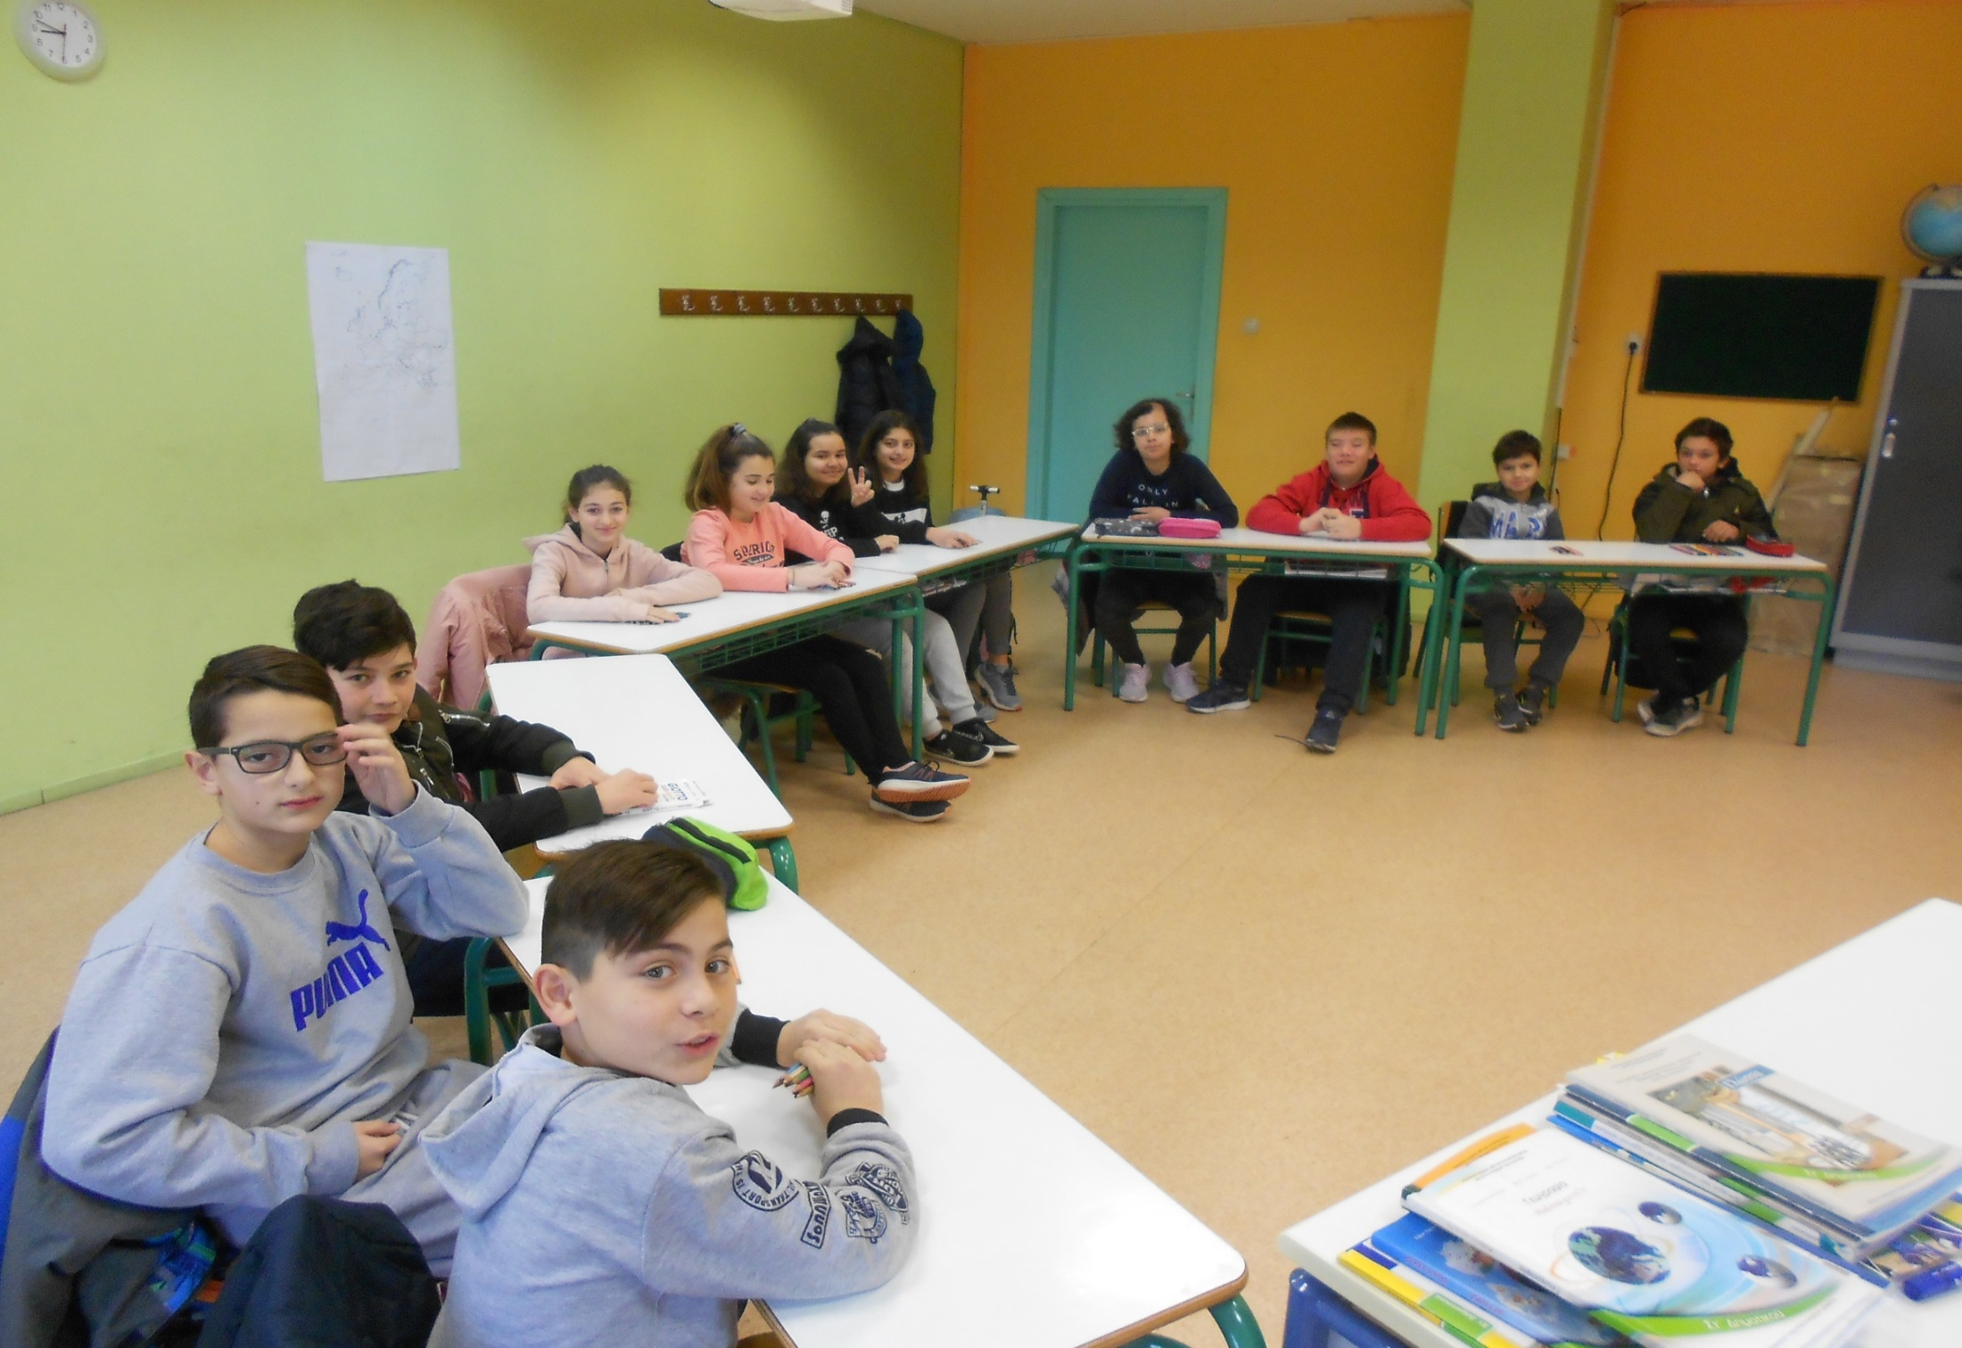
Η ομάδα εργασίας της Στ1 τάξης The working group of F1 class

Slide 3
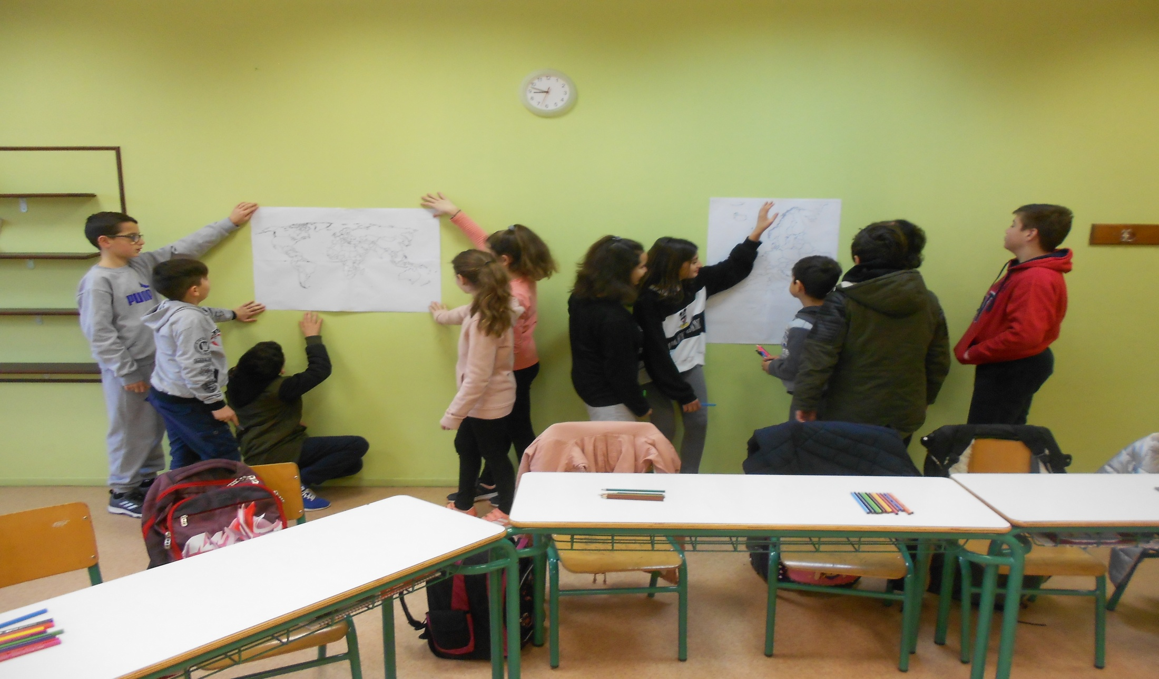
Χωριστήκαμε σε δύο ομάδες We split into two groups

Slide 4
Συγκεντρώσαμε πληροφορίες από : εφημερίδες περιοδικά διαδίκτυο We have gathered information from newspapers, magazines and internet

Slide 5
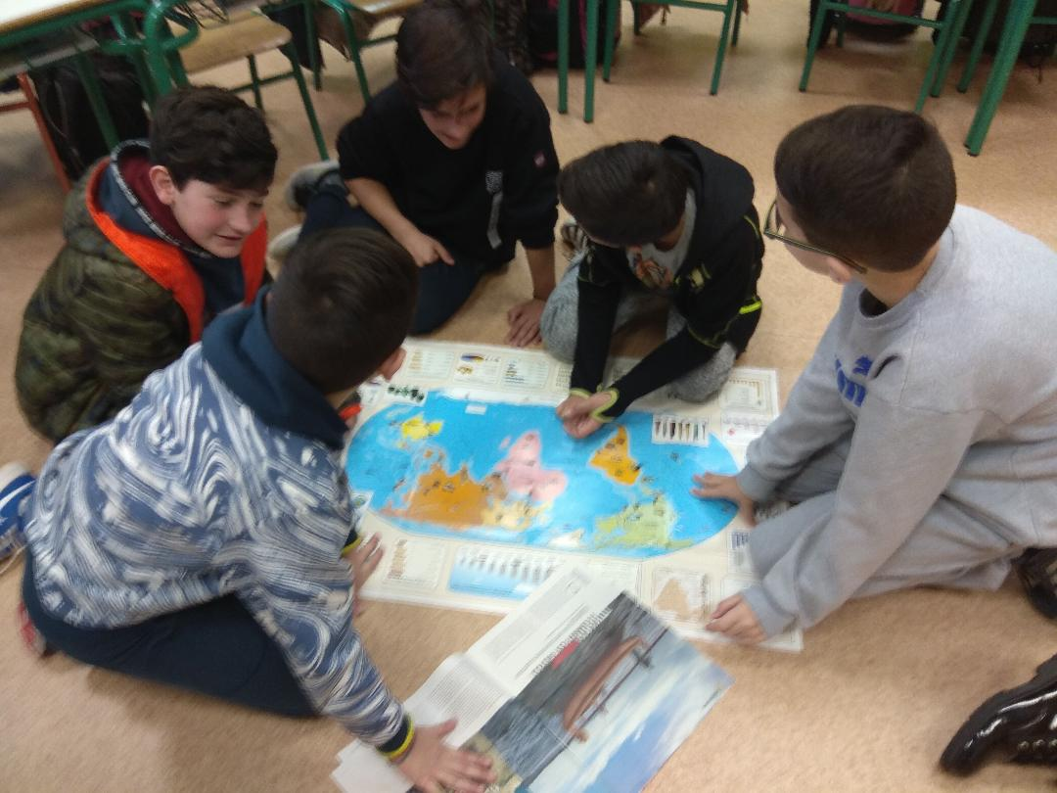
Μελετήσαμε προσεκτικά τον χάρτη, Συζητήσαμε στις ομάδες μας We discussed in our teams

Slide 6
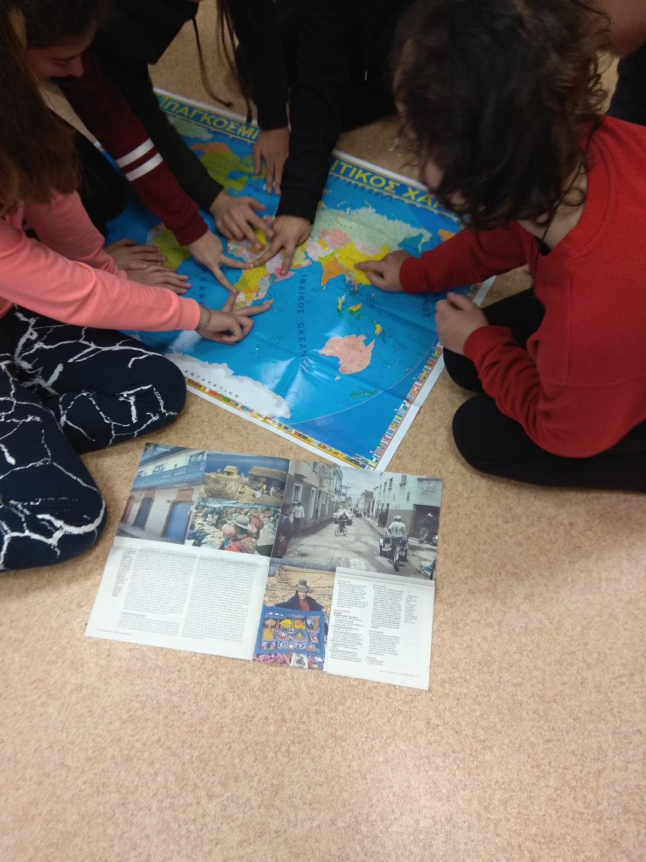

Slide 7
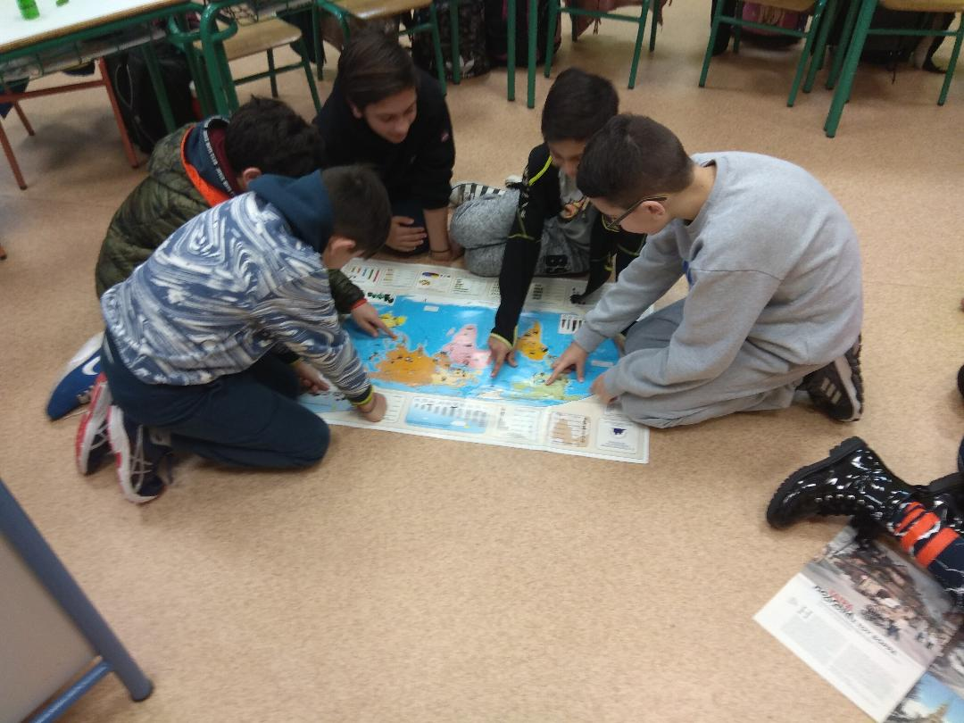

Slide 8
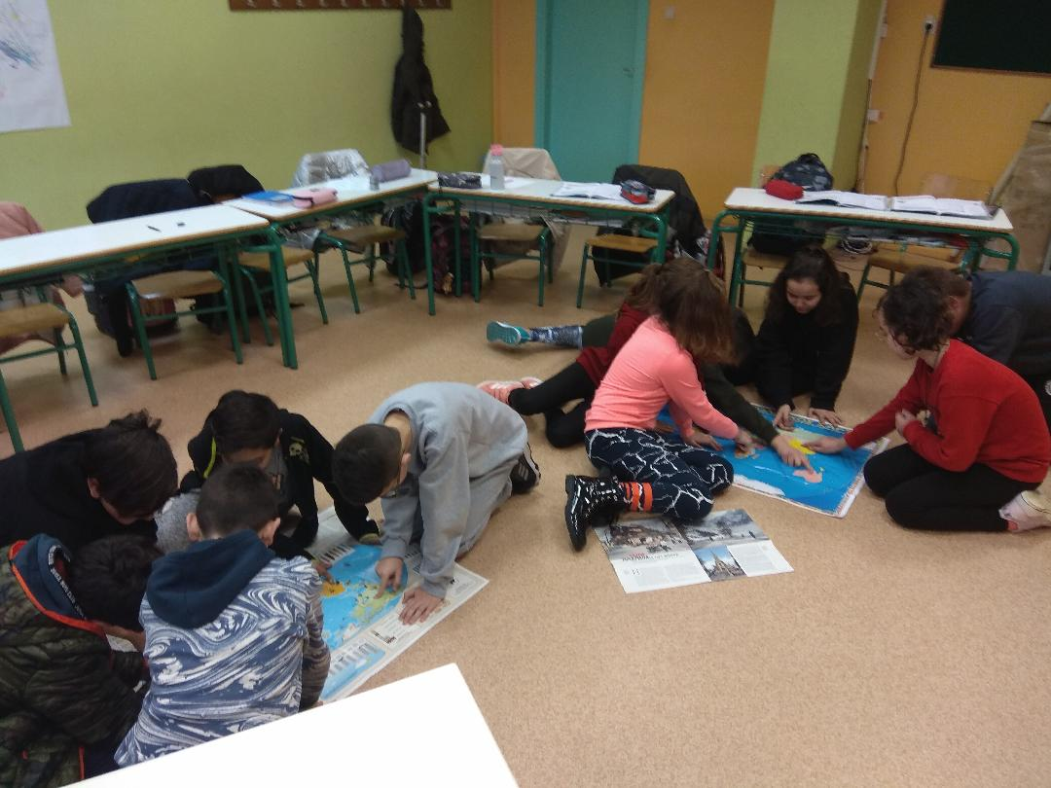

Slide 9
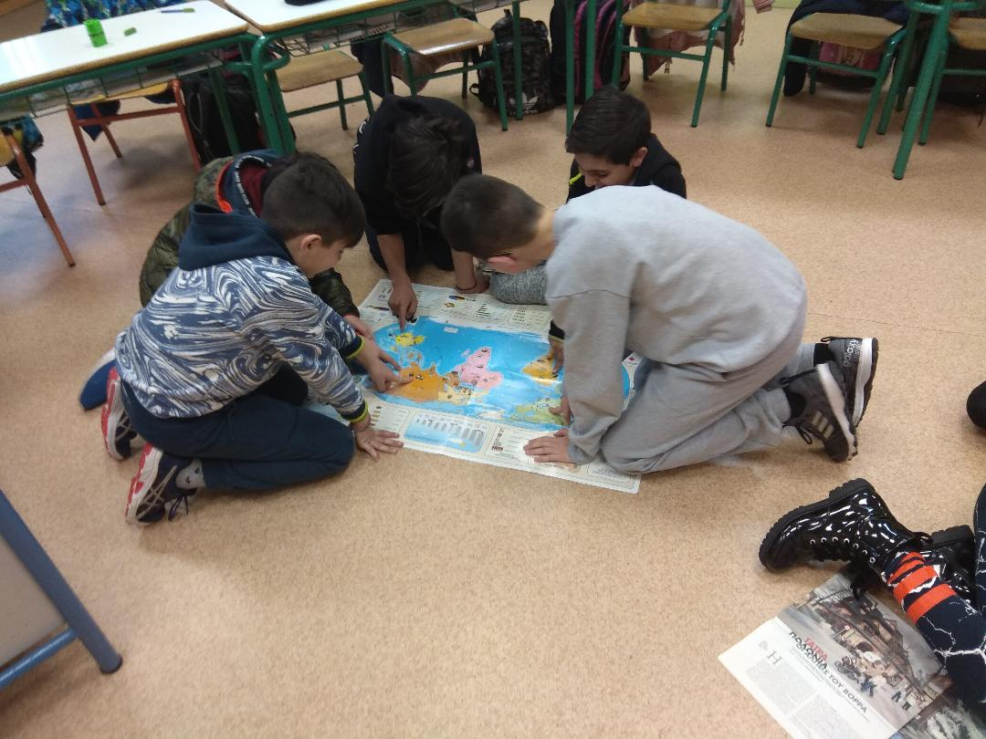

Slide 10
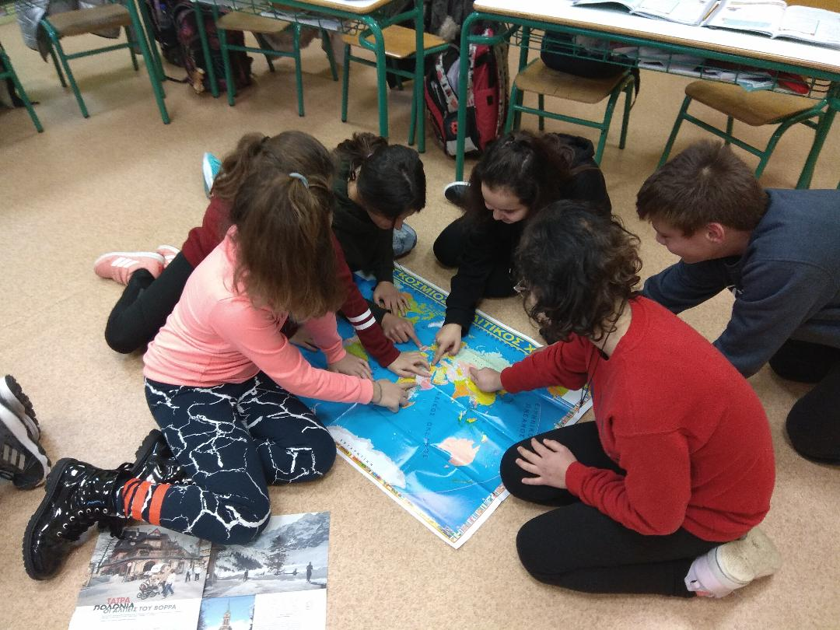

Slide 11
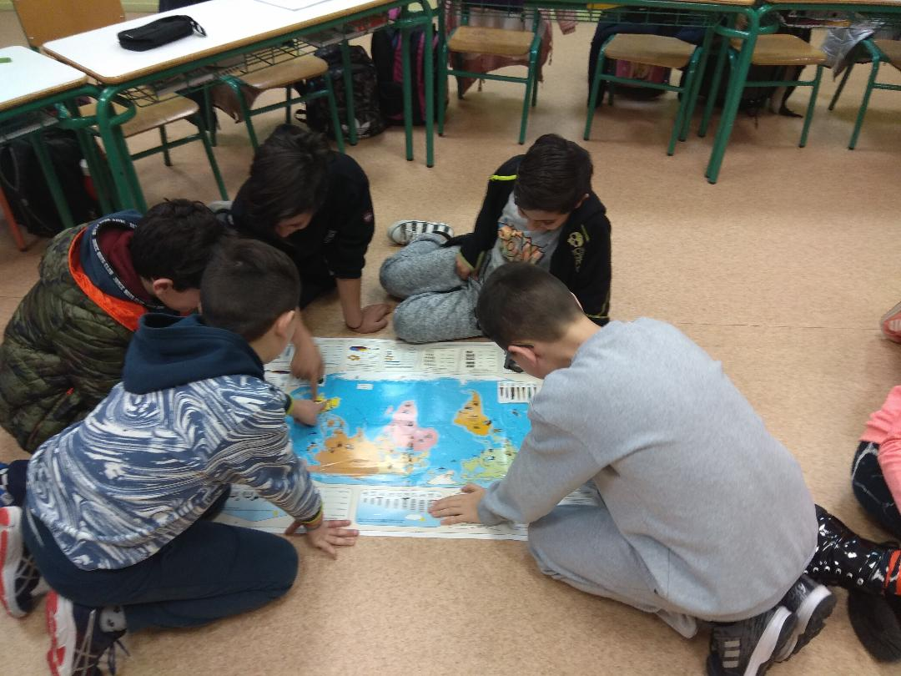

Slide 12
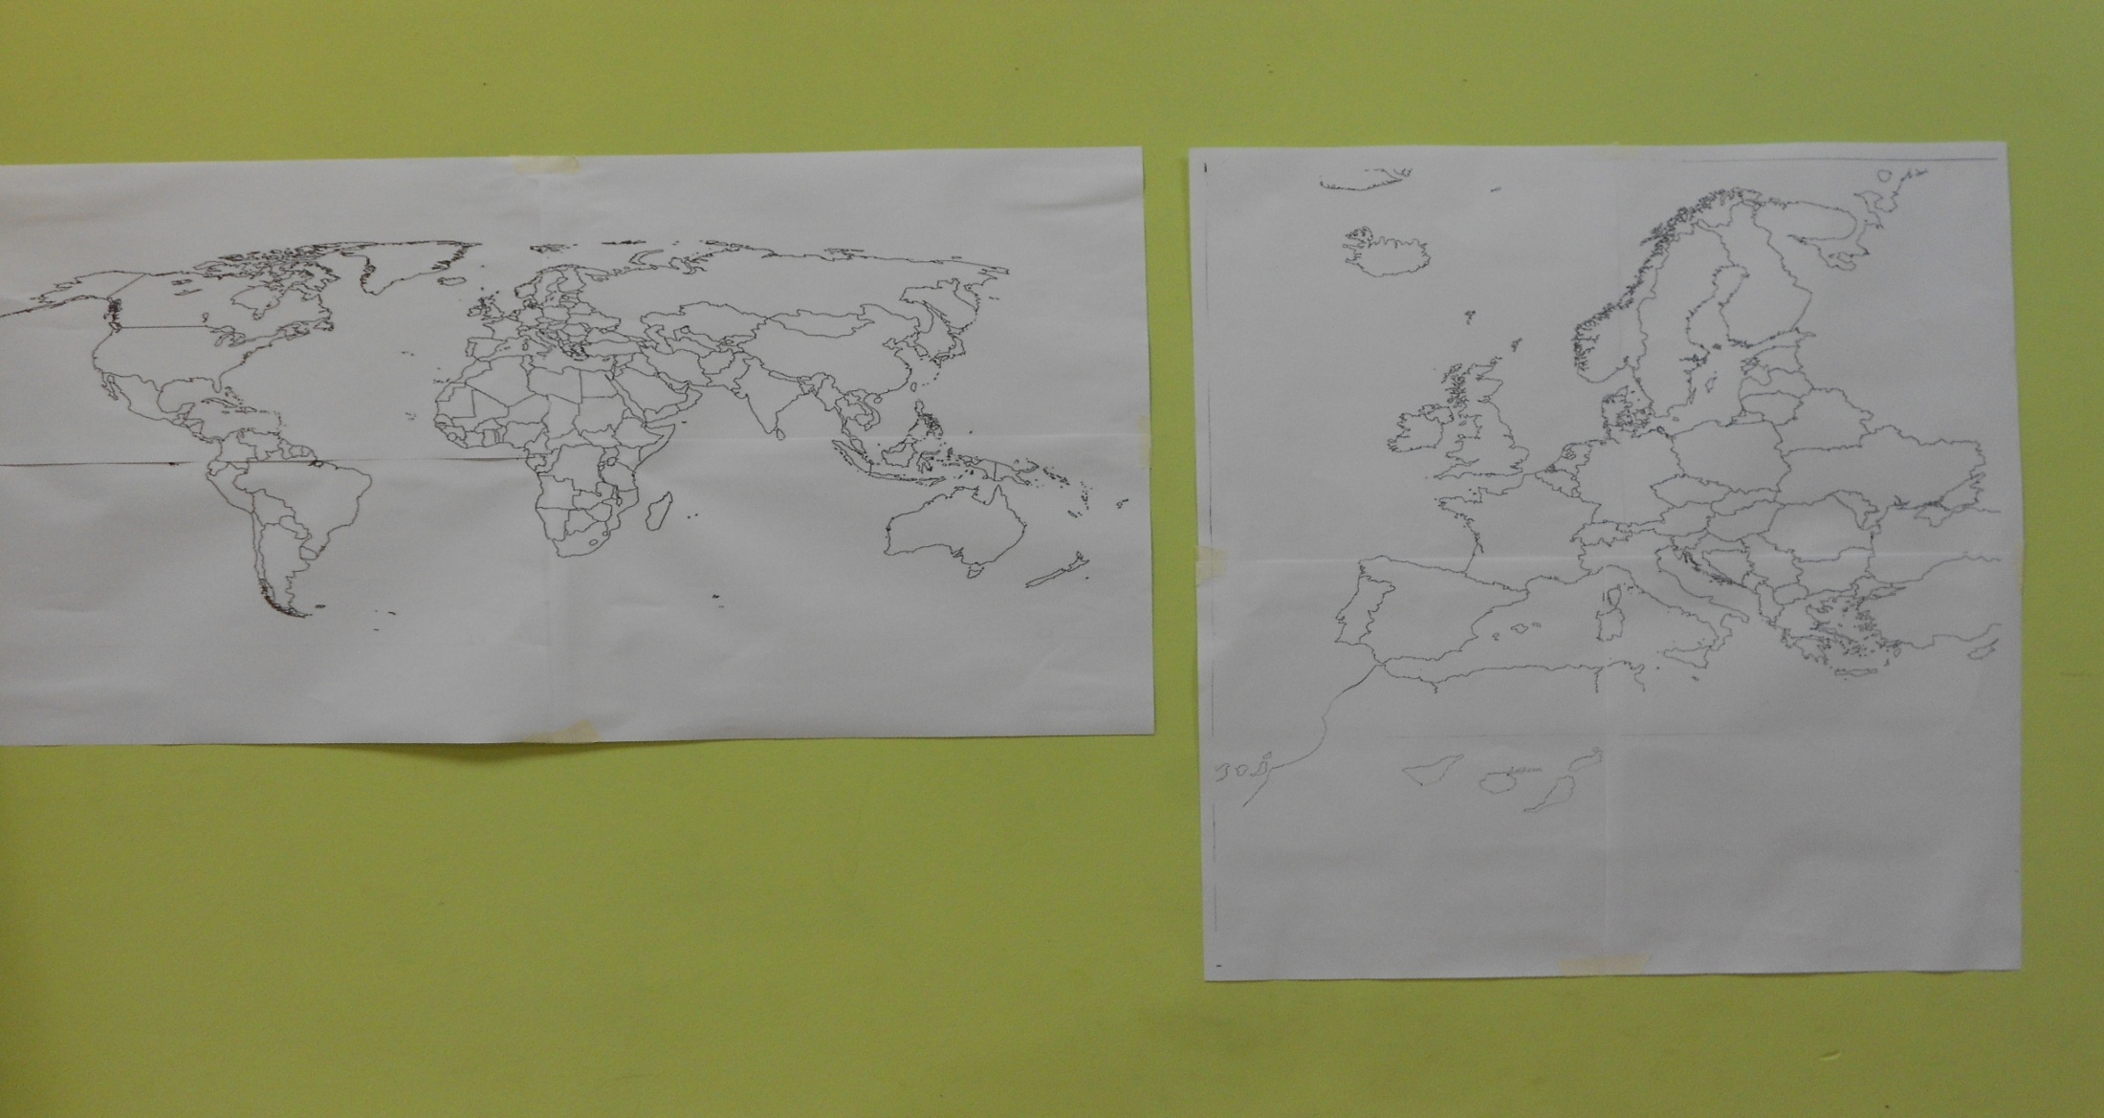
Σχεδιάσαμε σε χαρτί έναν παγκόσμιο & έναν ευρωπαϊκό χάρτη We drew on paper a global and a European map

Slide 13
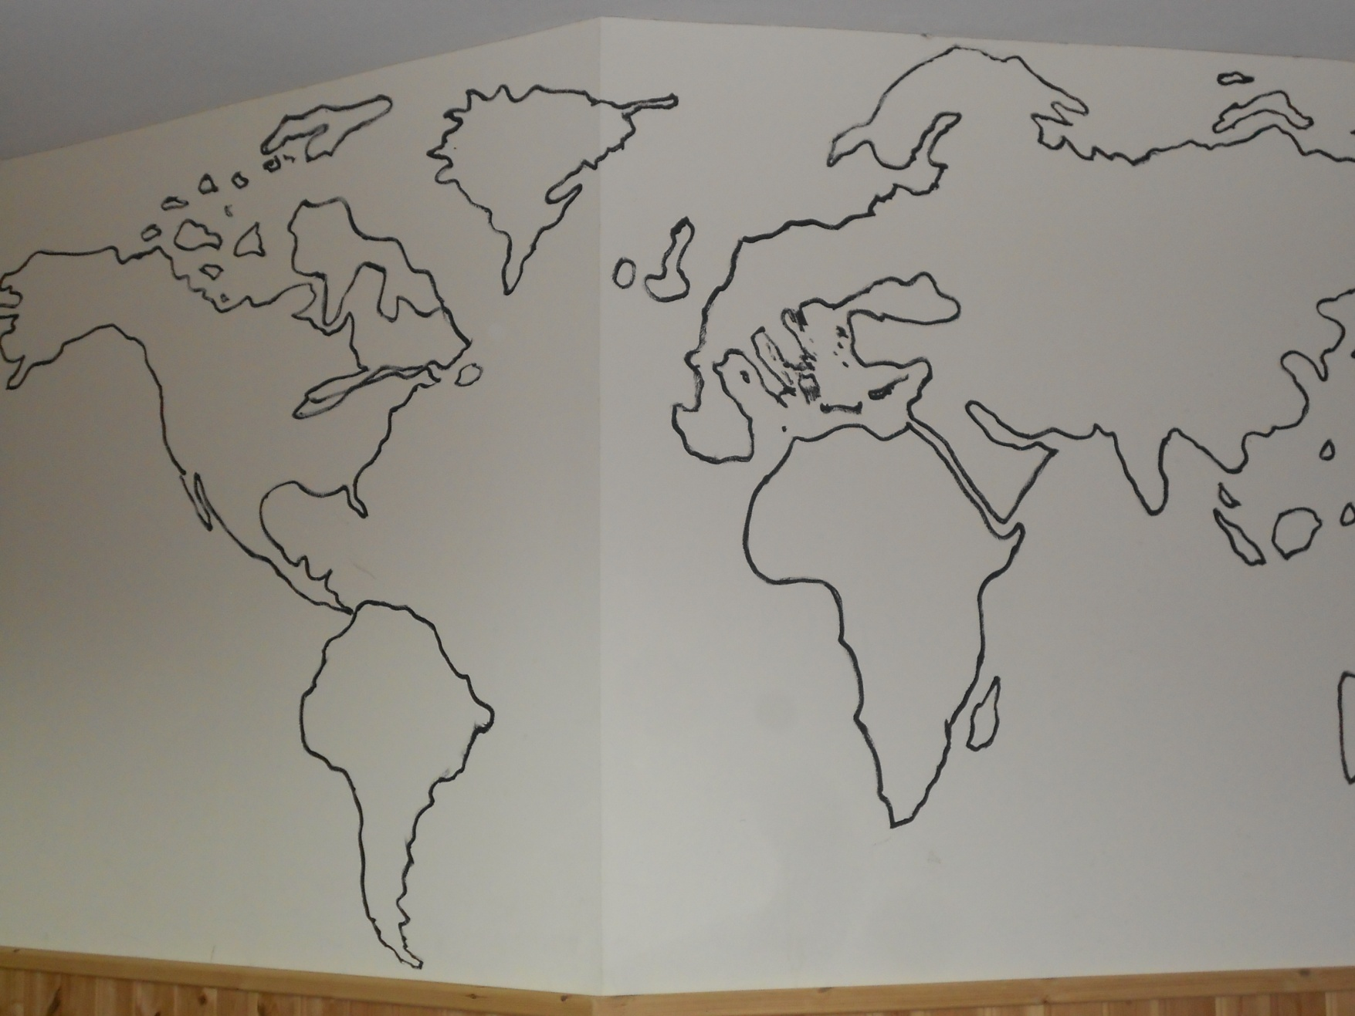
We drew on the wall of the school

Slide 14
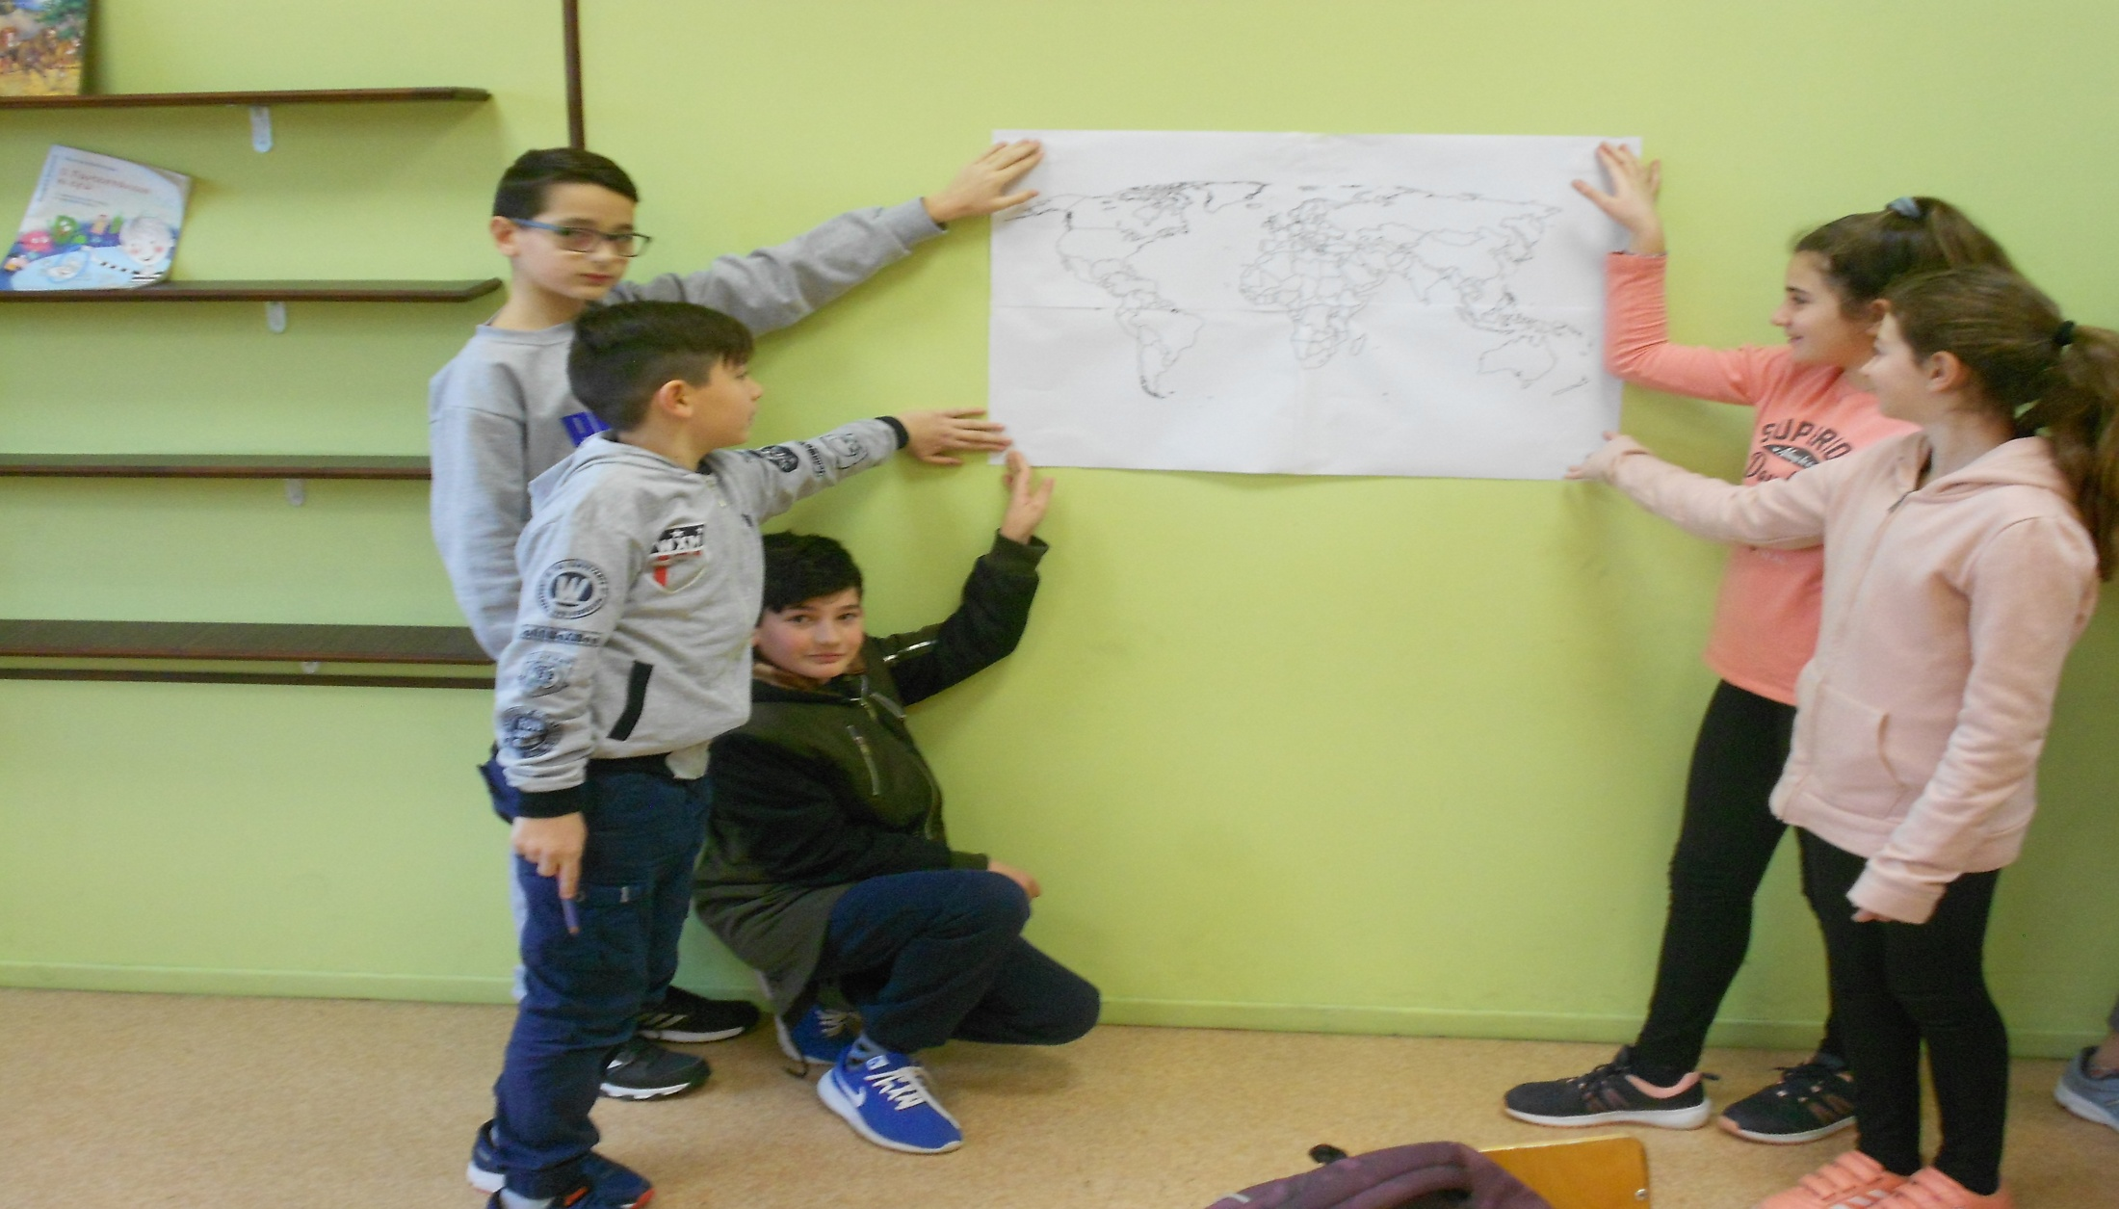
Team 1 chose the world map

Slide 15
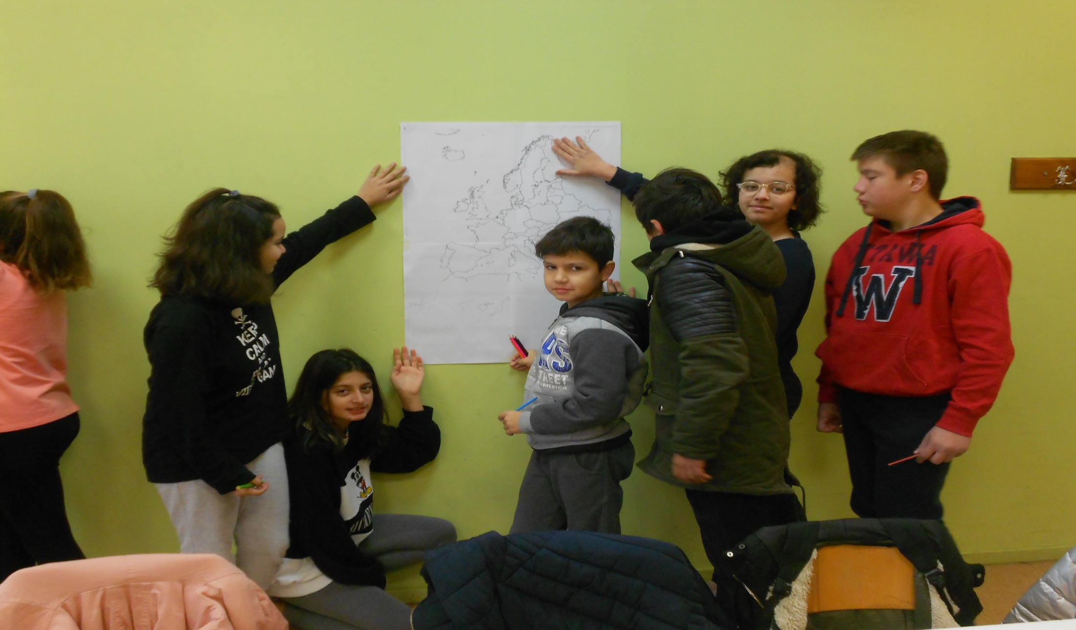
Team 2 chose the European map

Slide 16
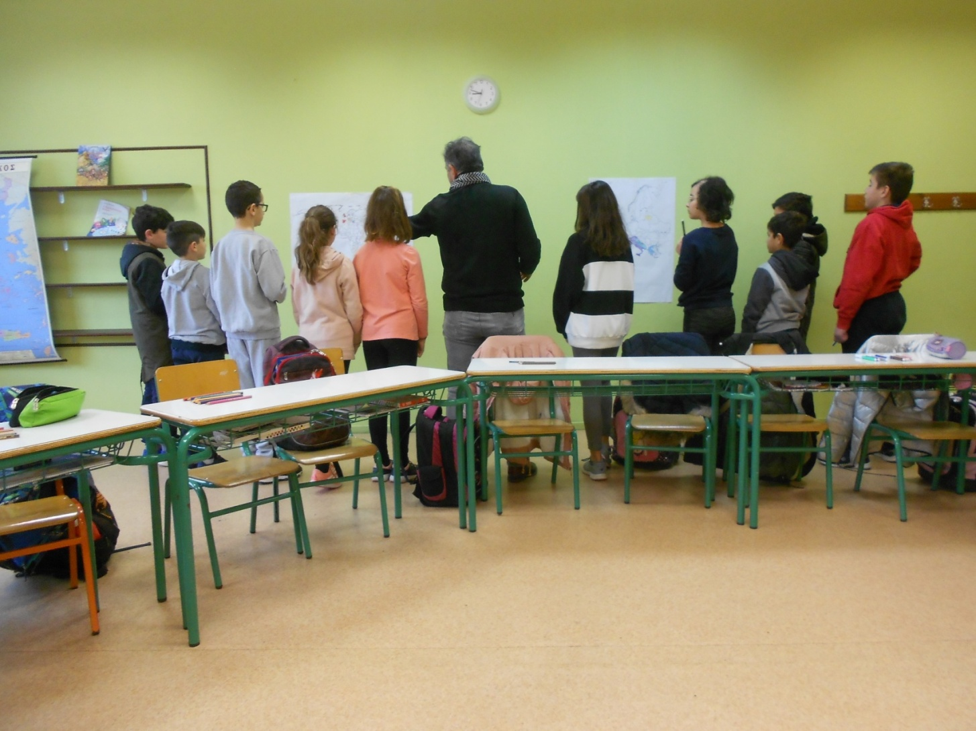
Teams talk to the teacher

Slide 17
Team members share activities

Slide 18
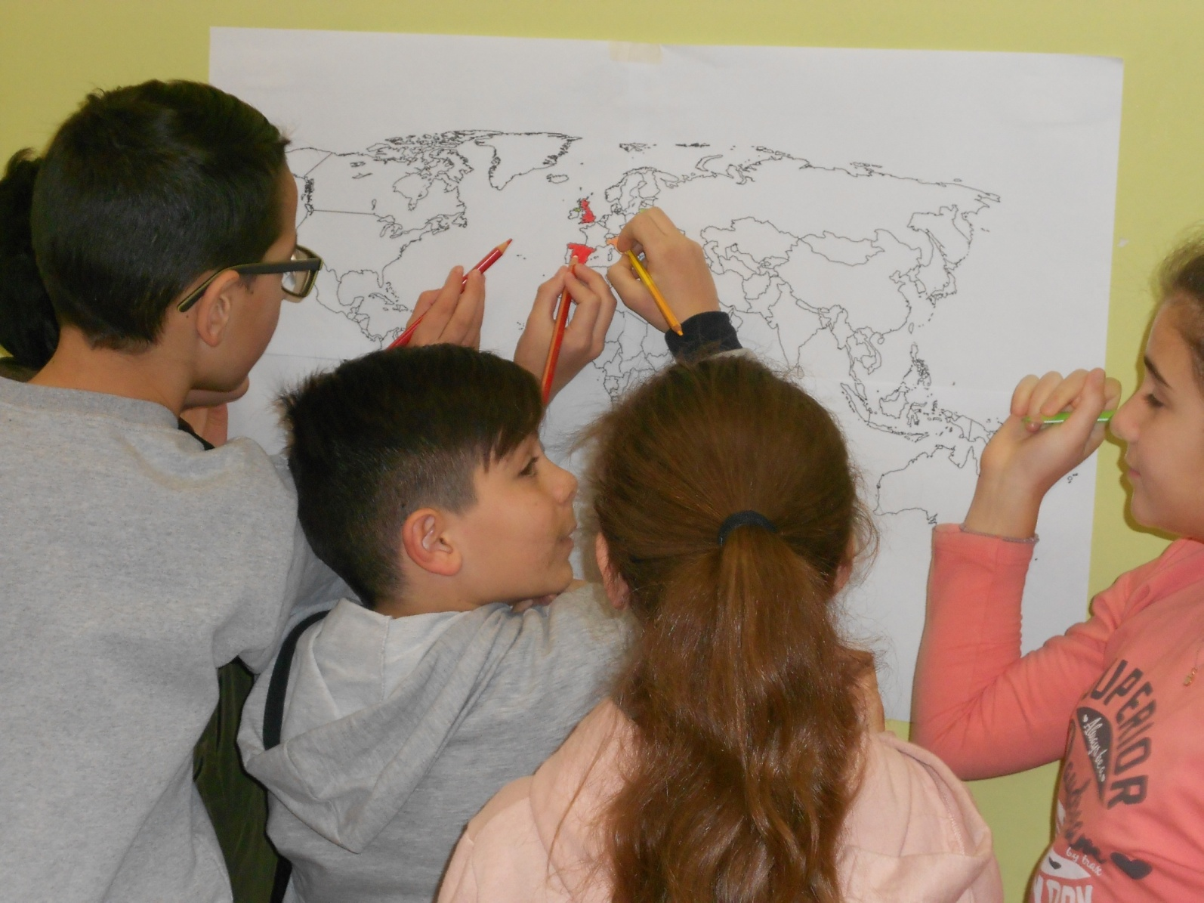
The flow representation is given by dots

Slide 19
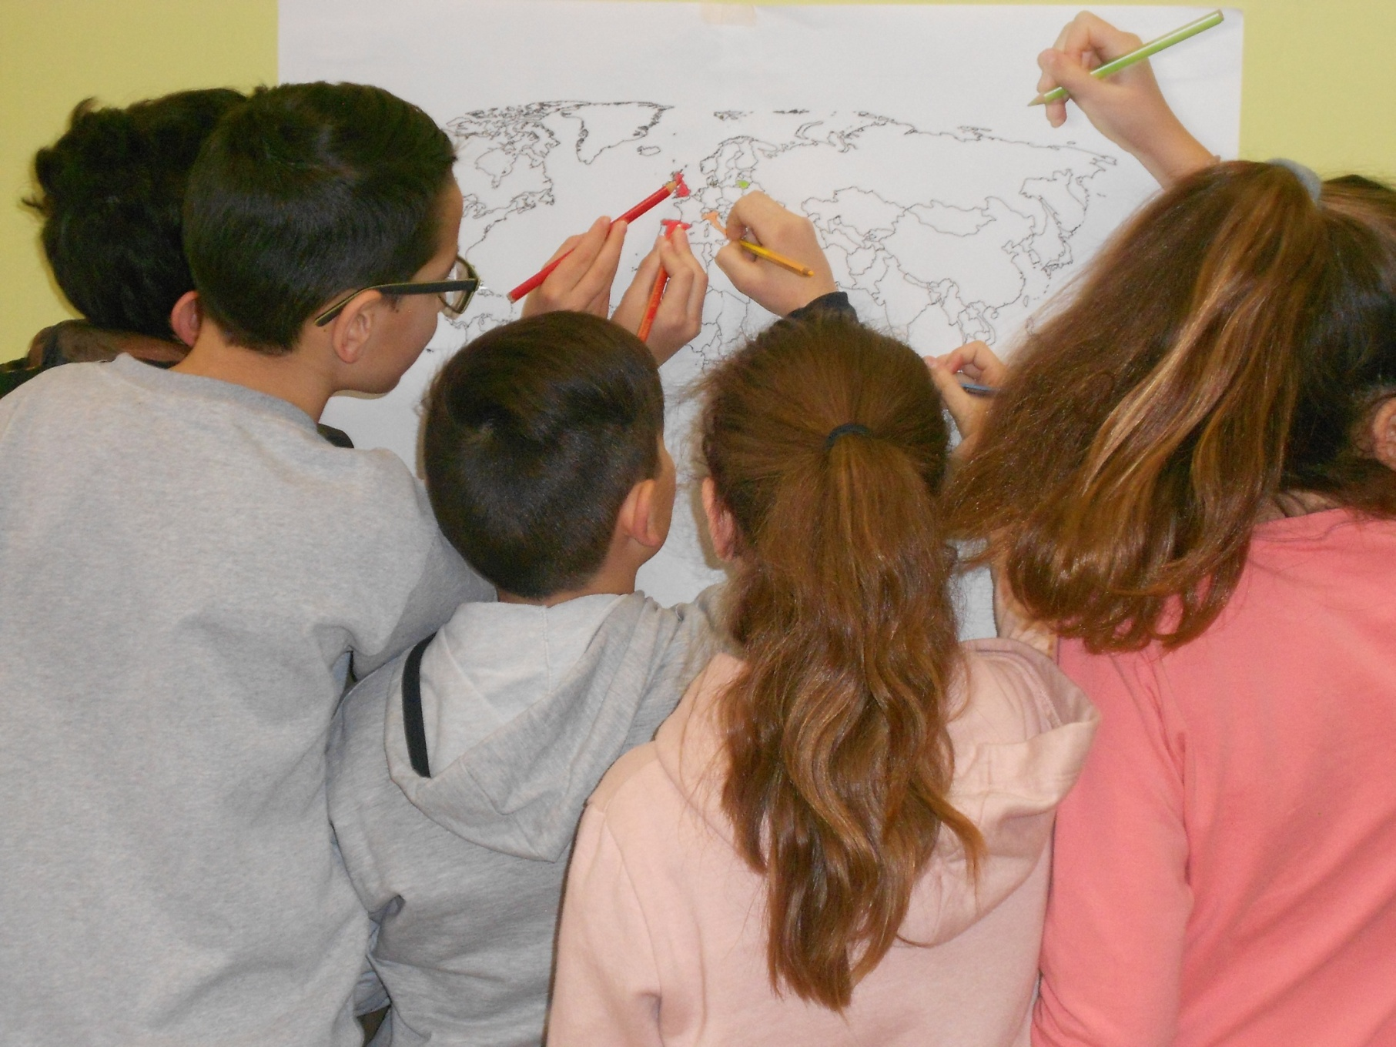
Teamwork continues

Slide 20
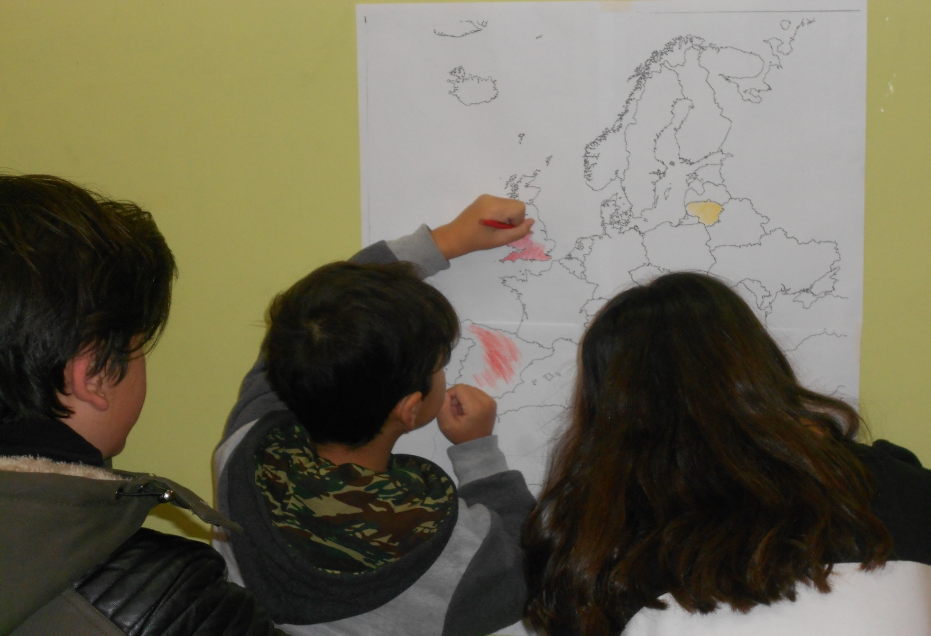

Slide 21
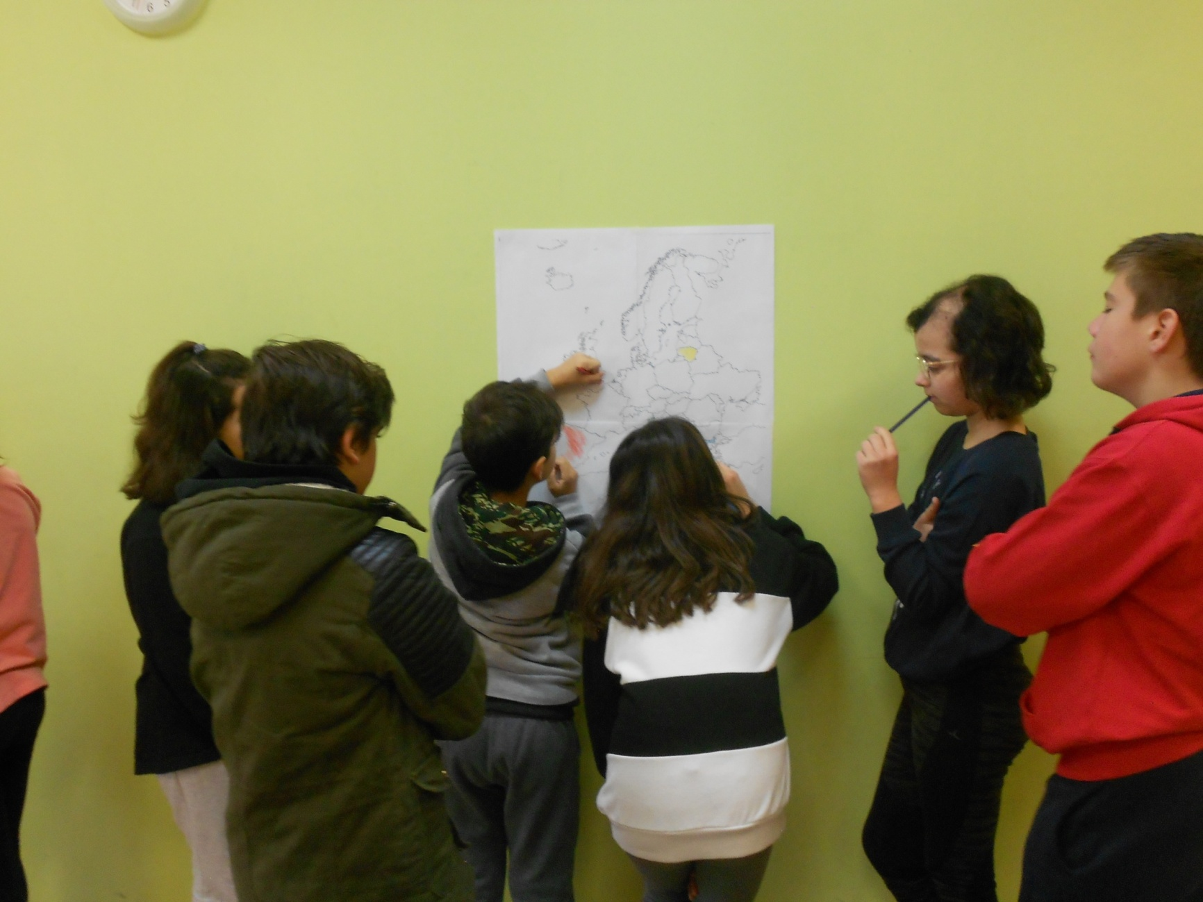
The team is being consulted

Slide 22
Blue arrows indicate the direction of the flow of Greeks who emigrated

Slide 23
By arrows we have identified the countries through which immigrants came to Greece

Slide 25
We have completed the map entitled: Greeks immigrate to Europe

Slide 26
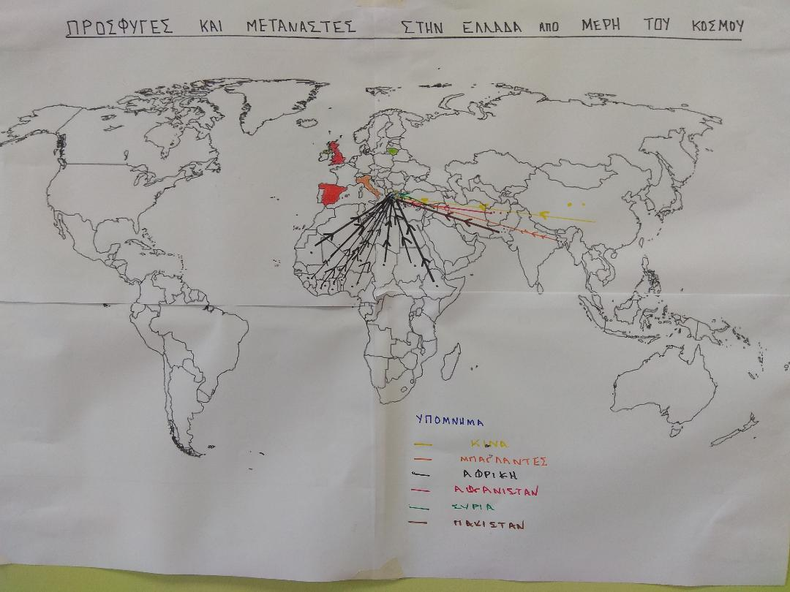
We have also created a note at the bottom of the map,showing the origin countries of the refugees

Slide 27
Finally, we evaluated the process and the outcome

Slide 28
In this project, the students of F1 class have worked Anastasia, Stella, Olga , Joanna M, Konstantinos A , Joanna N , Thanassis ,Diogenes , Nick, Kyriakos,Stelios,Konstantinos G. Their teacher: Nick Papanicolaou

