Slide 2
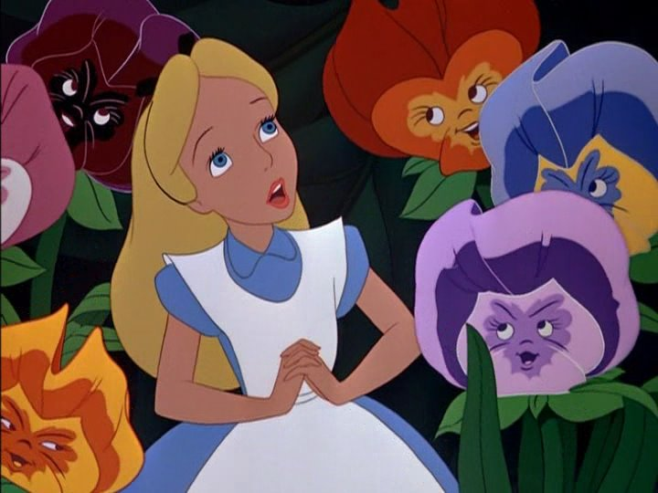
Alice in wonderland : Discovering our roots

Slide 3
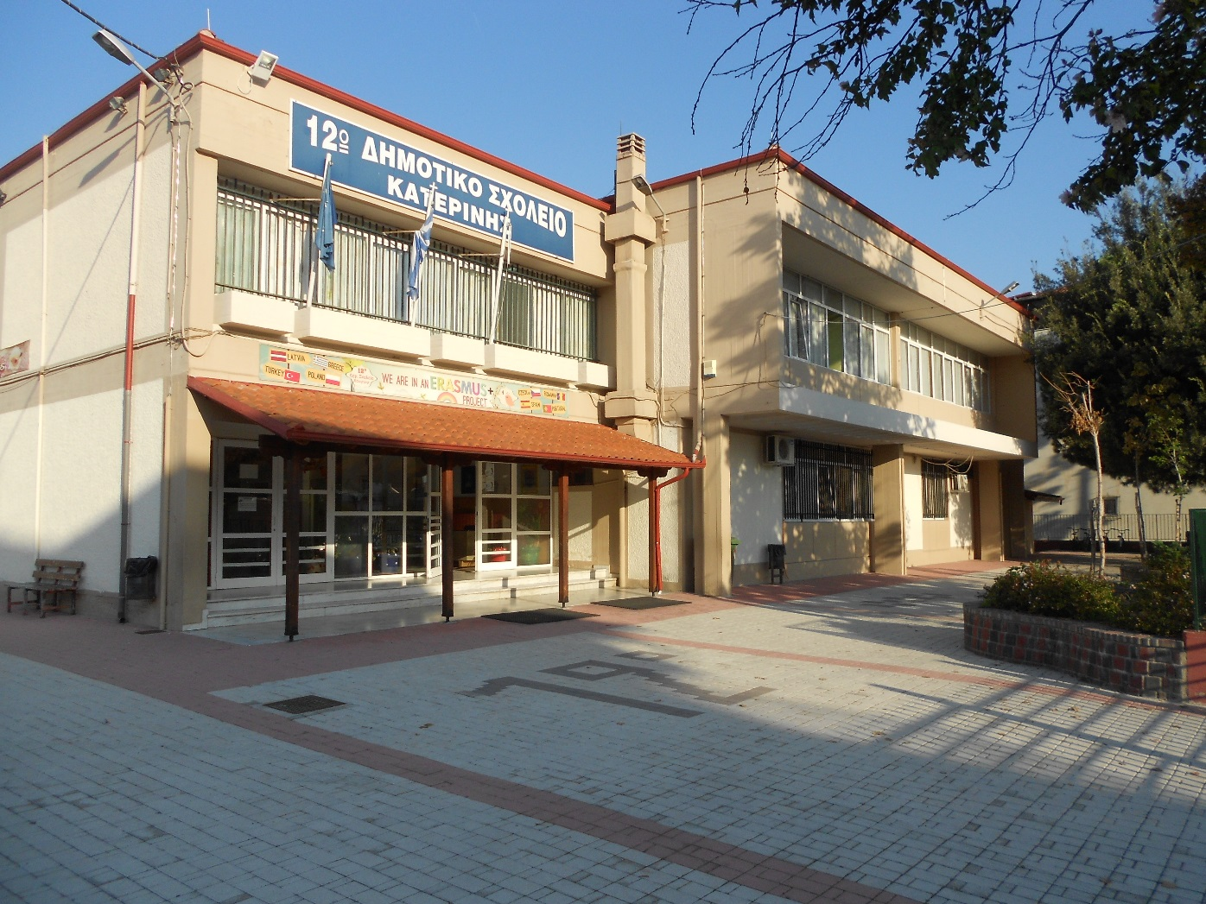
12 th primary school Katerini Greece

Slide 4
EVALUATION-RESULTS
1 st year evaluation

Slide 5
STUDENTS:60
Questions :10

Slide 6
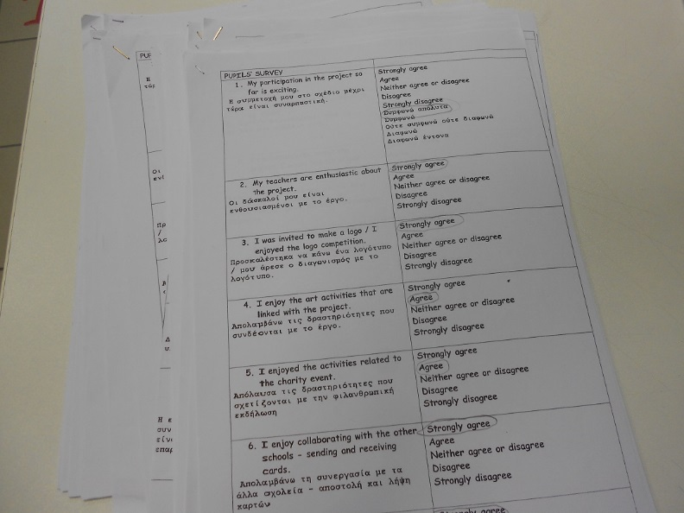

Slide 7
Evaluation –results
Their participation in the project is exciting, they were informed about the project, they took part in the making of logo, and they enjoy the activities of the project and their cooperation with the partner schools. They would like to get involved in a new project in future

Slide 8
The students’ answers
Strongly agree60%
Agree 45 %
Neither agree or disagree 5%
Disagree
Strongly disagree

Slide 9
TEACHERS :24
Questions :10

Slide 10
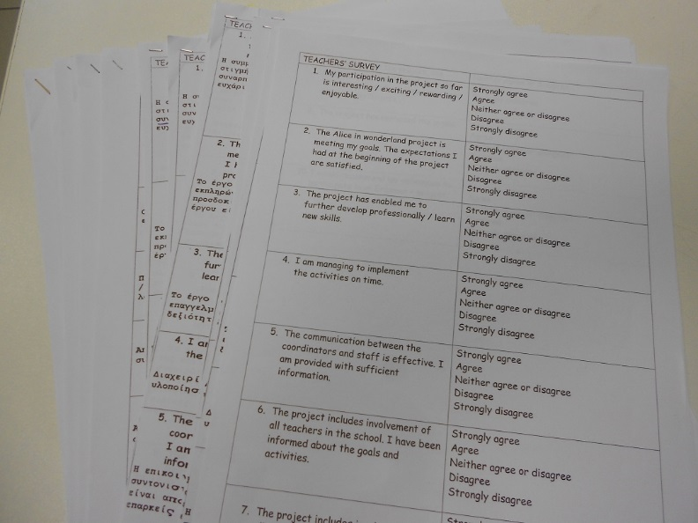

Slide 11
Evaluation –results
Given the answers in the questionnaire, we conclude that teachers are interested in the project and that it meets their goals. They believe that through their participation they develop and learn new skills. From their answers, it is shown that the communication between the coordinator and the school is effective and their participation is overall

Slide 12
The teachers’ answers
Strongly agree 50%
Agree 50%
Neither agree or disagree
Disagree
Strongly disagr

Slide 13
Parents :30
Questions :7

Slide 14
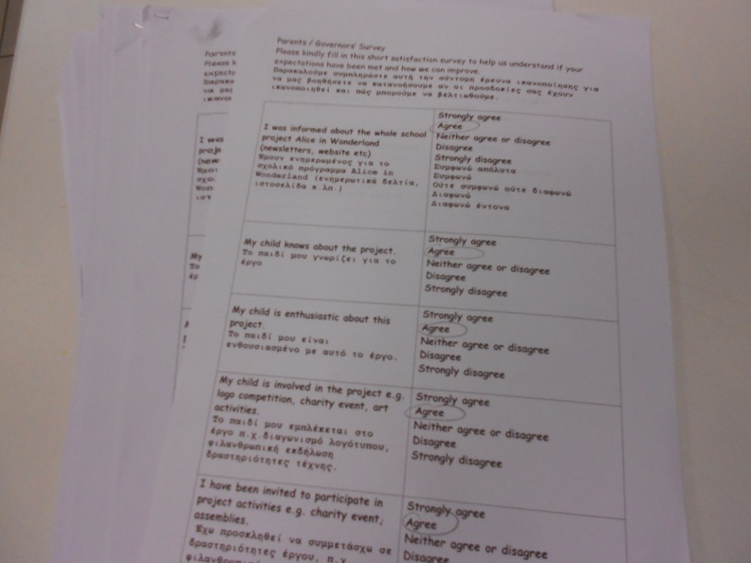

Slide 15
Evaluation –results
The parents have answered that the school informed them about the project and their involvement when needed. They know that their children are enthusiastic about the project and they believe that they will benefit from their participation in it.

Slide 16
The parents’ answers
Strongly agree 50%
Agree 40 %
Neither agree or disagree 10%
Disagree
Strongly disagree

Slide 17
General results
Generally , all teachers, students and parents see the Erasmus + KA2 project positively.
They think they can benefit from it.
They like the project .
They show interest and participation in the project.
They want to implement a new project .

Slide 18
Thank you for watching
Tsirikas Konstantinos
Effie Samara

