Slide 1
Free time activities and hobbies
TURKEY

Slide 2
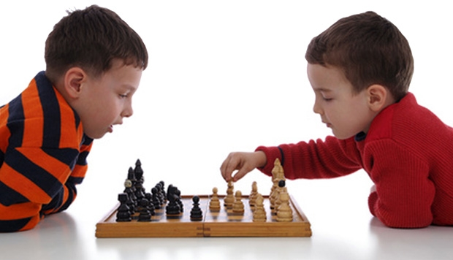
KIDS AND TEENAGERS ☺
THEY LIKE PLAYING CHESS

Slide 3
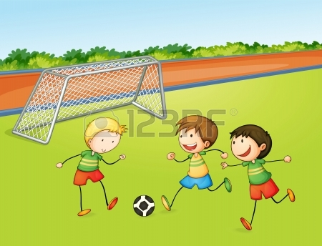
THEY LIKE PLAYING FOOTBALL

Slide 4
THEY LOVE READING BOOK

Slide 5
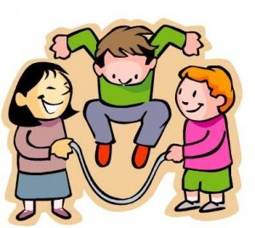
THEY LIKE SKIPPING ROPE

Slide 6
THEY LIKE FISHING

Slide 7
THEY LIKE DOING SHOPPING

Slide 8
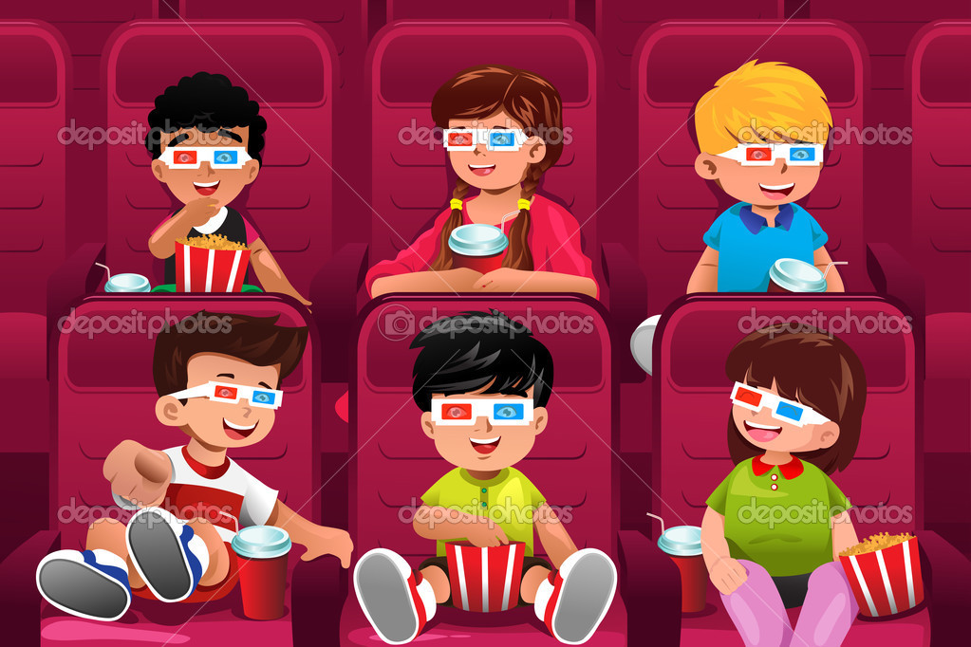
THEY LOVE GOING TO THE CINEMA

Slide 9
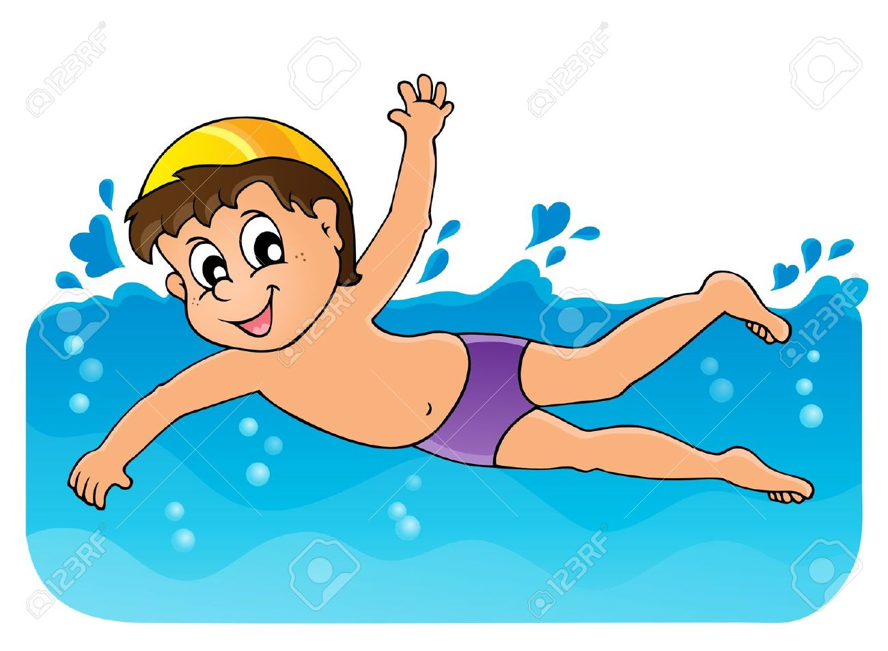
THEY LIKE SWIMMING

