Slide 1
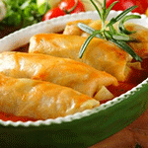
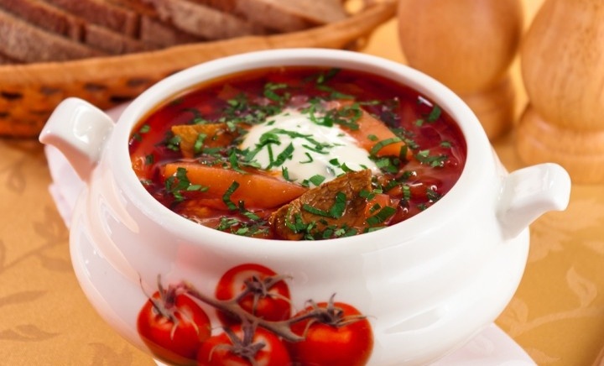
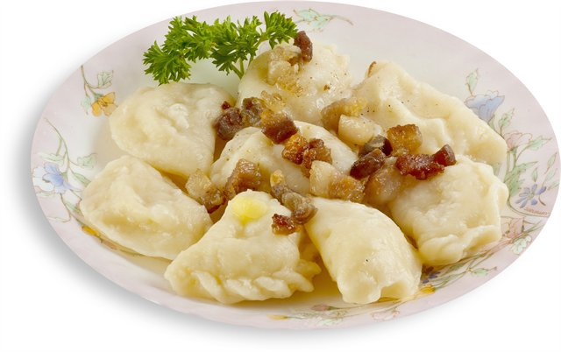
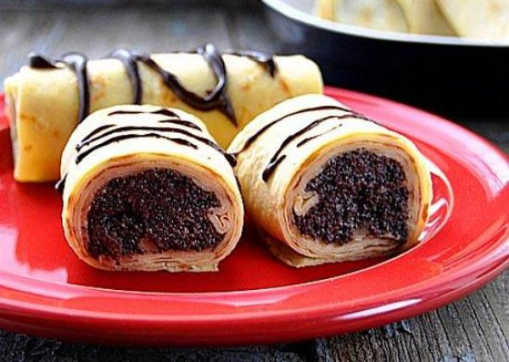
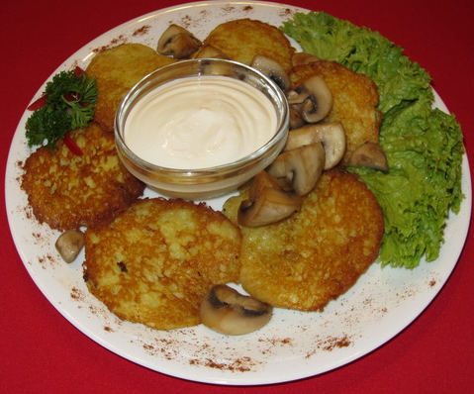
Ukrainian cuisine
National dishes

Slide 2
Borsch
Beef on the bone 500 g
Cabbage
Potatoes 5 pieces
Beetroot
Tomato paste 2 tbsp
Carrot
Onion
Garlic 3 cloves
Salo (pork fat) 20 g
Sour cream 150 g
Table vinegar 1 tbsp
Bay leaf to taste
Ground black pepper to taste
Parsley to taste
Dill to taste
Cook the meat broth. Gather the fat formed during the cooking in the bowl.
Peel and rinse the beetroot. Then either shred it finely or grate. Add the vinegar, sugar, tomato paste and braise it in fat. Braise until half-ready; add a little of broth if necessary.
Chop the carrot, slice the onion; and then brown everything in preheated sunflower oil or lard.
Put the diced potatoes in the boiling stock; then bring to the boil. Add the shredded cabbage and cook for 10-15 minutes. Then add the braised beetroot, browned vegetables, salt and bay leaf.
Dress the finished borsch with salted pork fat minced with garlic and parsley. Bring back to the boil and set aside for 15-20 minutes covered with a lid. Put the pieces of meat in every plate, drizzle with chopped herbs and dress with sour cream before serving it to the table.

Slide 3
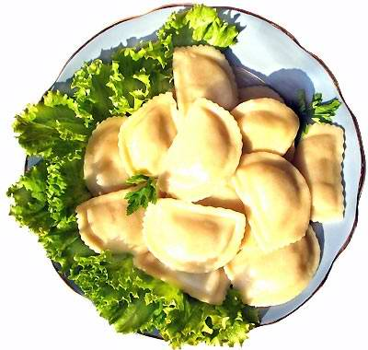
Varenyky
Dough: 600 g flour, 3 eggs, 40 g melted butter, 250 g milk/water, 10 g salt.
Fillings: stewed cabbage, cottage cheese with sugar, boiled potato with fried onion and mushrooms, minced meat.
Mix flour with milk, eggs, salt and work into dough. Finally, add the melted butter and knead it in.
Roll the dough out thinly and cut out small round shapes. Place the desired filling on each piece of dough, fold the dough into half-moon shape and press together firmly.
Cook varenyky in a good amount of boiling water for 5 minutes until they emerge on the surface.
Get varenyky out of water, add some butter and serve with sour cream.

Slide 4
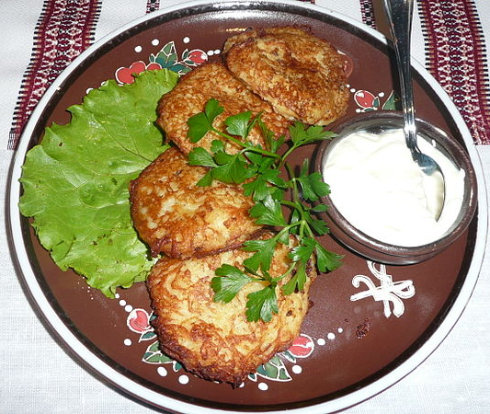
Deruny
3/4 c. bread crumbs (dry) / flour
2 1/2 c. potatoes (grated)
1 sm. onion (grated)
1 egg (beaten)
1/2 tsp. salt, pepper
Mix all ingredients until well blended.
Drop batter by tablespoonfuls onto hot, greased skillet. Spread the batter and brown pancakes on both sides.
Serve hot with butter.
Tip: using bread crumbs instead of flour makes the pancakes lighter and they brown quicker.

Slide 5
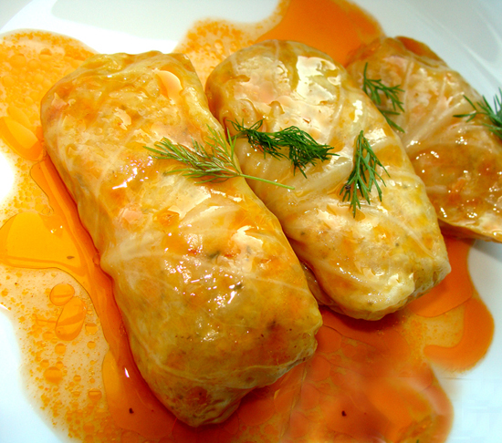
Golubtsi (cabbage- rolls)
1 tbsp black pepper
18 cabbage leaves
1 medium carrot
1 medium onion
2 small tomatoes
2 c water
3 c white rice
600 g minced beef (20% fat)
Boil a cabbage head just enough to separate leaves from it.
Cook or half-cook rice to yield 3 cups.
Mix with ground beef, grated carrot, diced tomato and onion. Salt and pepper to taste. Mix well.
Stuff this mixture in each cabbage leaf making cabbage rolls.
Pour some broth mixed with tomato sauce or ketchup into the pot, place the golubtsi and simmer until cabbage is very soft and translucent ; about an hour .

Slide 6
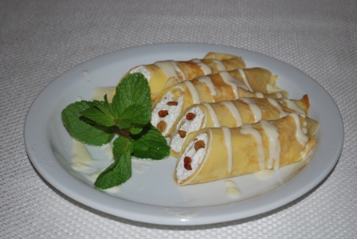
Thin pancakes (crepes)
4 eggs
1½ cups of flour
1 cup of milk
½ cup of water
1 tablespoon of sugar
1 teaspoon of salt
1 teaspoon of butter
Cottage cheese/ poppy / fruit
Combine flour and milk, water, sugar and salt. Blend. Add eggs. Blend with mixer.
Melt butter in skillet and then pour butter into the batter.
Set the batter inside the fridge for 15 minutes.
Heat skillet to high. Pour extremely thin layer of batter into the skillet. Tilt the skillet around so the crepe will fill most of the surface area.
Keep a close eye and reduce heat to medium. Flip gently with fingers or a spatula when the one side looks ready.
Fill crepes with fruit (cherries)/cottage cheese/ poppy and put powdered sugar or whipped cream on top.

