Slide 1
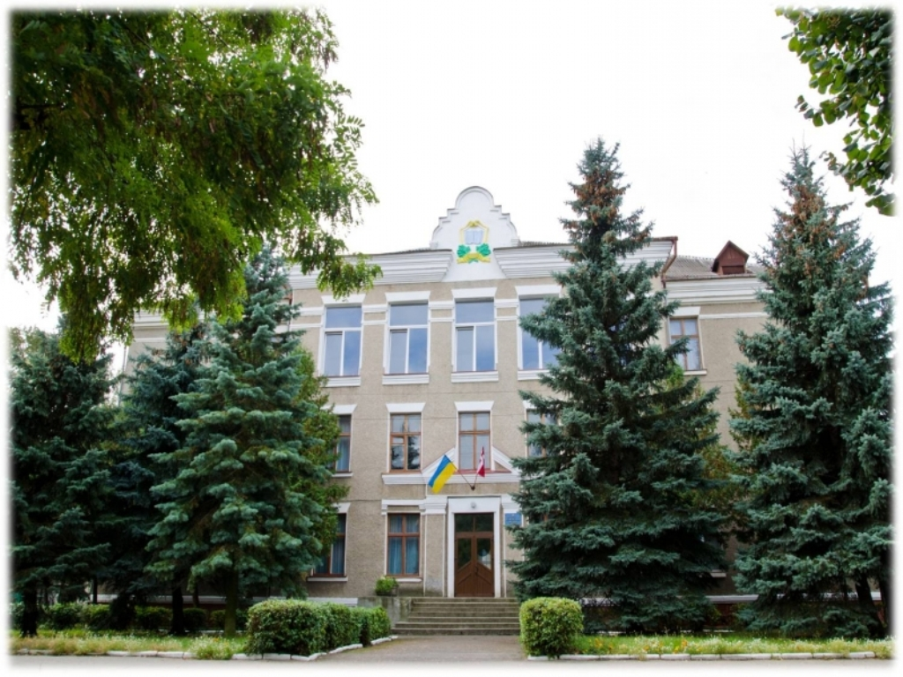
Kovel City Gymnasium
Ukrainian Students

Slide 2
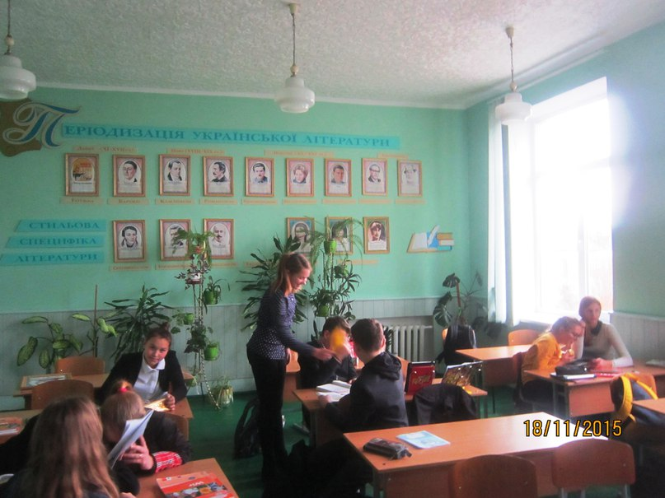
Our class is studying in Ukrainian Literature room. Here we study the Ukrainian Language and Literature

Slide 3
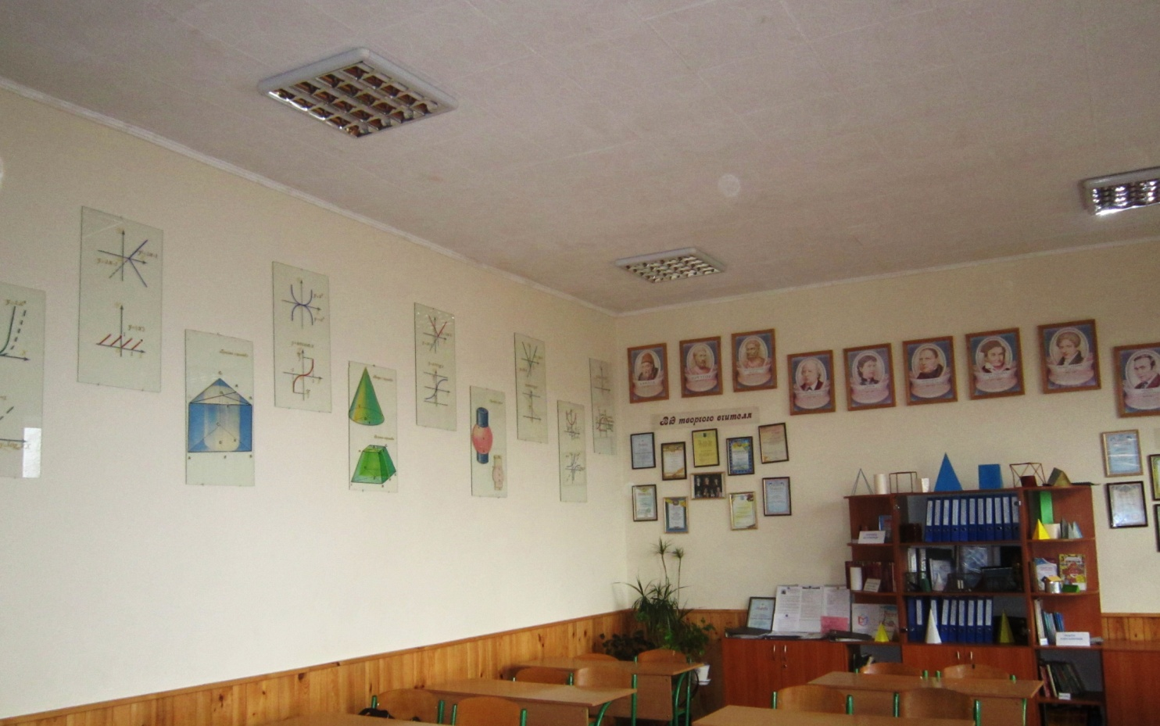
We also study Algebra and Geometry.

Slide 4
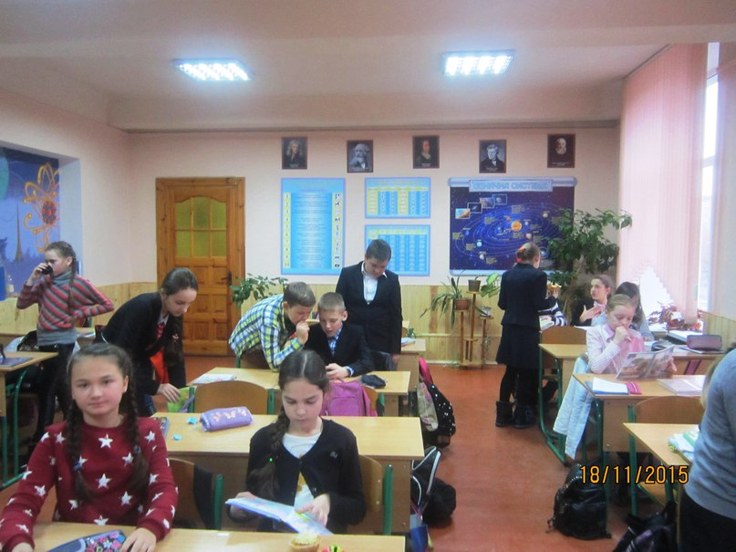
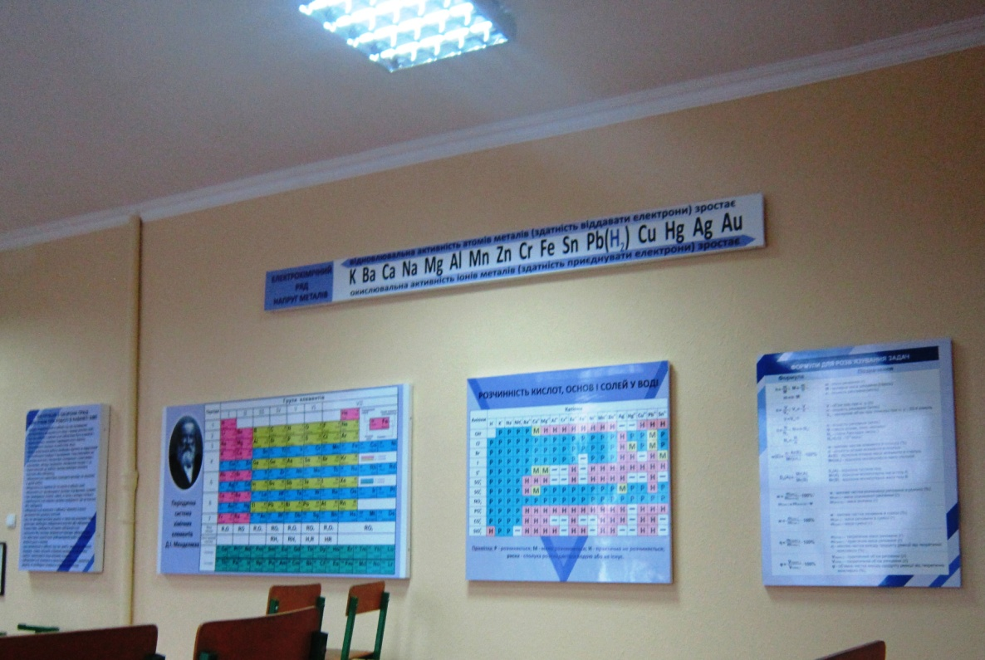
Like all children we study Physics, Biology and Chemistry at our special classrooms.

Slide 5
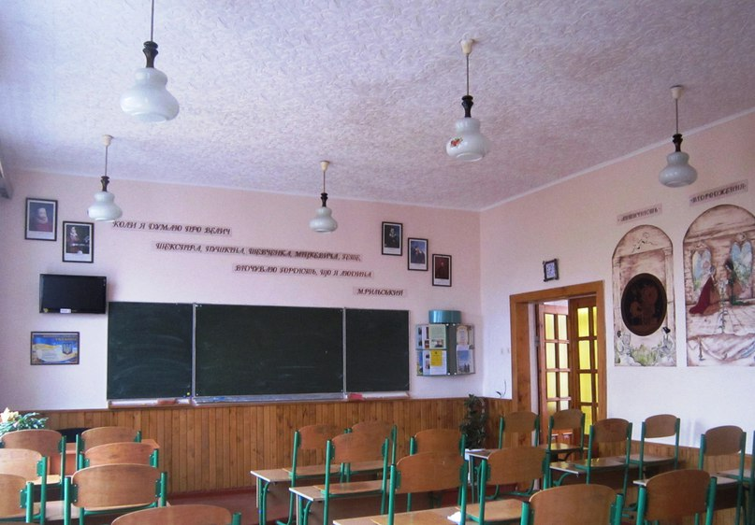
We study Foreign Literature and
History in
special
classrooms

Slide 6
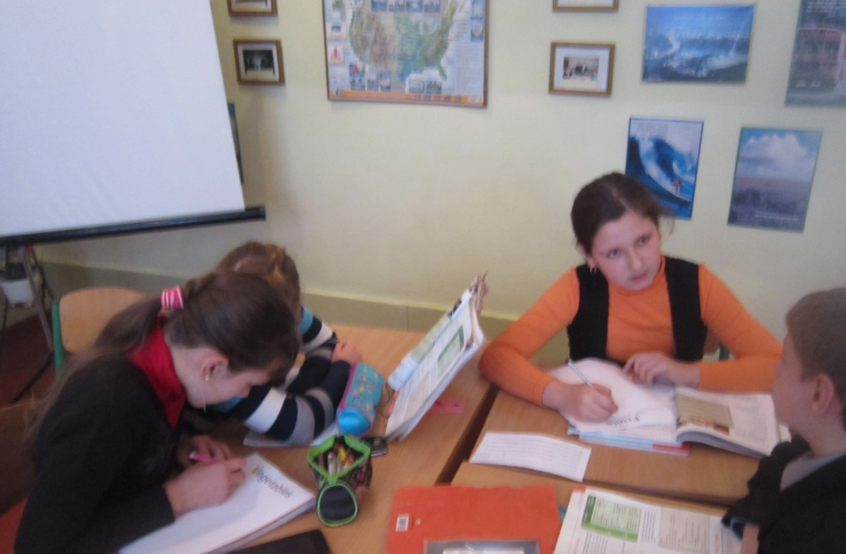
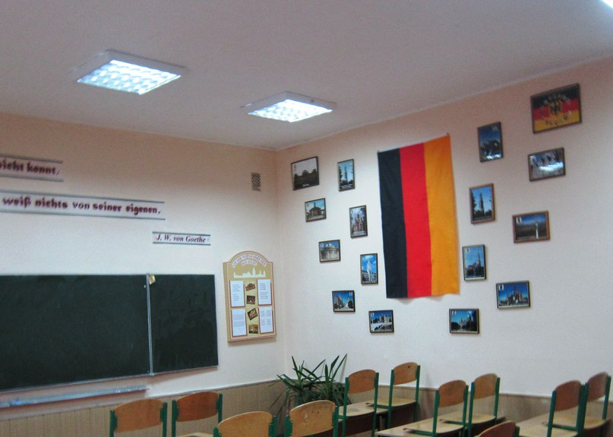
And of course we can not imagine our school life without studying foreign languages such as English and Germany. For these lessons in our school there are special classrooms

Slide 7
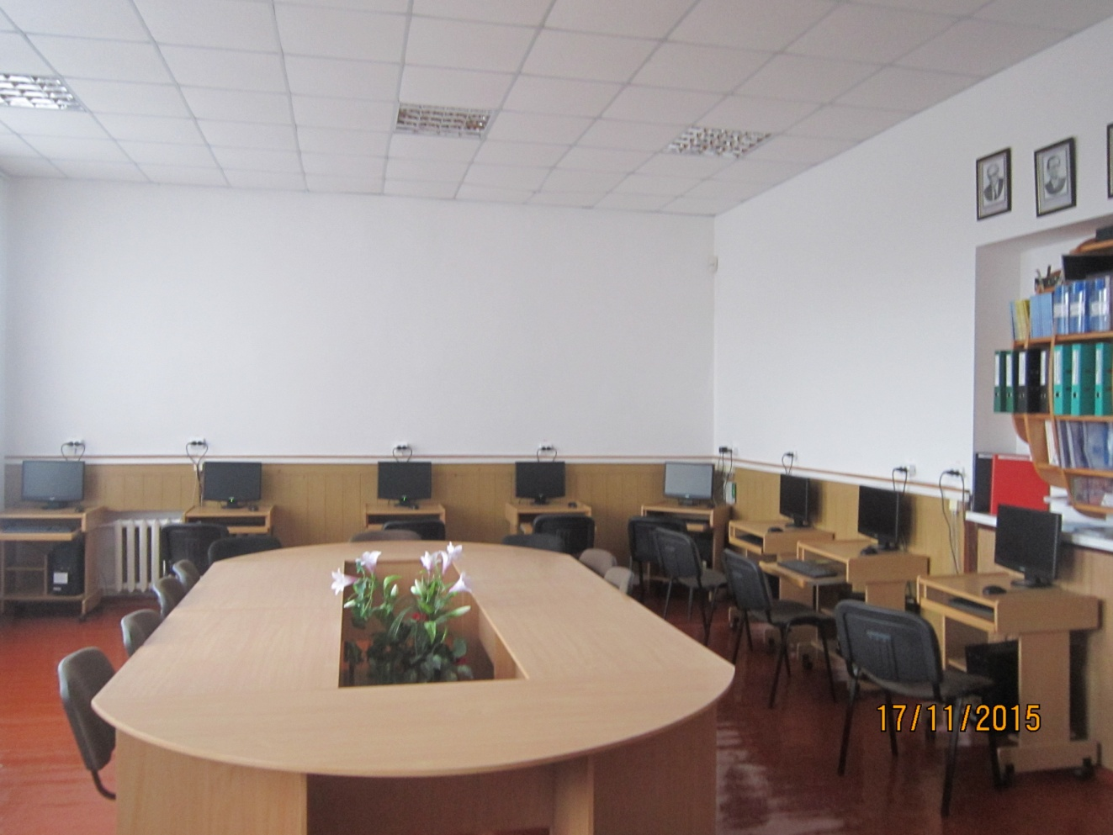
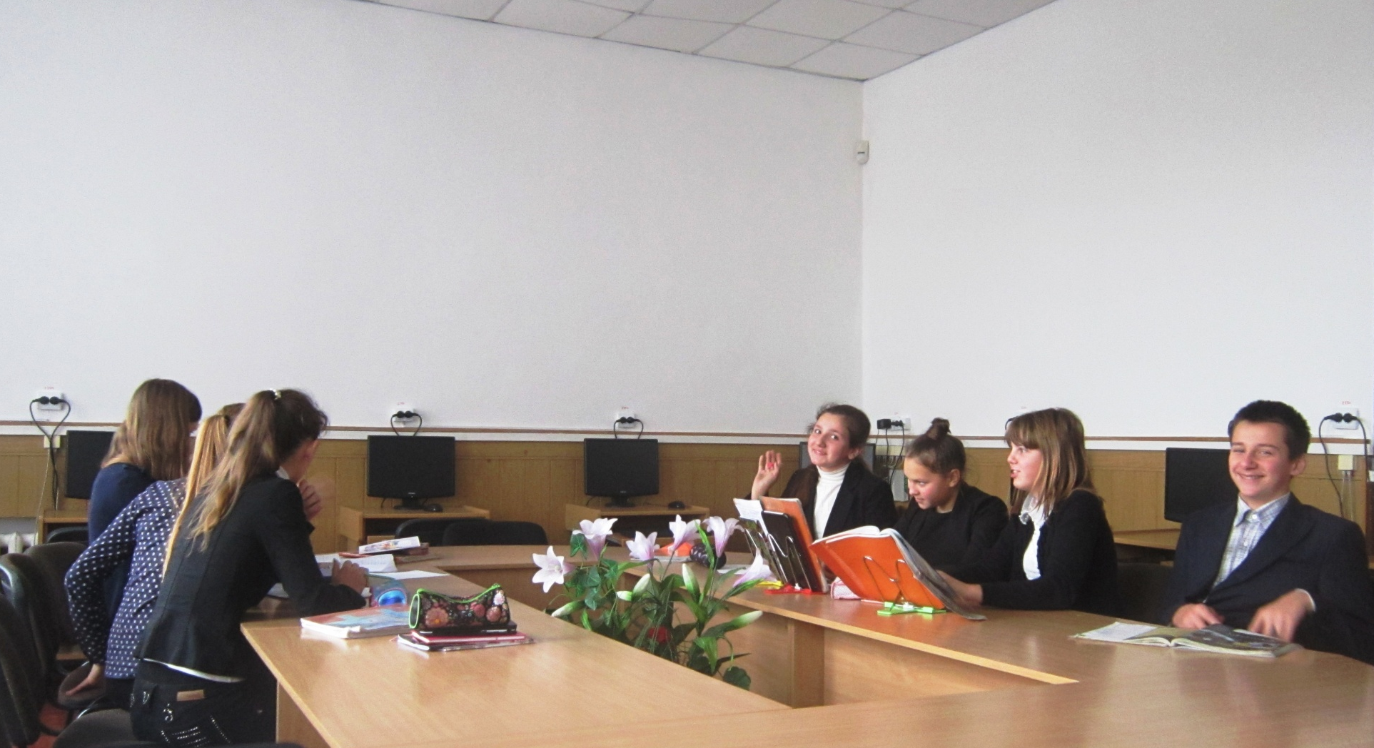
Our favourite lesson is Computer Science which we have in a special computer lab

Slide 8
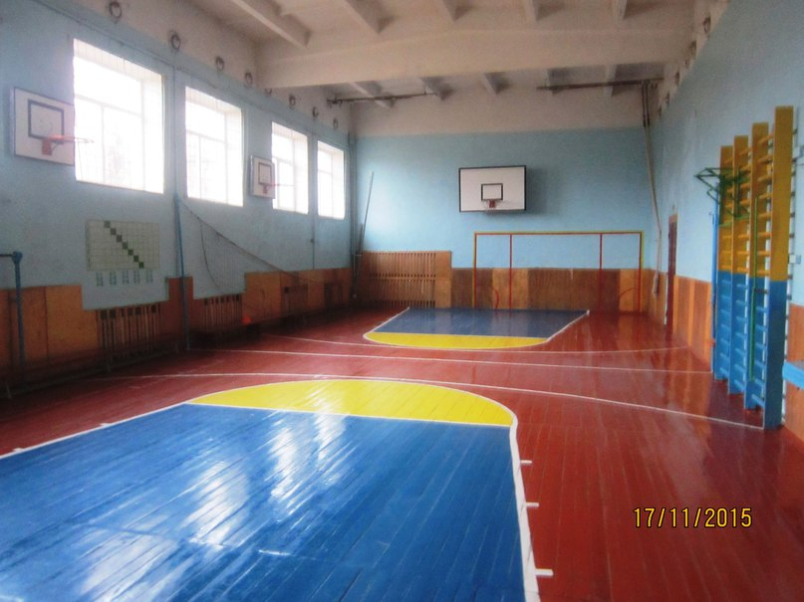
We have Physical Education classes on Monday, Thursday and Friday in our gym

Slide 9
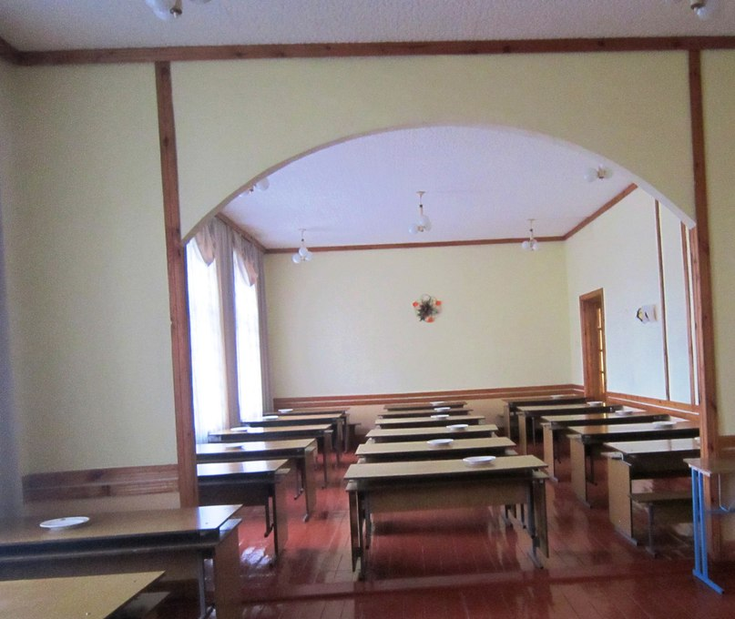
Like all schools we have our school canteen where they serve delicious meals

Slide 10
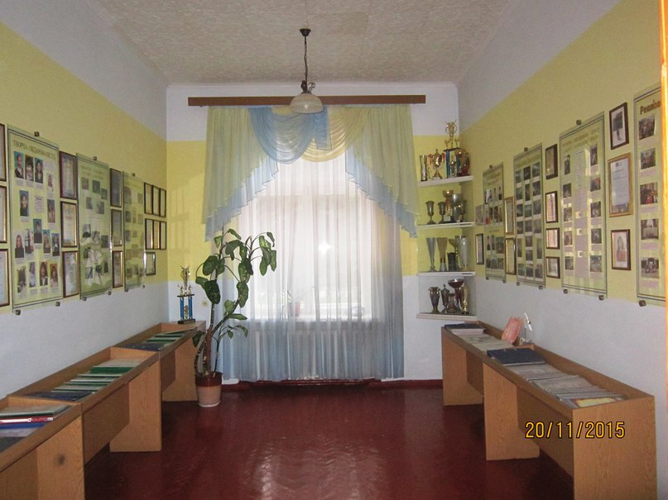
We also have a museum of our Gymnasia

Slide 11
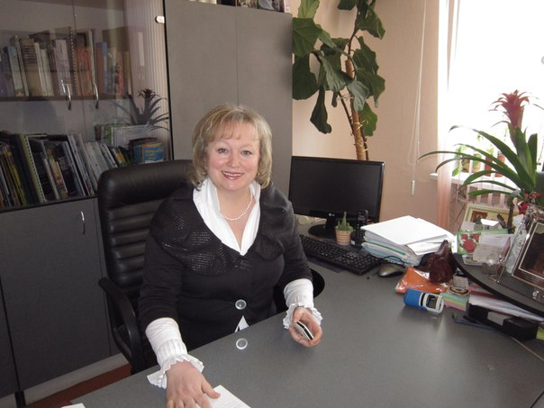
And here is the headmistress of our school. Her name is Olena Valchuk

Slide 12
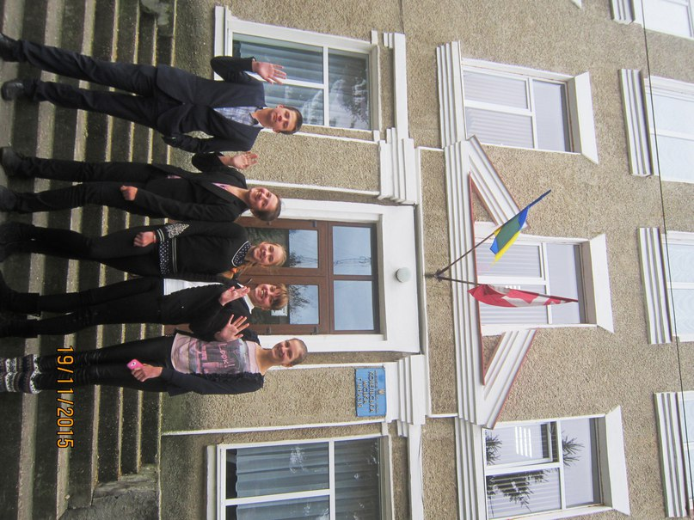
Thank you for your attention

