Slide 1
Famous people
from Poland

Slide 2
Scientists

Slide 5
Artists

Slide 6
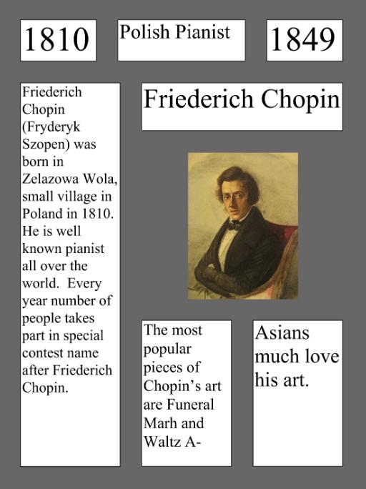

Slide 8
Models

Slide 9
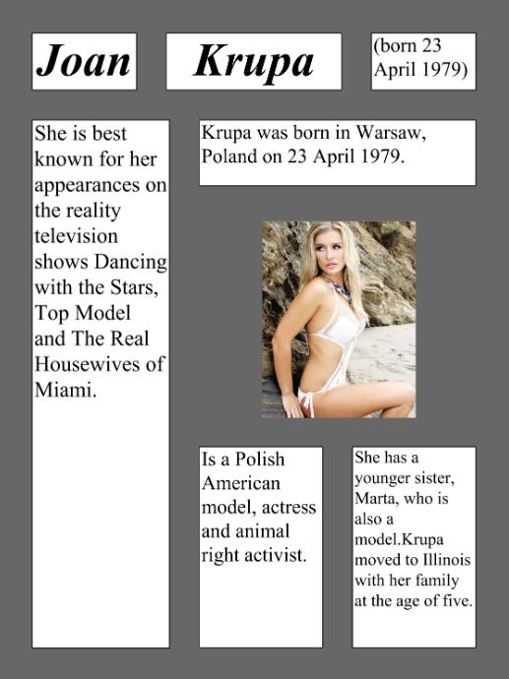

Slide 11
Actors

Slide 12
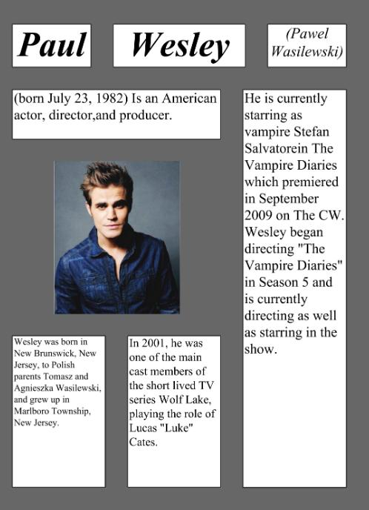

Slide 13
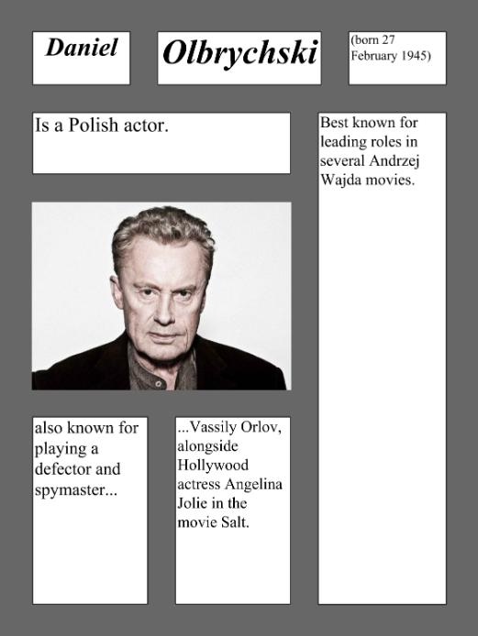

Slide 14
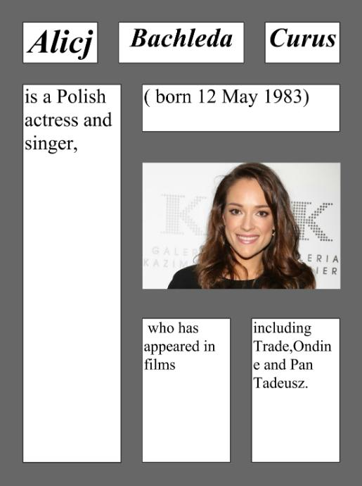

Slide 15
Sportsman

Slide 17
Religion

Slide 19
Politicans

