Slide 1
THEMISTOΚLIS EDUCATIONAL ΟRGANIZATION
65 Years of Education

Slide 2
History of our School
1955
Just on the anniversary of the Battle of Salamis on September 18, a private school was founded and opened in Piraeus under the name "THEMISTOKLIS". It begins with 100 students, 4 teachers and manager Katerina Pavlaki .
1958
"THEMISTOKLIS" consistently and upwards with 300 students
1962
Τhe inauguration of the Hich School
1984
THEMISTOKLIS Kindergarten is established
1993
"THEMISTOKLIS" Institute of Vocational Training, established in separate privately owned facilities.
1993
APEL Association is established. (Humanitarian Core Hope)
1996
Our Kindergarten relocates to an independent newly building and gets the new name "The Palace of the little ones "

Slide 3
1997
The Alumni Association of our school is established. Our school has already trained 10,000 students
1999
Inauguration of our new School building which includes new modern classrooms
1999
Vocational senior high school THEMISTOKLIS is established
2004
The 50th anniversary of the school is celebrated
2007
Our school becomes a member of ASIS (Private School Sport Meetings).
2008
Our school is implementing first Community program under Comenius
2015
The 60th anniversary of the school is celebrated with a festive event
2017
A Model Kindergarten is inaugurated
2019
More than 25,000 students have graduated and excelled in all areas.

Slide 4
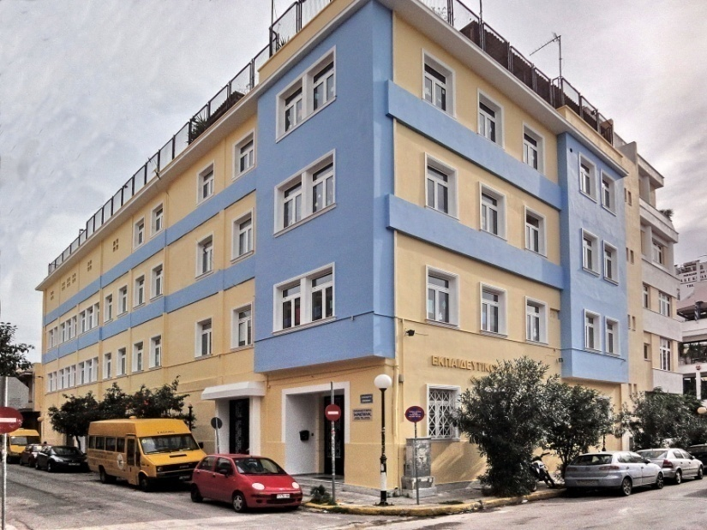
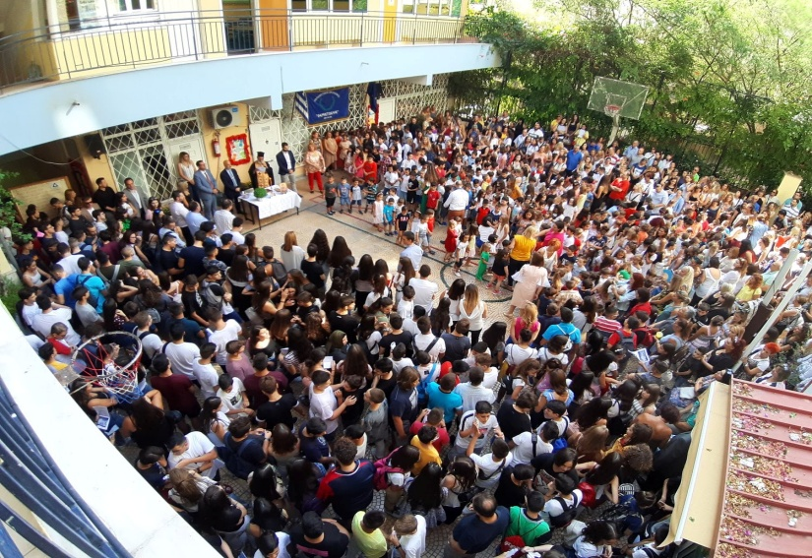
School Grades
Preschool Education
Primary School
Secondary School
High School

Slide 5
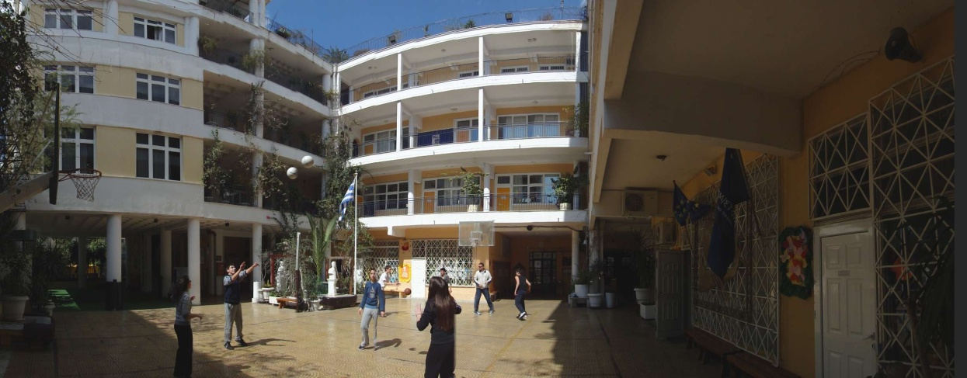
Secondary & High School
The Secondary & High School consists of three classes
First
Second
Third

Slide 6
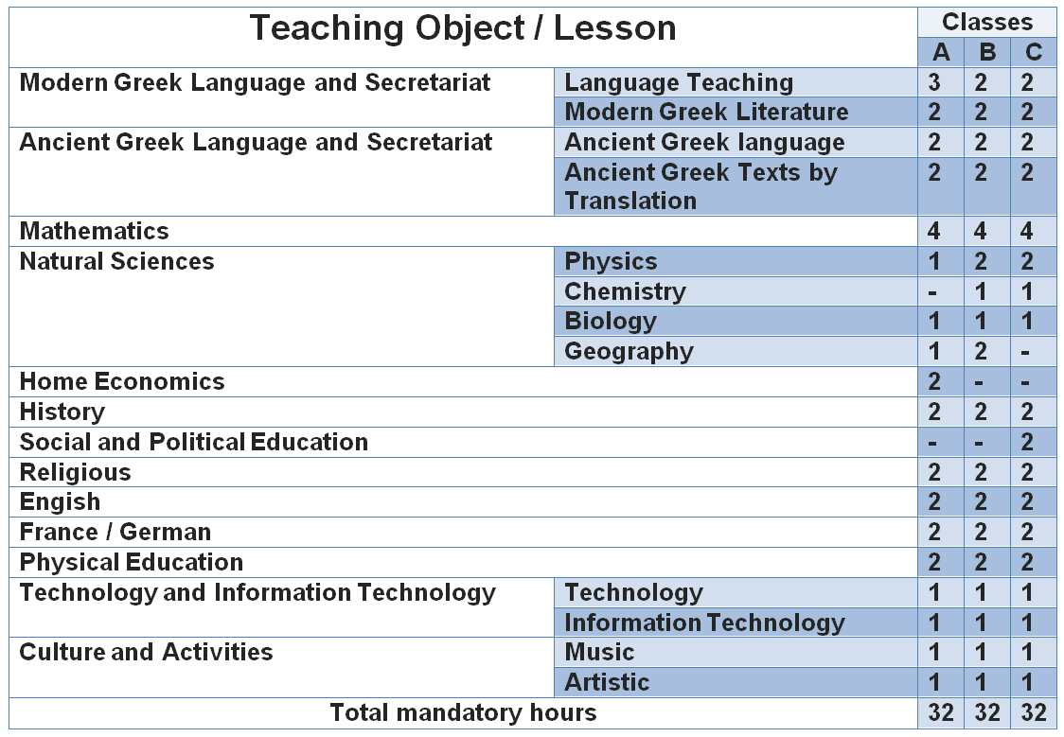
Courses for Secondary School

Slide 7
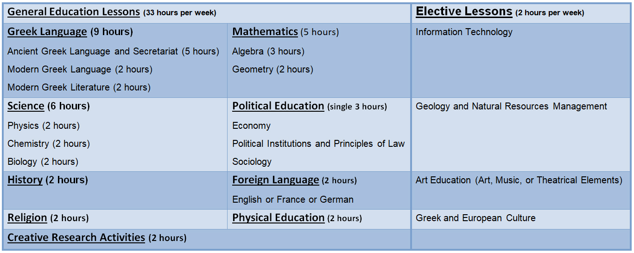
1st Class of High School “Course”

Slide 8
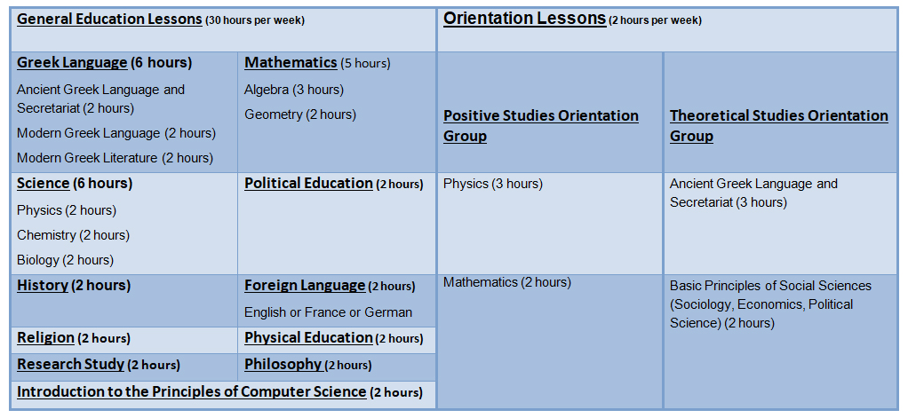
2nd Class of High School “Course”

Slide 9
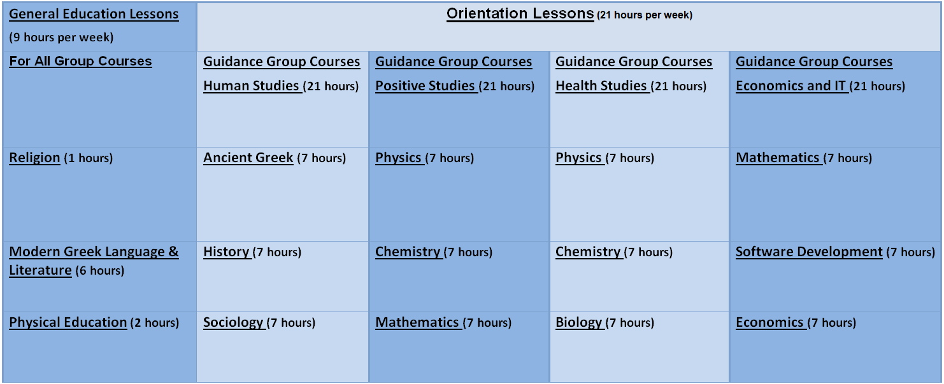
3rd Class of High School “Course”

Slide 10
Activities for Secondary & High School

Slide 11
Foreign Languages

Slide 12
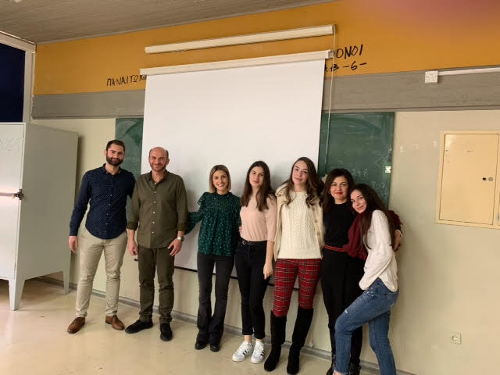
Diplomas
Our school offers the opportunity to obtain all diplomas in English, French & German.

Slide 13
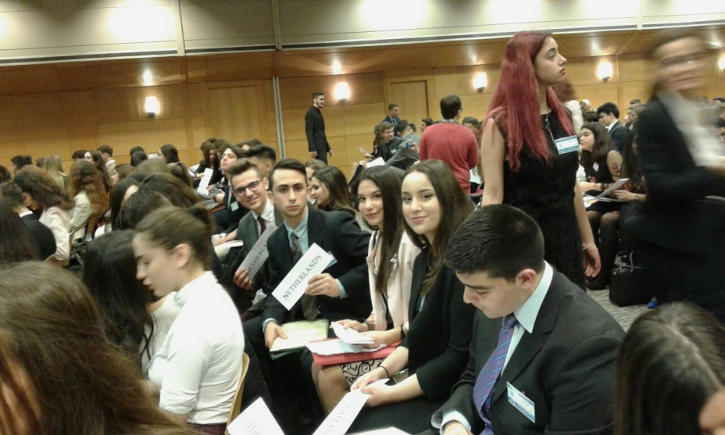
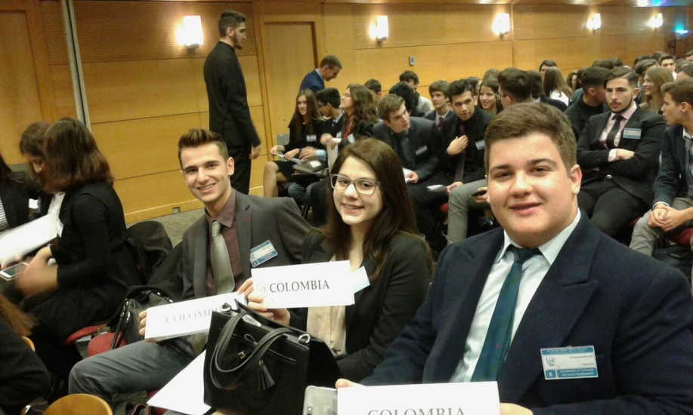
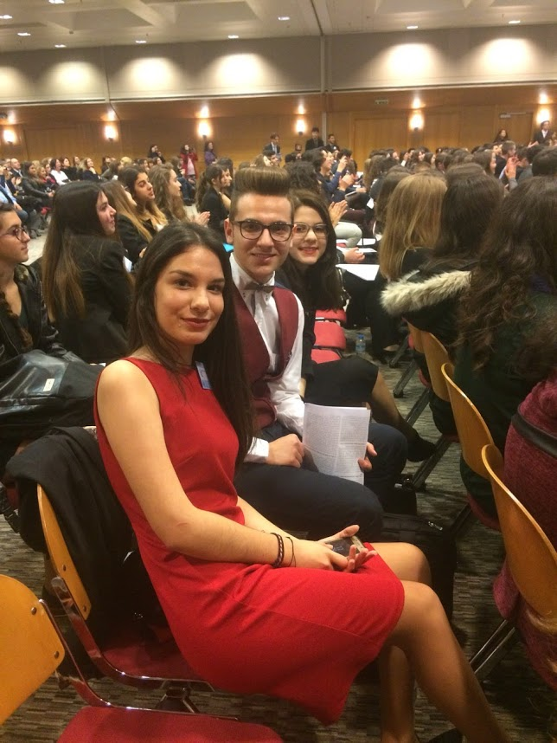
Amun
The AMUN is a 3-day simulation of the work of the United Nations. 2nd High School students participate representing a country or an organization in various UN forums, like the General Assembly and its committees, the Economic and Social Council and the Security Council.

Slide 14
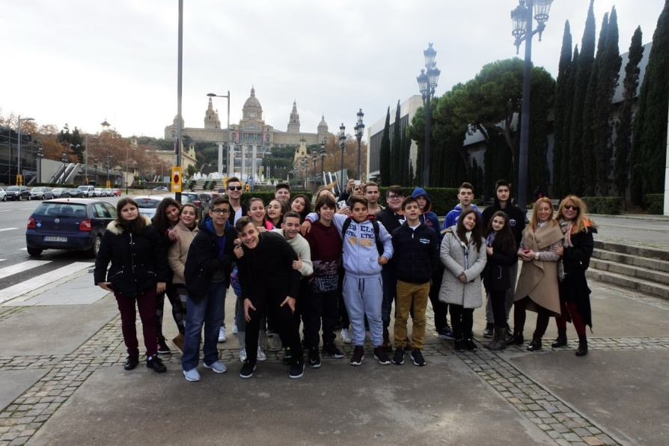
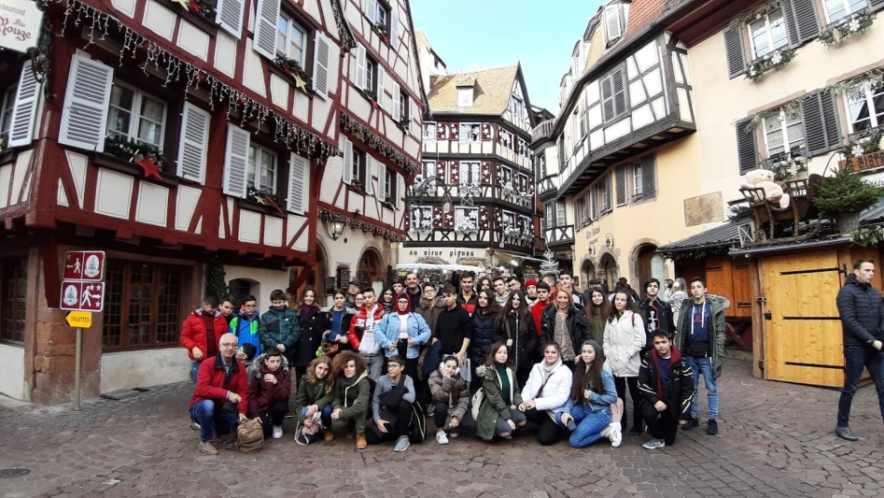
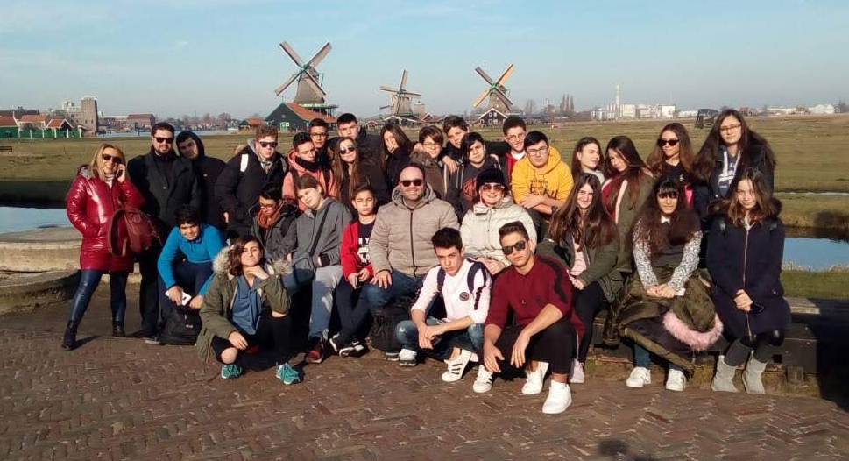
Visits
Our students visit countries abroad every year. The purpose of the visits is to practice foreign languages.

Slide 15
Athletic

Slide 16
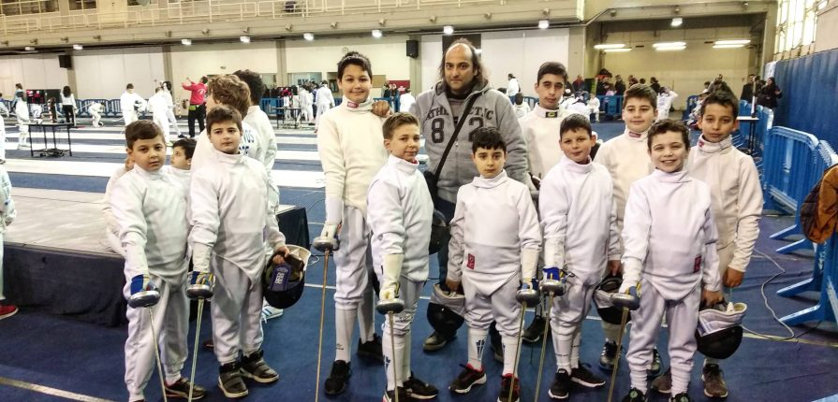
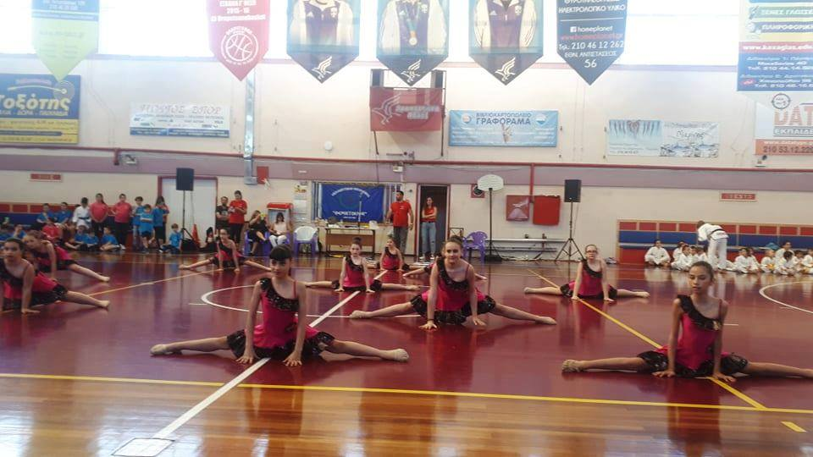
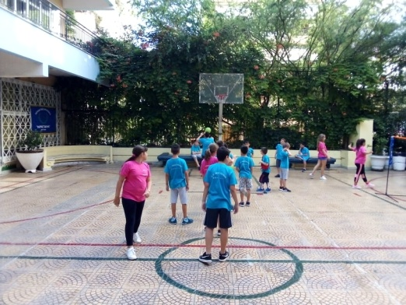
Athlopolis
In our school there are the following sports departments
Basketball
Rhythmic Gymnastics
Volleyball
Dance (Zumba, Modern, Latin)
Ju Jitsu
Traditional Dances
Fencing
Track and Field

Slide 17
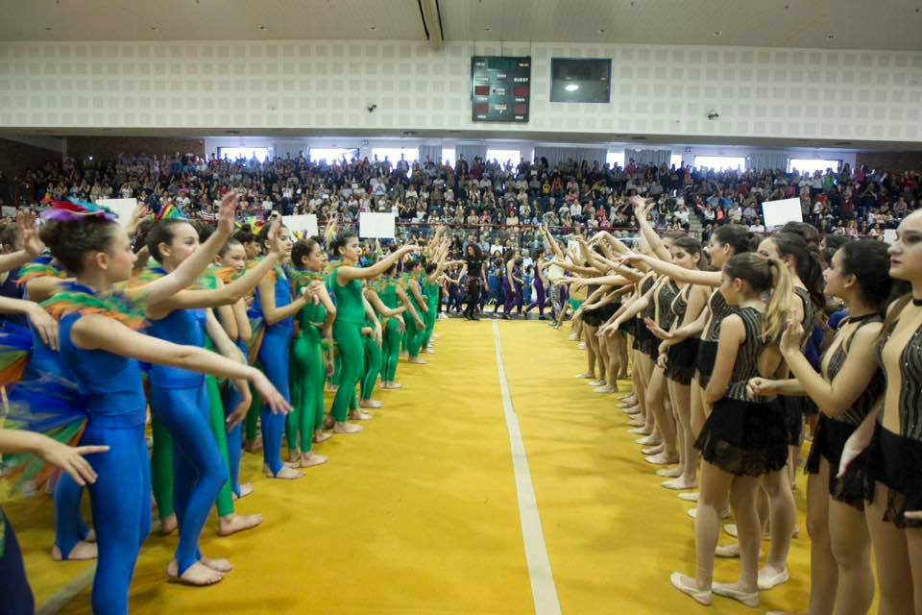
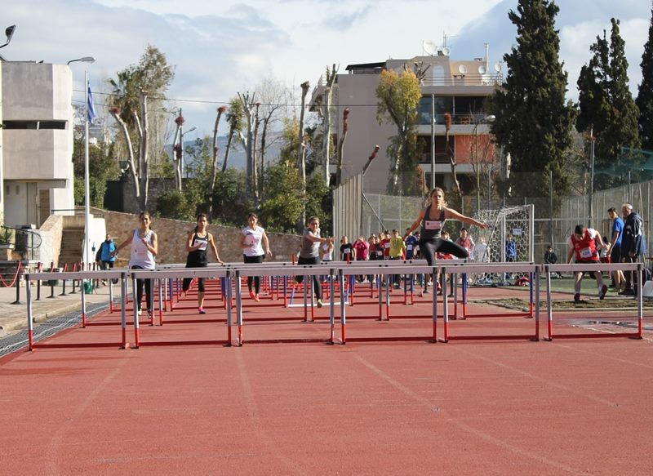
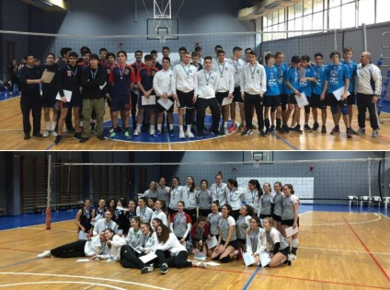
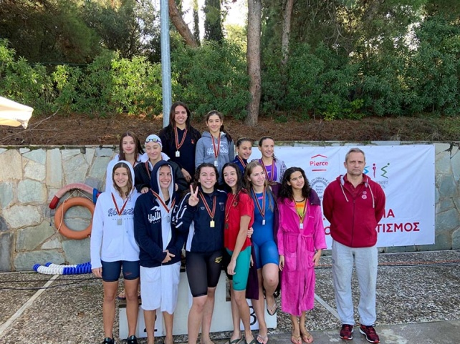
ASIS PRIVATE SCHOOLS SPORTS MEETINGS
Our school, the only one in our region, is a member of ASIS with private school sports programs at all school levels.
Basketball
Rhythmic Gymnastics
Volleyball
Football
Tennis
Swimming
Traditional Dances
Track and Field
Handball
Running on Rough Terrain

Slide 18
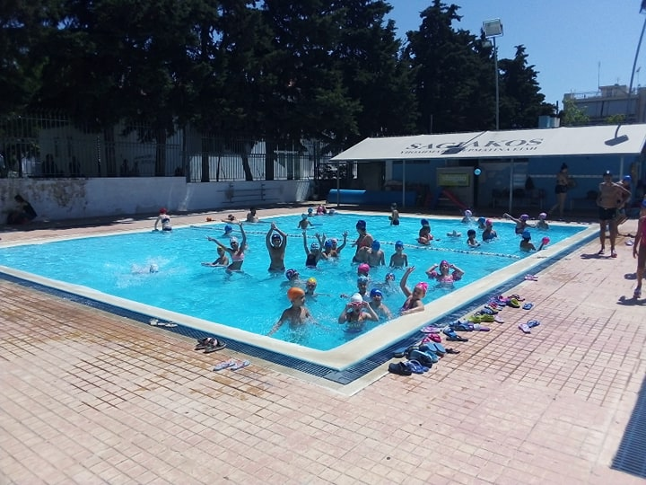
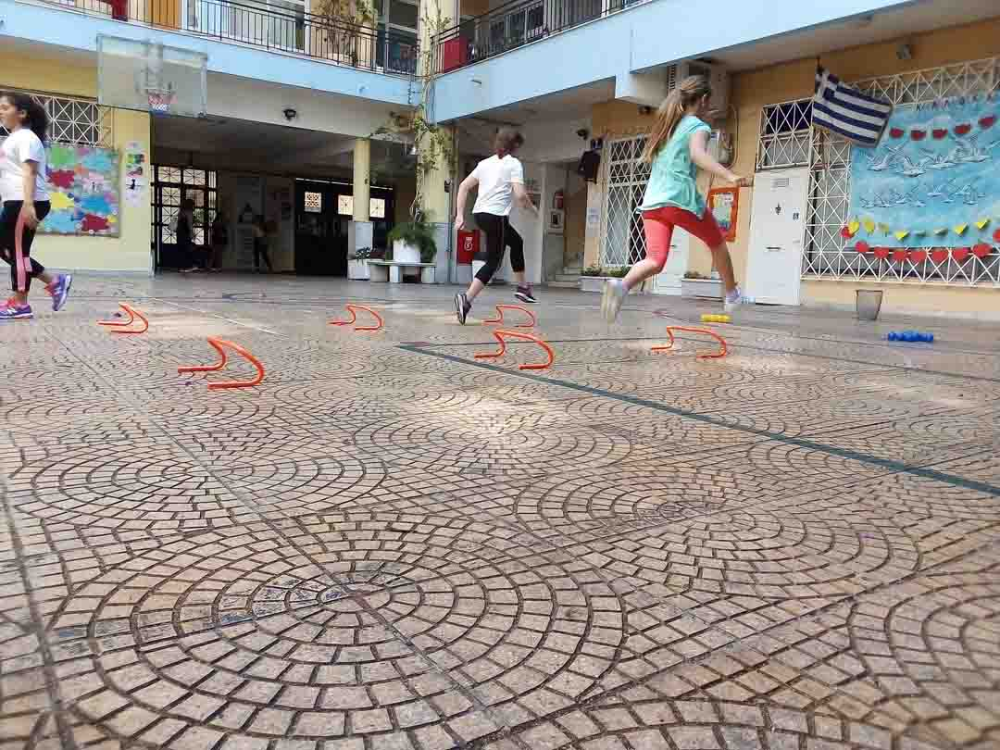
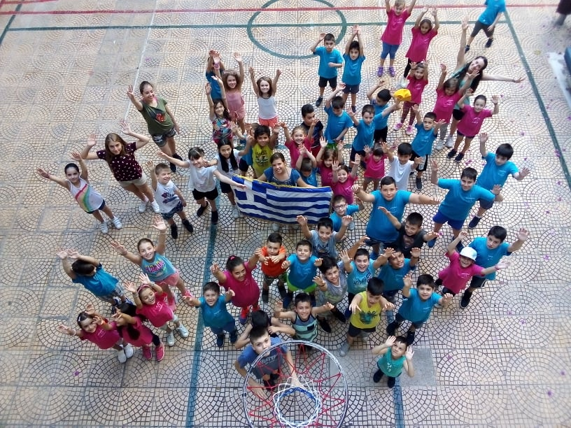
Summer Camp
Our students participate in sports programs every summer.

Slide 19
Artistic

Slide 20
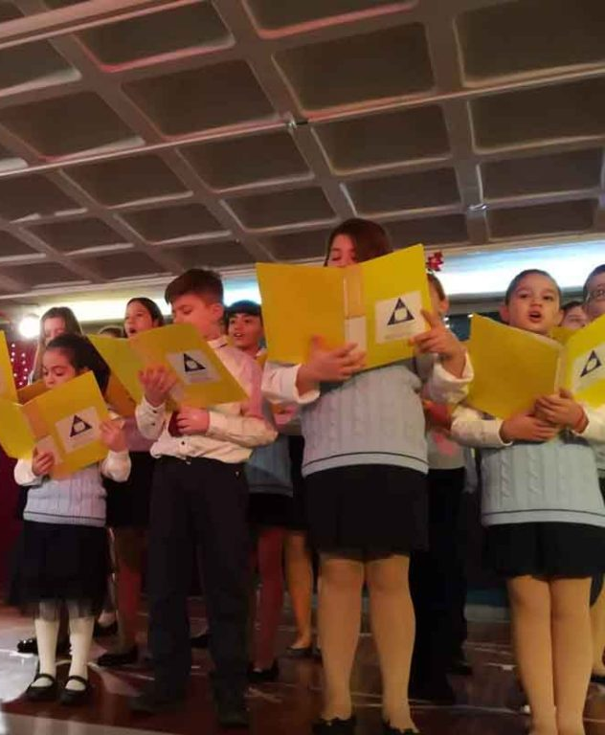
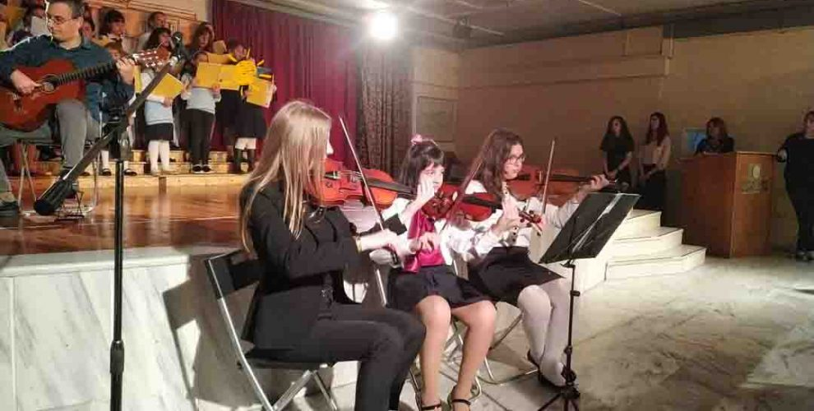
Our school provides
Music diplomas in collaboration with conservatories.
Choir lessons while attending festivals
Orchestra
Art lessons
Theatre Education
Organization of art festivals

Slide 21
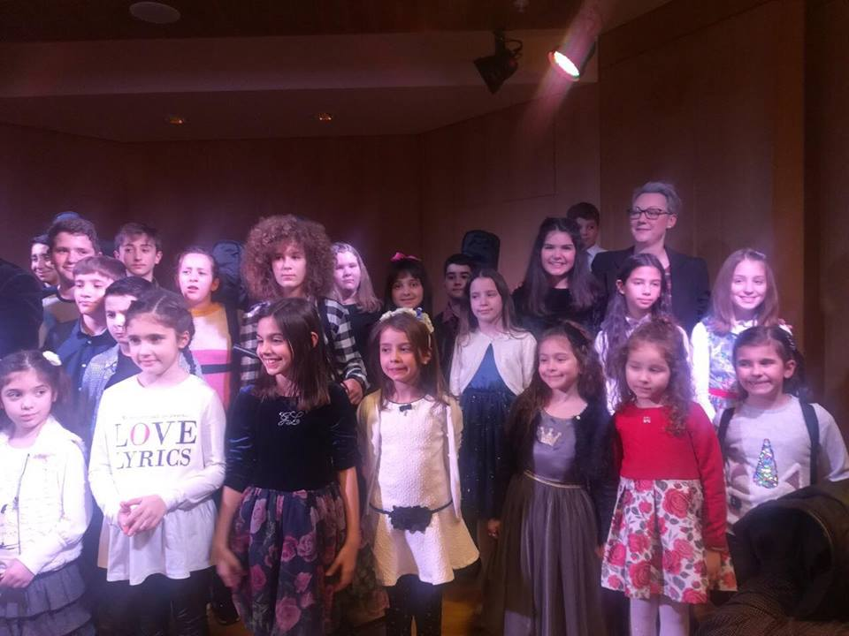
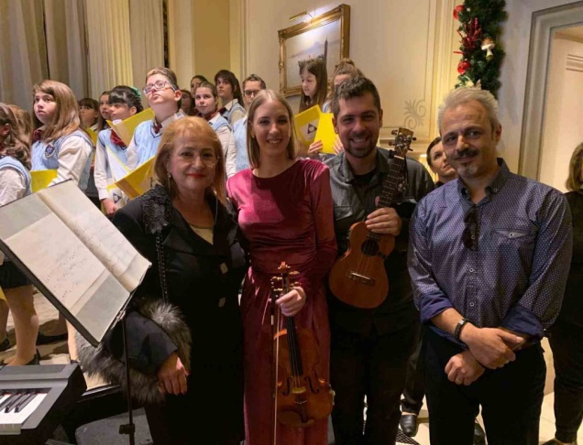
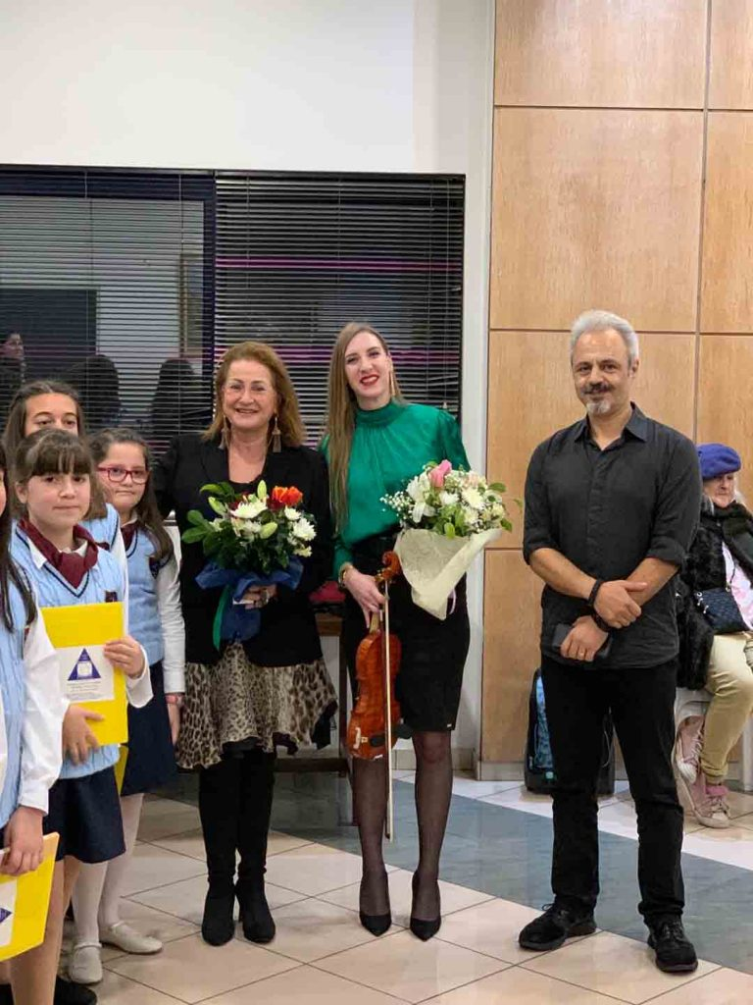
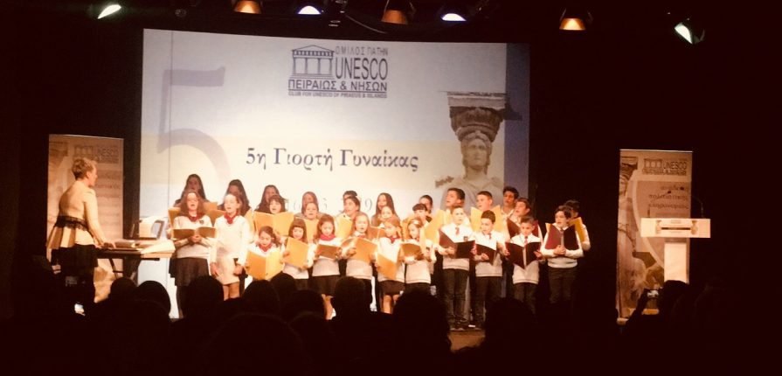
Concerts
Our school participates in student concerts

Slide 22
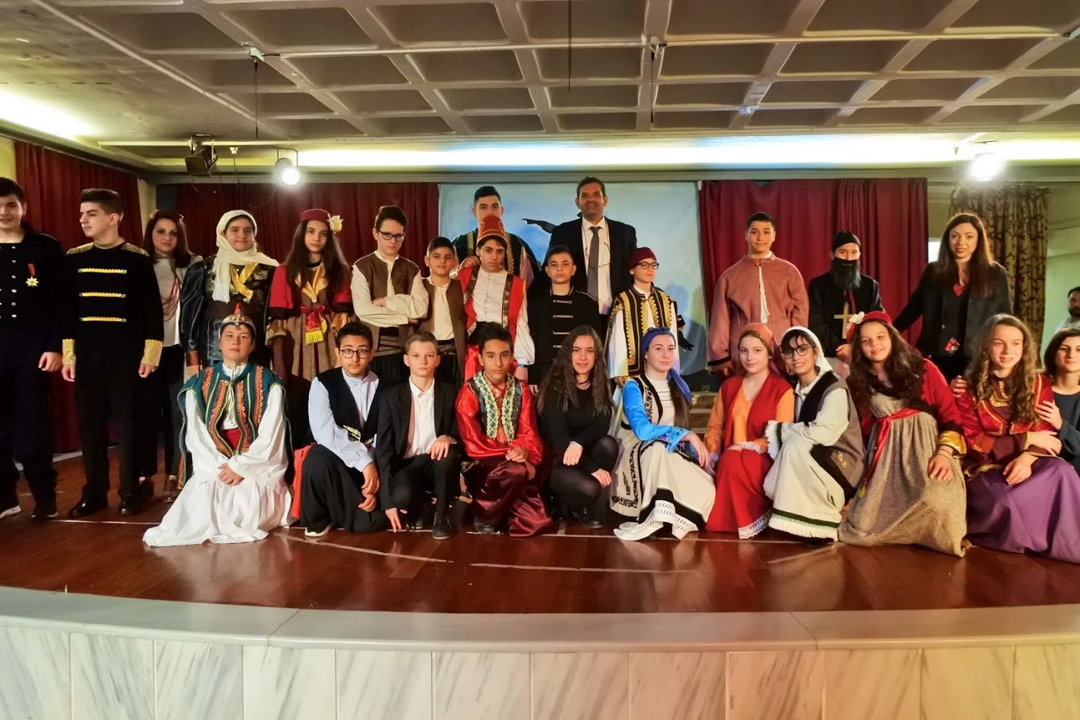
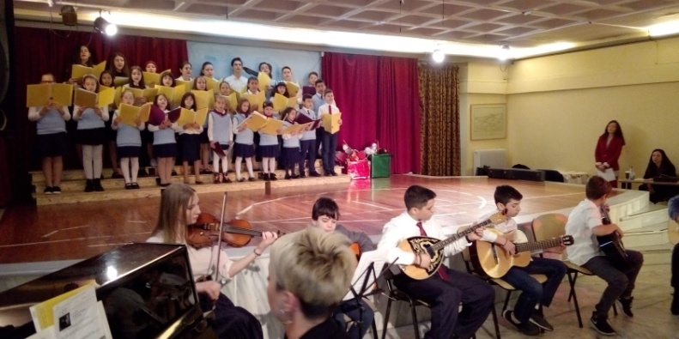
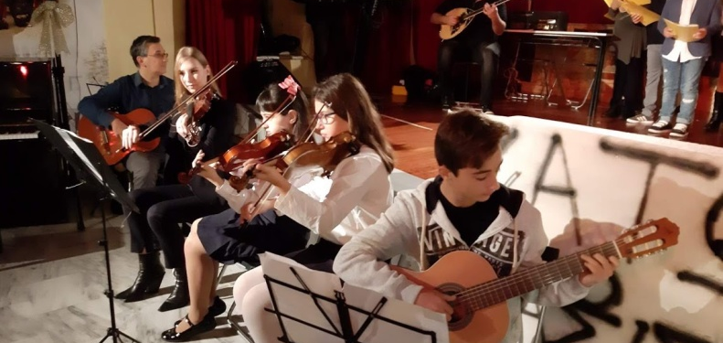
Celebrations
Our students are the main protagonists,
participating in theatrical performances, recitations of poems and songs.

Slide 23
Competitions for Secondary & High School

Slide 24
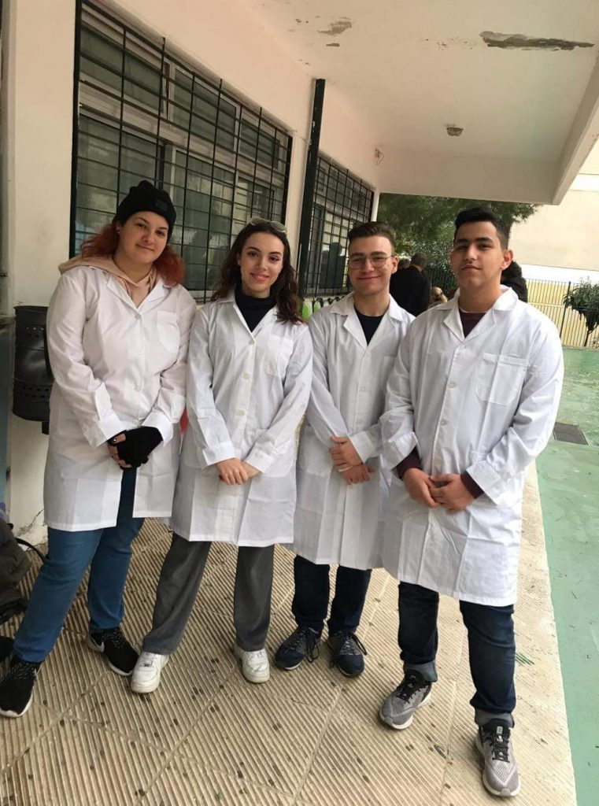
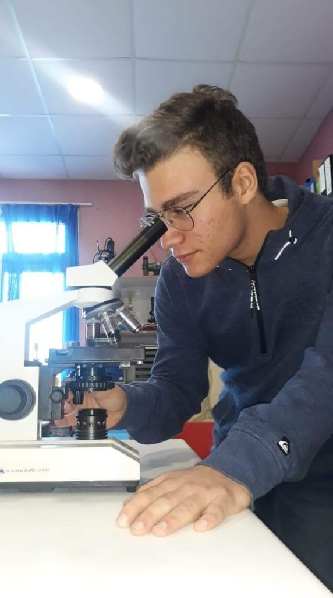
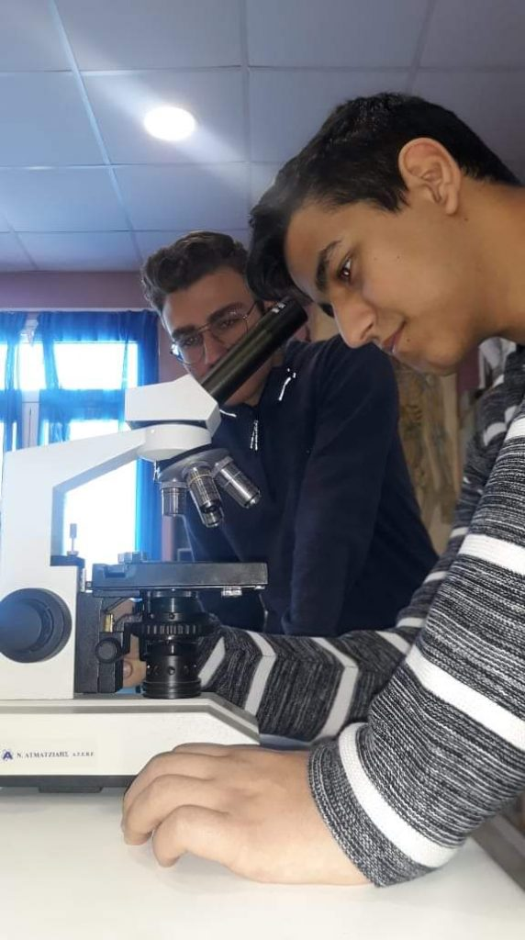
EUSO “European Science Olympiad”
Students of our high school participated in the EUSO laboratory competition

Slide 25
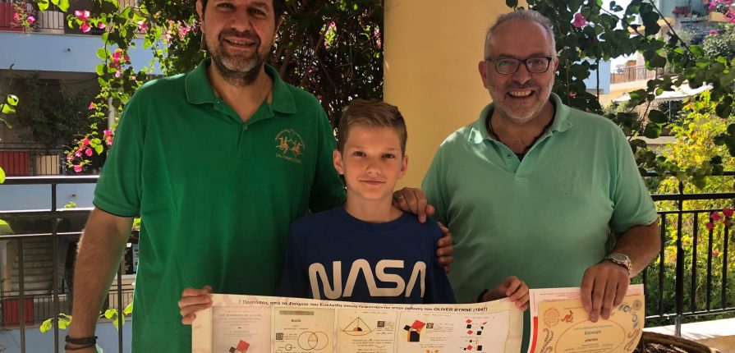
Mathematical Competition
Our student was awarded to the Mathematical Kangaroo Competition

Slide 26
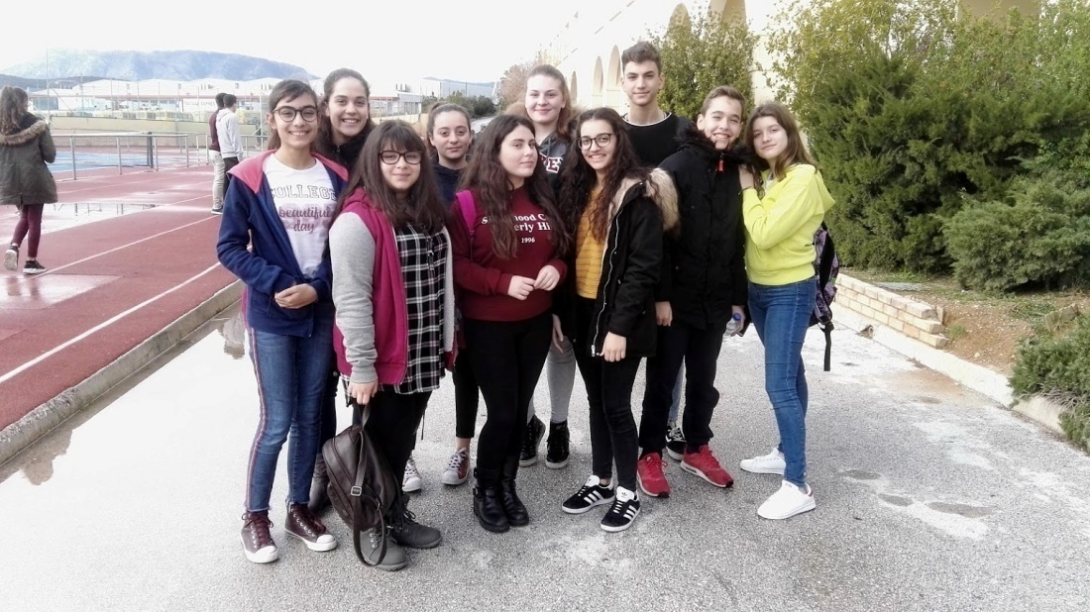
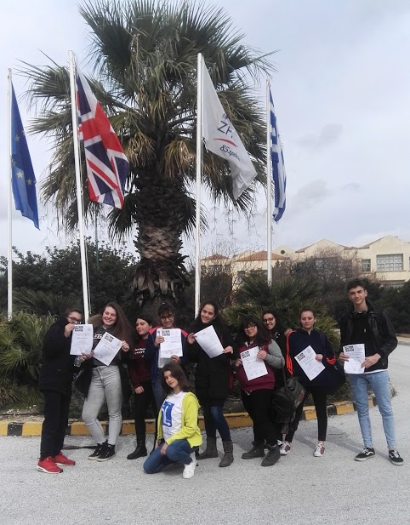
Spelling Competition
Our students successfully completed the written phase of the competition and qualified for the final.

Slide 27
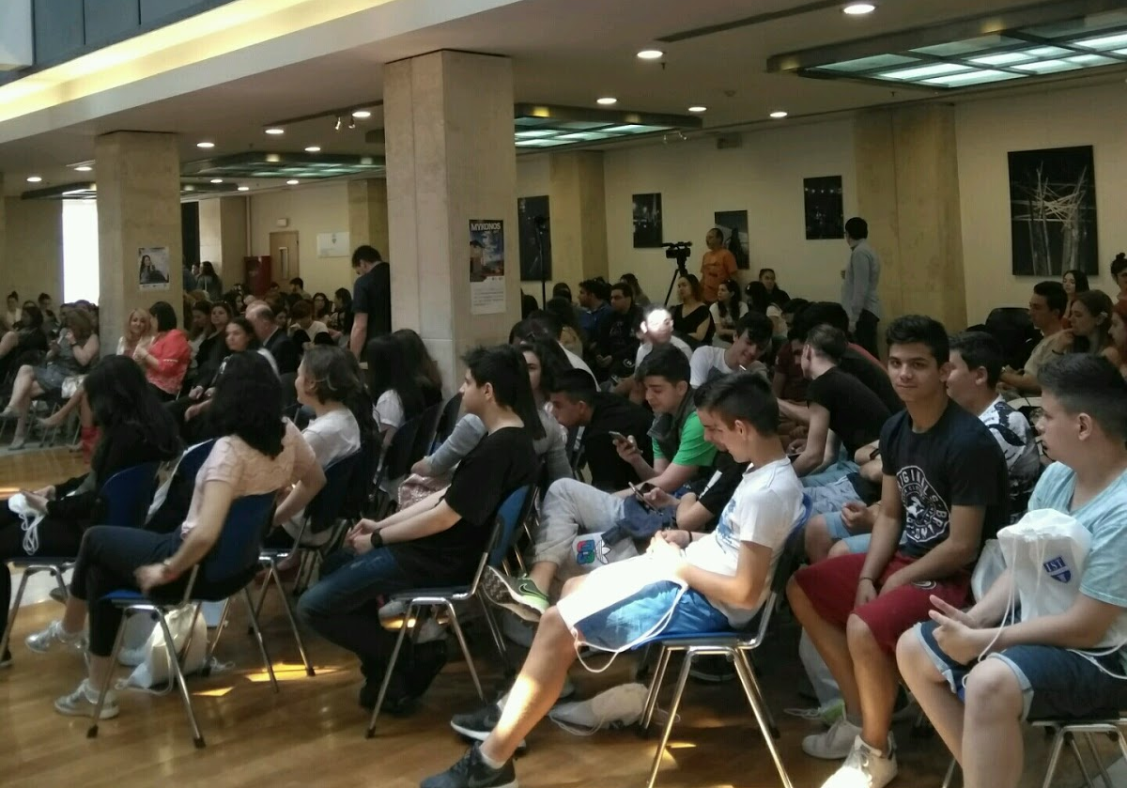
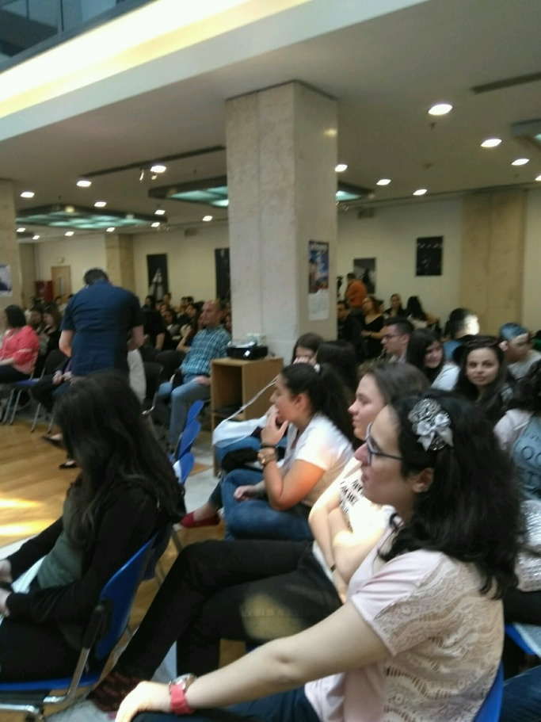
Social Innovation Relay
The 1st Class of High School participated in the Social Innovation Competition.

Slide 28
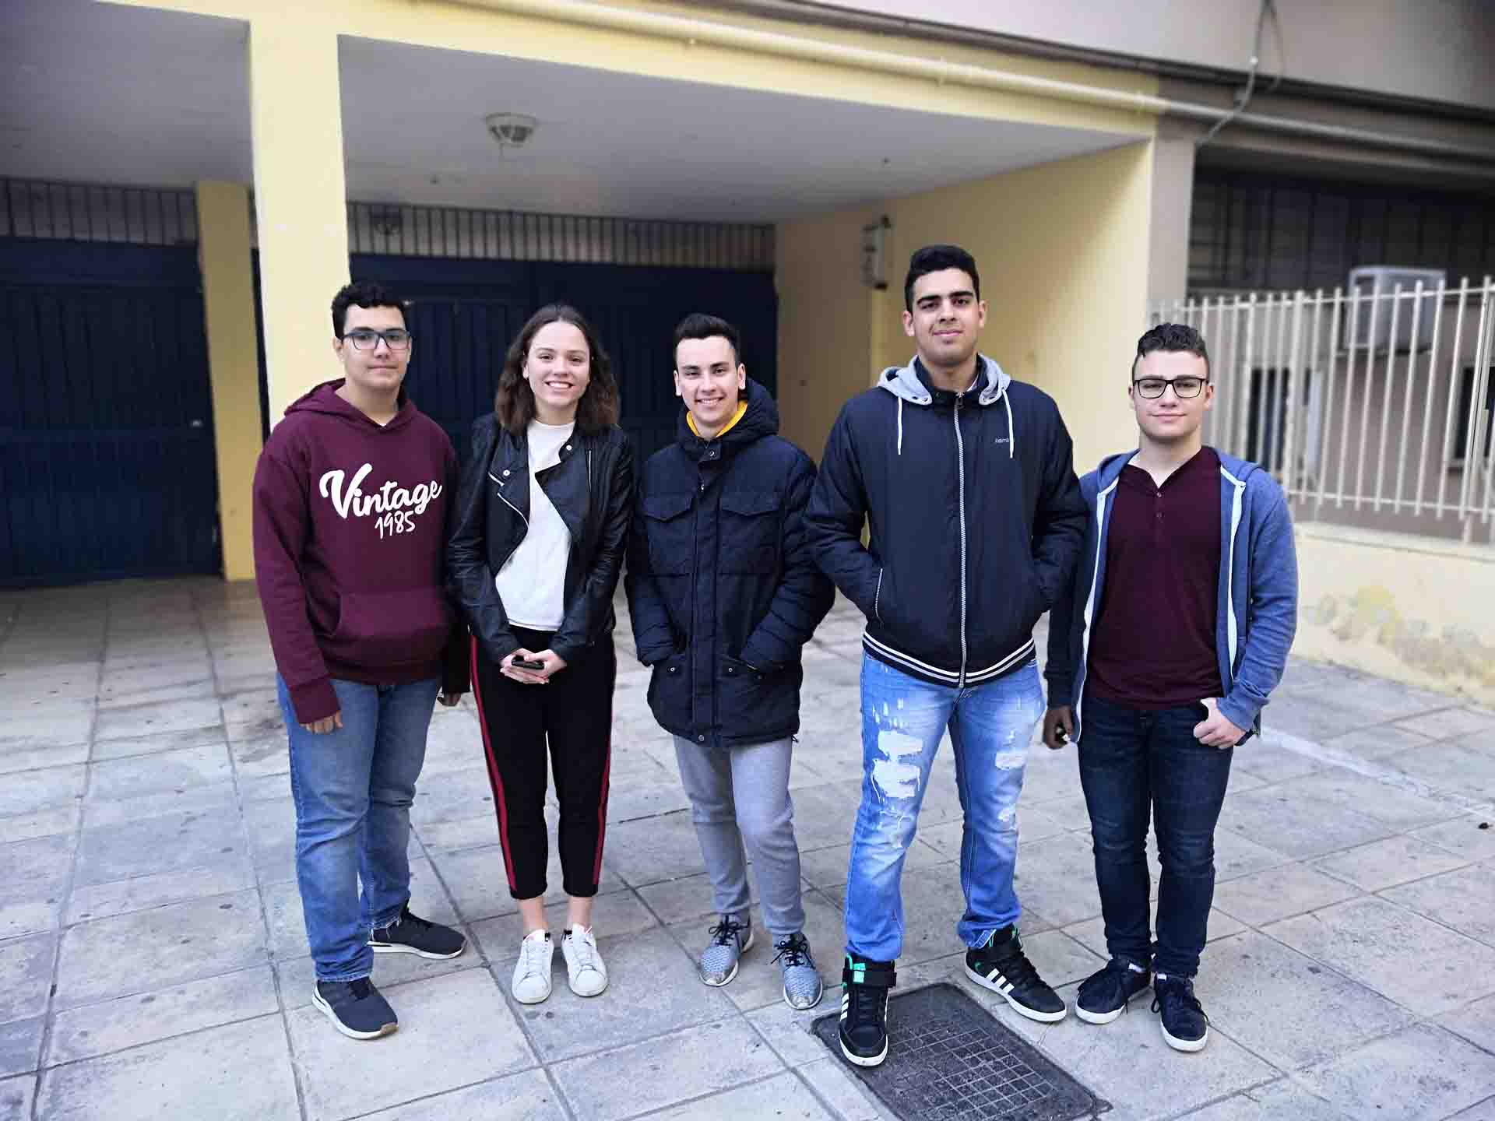
Panhellenic Chemistry Competition
The intention of the competition was to detect talented students in the Chemistry course through a demanding, three-hour written test in which they tried to demonstrate their skills.

Slide 29
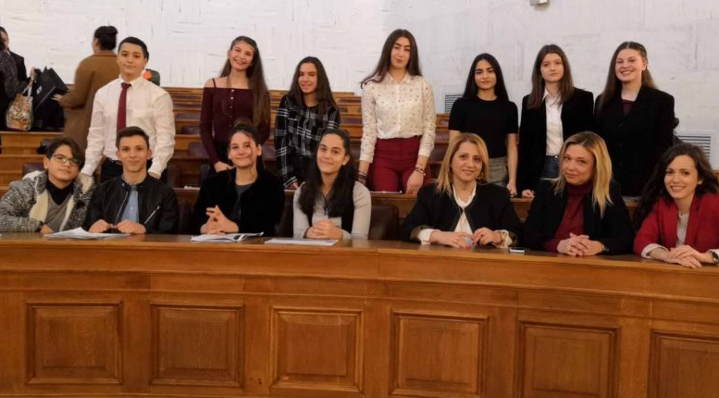
Written Competition
Students of the 3rd class of our secondary school participated in a Writing Competition on the topic "Maria Sklodovska Kuri«

Slide 30
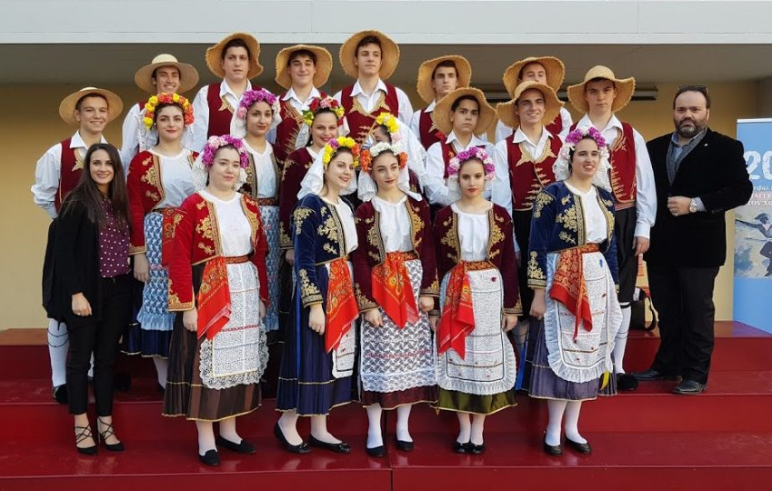
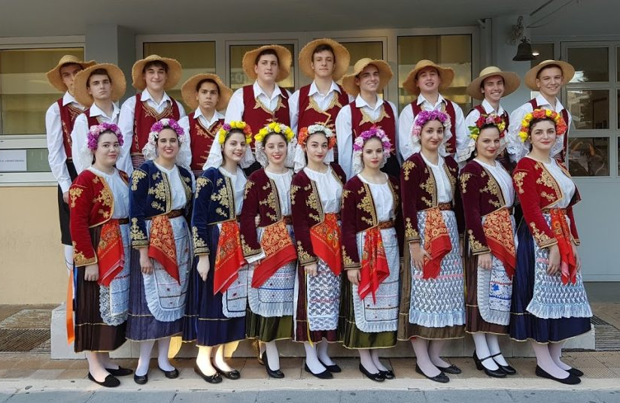
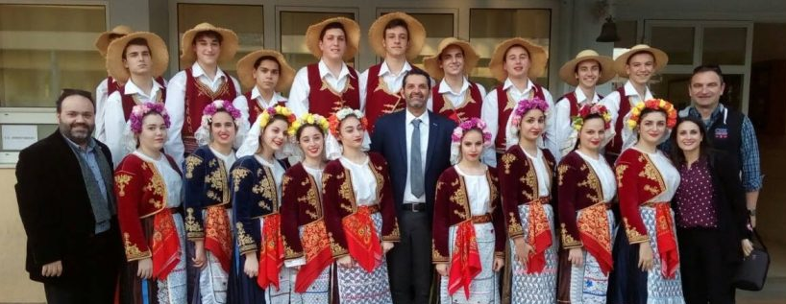
Traditional Dance Competition
Our school in traditional costumes in traditional dance competition

Slide 31
This is our School Life

Slide 32
Thank you for Watching

