Slide 1
TECHNOLOGICAL HIGHSCHOOL OF TOURISM CĂLIMĂNEȘTI VÂLCEA,ROMÂNIA

Slide 5
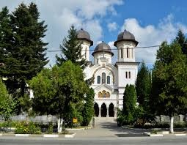
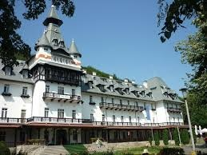
Călimănești, often known as Călimănești-Căciulata, is a town in Vâlcea County, southern Romania. It is situated in the historical region of Oltenia and the northern part of the county, on the traditional route connecting the region to Transylvania, and at the southern end of the Olt River valley crossing the Southern Carpathians.

Slide 6
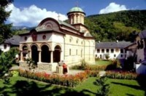
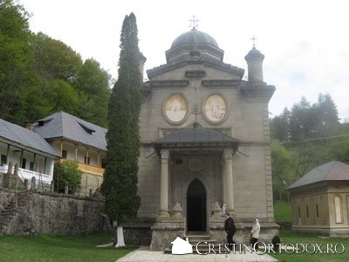
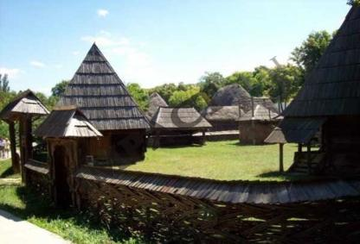
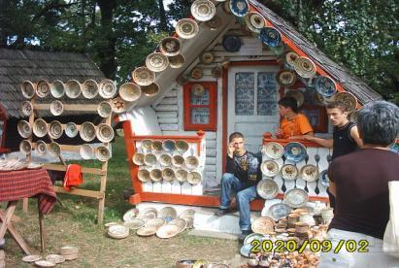
Local sights
Monastery Stânişoara
Monastery Cozia
Village Museum Bujoreni
Horezu Potery

Slide 7
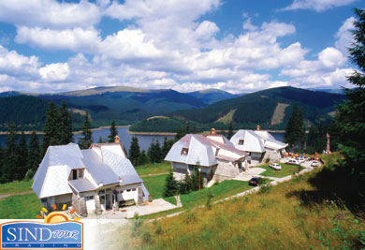
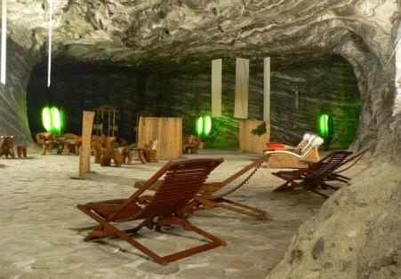
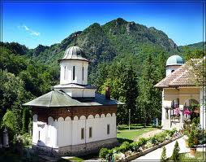
Vidra’ Spa
Ocnele Mari
Salt mine
Monastery Turnu

Slide 8
Technological High School of Tourism –Calimanesti,Valcea

Slide 9
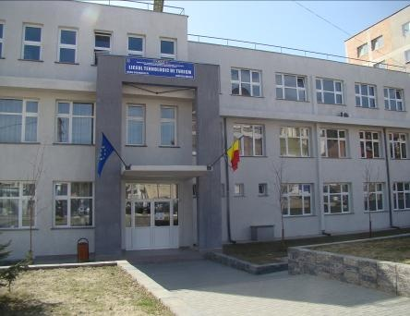
Our school offers:
High school classes: Accounting and Tourism
Vocational classes: Cooks and Waiters
Post Highshool classes: Tourism
Address: Str.Calea lui Traian nr.278
Călimăneşti-Vâlcea
Tel: 0250-750-182
Fax: 0250-750-182
E-mail: liceulcalimanesti@yahoo.com
website: www.economiccalimanesti.ro

Slide 10
Over the years our school was rewarded for quality in education with:
Goldon Trophy in London
Platinum Trophy in New York
Diamond Trophy in Frankfurt
Diamond Trophy in Geneva

Slide 11
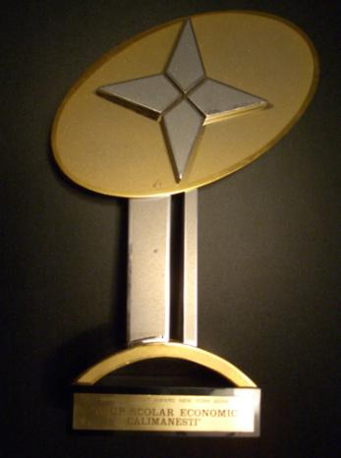
Golden Trophy
Platinum Trophy

Slide 12
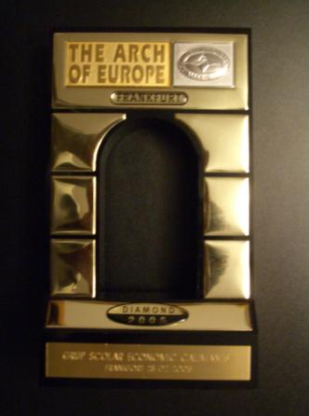
Diamond Trophy
Diamond Trophy

Slide 13
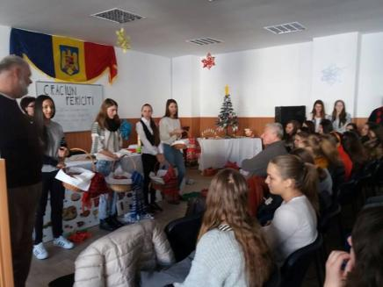
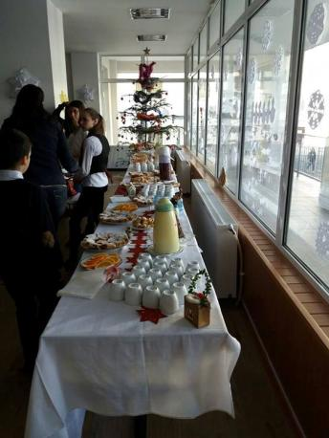
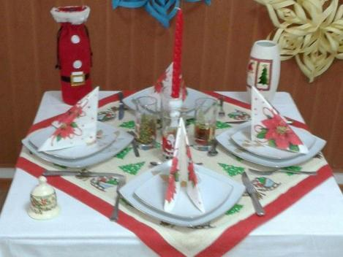
School activities:

Slide 14
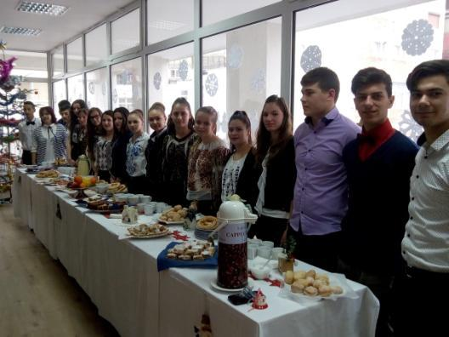
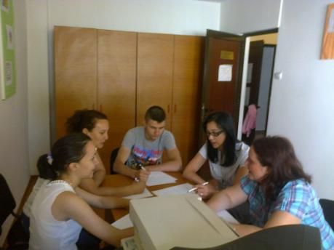
Be the best and you will succeed !
Quality is our main aim.

Slide 15
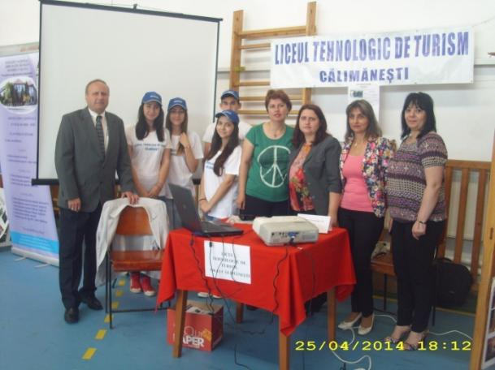
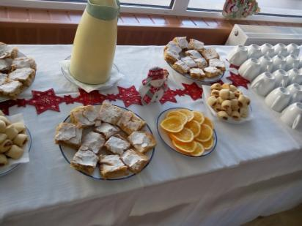
School offer exhibition and our students
Learning by doing

Slide 16
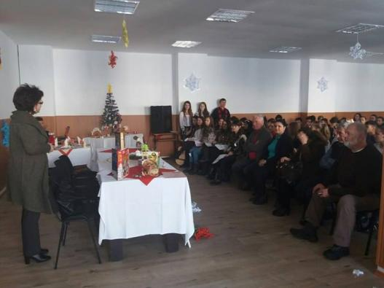
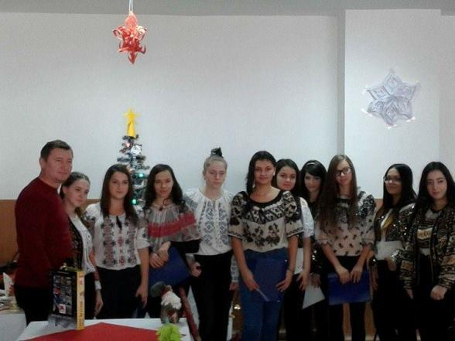
Extra activities –holidays,
music,
Art craft ,dance,
public speaking
Proud of our culture,
tradition, proudly wearing
Our national clothes.

Slide 17
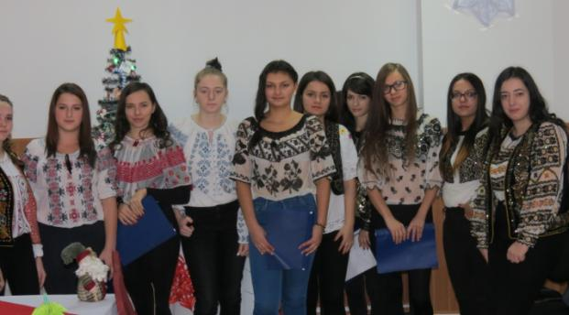
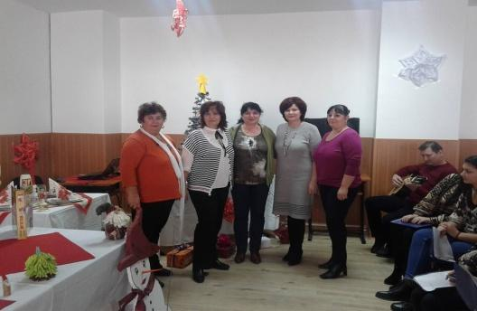

Slide 18
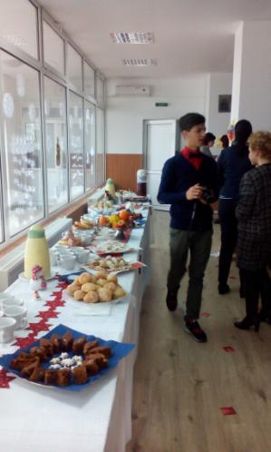
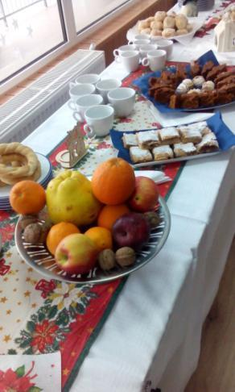
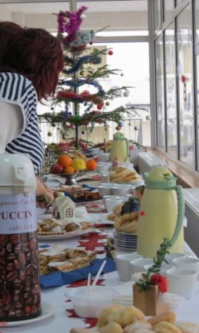
Students and their work products – Special events
( cooking, decorating rooms )

Slide 19
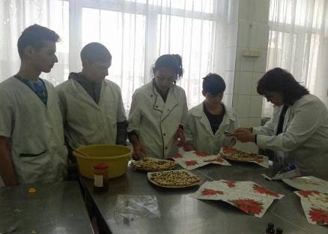
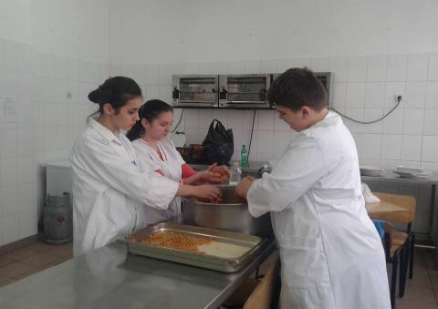
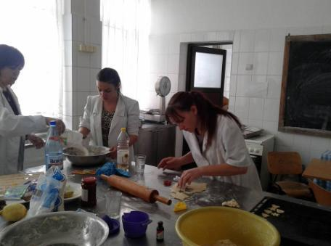
Gastronomic
Laboratory- teachers and students at work

Slide 20
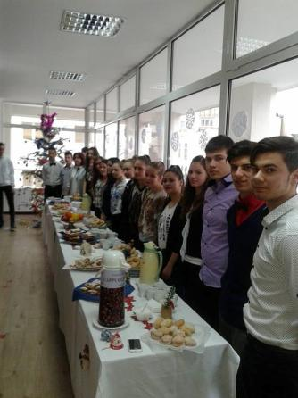
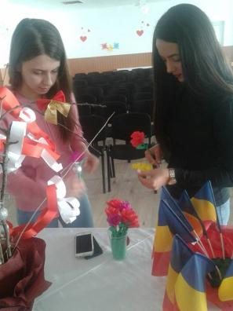
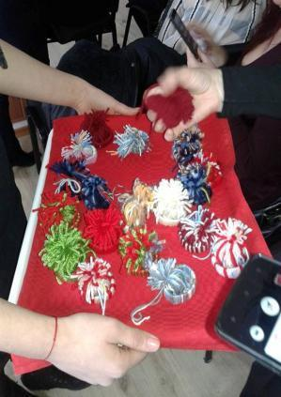
Art craft workshops
Creativity, imagination,
Cooperation , team work

Slide 21
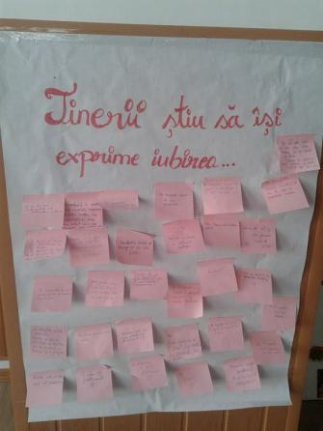
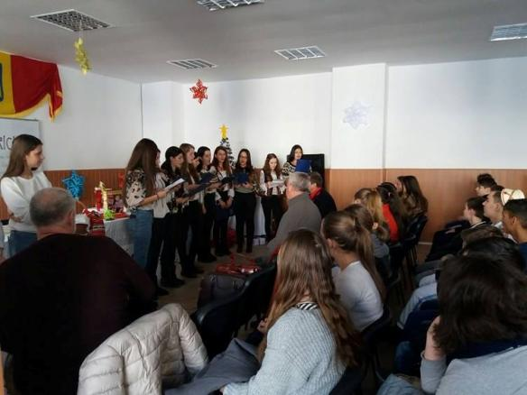
Valentines Day and
Poetry workshop
Teenagers and love

Slide 22
WELCOME TO OUR
COUNTRY!

