Slide 1
HITBALL
Naïm and Sergi

Slide 2
BASIC RULES OF HITBALL
1. To play you need two teams of four people each team.
2. The ball can’t touch the ground.
3. You can hit the ball with all your body: (Hands, feet, head…)
4. To score goal you need to hit the ball to the goal.
5. There is the same system of faults of football.
6. The match finishes when it has passed 20 minutes or one team has scored more than 50 goals.

Slide 3
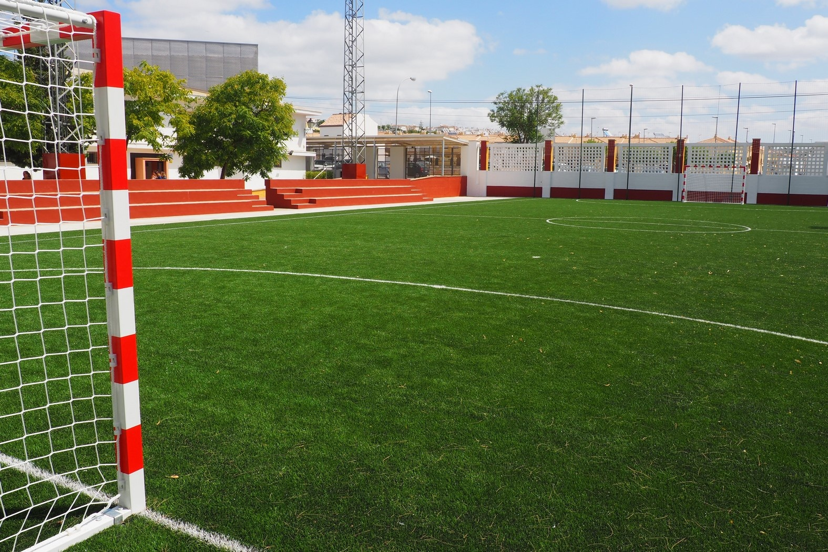
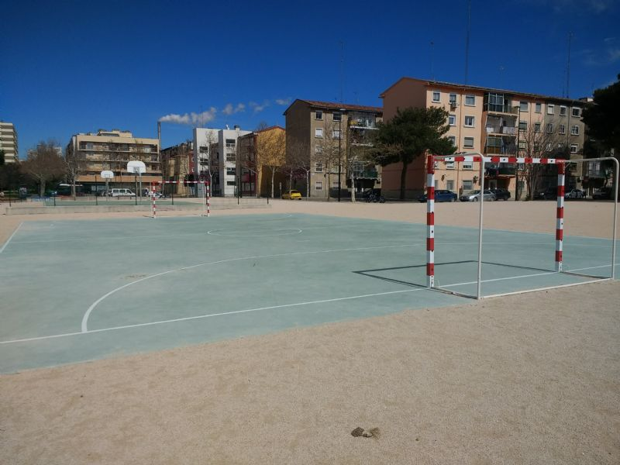
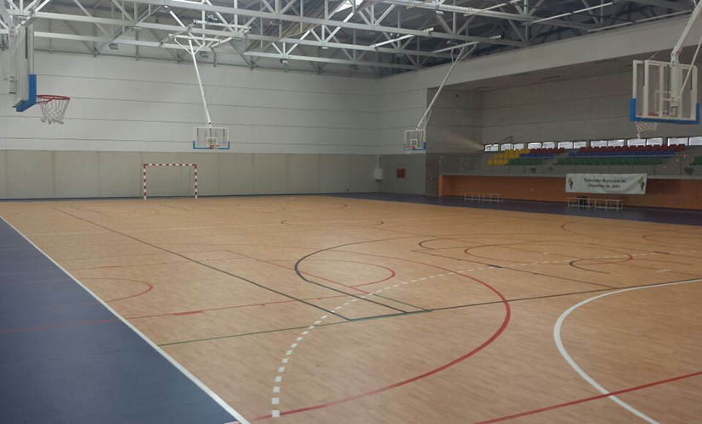
¿WHERE HITBALL CAN BE PLAYED?
Hitball can be played in any surface of football pitches (grass, concrete, wood…), but is required to be a football 5 size pitch. Examples:
Grass Pitch
Concrete Pitch
Wood Pitch

Slide 4
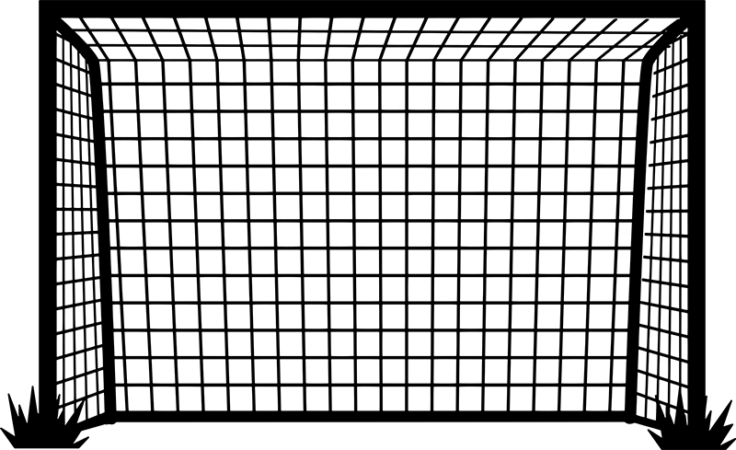
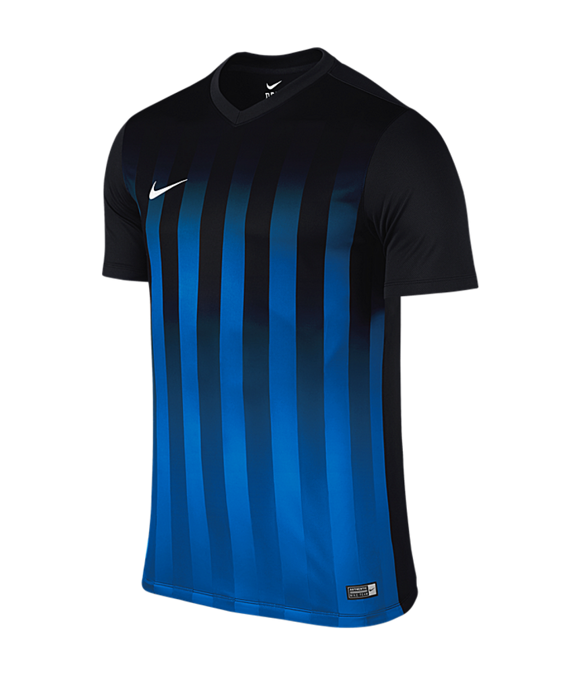
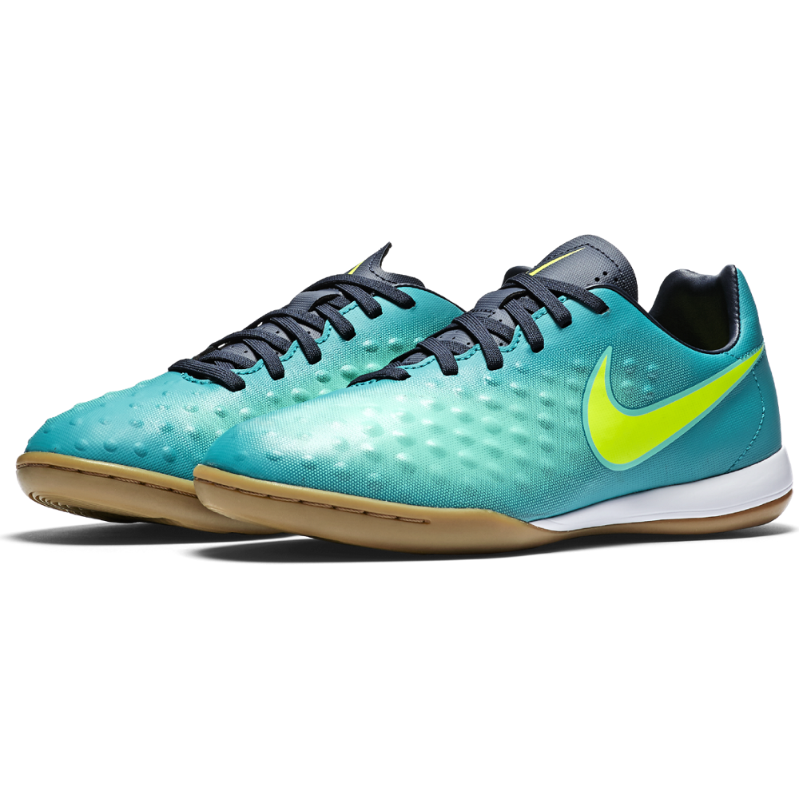
EQUIPMENT NECESSARY
For Playing Hitball, you must need to wear specific equipment:
-Each team has to wear a t-shirt of an specific colour.
-You need to have 2 goals
-You need to have a ball (preferably of handball), but it can be of volleyball.
-The players must wear special shoes according to the surface.

Slide 5
VIDEO OF HITBALL

