Slide 1
MAX
PAU
ALVARO
ANDREA
SPAIN

Slide 2
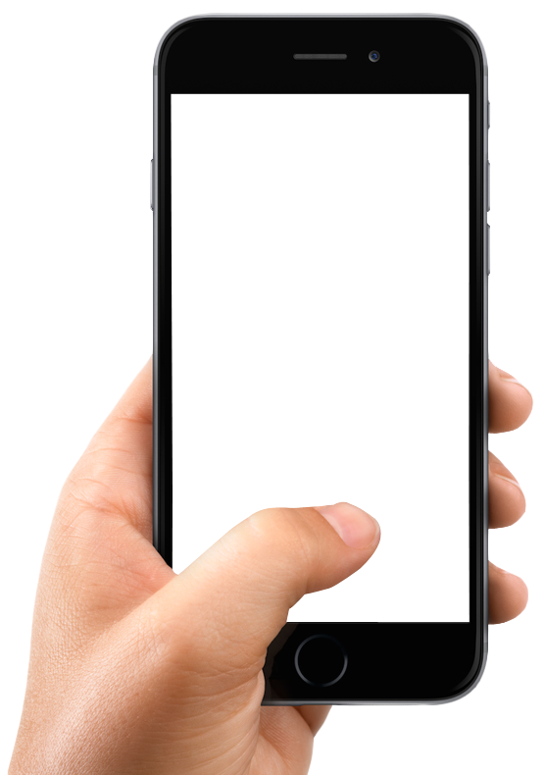
Throughout your life you will spend 408.800 hours watching your screen
1.25 million people die in road crashes each year

Slide 3
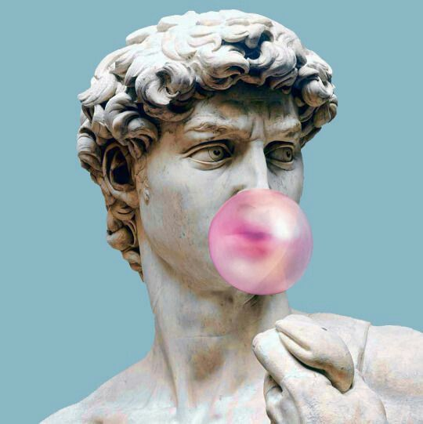
ÍNDEX:
ACTIVITY 1: SHORTFILM
ACTIVITY 2: POSTER
ACTIVITY 3: REFLECTION ON SCREEN USAGE LIST
michelangelo
#David @DaVinci who is the teacher now?

Slide 4
ACTIVITY 1:
SHORT FILM
DESCRIPTION OF THE TOPIC:
Create an investigative short film after the reflection on screen abuse.
OBJECTIVES OF THE ACTIVITY:
Have a critical attitude regarding their own habits on the use of screens.
Learn the dangers of misuse of technology and the shortcomings that may arise.
Create a short film with the aim of raising awarement about screen abuse among the community.

Slide 5
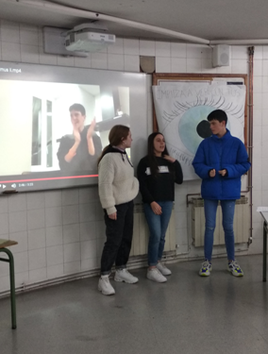
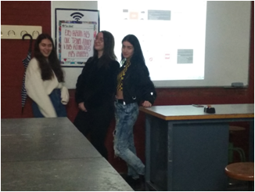
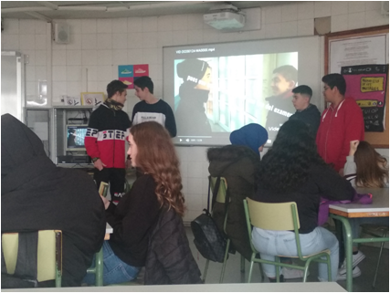
ACTIVITY 1:

Slide 6
POSTER ABOUT RESPONSIBLE SCREEN USAGE.
ACTIVITY 2:

Slide 7
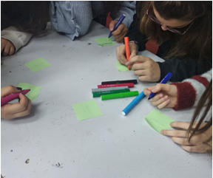
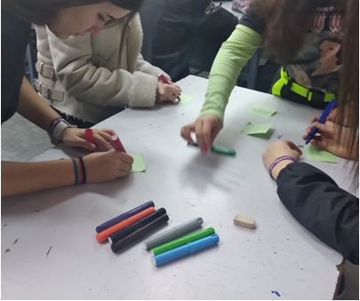
ACTIVITY 2:

Slide 8
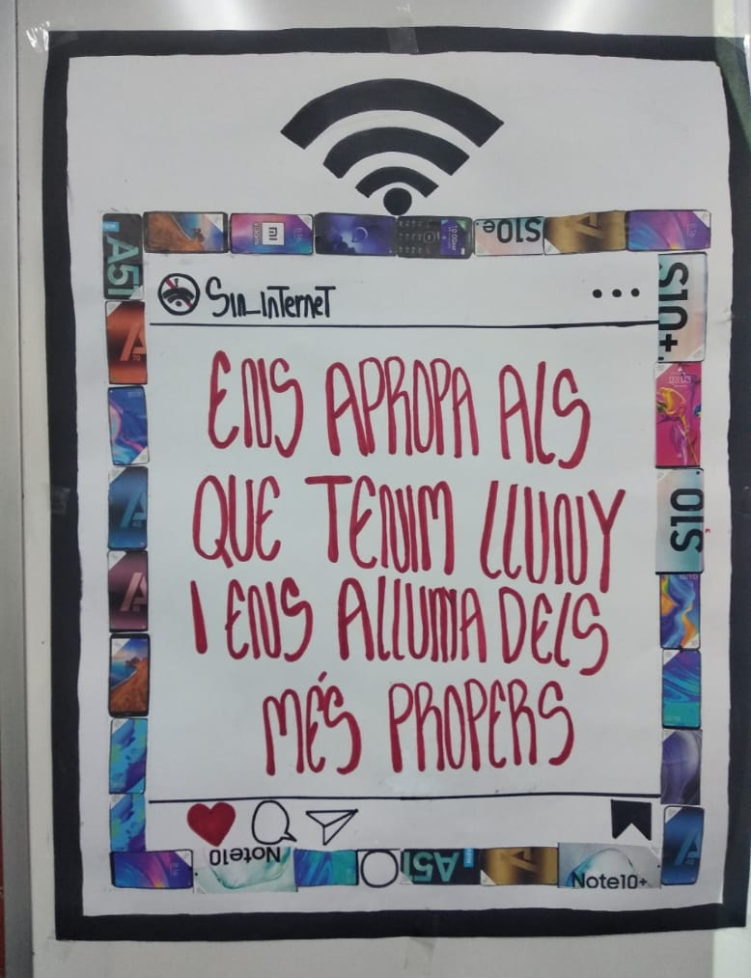
ACTIVITY 2:
“Brings us closer to those we have far away and takes us away from those we have close.”

Slide 9
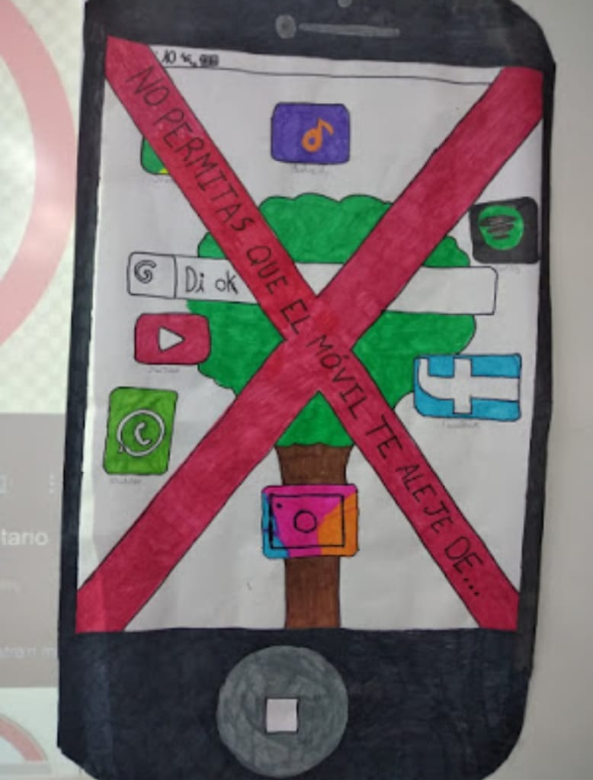
ACTIVITY 2:
“Don't let the phone take you away from …”

Slide 10
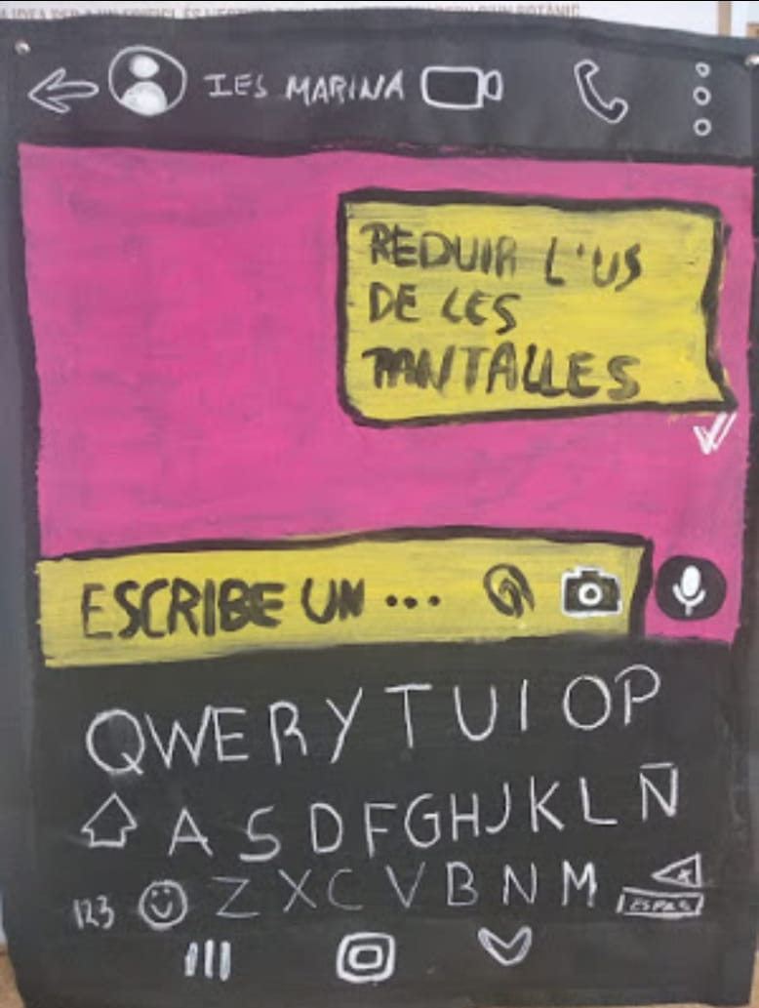
ACTIVITY 2:
“Reduce screen usage.”

Slide 11
ACTIVITY 3:
REFLECTION ON SCREEN USAGE LIST
DESCRIPTION OF THE TOPIC:
Explore the habits of the community regarding screen usage and publish their conclusions by creating a list of ten good intentions related to it.
OBJECTIVES OF THE ACTIVITY:
Provide tools for students to be critical about their own habits regarding the use of screens. Teach them about the dangers of misuse of technology and the shortcomings that may arise.
Notes:
Bye bye

Slide 12
ACTIVITY 3:

Slide 13
ACTIVITY 3:

Slide 14
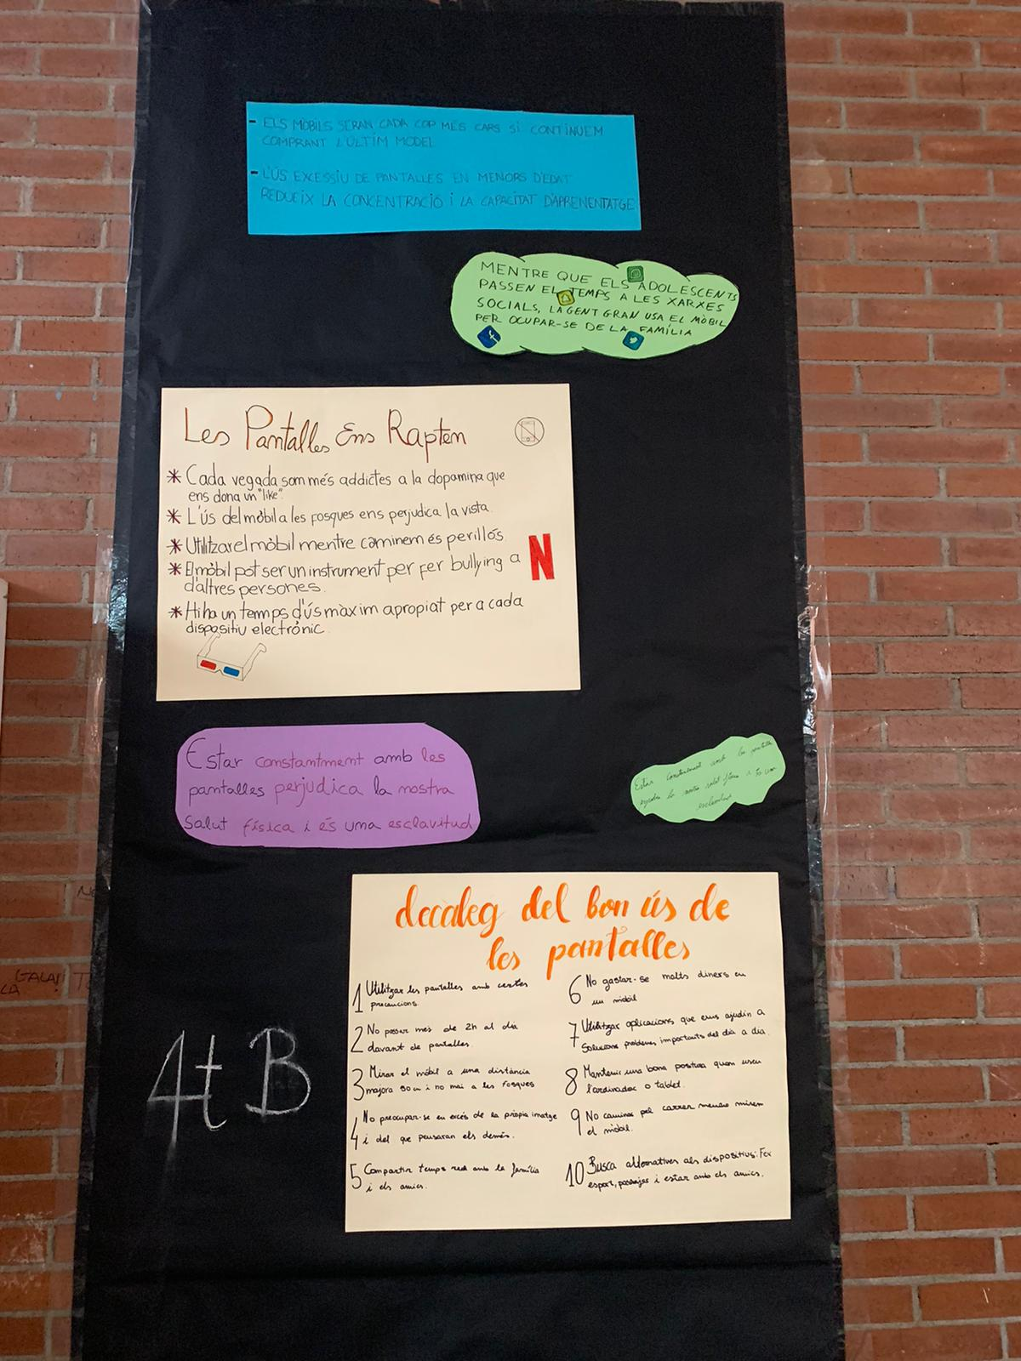
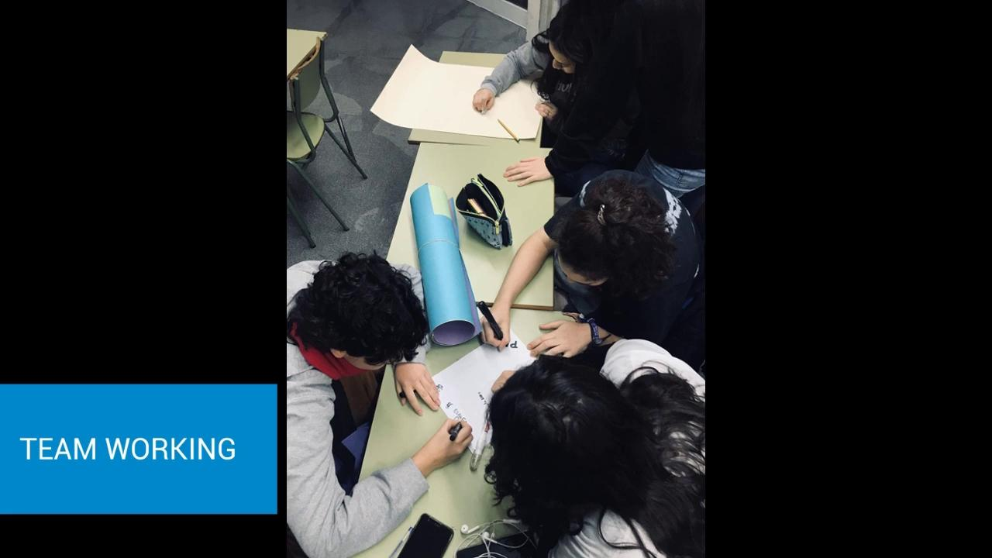
ACTIVITY 3:

Slide 15
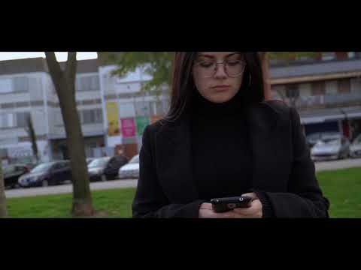

Slide 16
THANK YOU FOR YOUR ATTENTION !

