Slide 1
AD DETECTIVES
Naïm Mokrani and Sergi Villarraso

Slide 2
INDEX
1. Leo Messi and De Gea Ad (Lays)
·Does it follow the advertising rules?
·Advertising strategies
2. Adidas World Cup Ad
·Does it follow the advertising rules?
·Advertising strategies
3. Monster Jam Ad
·Does it follow the advertising rules?
·Advertising strategies
4. Rubius Fanta Ad
·Does it follow the advertising rules?
·Advertising strategies

Slide 3
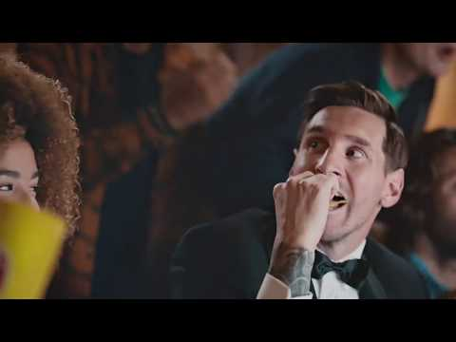
LAYS MESSI AND DE GEA AD (LAYS)
In this ad we can see that are promoting fried chips. This product it is directed to a young audience. In the advert, there is a group of people watching a football game, and, when they open a bag of chips, Messi and De Gea appear.

Slide 4
DOES IT FOLLOWS THE RULES OF ADVERTISING?
First of all we can see that Lays is exaggerating their product because when the boy opens the bag of chips, Messi appears through the door. The advertisers make you believe that if you buy a bag of chips, you are going to meet Messi and De Gea and advertisers make you think that the chips will make you better than other things. So, the ad doesn’t follow the rules of advertising.

Slide 5
ADVERTISING STRATEGIES
·Star Power: In the ad, Messi and De Gea are telling you to buy their product because is the best product.
·Repetition: This ad was announced in TV, was broadcasted minimum 5 times a day, especially, when football matches were broadcasted. This strategy is very successful because the more you see it, the more you will want to buy it.

Slide 6
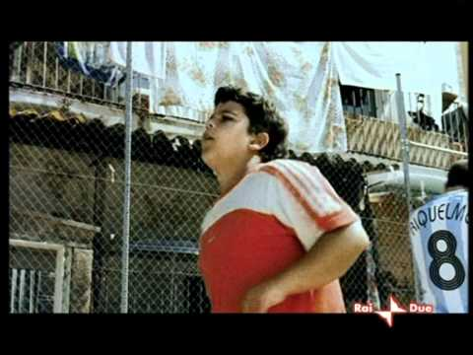
ADIDAS WORLD CUP AD
In this ad we can see that there are two kids that want to play a football game. They began to choose players, but, they choose famous players of football. When they finish choosing, they play with all the players.

Slide 7
DOES IT FOLLOW THE RULES OF ADVERTISING?
The ad presents high levels of exaggeration because you are not going to play a football game with famous players ever. The advertisers are making you believe that if you buy their boots or their ball, you are going to play with your favourite football star. They are trying to convince you that you will be the best among your friends.

Slide 8
ADVERTISING STRATEGIES
Excitement: In this ad, Adidas is promoting that if you buy their product you will be the best and you will play with your favourite football star.
Star Power: There are lots of football players appearing in this ad to promote the product.
Bandwagon: Adidas is proving that if you buy this product, you will be spending a good time.

Slide 9
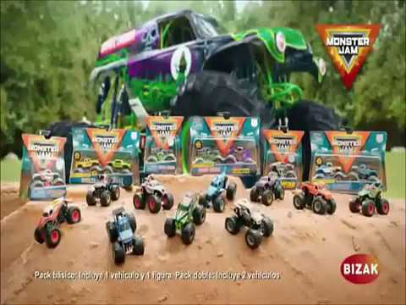
MONSTER JAM ADVERT
In this ad we can see that they are promoting toys of monster trucks. In the ad, they are showing lots of monster trucks but they sell them individually. This car it’s destined for kids and young people.

Slide 10
DOES IT FOLLOWS THE RULES OF ADVERTISING?
In this advert we can see that the man who is talking is exaggerating a lot to impress the audience and sell more.
In the ad, you can see lots of monster trucks although you only can get them individually. We also can see kids playing with the toy, which can’t be allowed.

Slide 11
ADVERTISING STRATEGIES
Excitement: The man and is talking so exaggerated to capt the attention of people and the kids seem to have a lot of fun playing this toy.
Weasel words or puns: The man who is talking about the monster truck sais that you can bring action to your house with this toy and you can have fun with your family by this way.

Slide 12
RUBIUS FANTA AD
In this ad we can see that they are selling fanta. This ad is for everyone who likes fanta, for child and adults. Rubius, a famous youtuber is in the advert to promote it.

Slide 13
DOES IT FOLLOWS THE RULES OF ADVERTISING?
In this advert we can see that they are exaggerating a lot for a fanta ad because a punch machine break a wall and enters to the fanta office. They are using a famous person who is Rubius, a famous youtuber and streamer for promote fanta.
They also give a link of a fanta contest “made” by Rubius.

Slide 14
ADVERTISING STRATEGIES
Star power: We can see in this ad that fanta is using Rubius to promote their products and sell more.
Excitement: We can also see that in this ad they are exaggerating a lot because a machine break a wall to enter to fanta’s office.
Bandwagon: They are giving a contest for people online to promote fanta too, by this way they sell more.

