Slide 1
BODY IMAGE
Paula Macias, Jose M. Campanario i Laia Alba

Slide 2
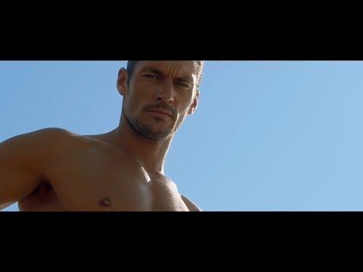
AD PERFUME

Slide 3
Ad body features
Girl: She is young, brunette, beautiful, good body and clear eyes. What the girl in the ad represents is that if you wear the cologne you will be more attractive and you will flirt more
Boy: He is young, athletic, strong, handsome, brown and tall. What the boy in the ad represents is the same as the girl

Slide 4
How much does it cost to get those bodies?
It costs gym hours a week, eating healthy, a lot of willpower and sometimes genetics help, cosmetic operations, creamers or pills.

Slide 5
Video of the new AD.

