Slide 1
Identifying the hidden persuaders in advertising
Erasmus + K229 project «Health to meet you»
Nīkrāces pamatskola

Slide 2
The hidden persuaders
A message that is subconscious to advertise a product and reach the audience without them being aware.
Advertisers often use visual language or human instincts to symbolically represent feelings and desires on an unconscious level.

Slide 3
Pressure

Slide 4
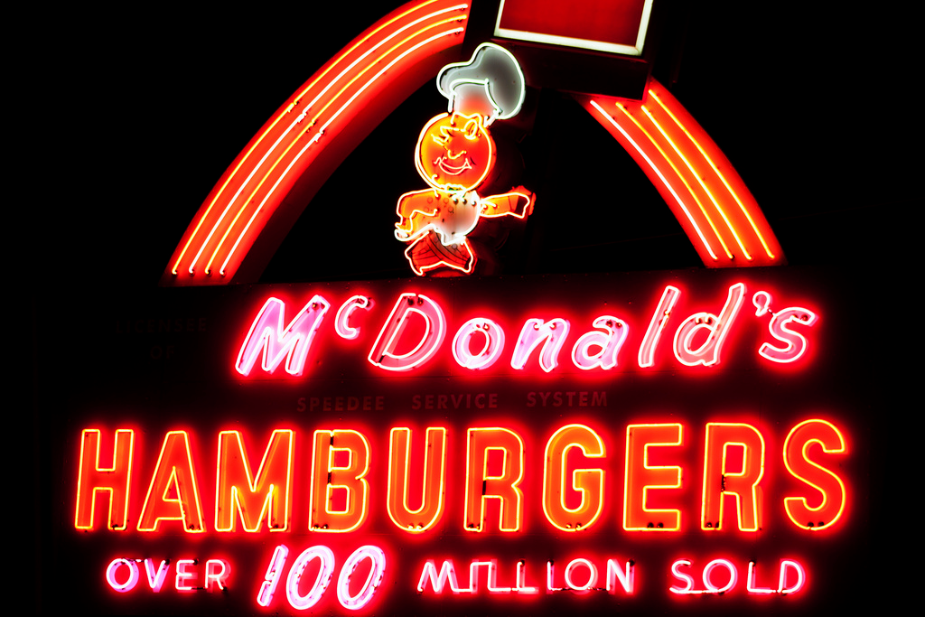
Bandwagon

Slide 5
Testimonial / endorsement

Slide 6
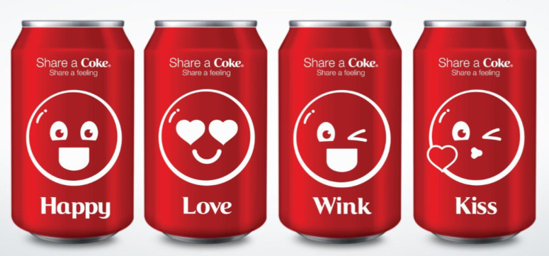
Emotional appeal

Slide 7
Weasel words

Slide 8
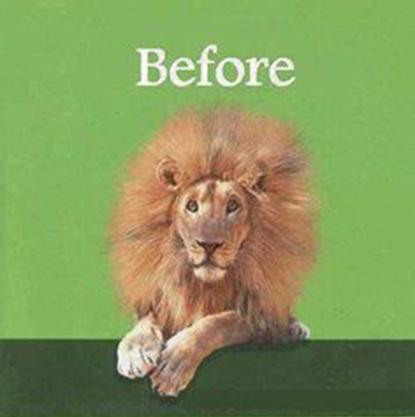
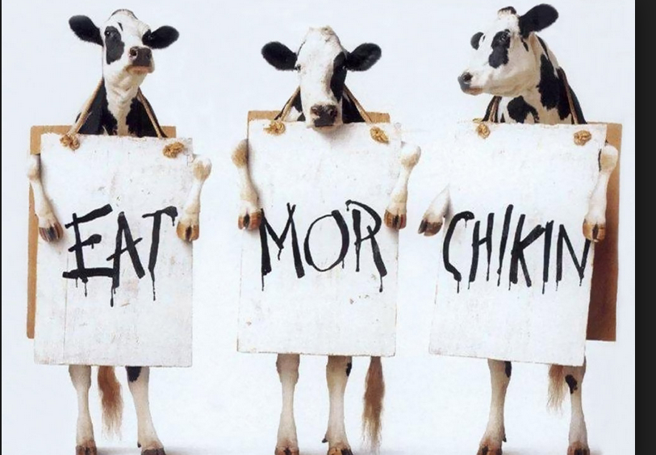
Humor

Slide 9
Association

Slide 10
conclusion
Advertising works by using different psychological techniques to change the way people think and feel about a product.
These techniques take advantage of certain desires, fears, or needs that people might have in order to make them buy the product.
It also uses different forms of influence (authority, group consensus, reciprocation, social proof, testimonials) to make people more open to persuasion.

Slide 11
Thank you for your attention!

