Slide 1
CHRISTMAS IN ITALY
P.14
HOW WE CELEBRATE CHRISTMAS – ITALY

Slide 2
CHRISTMAS TIME
The Christmas celebrations in Italy last for nearly a full month from December 8th to January 6th. It begins with the Feast of the Immaculate Conception, which is a national holiday. To mark the occasion the Christmas decorations are put up, including the tree and the very important nativity crib. The festivities then continue all of the way through until January 6th, the feast day of Epiphany. It is a month for religious devotion and spending time with family. One of the most important decorations at Christmas is the nativity scene. These cribs, “ presepe” in Italian, depict the stable scene within the story of the birth of baby Jesus. They are enjoyed all month round in churches, city squares and home - but importantly the baby Jesus is not settled into his place until Christmas Day.

Slide 4
-CHRISTMAS IN FOGGIA-

Slide 6
On Christmas Eve families have a light lunch. At lunch time, people fry and eat “pettole” and enjoy shopping. Then families meet for dinner at about 5.00 p.m. and have lots of courses from starters to dessert. Our dinner is based fish and vegetables: eel, cod fish, salmon, broccoli, green salad and so on. For dessert we have “torrone”, “panettone”, “pandoro”, “spumante” and traditional cakes.
After dinner we go to the Midnight Mass at the local church to celebrate the Birth of Christ.
The joy of this time rises on 25th December which is made to eat! This is the perfect occasion to meet up with your family, sit round the table (almost all day long!) and enjoy a delicious and exquisite menu. For lunch we have starters, pasta (lasagna), meat, salad, fruit salad and several cakes. The charm of this day lasts until late, while playing games, tasting delicacies, exquisite wines and unwrapping all the presents! After the good cheer of this day, the festivities go on. December 26th “Santo Stefano” day, is a national holiday in Italy and obviously another occasion to gather with your loved ones and taste other homemade specialities.

Slide 7
-CHRISTMAS TREE- -PRESENTS-

Slide 8
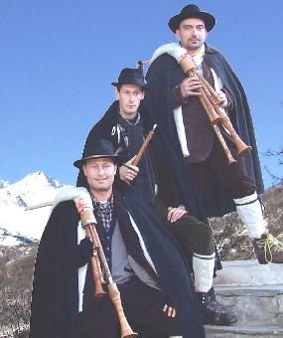
BAG PIPES IS THE SOUND OF CHRISTMAS
Perhaps the most unusual fact in the list is that the sound of Christmas in Italy is the bagpipes. It is the “zampognari” in the Abruzzi region that play bagpipes and flutes around the town to symbolise the arrival of the shepherds to greet the baby Jesus. The story goes that, after having seen the blessed baby in Bethlehem, the shepherds started to play the bagpipes. This performance was then embodied by the “zampognari” - shepherds who would come down from the hills into the villages to see their families and entertain the people with their music. So now, still with the players wrapped in a sheepskin vest and thick cloak, the tradition is continued in towns across Italy.

Slide 9
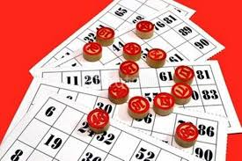
THIS IS THE SEASON OF TOMBOLA
During Christmas season Italian families gather together to play board games like cards and “Tombola”. The most commonly played form of the game is the Neapolitan version. On a brightly decorated board, each number represents a symbol, and then the game is played essentially in the same way as bingo. It is a simple tradition that brings everyone from age nine to ninety together

Slide 10
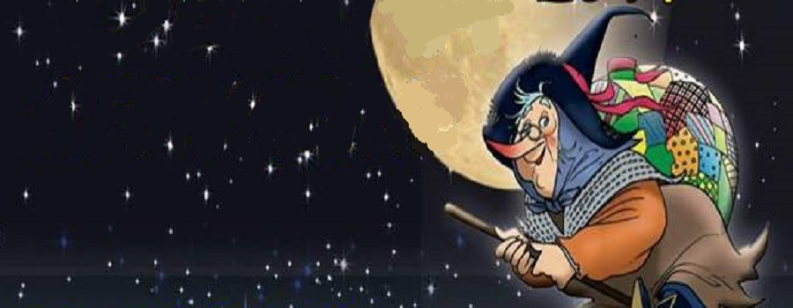
Celebrations are not over yet! New Year’s Eve (31st December) and 1st January are important, too. Families meet again round the table and enjoy food.
On Epiphany day (6Th January) children wait for “la Befana” who, according to Italian folklore, is an old witch-like woman who arrives on a broomstick, comes down the chimney and fills kids’ stockings with sweets, chocolate, or a lump of coal for those who have been naughty.
The holidays mean eating a lot and enjoy the family warmth.

Slide 11
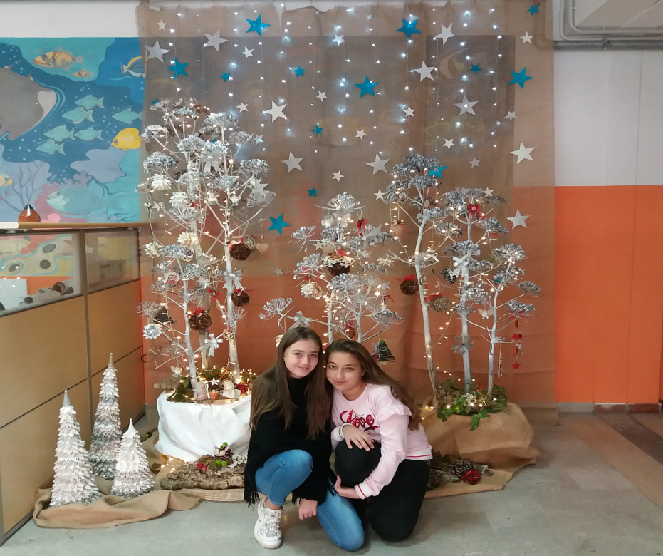
CHRISTMAS AT OUR SCHOOL

Slide 12
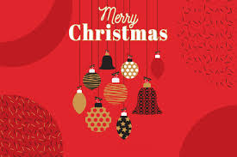
AND HAPPY NEW YEAR
SCUOLA SECONDARIA DI PRIMO GRADO GIOVANNI BOVIO FOGGIA – ITALY
REALIZED BY CLASS 2 E

