Slide 1
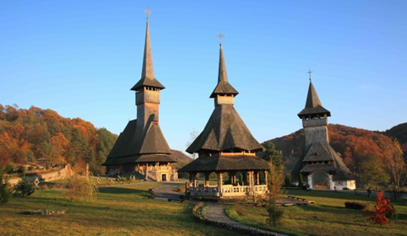
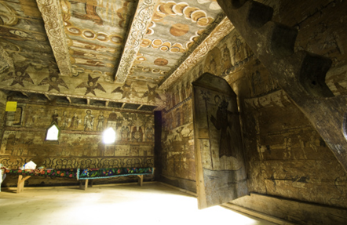
Maramureș is one of the better-known regions of Romania, with autonomous traditions since the Middle Ages. Its well-preserved wooden villages and churches, its traditional lifestyle, and the local colourful dresses.
SALINA TURDA
Romania is a country located at the crossroads of Central, Eastern, and Southeastern Europe
Salina Turda
Located in Turda, Transylvania, the site is a large underground wonderland with a brightly lit modern art theme park nestled 120 meters below the surface of the Earth inside one of the oldest salt mines ever known. The innovative look of this gargantuan amusement park seems like something out of a science fiction movie. It contains attractions like an amphitheater, an underground lake that may be explored with paddles and rowboats, a Ferris wheel, spa treatment rooms with natural aerosols, bowling alley, mini-golf, sports field, table tennis, pool tables.
Romanian is the official language of Romania and is spoken by over 90% of the population of the country.
Deșteaptă-te, române!„ (variously translated as “Awaken thee, Romanian!”, “Awaken, Romanian!”, or “Wake up, Romanian!”) is the national anthem of Romania.
Notes:
Norėdami pakeisti šį bukletą, pakeiskite mūsų pavyzdžio turinį savuoju. Arba jeigu norėtumėte geriau pradėti viską iš naujo, paspauskite skirtuke Pagrindinis esantį mygtuką Nauja skaidrė, kad įterptumėte naują puslapį. Dabar įveskite savo tekstą ir paveikslėlius ten, kuri yra tušti vietos rezervavimo ženklai. Jeigu reikia daugiau vietos rezervavimo ženklų pavadinimams, paantraštėms, pagrindiniam tekstui, nukopijuokite bet kurį esamą vietos rezervavimo ženklą, o tada vilkite naują vietos rezervavimo ženklą į norimą vietą.

Slide 2
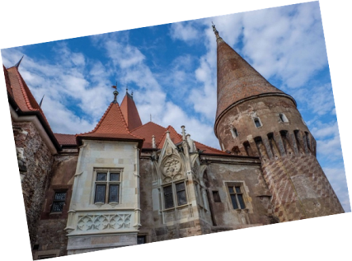
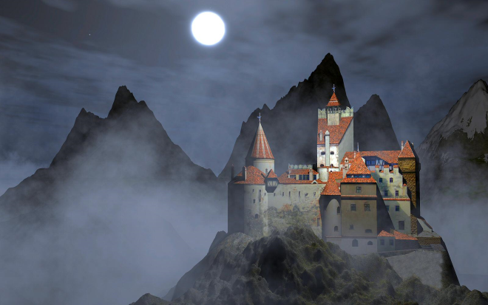
THE DANUBE DELTA
The Corvin Castle
The Corvin Castle, also known as the Hunyadi castle is one of the most beautiful and well-preserved medieval castles in Transylvania. The castle was built in the 14th century, being the most famous property of Romanian ruler Iancu of Hunedoara.
To this day, this impressive castle dominates the city of Hunedoara with its Gothic architecture. It only takes one visit to the Corvin Castle for a traveler to imagine this as the perfect setting for Edgar Allan Poe’s“ghost stories”.
Mūsų produktai ir paslaugos
Commonly known outside Romania as Dracula's Castle it is often erroneously referred to as the home of the title character in Bram Stoker's Dracula.
Dutch author Hans Corneel de Roos proposes as location for Castle Dracula an empty mountain top, Mount Izvorul Călimanului, 2,033 metres high, located in the Călimani Alps near the former border with Moldavia. Stoker's description of Dracula's crumbling fictional castle also bears no resemblance to Bran Castle. The castle is now a museum dedicated to displaying art and furniture collected by Queen Marie. Tourists can see the interior on their own or by a guided tour. At the bottom of the hill is a small open-air museum exhibiting traditional Romanian peasant structures from the Bran region.
The majority of the Danube Delta, Europe’s second largest river delta, lies in Romania. Originally part of the Black Sea, the Danube Delta is a good place to observe nature. It is home to many unique species of plants and animals in Europe, as well as contains 23 different ecosystems, including some of the world’s largest wetlands. Previous visitors rave about the spectacular sunsets and highly recommend taking a slow boat ride on the river.
The castle integrates various
architectural styles, because of the presence of some military innovations. It was meant to be not only a luxurious residence during Iancu of Hunedoara’s reign, but also a strategic point to defend the region against various attacks.
Įveskite nuotraukos pavadinimą
The content of this booklet does not reflect the official opinion of the European Union

