Slide 1
St. Anne’s Church
RAUDONDVARIS MANOR HOUSE
This is one of the most impressive castles of Lithuania. The last hosts of the castle were earls Tiškevičiai.
LITHUANIA
St. Anne’s Church in Vilnius is one of the prettiest buildings in Lithuania. The church has a grand bell tower.
Capital city-Vilnius
Language-Lithuanian
Notes:
Norėdami pakeisti šį bukletą, pakeiskite mūsų pavyzdžio turinį savuoju. Arba jeigu norėtumėte geriau pradėti viską iš naujo, paspauskite skirtuke Pagrindinis esantį mygtuką Nauja skaidrė, kad įterptumėte naują puslapį. Dabar įveskite savo tekstą ir paveikslėlius ten, kuri yra tušti vietos rezervavimo ženklai. Jeigu reikia daugiau vietos rezervavimo ženklų pavadinimams, paantraštėms, pagrindiniam tekstui, nukopijuokite bet kurį esamą vietos rezervavimo ženklą, o tada vilkite naują vietos rezervavimo ženklą į norimą vietą.
Ar pastebėjote lenkimo žymes? Jos neryškios, tačiau jei nenorite jų matyti buklete, pažymėkite panaikinkite prieš spausdindami.

Slide 2
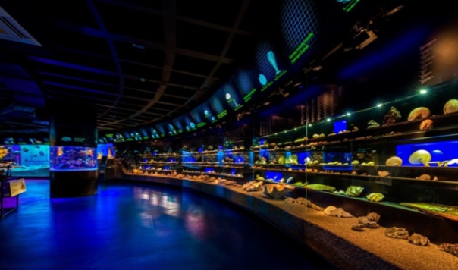
CURONIAN SPIT
RUMŠIŠKĖS OPEN-AIR MUSEUM
It spans a narrow peninsula called Curonian Spit, merely 2 km wide and 98 km long, with half of that length in Lithuania. The Curonian Lagoon separates the Spit from the mainland Lithuania.
Rumšiškės Open-Air Museum is the place to come if you want to learn more about the fascinating folk customs found in Lithuania.
LITHUANIAN SEA MUSEUM
There are around 80 buildings here including farms and reconstructed villages with churches.
You can look at the traditional rooms here and see typical Lithuanian period furniture as well as cooking implements and tools.
The Lithuanian Sea Museum located in Klaipėda, Smiltynė, is one of the most impressive museums in Lithuania. It always astonishes its visitors and attracts to come back and visit it again. The museum undoubtedly justifies its motto “Together we will learn to explore, enjoy and preserve our harmony with the sea”.
The Curonian Spit for centuries has been an area of massive traveling dunes, the so-called “Lithuanian Sahara”. Over 10 of fishing villages were consumed by the moving dunes.
The content of this booklet does not reflect the official opinion of the European Union.

