Slide 1
FLORA AND FAUNA
ZAGREB COUNTY
CROATIA

Slide 2
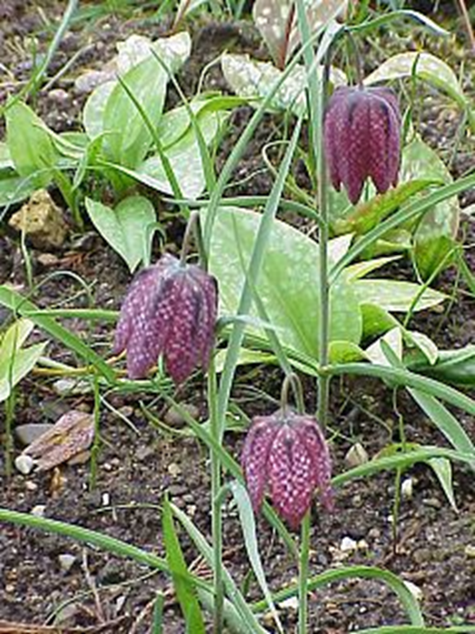
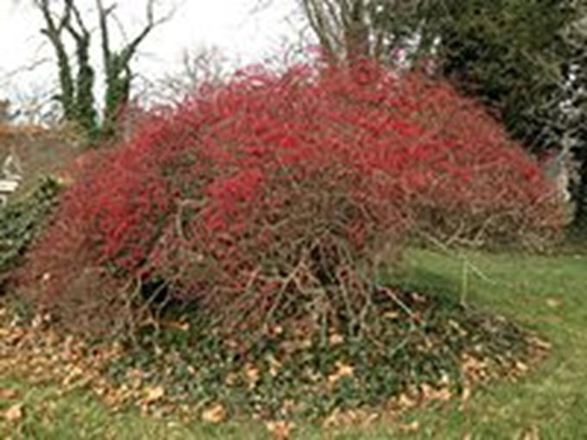
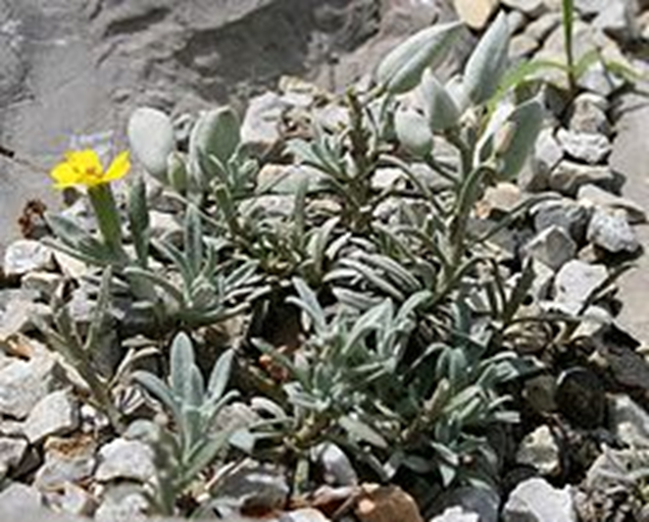
FLORA
(by goddess Flori) is collective name for all plant species of a particular area or Earth as a whole.

Slide 3
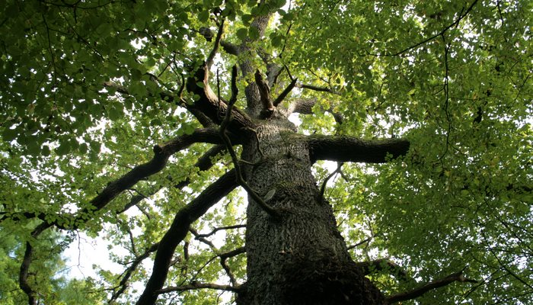
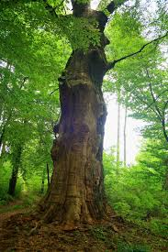
OAK
Oak is a tree trunk of a beech tree that has over 600 recognized species
Most grow like bulky trees
Oak trees are important in the northern moderate area

Slide 4
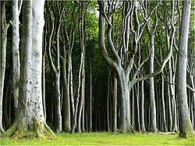
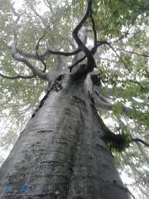
BEECH
Beech grows on mountain and mountainous locations
In Croatia, it is an indigenous tree species
Grown up to 40 m in height, trunk thickness can be over 1 m in diameter

Slide 5
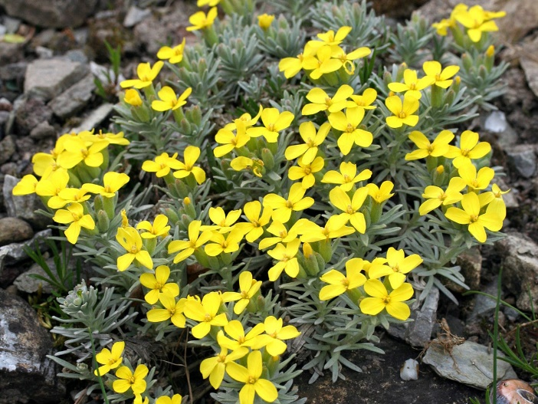
VELEBIT DEGENY
Velebit degeny is the rarest species of Velebit and Croatian flora.
Blooms in May and June
She has beautiful yellow flowers, the fruits are greasy

Slide 6
DANDELION
Dandelion is a perennial perennial with toothed leaves
All parts contain bitter dairy juice. Since ancient times, it is known as a medicinal herb, and serves as a dish, especially as a salad
It grows on meadows, pastures, gardens and fields

Slide 7
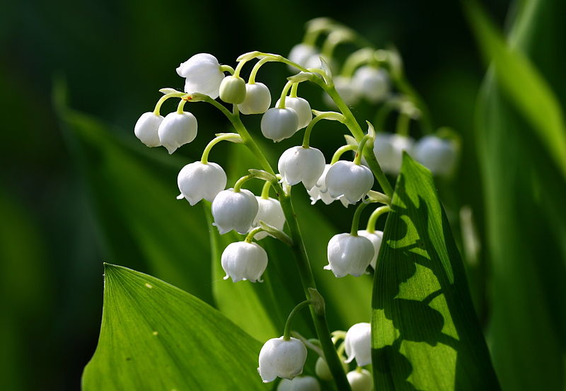
GOBLET
Goblet is a hereditary species of lily of the valley
Types of this genus have leafy overhead stem and underground bulb
There are over 100 species known in the world, and in Croatia alone three species grow, on wet lowland meadows.

Slide 8
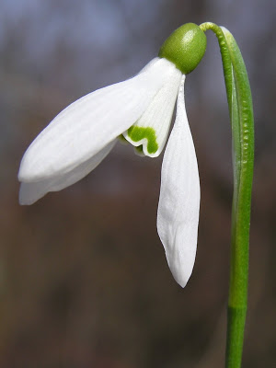
VISIBABA
Visibabe are one of the most prolific springers
Visibaba appears in January and February
The flowers are hanged, simple or full.

Slide 9
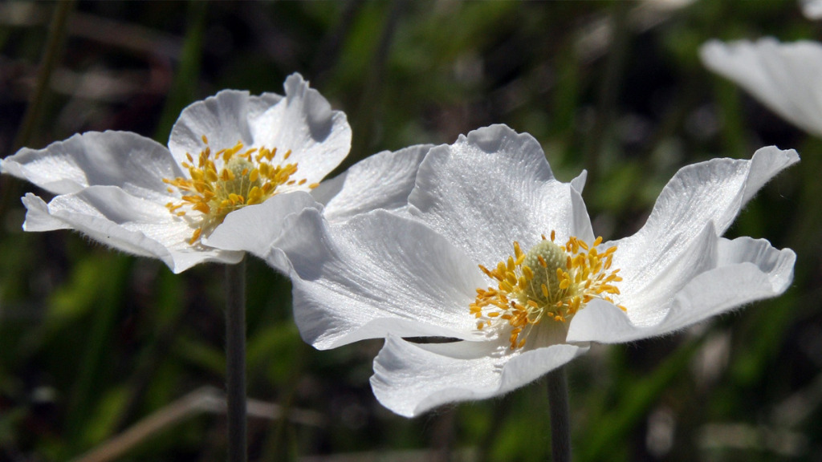
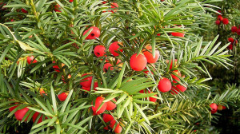
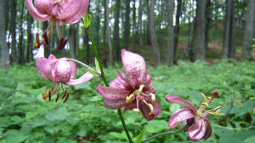
TISZA
ANEMONE
LILIAN GOLDEN

Slide 10
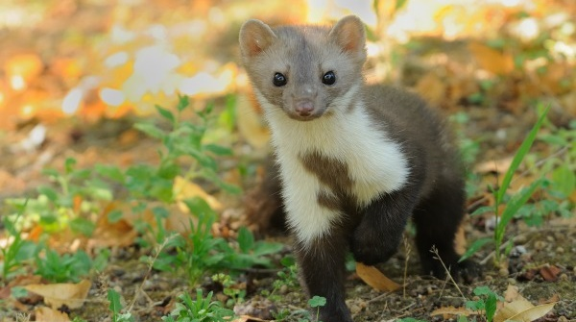
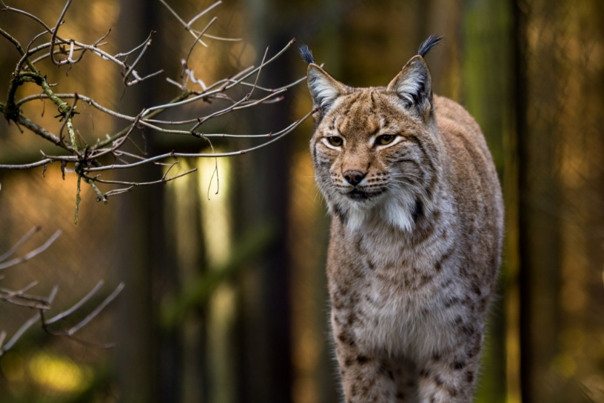
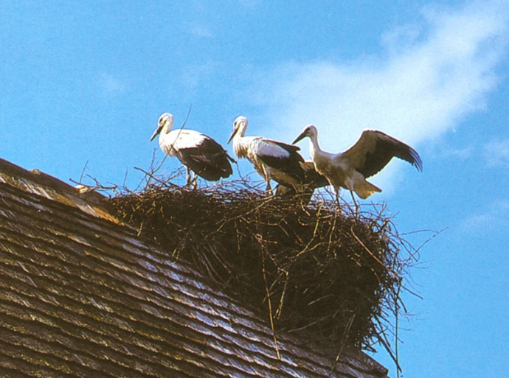
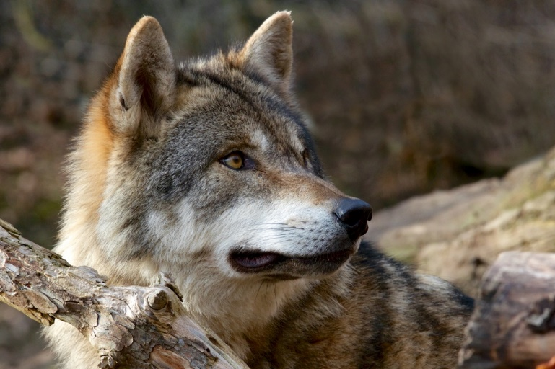
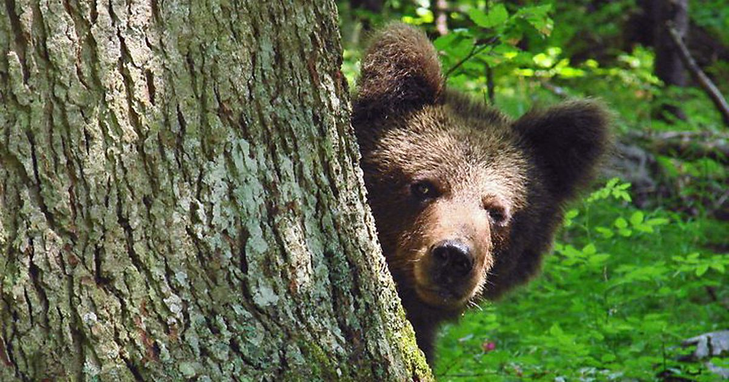
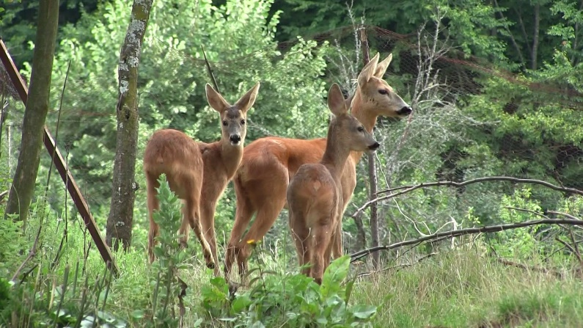
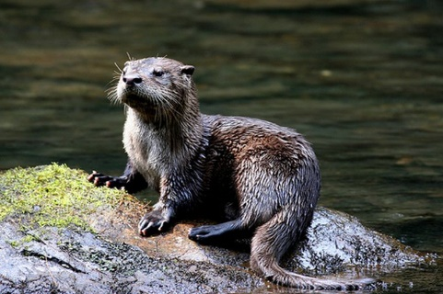
FAUNA
is collective name for all the animal life of a certain environment

Slide 11
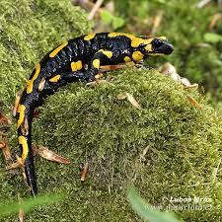
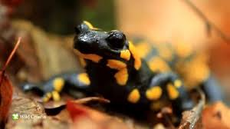
SPOTTED DAGGER
Spotted daydream, also known as colorful dawn
Its lengthy body, with four short legs of equal length and long tail
Most copies shorter than 20 cm, but can reach 25 cm in length
It is solid and robust

Slide 12
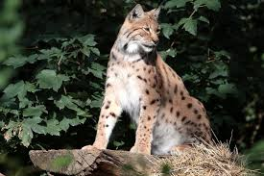
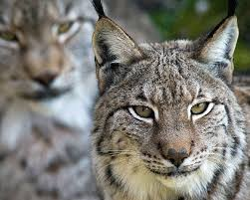
TRIM
The length of the body is up to 1.30 m (with the addition of tail from 11 to 25 cm), and in the shoulders are about 65 cm high
Females with an average weight of 17 to 20 kg are considerably easier than males
Common to all species of larvae are pointed ears with a pair of hair on top and a short tail

Slide 13
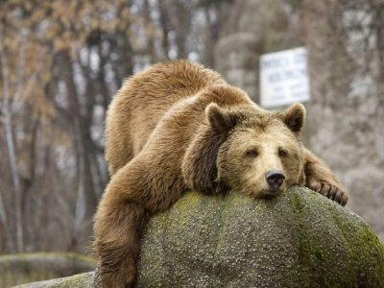
BROWN BEAR
Usually brown
Weighing between 100 and 300 kg
Sleeps a winter dream

Slide 14
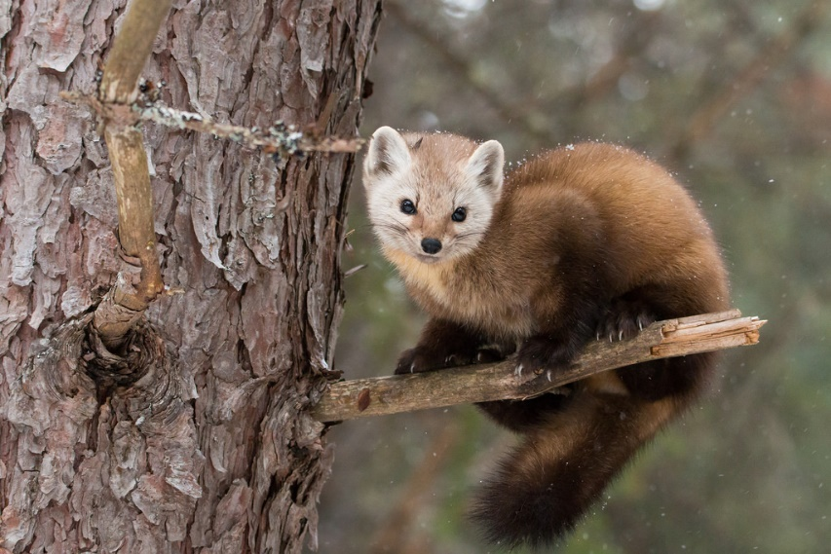
KUNA ZLATICA
Kuna zlatica is a smaller mammal from a row of beasts.
Their body is prolonged, their legs are short, each with 4 or 5 fingers with a claw that climbs on the walk. They climb great, swim well.
Along with the intestinal opening are developed anal glands which in some kuna are in danger of excreting the liquid with unpleasant smells.

Slide 15
WILD BOAR
Wild boar has a heavy body covered with coarse brown-coat bristles, which make up the ridge on the ridge
The legs are short and strong with 4 fingers, of which 2 are stronger, developed, the big head is stretched in a long rhythm, eyes are tiny

Slide 16
WILD BOAR
Wild boar has a heavy body covered with coarse brown-coat bristles, which make up the ridge on the ridge
The legs are short and strong with 4 fingers, of which 2 are stronger, developed, the big head is stretched in a long rhythm, eyes are tiny

Slide 17
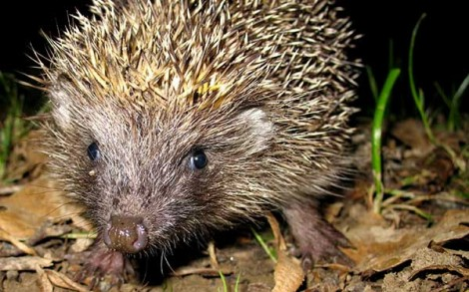
HEDGEHOG
His skin is covered with pointed sticks.
Almost all the body covers a very developed skin muscle that allows him to drift in the dangers in the toe, and the spine appears in all directions.
He lives in dry places in the woods and shrubs

Slide 18
OTTER
All otter have long, slender body and short limbs. Among their fingers are swiming dogs. Most species have sharp claws. Every time after the swim the otter is ripped from the ground to leave the salt with itself.

Slide 19
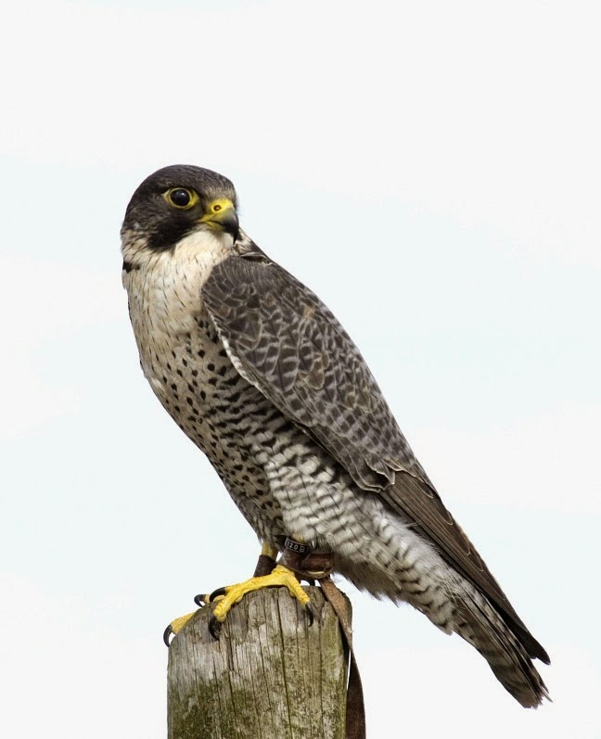
GREY FALCON
Has darker wings, and the lower part of the body is white with black and brown coats.
Feeds on smaller birds (pigeons, ducks, crows, sheep ...)

Slide 20
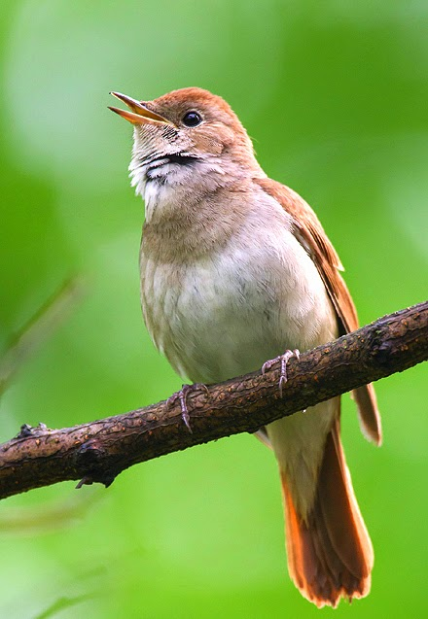
NIGHTINGALE
It has an uncomfortably brown feathers
Nests mostly work on the ground, hidden in shrubs (nettle, blackberry ...)
Feeding insects and spiders
Spend the winter in Africa

Slide 21
THANK YOU FOR YOUR ATTENTION

