Slide 1
Polish students at Timber Company ZPU „Prawda” in Olecko

Slide 2
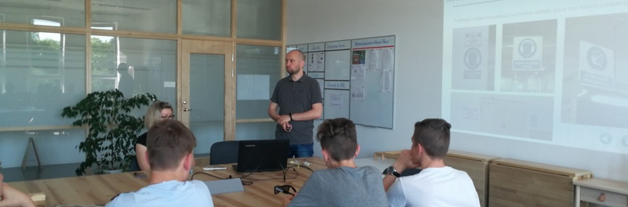
OSH training

Slide 3
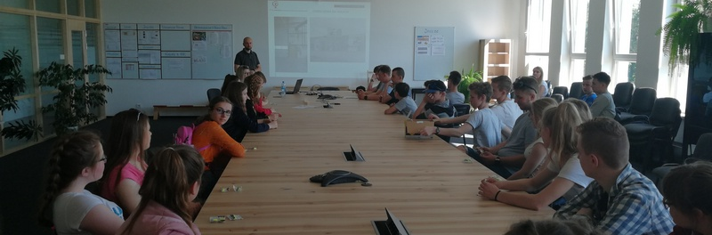

Slide 4
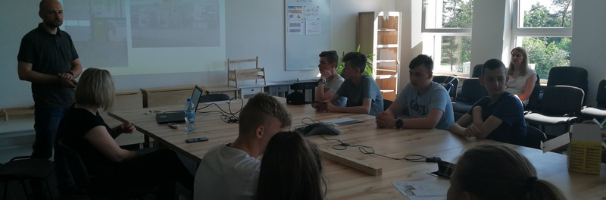

Slide 5
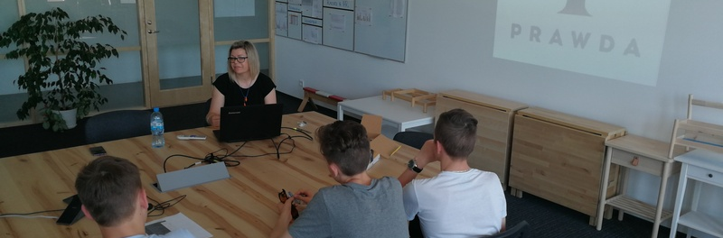

Slide 6
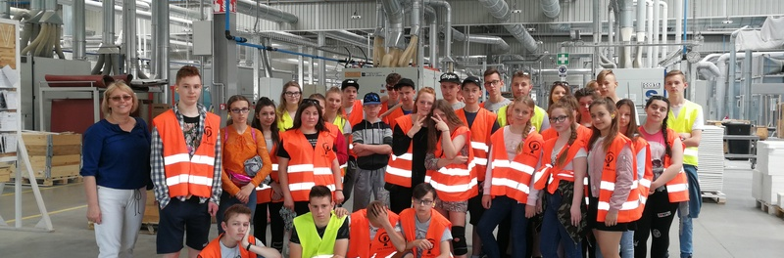
8th grade of primary school in Wieliczki

Slide 7
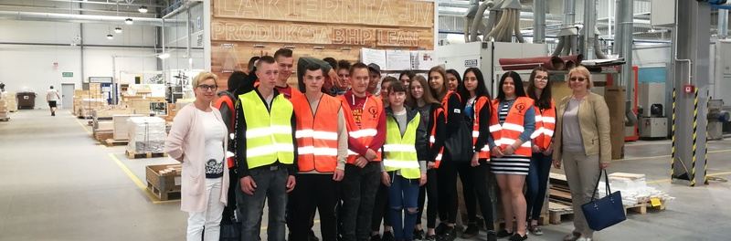
3rd grade of lower secondary school

Slide 8
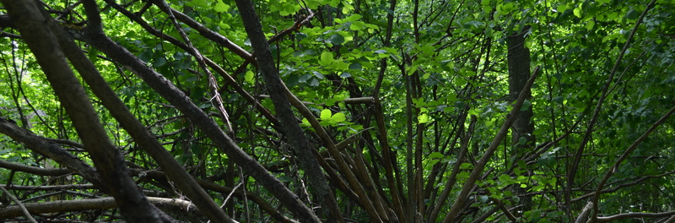
THE END

