Slide 1

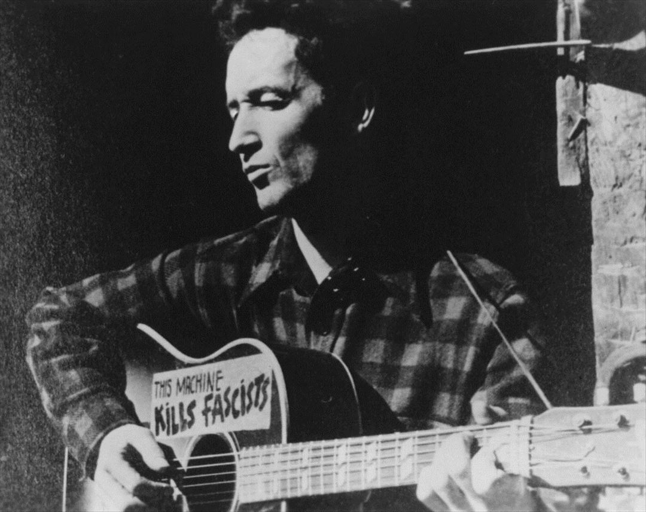
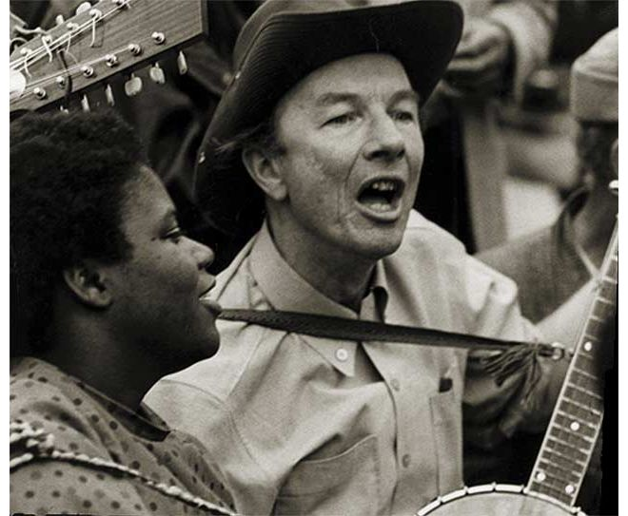
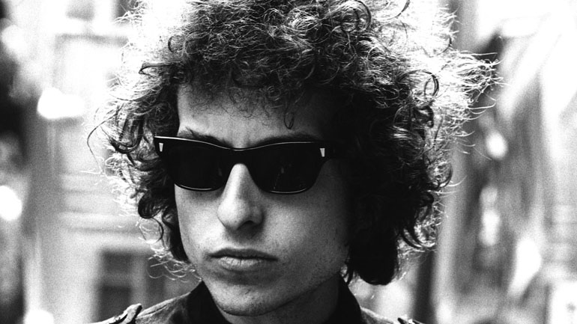
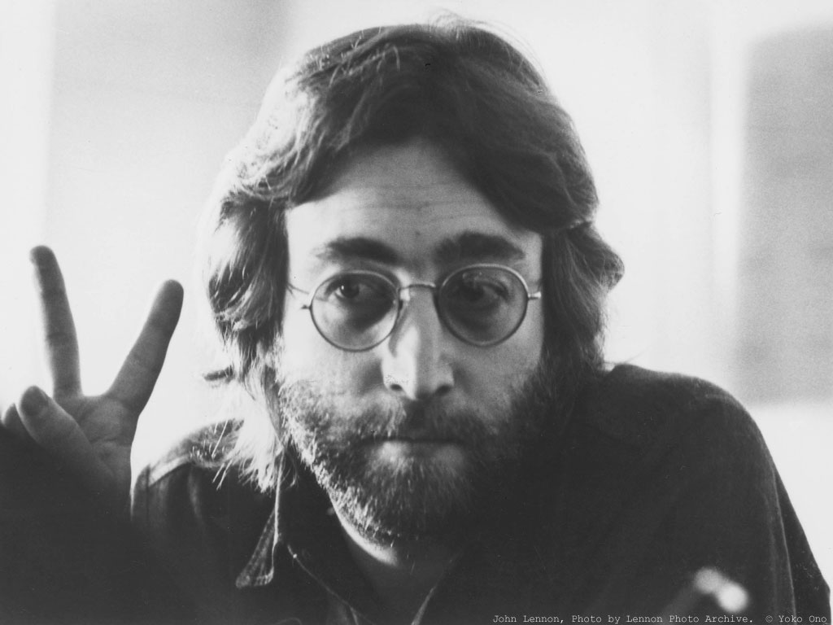
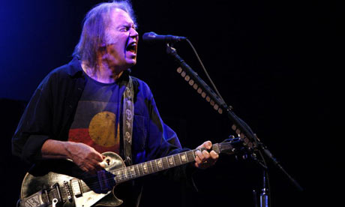
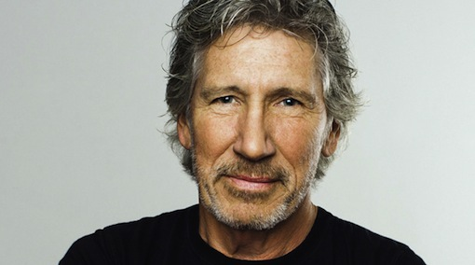
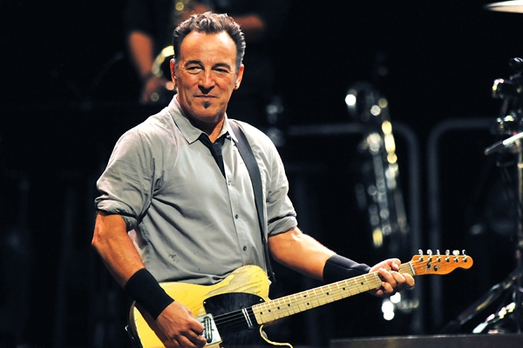
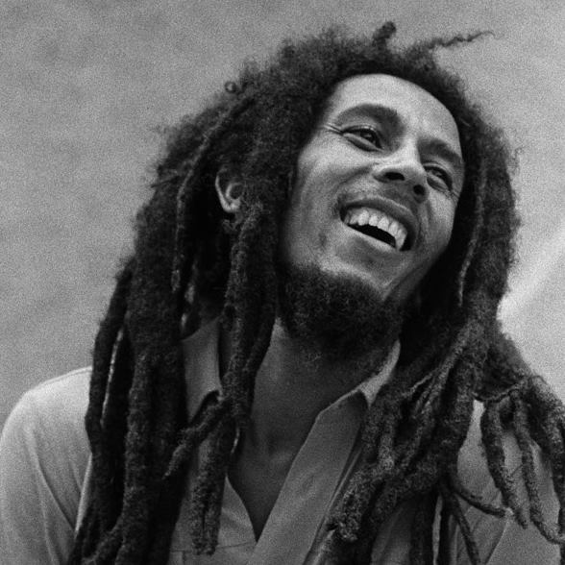
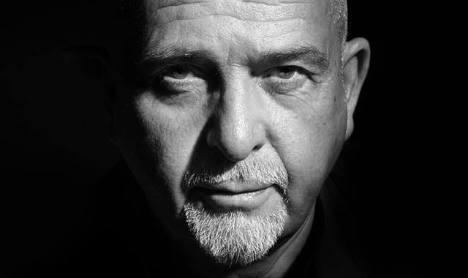

Slide 2
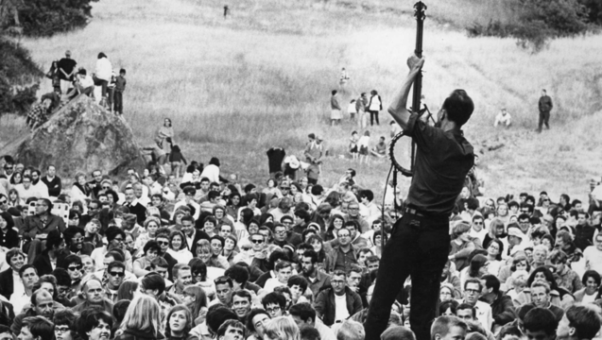
Let's take a look!
→ Describe what the man is doing.

Slide 3
Step 1: Listen to the song and  take notes about ...
Pete Seeger "We shall overcome"
… the topic (le sujet)
→  I think the song is about…
→  Maybe the song is about…
For the champions :
→  The song MAY be about ...
… the title
… the repeated words

Slide 4
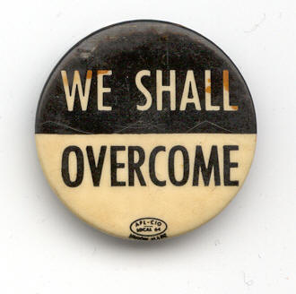
Have a guess!
→ To overcome???

Slide 5
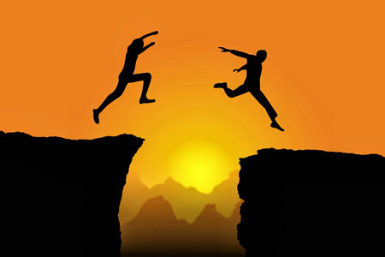
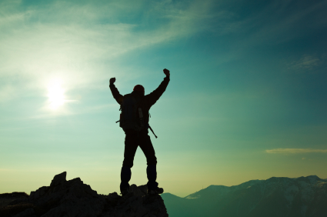
If you manage to go OVER an obstacle, you overcome it.

Slide 6
Step 2: Listen to the song again & watch
 Talk about the pictures in the video.
 → ''On one picture, I can see… On another picture, I can see… there is / are…''

Slide 7
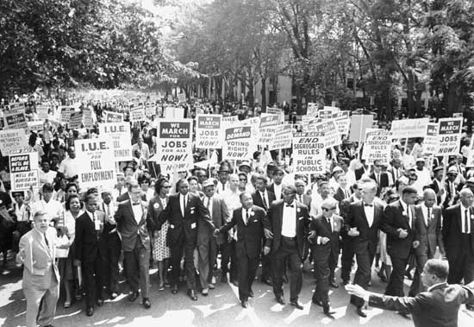
To demonstrate
A march

Slide 8
On the pictures, we can see black and white
people demonstrating together for equality,
against racism. We can also see a badge that
says ''March on Washington for Jobs and
Freedom''

Slide 9
This picture shows the March on Washington for Jobs and Freedom with Dr. Martin Luther King, Jr. (centre) and thousands of other civil rights supporters on 27th August 1963.

Slide 10
Have a guess!
To overcome in the song means…
to defeat racism / segregation

Slide 11
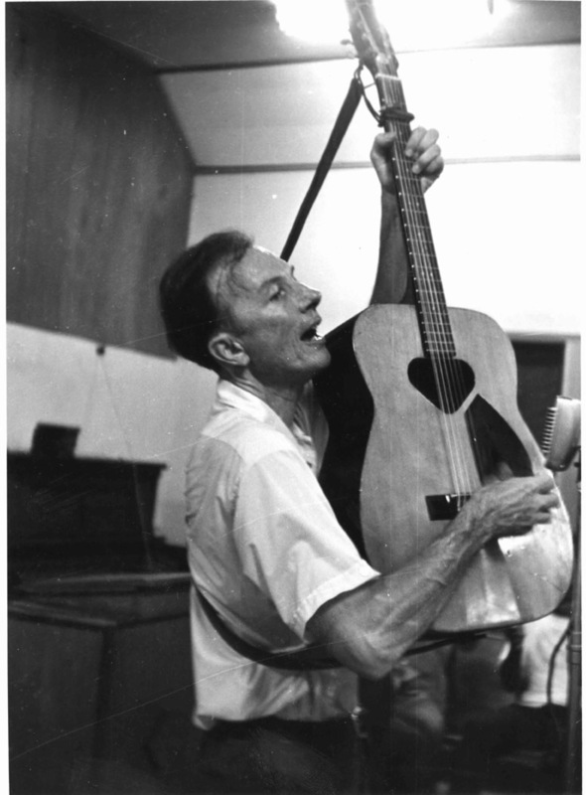
Wait a minute! We still don't know who the singer is!

Slide 12
                Pete SEEGER (1919-2014)
                He was an American folk singer and activist.
                He wrote and sang songs about social change, civil rights, peace and non-violence.
                He can be considered one of the most important protest singers of all time.

Slide 13
Step 3:  Your turn to write!
''We Shall Overcome'' is…

Slide 14
Step 3:  Your turn to write!
''We Shall Overcome" is a protest song that became one of the anthems of the African-American Civil Rights Movement. It was originally written by Charles Albert Tindley, who was African-American preacher. The precise date of composition is still unknown today.
Pete Seeger and other famous folksingers in the early 1960s, such as Joan Baez, sang the song at rallies, folk festivals, and concerts in America. The song is still sung today in a variety of protests worldwide.

Slide 15
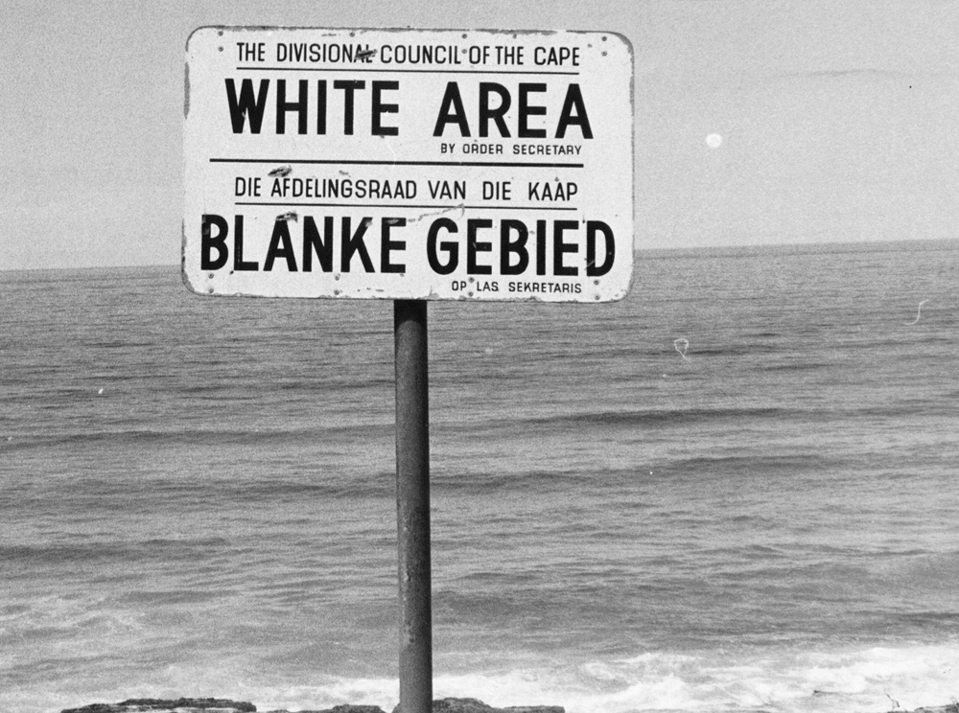
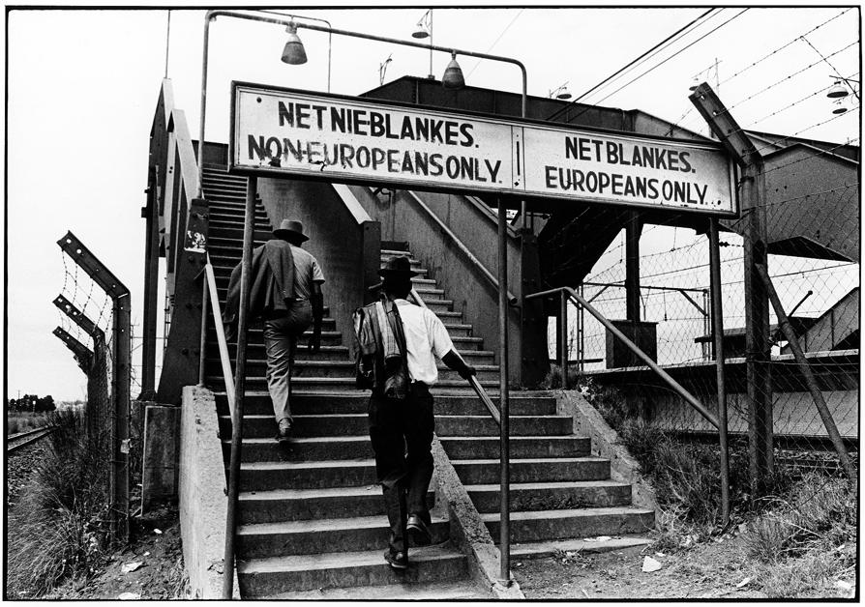
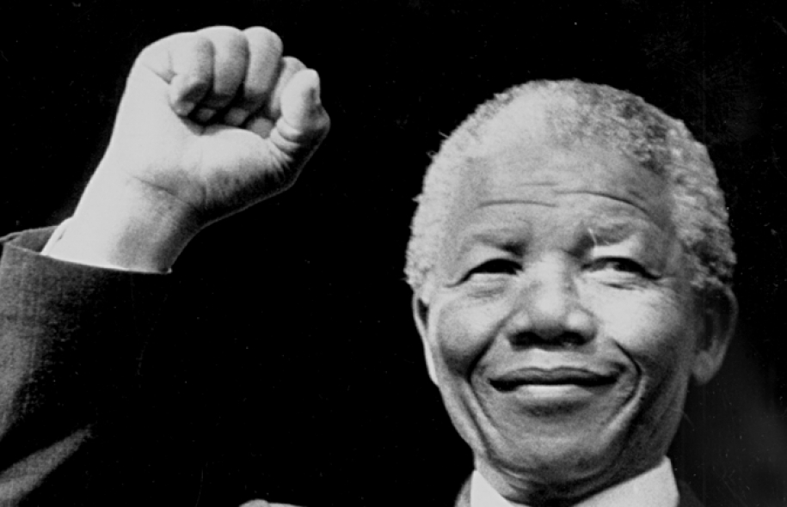
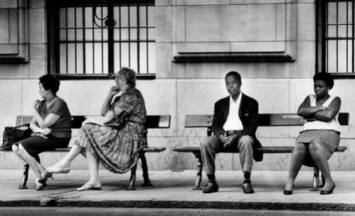
Let's take another look!

Slide 16
Step 4: Listen to another song and  take notes about ...
Peter Gabriel "Biko"
… the topic (le sujet)
→  I think the song is about…
→  Maybe the song is about…
For the champions :
→  The song MAY be about ...
… the title
… the repeated words

Slide 17
Step 5: Listen to the song again & watch
 Talk about the pictures in the video.
 → ''In the video, I can see…
 → ''In the video, there is / are…''

Slide 18
Have a guess!
''Biko'' is about…

Slide 19
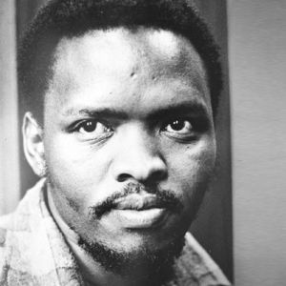
                Steve BIKO (1946-1977)
                He was an South African anti-apartheid activist.
                He founded the Black Consciousness Movement to mobilize people against apartheid.
                He was famous for inventing the slogan ''Black is Beautiful''
                He was murdered by the white South African police while in custody after he was arrested.

Slide 20
Wait a minute! We still don't know who the singer is!

Slide 21
                Peter GABRIEL (born 1950)
                He is a British singer-songwriter who used to be the lead singer in the band Genesis.
                He was one of the first musicians to support and develop world music.
                He is a committed singer who supports humanitarian efforts and he is politically involved for the defense of human rights.

Slide 22
 Let's write a CONCLUSION!
 Say what Pete Seeger's song ''We Shall
Overcome'' and Peter Gabriel's song ''Biko''
have in common.

