Slide 1
Dialogue of the gods
theatre

Slide 2
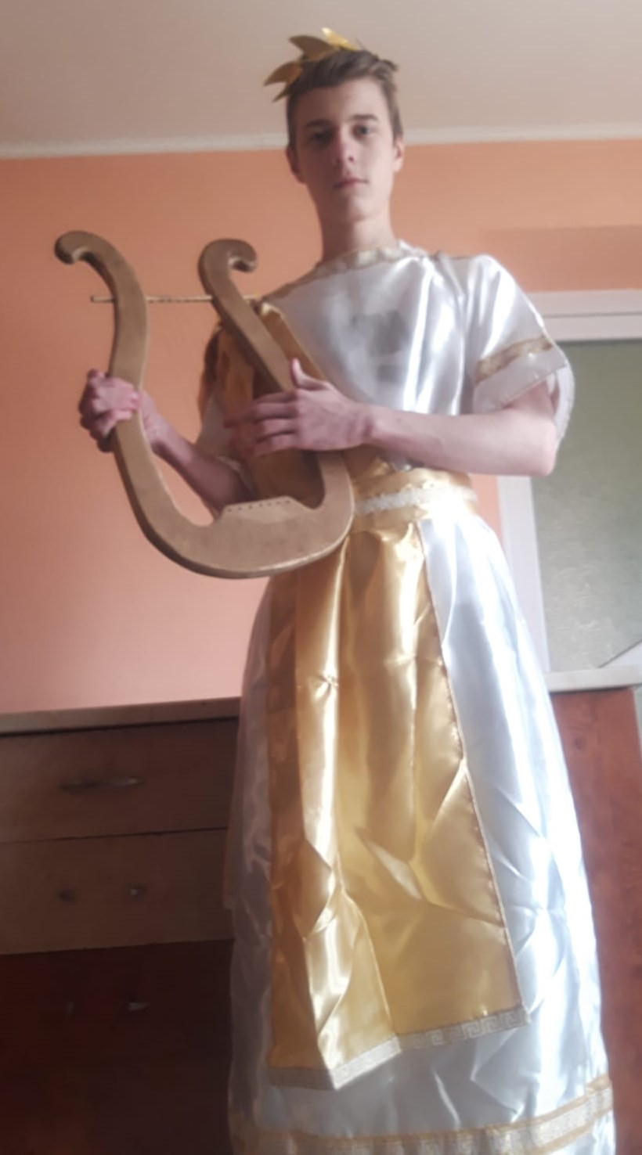
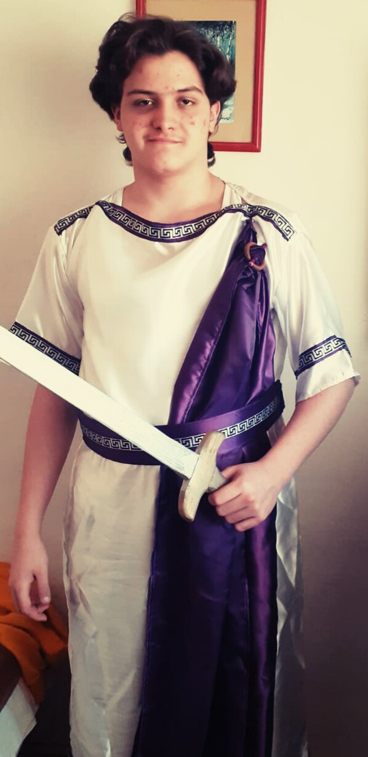
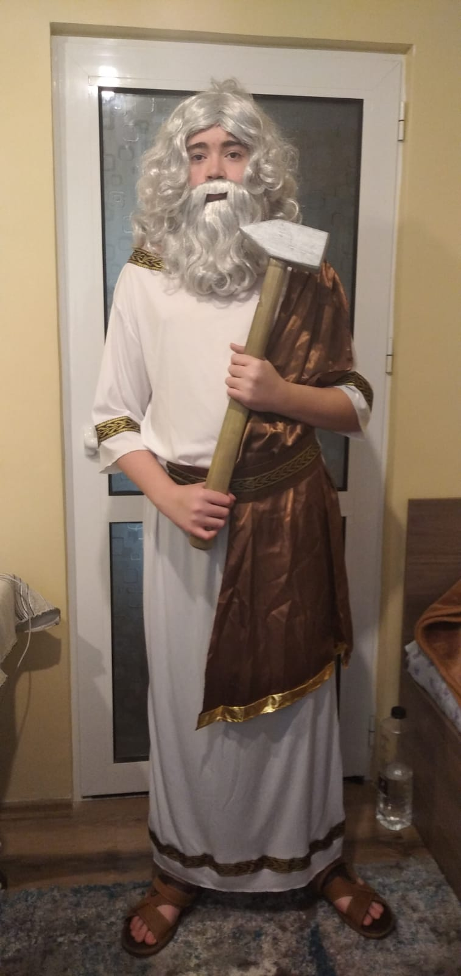
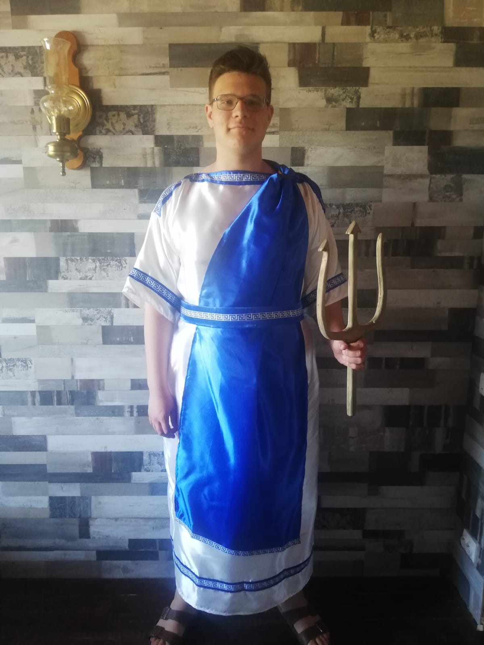
Never before had the gods of Mount Olympus had to deal with such a deceiving little creature. A trickster, but a little innocent boy at the same time, the son of Maia and Zeus loved playing pranks on the sacred but arrogant deities of the Greek mountain. His name was Hermes. Sometimes good, sometimes evil, and the protector of human heralds, travellers, thieves, and merchants.
Today the little prankster is terribly bored. He probably thinks the other gods are bored as well. He says to himself: ‘What would happen if….some of their things disappeared?’ He is so excited at that thought! So, he chooses his victims: Apollo, Ares, Hephaistos, and Poseidon.
Watch what happens!
APOLLO
ARES
POSEIDON
HEPHAESTUS

Slide 3
HEPHAESTUS Have you seen Maia's baby, Apollo? such a pretty little thing, with a smile for everybody; you can see it is going to be a treasure.
APOLLO That baby, a treasure? well, in tricks and bad behaviour, all the practical jokers in the world are young compared to him. Here I am, feeling useless and deceived by a little child. My lyre has been missing for some days and mortals are sad… Greece has been deprived of my music, they are no longer dancing and singing in the streets or in their homes. They have forgotten about arts and their lives slowly become sad and boring. I am sure that soon, having nothing else to do to make the world more beautiful, they will slowly become loyal to war and bloody sea adventures, to Ares and Poseidon…

Slide 4
ARES, entering the stage
What are you saying there? HA! Leading them into the battle? You talk about wars? How can they win a war when my victorious sword is missing? I can’t find it anywhere I am sure that the most crafty among all thieves and the most diabolic of all gods has taken it…
APOLLO
Nope! Not even close…
ARES
Was it Hera, as a revenge…I forgot to visit her…
APOLLO
You are mistaken…
ARES
Was it Aphrodite? I haven’t bought her a gift lately…
APOLLO
You are dreaming…

Slide 5
ARES
I know! It is Athena, she wants to be a better warrior than I am…I knew it! All that thinking, planning…she finally realised that she needed brutal force, not wisdom…
APOLLO
In your dreams! It is Maia’s baby!
ARES
HA HA HA, don’t make me laugh! This is the best joke I have heard so far, and I know you aren’t good at making jokes. By the way, where is your lyre?
POSEIDON
Apollo is right! It was yesterday when I heard a conversation between Hephaestus and that little…what’s his name…Maia’s baby…Hermes!

Slide 6
HEPHAESTUS
What…did you hear?
POSEIDON
He was asking you to make him a swimming suit so he would look like a fish!
HEPHAESTUS
I thought he wanted to learn how to swim! He looked so innocent and I could not refuse him…
POSEIDON
Well…my mermaids told me that a beautiful, majestic fish like they have never seen before, with blue and green steel scales, was swimming round the box where I keep my precious trident!
HEPHAESTUS
Yes…I can see you have left it in the box today…
POSEIDON
No…take another guess!

Slide 7
HEPHAESTUS
You…took it to the cleaners’ to have it all nice and shiny?
POSEIDON
Ummmm, no…
HEPHAESTUS
You gave it to Zeus to play with it a bit because he was sick and tired of listening to Hera all day long?
POSEIDON
Don’t mention her! She has this special gift of hearing all the bad things said about her…and she comes right away!
NO! I will tell you what happened, but I think you already know…from Apollo and Ares…you helped Hermes turn into a fish and he stole my precious trident!
HEPHAESTUS Why, what harm can it do, only just born? I am sure that once he gets bored with the lyre, sword, and your trident, he will return them!

Slide 8
ARES Ah, you will find out, Hephaestus, if he gets within reach of you. He is not going to return them! He keeps them in his hiding forever! But of course…why would you care? You helped him, he is your little friend! He won’t take your tools! He hasn’t been playing with your hammer and anvil!
HEPHAESTUS He has been.
ARES Well? all your tools safe? none missing?
HEPHAESTUS Of course not.
ARES I advise you to make sure.
HEPHAESTUS Oh, no! Where is my hammer? I can’t make weapons anymore. And I need to work today! I must make a new bow and arrows for Artemis, a new helmet for Athena and a horse for Ares!

Slide 9
APOLLO
A horse for Ares? As a weapon?
ARES
Yes, it is a special horse…my idea! You put your soldiers inside and present it as a gift to the enemy. As soon as they let it in the city, the soldiers get out of it and conquer the fortress.
APOLLO
What a stupid idea…better let Athena have it! She will surely lose all wars.
POSEIDON
Listen! Who cares about that nonsense? I need my trident! It is more important than your…horses! I can’t let my people sail the waters anymore (points to the audience) The waves do not listen to me anymore. The earth is shaking and I cannot control it! Soon, people will think I am weak and they will lose their trust in me. They will laugh at me. They will say Athena is more powerful! I can’t allow it.
ARES Oh, Poseidon, your pride is not the most important thing! Look at them! They don’t celebrate arts anymore, they can’t go to war or sail on the blue sea. We really need to get a hold of that little boy! Hephaestus, where can we find him?

Slide 10
HEPHAESTUS
I don’t know!
ARES
What do you mean? He is your friend!
HEPHAESTUS
I thought he was! Look…I am lame, no god wants to talk to me…but this child’s innocence, I looked him in the eyes…he liked me, although I look like this! I thought he was a true friend!
APOLLO
No, he tricked you! So you would help him steal things!
HEPHAESTUS
I don’t know where he is. He is fast and I can’t see where he runs. More than that, he went into the skies, on land and in the deep waters, there are no boundaries anymore!
POSEIDON
Have you heard that? What was it? A hurricane? Troubles in the sky?
HEPHAESTUS
No, it was him! I know how he moves, what he sounds like!

Slide 11
Ares:
Look in that cave over there! Something is shining close to the entrance! And I think I can hear the faint sound of a lyre.
Apollo : Yes! Yes! I can hear it as well… let’s have a look! (searches for and finds his lyre): Oh, here it is! But what is this? It looks like a letter…to me? (opens it) It says: ‘Physical beauty is a passing thing…give the people more music and more sun! Live through them and love them! Your perfection doesn’t mean much if they don’t cherish you.”
Poseidon:
Here is my trident, I found it! What is this, a note? ‘Relax and don’t be hasty! Make waters friendly for the people, do not let the waves be their enemy but a source of joy and admiration.’
Ares:
I finally found my sword! Also something written over here…let’s see: ‘Stop the unnecessary fighting! Let the people live in peace and guide them through fights only if needed. They are more creative in times of peace.’

Slide 12
Hepahistos:
And my hammer! (sheds a tear) How beautiful! ‘Don’t forget you are just as beautiful as the rest of them! And noble, because you help everyone. It is what counts the most, remember this. Let your inner beauty shine through!’
Such wise words coming from such a young boy! When the gods are too busy being arrogant, vengeful and overconfident, it is time to listen to the voice of reason!

