Slide 1
Inclusion in Secondary School
2018-1-DE03-KA229 -047219_4

Slide 2
Greek Mythology
The Greeks had numerous gods and many stories and myths that surrounded them.
Greek mythology consists of all the stories and tales about the Greek gods, goddesses and heroes.
It is also the religion of Ancient Greece as the Greeks built temples and offered sacrifices to their major gods.

Slide 3
1. Who was the leader of the Greek gods?
Hera
Zeus
Apollo
Athena

Slide 4
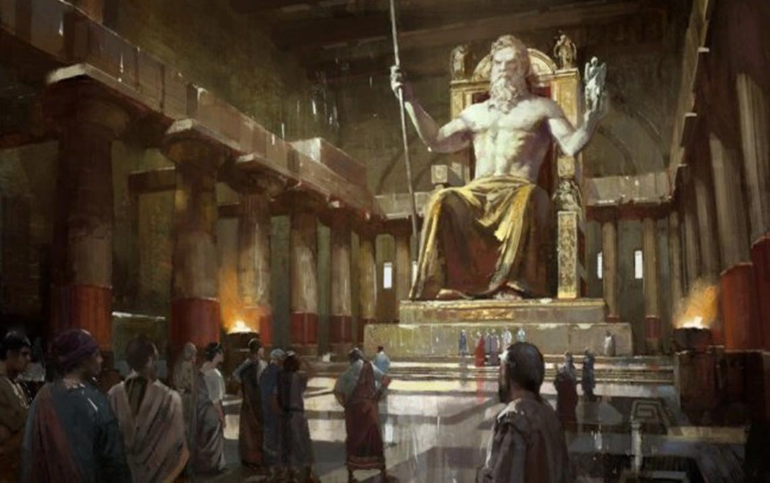
Zeus - Leader of the Olympians and god of the sky and lightning. His symbol is the lighting bolt. He is married to Hera, his sister.

Slide 5
2. What two gods were twin brother and sister?
Zeus and Hera
Athena and Ares
Apollo and Artemis
Aphrodite and Hades

Slide 6
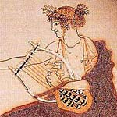
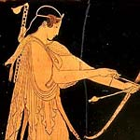
Apollo
Artemis

Slide 7
3.Who were the Titans?
The first Greek gods
Twelve gods that were overthrown by the Olympians
The parents of Zeus
All of them

Slide 8
The Titans were the first or elder gods. There were twelve of them including the parents of Zeus, Cronus and Rhea. They ruled during what was called the golden age. They were overthrown by their children, led by Zeus.

Slide 9
4.Which of the descriptions below best describes the goddess Aphrodite?
Goddess of family and marriage who was queen of the gods
Goddess of love and beauty who was married to Hephaestus
Goddess of the hunt whose symbol was the bow and arrow
Goddess of wisdom and war who was the patron god of Athens

Slide 10
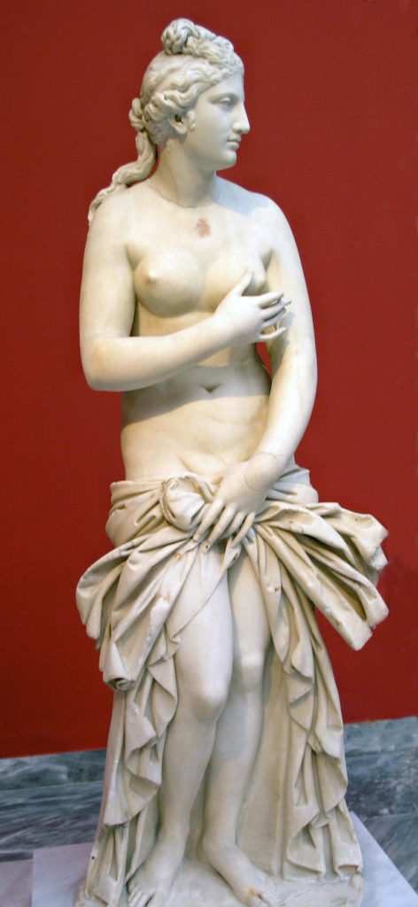
Aphrodite - Goddess of love and beauty.
Her symbols include the dove, swan, and rose.
She is married to Hephaestus.

Slide 11
5. What powerful god lived in the Underworld rather than on Mount Olympus?
Hephaestus
Demeter
Poseidon
Hades

Slide 12
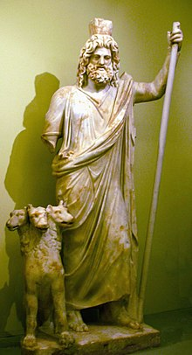
Hades - God of the Underworld. He was a god of the Olympians stature, but lived in the Underworld rather than on Mount Olympus.

Slide 13
6. What Greek hero from Homer`s epic poem the Iliad, was invulnerable except for his heel?
Achilles
Perseus
Hercules
Jason

Slide 14
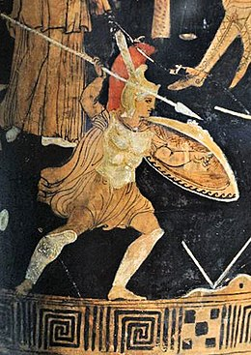
Achilles - The greatest hero of the Trojan war, Achilles was invulnerable except for his heel. He is the central character in Homer's Iliad

Slide 15
7. Which description below best describes the god Poseidon?
God of wine and celebrating, he was the youngest of the Olympians
God of commerce and thieves, he was the messenger to the rest of the gods
God of war, his symbols were the spear and shield
God of the ocean and horses, his symbol was a trident

Slide 16
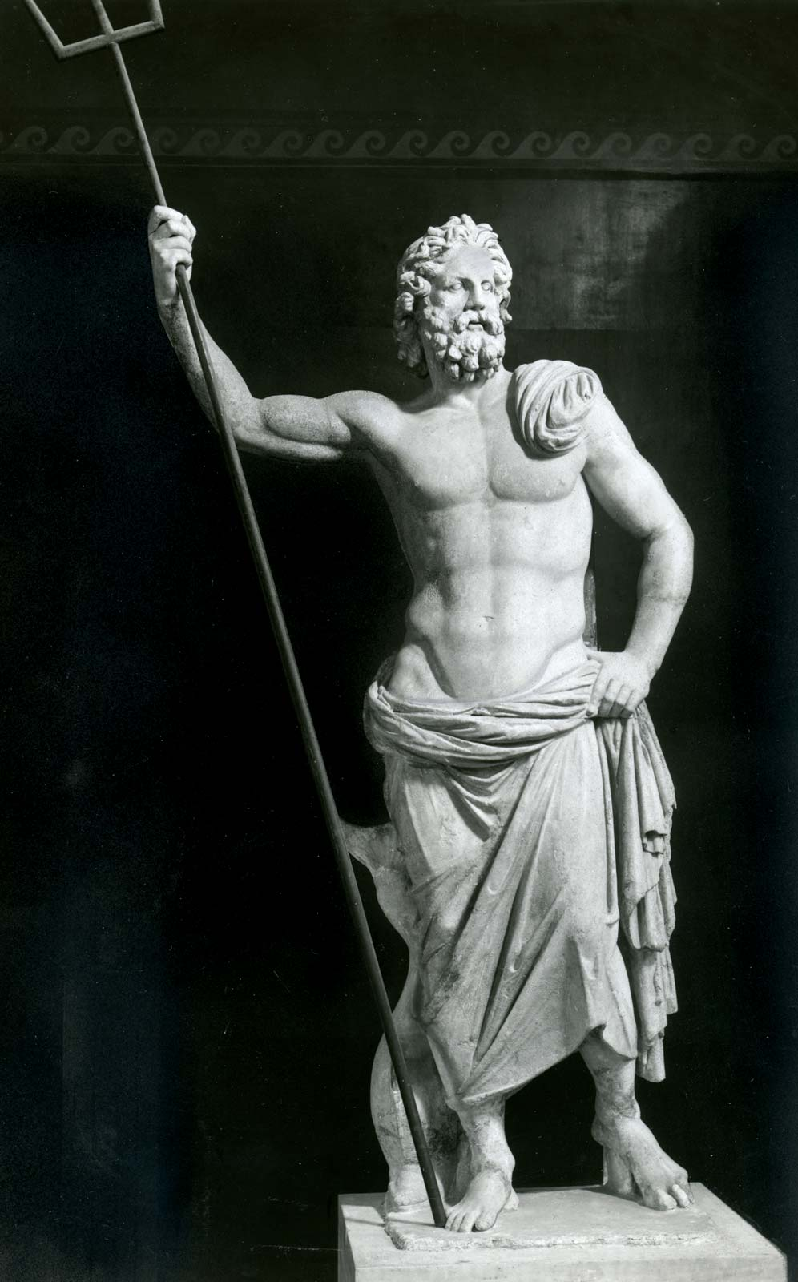
Poseidon - God of the ocean, earthquakes, and horses. His symbol is the trident. He is Zeus' and Hades brother.

Slide 17
8.What Greek hero was a son of Zeus and was required to perform many labors for the gods?
Odysseus
Achilles
Hercules
Perseus

Slide 18
Hercules - A son of Zeus and the greatest hero in Greek Mythology, Hercules had many labors he had to perform. He was very strong and fought many monsters in his adventures.
The king did not like Hercules and wanted him to fail. Each time he made the tasks more and more difficult. The final task even involved traveling to the Underworld and bringing back the fierce three-headed guardian Cerberus.

Slide 19
9. What married brother and sister were king and queen of the Olympian gods?
Zeus and Hera
Artemis and Apollo
Aphrodite and Hephaestus
Ares and Artemis

Slide 20
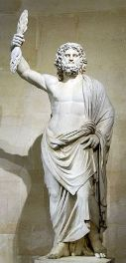
Zeus - Leader of the Olympians and god of the sky and lightning. His symbol is the lighting bolt. He is married to Hera, his sister.

Slide 21
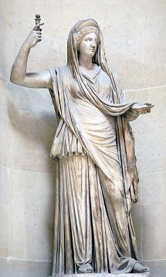
Hera - Queen of the gods and married to Zeus. She is the goddess of marriage and family. Her symbols are the peacock, pomegranate, lion, and cow.

Slide 22
10.Who was the patron god of theatre and art?
Artemis
Dionysus
Athena
Demeter

Slide 23
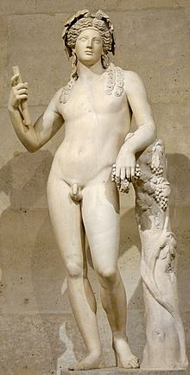
Dionysus - Lord of wine and celebrations. Patron god of the theatre and art. His main symbol is the grapevine. He is the son of Zeus and the youngest Olympian.

Slide 24
11.What Greek god was the Parthenon dedicated to?
Aphrodite
Apollo
Hera
Athena

Slide 25
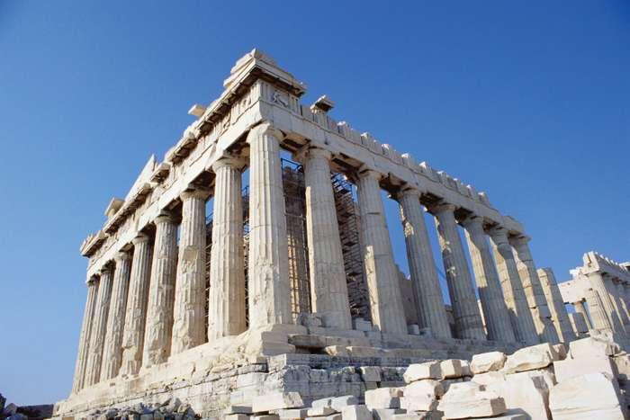
Athena - Greek goddess of wisdom, defense and war. Her symbols are the owl and the olive branch. She is the patron god of Athens.

Slide 26
12.Which order of architecture wasn’t used in ancient Greece?
Doric
Ionic
Franklin
Corinthian

Slide 27
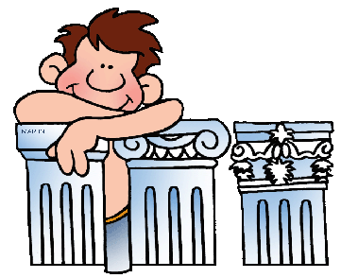
Doric, Ionic, Corinthian were the main orders of architecture in ancient Greece

Slide 28
Congratulations!

