Slide 1
Specific learning disorders
Authors:
Prof. Daniela Gurgu
Prof. Mihaela Chirilă
Prof. Alina Mendelovici

Slide 2
Learning difficulties
disorders manifested
in
the acquisition and use of listening, speaking, reading, writing, reasoning,
mathematical skills and social competence
a dysfunction of the central nervous system
due to

Slide 3
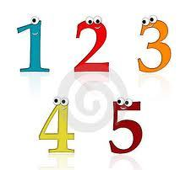
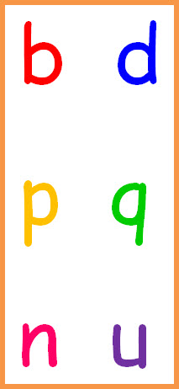
Learning difficulties
affect children
with normal cognitive abilities but who experience specific
academic-related difficulties (reading, writing, mathematical skills)
by lack of exercise or motivation,
by sensorial disorders(seeing,hearing)
by emotional factors or inadequate educational intervention.
are
NOT explained

Slide 4
Basic academic abilities
Lexical acquisition
Dyslexia as a lexical acquisition disorder
Writing acquisition
Dysgraphia as a writing acquisition disorder
Mathematical calculus
Dyscalculia as a mathematical disability

Slide 5
Dyslexia a learning difficulty manifested by problems in
learning foreign languages
comprehending
basic instructions
Pronunciation difficulties;
Verbalize unfamiliar words
Reading below the age standard
establishing the normal sequence of things
perceiving the similarities and differences between letters / words
perceiving the similarities and differences between letters / words

Slide 6
The specific of dyslexia on age levels
Pre-primary school students | difficulty with word pronunciation, vocabulary acquisition, fine motor skills (tying shoelaces, buttoning clothes, using writing tools), with following the logical sequence of events in a story.
Primary school students | difficulties in establish the connection between letters and sounds, in learning the alphabet and the multiplication table, in spelling and reading (letter inversion in words, confusions between similar letters / numbers).
Middle school students | have difficulty in learning / identifying prefixes / suffixes, word roots, in word spelling and composition writing, in narrating events chronologically
High school / college students | have difficulty in reading and writing, in learning a foreign language, in memorizing and understanding instructions, in writing reports and unstructured essays
Adults | struggle with reading and spelling a significant number of words, with task and time planning

Slide 7
Dysgraphia as a disorder in the acquisition of writing
Discrimination disorders and confusions between vowels and consonants
Separation of words into syllables
Syllables omissions – usually of final syllables;
Prepositions and conjunctions omission
Motric disgraphy
Mirror writing
Omissions and substitution of graphemes
Omission of final graphemes
Words omission
The succession of the graphemes
Reversal of graphemes;

Slide 8
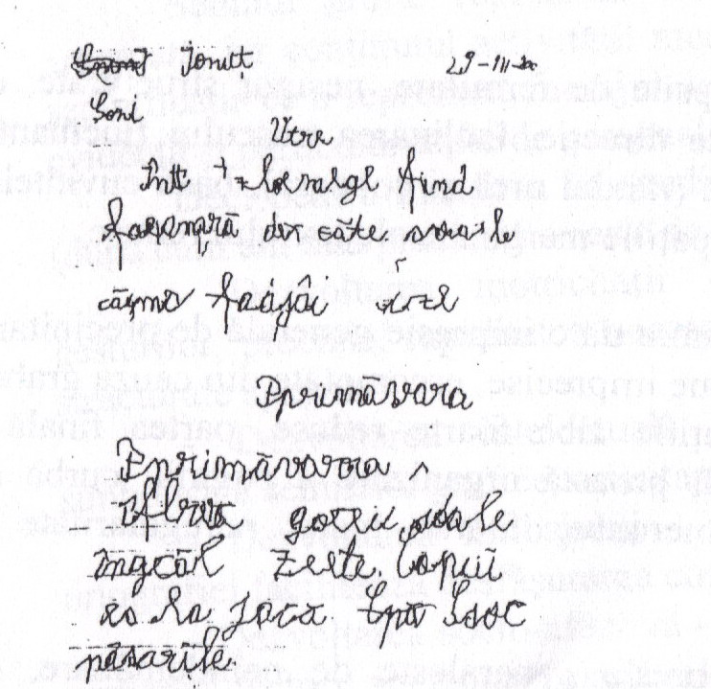

Slide 9
Dyscalculia - disorder in the acquisition of mathematical notions
is the correspondent of dyslexia in mathematics, affecting the capacity of understanding the number concept
the child suffering from dyscalculia is able to prove a
normal level of intelligence or even a level above normal
consists in weak results only as far as mathematics is concerned, without affecting the cognitive functioning.
cannot integrate numbers and their symbols, from the cognitive point of view.

Slide 10
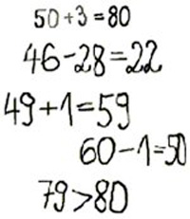
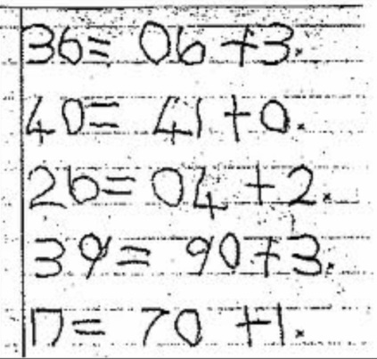

Slide 11
Dyscalculia
studies show
3-6% of the population,
with a tendency to increase the percentage,
which means
there is a chance to meet almost in each class such a student.

Slide 12
How do we know ??
symptoms the child with discalculia may have (Renee M. Newman)
counting: is done mechanically, as a sequence of words, but cannot count reverse or from 2 to 2;
mathematical computation: it is heavy, at a slower rythm than the average and with mistrust in the result obtained, even if it is the right one;
numbers containing 0: understanding that between the words ten, one hundred and a thousand is the same relation as between the numbers 10, 100, 1000;

Slide 13
How do we know ??
symptoms the child with discalculia may have (Renee M. Newman)
the difficulties in using money, such as the fact that he does not understand how to use the money, can not make a financial plan or calculate his budget, can not calculate how much he owes, how much he has to pay for a particular service.
poor ability to synthesize (poor ability to visualize and represent the location of the numbers on the clock, the geographical location of some countries, oceans, streets, etc.) orientation difficulties, hard forms, patterns of things, poor sense of direction
often lose things and often appear to be absent;
difficulty in tracking the score in a game, or difficulty in remembering the rule of tracking the scores of the various games.

Slide 14
Types of dyscalculia
the sequential difficulties, which consist in reversing the order of the figures - e.g.36 understanding like 63
difficulties in reading and writing large numbers, omitting or adding zeros, faulty number alignment in written operations
confusion between operating signs (+ addiction)(- substraction) (X multiplication)(: division), poor retention of arithmetic
deep difficulty with numbers, comparison difficulties.

Slide 15
6 types of DISCALCULIA (Purcia, D.C. 2006)
Verbal D. - difficulties in naming mathematical quantities, numbers, terms, symbols, and mathematical relationships;
Practognostic D. - difficulties in listing, comparing, manipulating the symbolic mathematical quantities;
Lexical D. - difficulties in reading mathematical signs and symbols;
Graphical D. - deficiencies in writing of mathematical signs and symbols;
Ideognostic D. - difficulties in doing mental operations and understanding some mathematical concepts;
Operational D. - difficulties in executing mathematical operations, exercise and problem solving, even if certain mathematical algorithms are mastered.

Slide 16
What to do??
The most effective is multisensitive delivery, including visual, auditory, tactile and kinesthetic modes. Step-by-step delivery of immediate application operations is important, as is the teaching that aims to "diagnose" students, whereby teachers, as they teach, assess their learning. Exercises must be in line with the students' level of education and the teaching method adapted to their unique learning style.
Only a few subjects should be taught at once, and the new concepts must be based on those taught earlier, using the following steps:
in the beginning, the use of concrete objects (calculators, geometric figures, earth globes, toy money) to teach children concepts and operations;
then using drawings and diagrams to represent these concepts;
then abstract concepts.

Slide 17
What to do??
Teach students with dyscalculia multi-sensory strategies to solve the problems of expression, such as creating models or drawings in solving problems.
Use numbers and mathematical symbols in handwriting.
encourage students to use notebooks with squares to write down numbers and signs.
use practical examples to understand the meaning and logic of their responses, then encourage them to wonder if their solutions have a logic.
ask students to solve exercises that involve only a concept or operation, so that they can easily find the solution.
test students with standardized tests against the timer, including marking the correct answer on the test sheet.
help pupils to be motivated by creating charts with their progress and rewarding their efforts.

Slide 18
The "prophylactic rules" (mentioned by D. Ungureanu) which each teacher should observe in mathematical activities with pupils with discalculia, are:
Full clarification of the structure of taught notions;
Clear and complete secularization of each math class:
first making a short summary of the previous time (lesson);
enunciating the new topic to be assimilated;
enumerating the steps and processes involved in learning it;
the conclusion with a brief recapitulative synthesis of those taught in that time.
Flexible attitudes by teachers to facilitate student understanding and generalization;
Using a wide range of methods, procedures, techniques, activities, etc. teaching mathematical information;
Using the algorithmic approach in the classroom for the presentation of each theme, based on the "small steps" principle of the programmed learning;
Using "visual keys" (cassettes, diagrams, schemes, etc.) or at least emphasis to warn and help students in capturing, understanding (decoding), applying and generalizing the information they teach;

Slide 19
Methods to help students
mathematical games;
the repetition of notions and methods of solving the problems that the child can practice at home;
writing on notebooks with squares where numbers are easier to view;
continuous use of rounded numbers, easier to remember,
the provision of concrete and only later examples of abstract ones;
using images in understanding the problems;
use examples of real, everyday life;
reading aloud the math exercises;
using music and rhythm to keep formulas easier.

