Slide 1
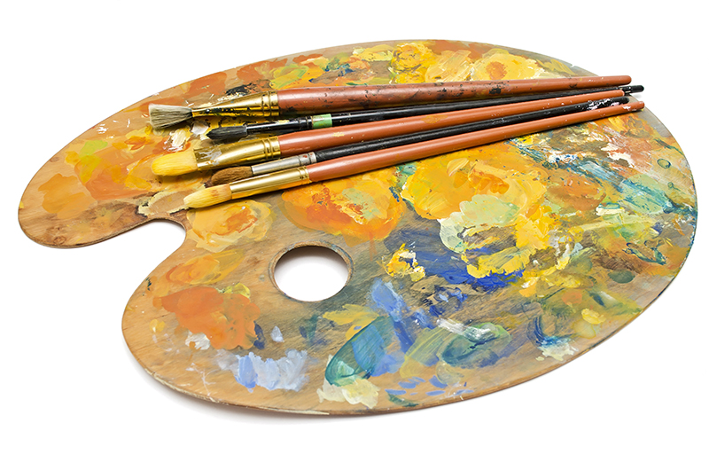
Still-lives in Romanian Painting
Famous Romanian PAINTERS
Nicolae grigorescu
Theodor Aman
Theodor Pallady
Octav bancila

Slide 2
NICOLAE GRIGORESCU(1838 – 1907) was one of the founders of modern Romanian painting.

Slide 3
Studies and artistic work
At a young age (between 1846 and 1850), he became an apprentice at the workshop of the Czech painter Anton Chladek and created icons for several churches and monasteries. In 1861 he received a scholarship to study in France, to Paris, where he studied at the École des Beaux-Arts. He also attended the workshop of SébastienCornu, where he met Pierre-Auguste Renoir.Attracted by the artistic concepts of the Barbizon school, he soon left Paris for that village, where he became the associate of artists such as Jean-François Millet, Jean-Baptiste-Camille Corot, Gustave Courbet and Théodore Rousseau. Under the influence of the movement, Grigorescu looked for new means of expression and followed the trend of en plein air painting, which was also important in Impressionism.

Slide 4
He participated at the Universal Exposition of Paris (1867) with seven works. He exhibited at the Paris Salon of 1868 the painting Young Gypsy girl.
He returned to Romania a few times and starting in 1870 he participated in the exhibits of living artists and those organized by the Society of the Friends of the Belle-Arts. Between 1873 and 1874 he traveled to Italy, Greece and Vienna.
In 1877 he was called to accompany the Romanian Army as a "frontline painter" in the Romanian War of Independence. During the battles, he made drawings and sketches which later used in creating larger-scale works.

Slide 5
In 1889 his work was featured in the Universal Exhibition in Paris and at the Romanian Atheneum. Centerpiece exhibits took place at the Romanian Atheneum would follow in 1891, 1895, 1897, 1902, and 1905.
From 1879 to 1890 he worked in France, especially in Vitré, Brittany and in his workshop in Paris. In 1890 he started depicting pastoral themes, especially portraits of peasant girls, pictures of ox carts on dusty country roads and other landscapes.
He was named honorary member of the Romanian Academy in 1899.

Slide 6
Nicolae Grigorescu – Still-life with lemons

Slide 7
Nicolae Grigorescu – Still-life with woodcocks

Slide 8
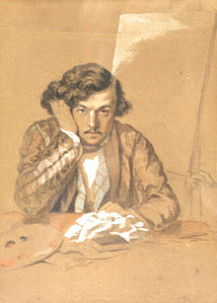
Theodor Aman ( 1831 –1891)
was a famous Romanian painter, engraver and art professor.

Slide 9
Studies and artistic work
After displaying an early affinity for art, he took his first lessonsat Carol I National College. In 1850, he went to Paris, where he studied with Michel Martin Drolling and François-Édouard Picot and he became part of the Romanian revolutionary circles. In 1853 he has his first display at the Salon in Paris, showing his Autoportrait. Influenced by revolutionary ideas, Aman completed the historical themed painting “MihaiVIteazul’s First Night”.

Slide 10
As a result of his strong patriotic sentiments, he participated in the Romanian Revolution of 1848 .
After that, he went to Istanbul in an effort to sell some paintings to the Sultan and visited Sevastopol during the Crimean War, creating history paintings with themes related to Romania's nationalist aspirations. In 1855, he presented one of his best-known works, depicting the Battle of Alma, at the Exposition Universelle.
He returned to Romania in 1857, settling in Bucharest where he starts the foundation of his school the Bucharest National University of Arts .

Slide 11
When he returned home, he was knighted by Prince BarbuDimitrieȘtirbei and presented with a scholarship to continue his studies in Paris, where he came under the influence of the Barbizon school. After a brief stay in Rome, he returned to Bucharest.
In 1864, "National School of Fine Arts" was founded and Aman was appointed its first Director.
Theodor Aman remained headmaster of the school until he passed away. In 1889 and 1890 he displayed his work in exhibits at the New Museum. At this point in his career he chose to focus on painting still life, and small portraits.

Slide 12
Theodor Aman – Still-life with cerises

Slide 13
Theodor Aman – Still-Life

Slide 14
Theodor Pallady ( 1871 – 1956)
was a famous Romanian painter.

Slide 15
Studies and artistic work
At a young age, his family sent him to Dresden, where he studied engineering at the DresdenUniversity of Technology between 1887 and 1889. At the same time, he studied art with ErwinOehme, who, recognising his artistic intuition, suggested that he go to Paris.
In Paris, Palladyenrolled in the Academy of Fine Arts . In 1892 he joined Gustave Moreau’s studio where he worked alongside painters such as Henri Matisse( with whom he developed a close friendship), Georges Rouaultand Albert Marquet.

Slide 16
In 1900, he presented his work “ The Prodigal Son”, at the Exposition Universelle, which earned him high praise. He opened a studio in Paris, on Place Dauphine, where he worked until 1940, traveling often between France and Romania.
In 1904, Pallady returned to Romania, where he held an exhibition at the Romanian Athenaeum. However, he maintained close connections with Paris, where he continued to hold many personal exhibitions, up until World War II.

Slide 17
Pallady never lost the contact with Romania and had friends from the community of Romanian artists and intellectuals living in Paris, including Benjamin Fondane, GeorgeEnescu, ConstantinBrâncuși, CamilRessu, NicolaeDărăscu, TraianVuia, Eugène Ionesco, Emil Cioran.
In 1940 he moved to Bucharest, where he died on 16 August 1956.

Slide 18
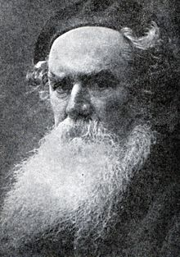
OctavBăncilă (1872 – 1944)
was a Romanian realist painter.

Slide 19
Studies and artistic work
After completing primary school, he entered the Fine Arts School in Iaşi, graduating in 1893. Between 1894 and 1897, he lived and studied abroad on a scholarship: first in Italy and France, and finally in Germany, where he studied at the Akademie der BildendenKünste in Munich.

Slide 20
Upon his return, he opened a studio in downtown Iaşi and began exploring his major themes: the lives of peasants, factory workers, impoverished Jewish traders and artisans, conscripted soldiers and of nomadic Roma people. Impressed by the outcome of the 1905 Revolution in the Russian Empire, he was soon active in socialist circles and became a major intellectual figure on the Left. In 1907, following the crushing of the Romanian Peasants' Revolt, Băncilă began traveling the country and attempting to gather evidence of government repression and violence. The result was a series of twelve paintings , including his famous figure of an old peasant standing open-armed (titled "Before 1907"), several images of dead bodies piled up in fields and the eponymous 1907, depicting three ragged peasants running into rifle fire.

Slide 21
Following the outbreak of World War I, he became involved in pacifist causes, using his work to comment on the results of conflict. In 1916, he was appointed professor at the Fine Arts School in Iaşi (a position he kept until his retirement in 1937).
He remained critical of social and political developments inside Greater Romania, was supportive of strike actions and used his art to attack anti-Semitic trends in Romanian society. Towards the end his life, he became to sympathise with communism.

Slide 22
Octav Bancila – Still-life

Slide 23
Octav Bancila – Still-life with peaches

