Slide 1
Oktoberfest Food
Bavarian specialities
(traditional bavarian food and drinks)

Slide 2
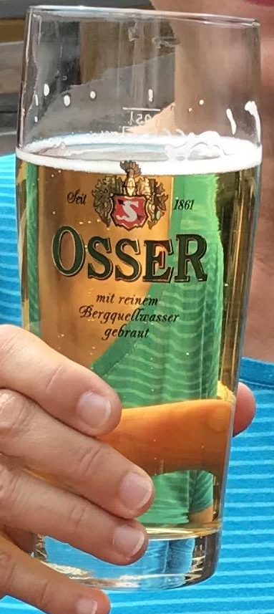
Radler
Radler is a mixture of 50% beer and 50% lemonade. Main ingredient is water. It also contains alcohol from the beer and sugar from the lemonade.
It was invented by a innkeeper because there was not enough beer for a big group of cyclists.

Slide 3
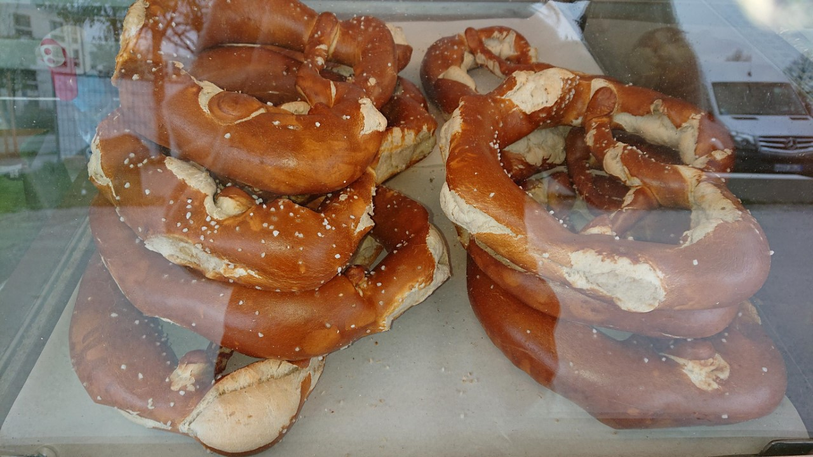
Brezen
Brezen is mostly 420g bread flour and 120 ml warm water.
The pretzel has been in use as an emblem of bakers and formerly their
guilds in southern German areas since at least the 12th century. Within the
Christian Church, pretzels were regarded as having religious significance for both ingredients and
shape. Pretzels made with a simple recipe using only flour and water could be eaten during Lent[14] when Christians were forbidden to eat eggs, lard, or dairy products such as milk and butter. Soft pretzels were introduced in the U.S. by German immigrants in the late 18th century, and grew quickly in popularity. These salty snacks are delicious on their own, but we love to use them as breadcrumbs and add them to sweet treats.

Slide 4
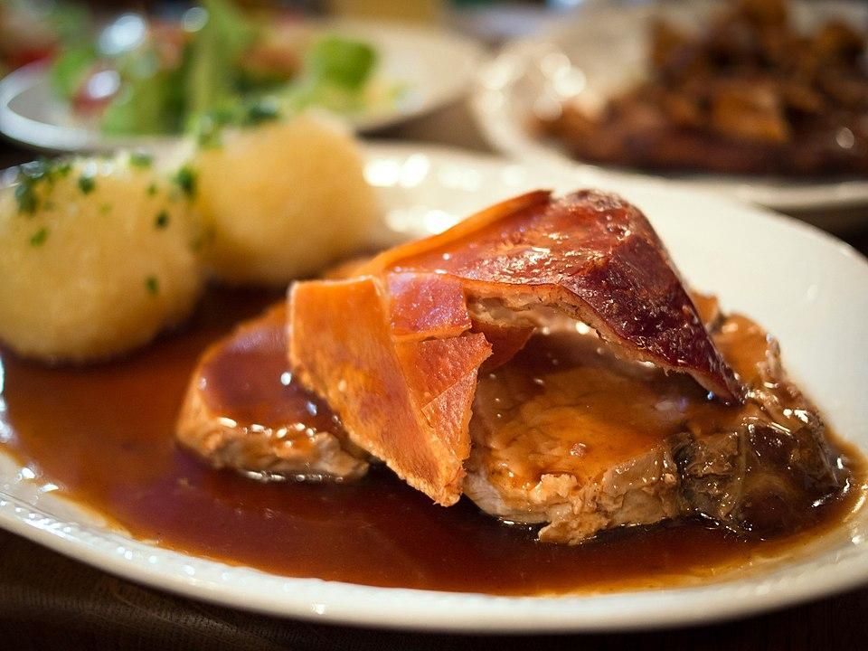
Schweinebraten

Slide 5
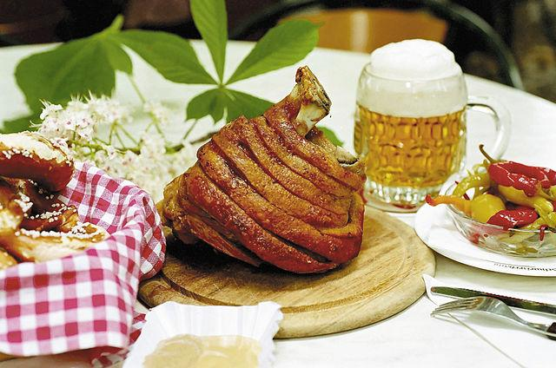
Schweinshaxe

Slide 6
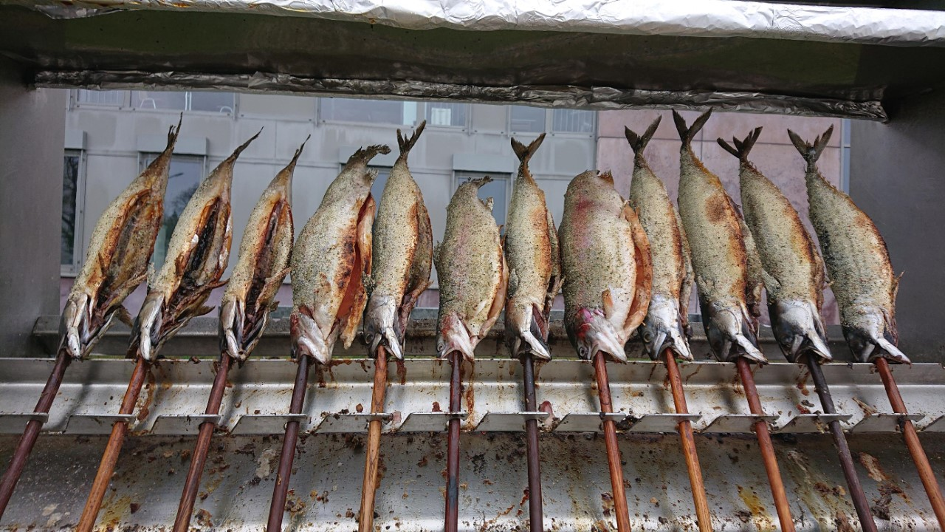
Steckerlfisch

Slide 7
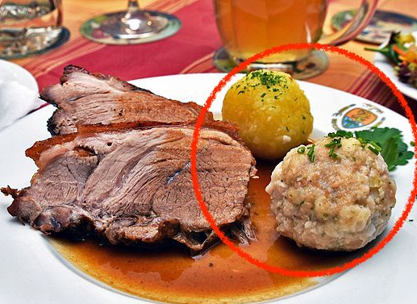
Knödel

Slide 8
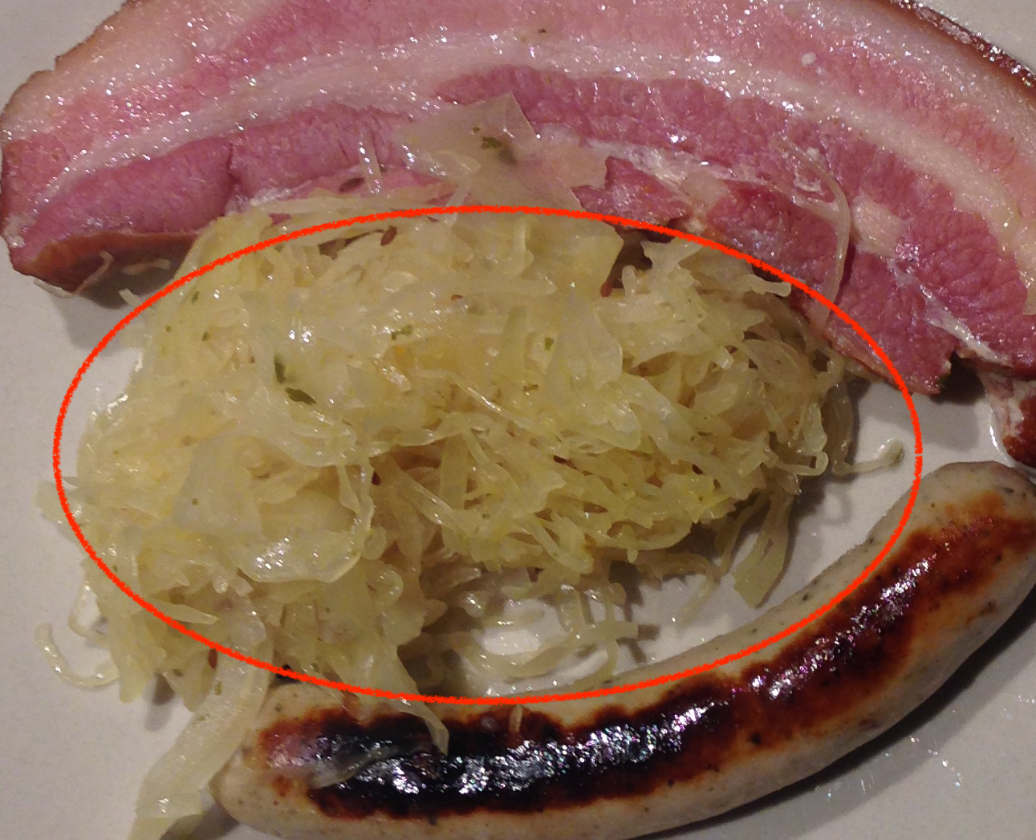
Sauerkraut

Slide 9
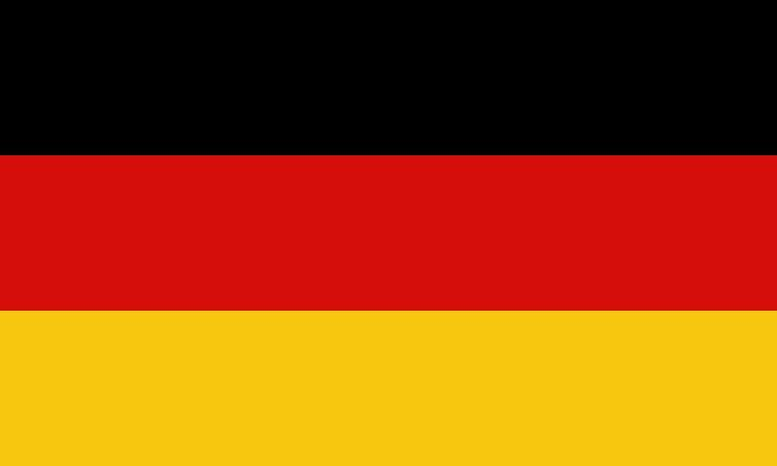
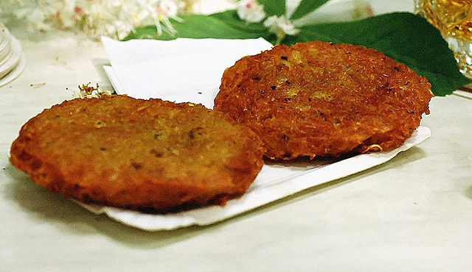
Reiberdatschi

Slide 10
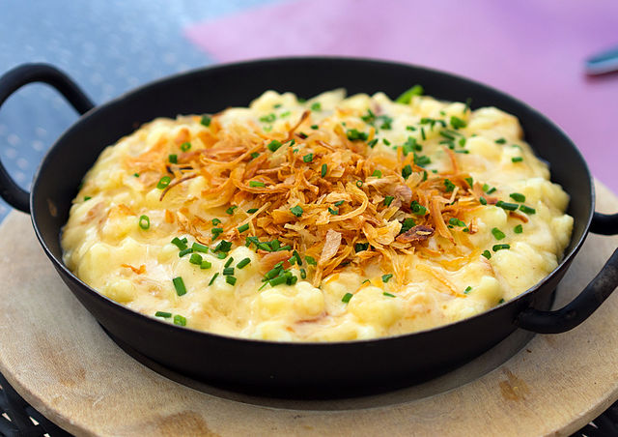
Käsespätzle

Slide 11
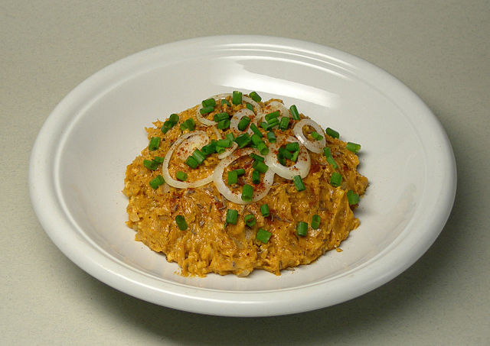
Obazda

Slide 12
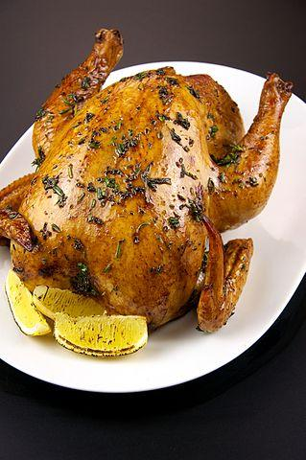
Grillhendl

Slide 13
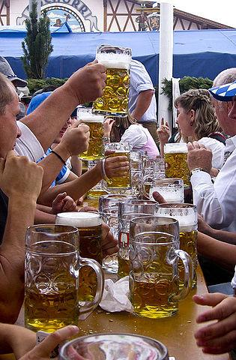
Wiesnbier

Slide 14
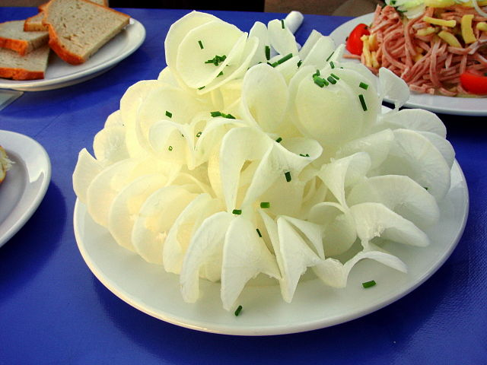
Rettich

