Slide 1
Inclusion in secondary school

Slide 2
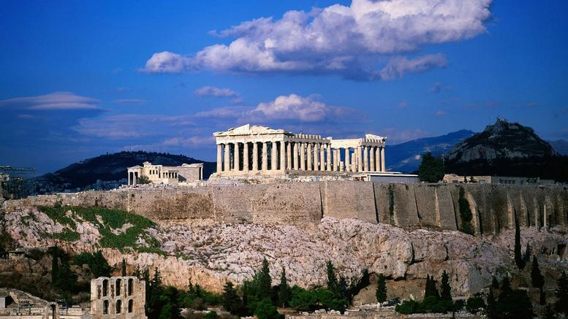
VIRTUAL Mobility in Athens
12-16 APRIL 2021

Slide 3
First Day Monday 12th of April
We welcome you to our school (virtual tour).
Getting to know each other on line.
Video about the city of Athens.
On line quiz about Athens: let’s see who is going to be the winner!

Slide 4
Second Day Tuesday 13th of April
Presentation of the activity prepared by the German team.

Slide 5
Third Day Wednesday 14th of April
Presentation of the activity prepared by the Romanian tram.

Slide 6
Fourth Day Thursday 15th of March
Presentation of the activity prepared by the French team.

Slide 7
Fifth Day Friday 16th of April
Presentation of the activity prepared by the Greek team (working with ancient myths).
Video with the presentation of a traditional Greek recipe… Stay tuned!!
Video with a traditional Greek dance prepared by our students and their physical education teacher.
Saying Goodbye!!

