Slide 1
Fairy tales and gastronomy
What if the heroes of fairy tales had the chance to cook?

Slide 2
Folktales
Folktales help the community to maximize their strengths. They develop their weaknesses into strengths and threats into opportunities. As folktales are figurative in nature, their comparison with various facets of life is expressed metaphorically. They identify culture which is learned and shared by all members of the community. They conceal the deeper meaning which is unambiguous in speech or writing and are truthful.

Slide 3
Folktales
They may be as old as the hill, but they contain real issues about life in general and human nature in particular which people have observed. The way in which folktales are composed, distinguish them from other parts of oral art. Through the folktales, people gain their cultural heritage which, to a great extent, determines their further thinking, desires and attitudes. They form a project which is seen as problems from real life and studied in detail from various possible angles.

Slide 4
Fairy tales and gastronomy
Food plays a magical role in lots of fairy tales and it generally serves one of the following: wish-fulfillment, fortune, misfortune, test, or challenge.
Who is your favorite fairy tale character? What recipe would you pair them with?

Slide 5
Little red riding hood-GERMANY

Slide 6
Little red riding hood-GERMANY
What recipe would the little red riding hood prepare for the big bad wolf in order to convince him to let her grandma free and why?
Use an appropriate picture from the web and justify your answer…

Slide 7
Snow-white-FRANCE

Slide 8
Snow-white-FRANCE
What would the seven dwarfs cook in order to persuade snow-white’s stepmother to break the spell she performed on Snow-white and why?
Use an appropriate picture from the web and justify your answer…

Slide 9
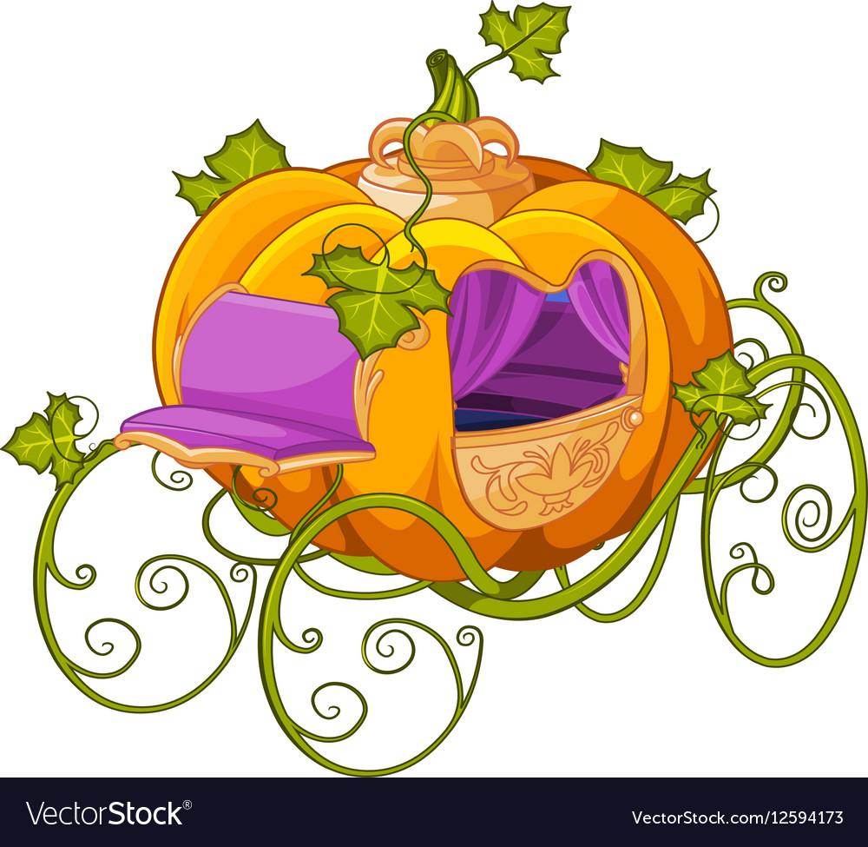
Cinderella-Romania

Slide 10
Cinderella-ROMANIA
What recipe would Cinderella cook for her stepmother in order to let her stay at the ball after midnight?
Use an appropriate picture from the web and justify your answer…

Slide 11
Alice in wonderland-GREECE

Slide 12
Alice in wonderland-GREECE
What would Alice cook for the Queen of hearts in order to satisfy her and keep her head?
Use an appropriate picture from the web and justify your answer…

Slide 13
And remember…
Fairy tales are the boiled-down bones of literature. They speak directly and bravely to our needs, arouse our desires, and, best of all, nourish our spirits.
Kali oreksi!

