Slide 1
GODS, PLANTS AND ANIMALS

Slide 2
APOLLO AND HIS SWAN
Apollo rides on the back
of a large swan. This bird
is associated with love,
music, and poetry.
How would you describe a swan?

Slide 3
APOLLO AND THE LAUREL
The laurel wreath that
Apollo wears is a symbol
of victory and honor,
which was used in Greek
times to identify the
victors in athletic
competitions, including the Olympics.
What qualities should an Olympics winner have?

Slide 4
HEPHAESTUS AND THE DONKEY
When Hephaestus returns
to Olympus after being
thrown out by Hera, some
authors / artists portray
him as riding a donkey.
Is the donkey a useful animal?

Slide 5
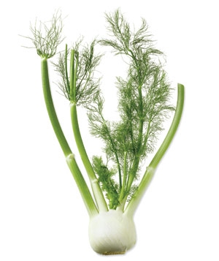
HEPHAESTUS AND THE FENNEL
The slow-burning stalk of the fennel was used in ancient times as a torch and a means to transport fire from one place to the other, thus being very appreciated by Hephaestus.
What other vegetables used from ancient times do you know?

Slide 6
POSEIDON AND HORSES
When Poseidon desired Demeter, she asked him to create the most beautiful animal in the world in an attempt to escape his advances. As a result, Poseidon created the first horse and also became the God of horses.
Do you know the name of a famous horse from Greek mythology?

Slide 7
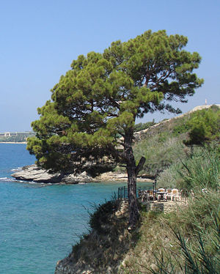
POSEIDON AND THE PINE TREE
At Poseidon’s most famous games held on the isthmus of Corinth, the victors were crowned with pine-tree wreaths.
What other plants would you add to the victor’s wreath?

Slide 8
ARES AND THE VULTURE
The vulture represented Ares because of its violent nature.
Could you name some other animal which you would associate with war?

Slide 9
ARES AND HIS DOG
Ares is associated with a dog because of his cult in Sparta and Thrake; dogs have a great significance in relation to the human soul and its passage through life and death.
What does a dog represent to you?

Slide 10
ATHENA AND THE OWL
The owl was a symbol for Athena, goddess of wisdom and strategy. According to myth, an owl sat on Athena’s blind side, so that she could see the whole truth.
How is Athena different from Ares?

Slide 11
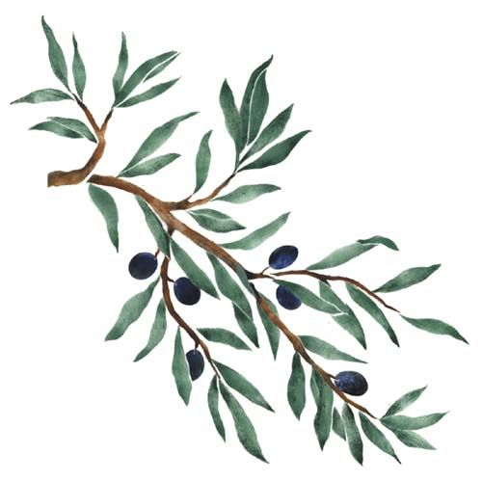
ATHENA AND THE OLIVE TREE
Athena invented the olive tree and presented it as a gift to the city of Athens, thus winning a contest with the god Poseidon.
Why do you think Athena’s gift to the city of Athens was appreciated?

Slide 12
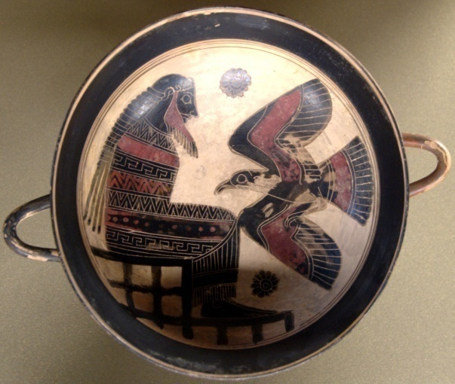
ZEUS AND THE EAGLE
The eagle is the symbol of victory; the emblem of a golden eagle can be found on Zeus’ war standard.
What other symbol would you include on Zeus’ war standard?

Slide 13
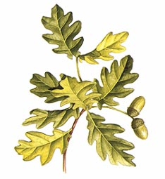
ZEUS AND THE OAK TREE
The oak tree is a symbol of strength, morale, resistance and knowledge. It is often linked to the most powerful gods, like Zeus.
Can you name another Greek god who has an exceptional power?

Slide 14
APHRODITE AND THE DOVE
The affectionate white or turtle-dove was the bird of love, was a bird sacred to the goddess Aphrodite.
What other symbols of love and friendship do you know?

Slide 15
APHRODITE AND THE ROSE
The legend tells that Aphrodite was running after her love interest when suddenly she cut herself and her blood turned a white rose into a red rose.
What other flower or creature would you associate with Aphrodite?

