Slide 1
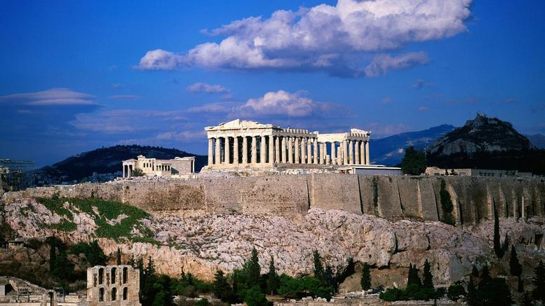
Mobility in Athens
9-13 MARCH 2019

Slide 2
First Day Monday 9th of March
We welcome you to our school
Getting to know each other
Coffee break
Workshop: creating theatre masks
Lunch at River West Mall
Presentation of the activity prepared by the first school in the Aula.

Slide 3
Second Day Tuesday 10th of March
Botanical Garden
Treasure hunt (topic: greek ancient theatre)
Lunch in the Garden Café
Afternoon: Visit of the National and Archaeological Museum of Greece

Slide 4
Third Day Wednesday 11th of March
Activity in the Acropolis Museum (writing task)
Coffee break
Presentation of the activity prepared by the second school either inside the café or outside in a small park.
Lunch
Guided tour in Anafiotika, Plaka

Slide 5
Fourth Day (Thursday 12th of March)
Visit to the Parthenon and the Acropolis’ monuments
Coffee break
Activity about the theatre
Lunch
Athens tour by bus

Slide 6
Fifth Day Friday 13th of March
Meeting point at Choroekfrasi Dance School
Presentation of the activity prepared by the third school at Baroutathiko park at the area of Egaleo
Coffee break
Closure of the program at Choroekfrasi Dance School
Traditional greek lunch
Saying Goodbye!!

