Slide 1
PAINTING THEATRE
Each team has two paintings assigned.
What you need to do is:
Try to find a title for the painting;
Imagine what those people are discussing or thinking about; write a line for each of them;
Come to the front of the classroom and try to ‘act’ the painting; one student should hold a piece of paper with the title of the painting and the actors say the lines, thus giving life to the work of art.

Slide 2
GERMANY

Slide 3
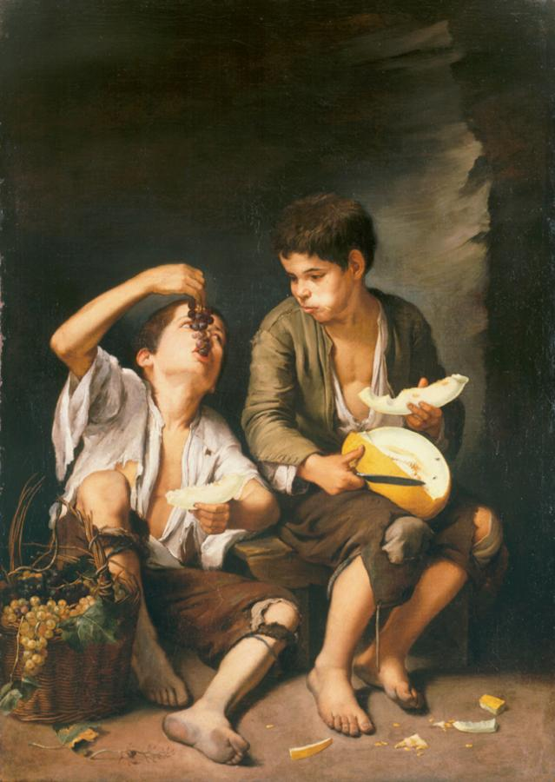

Slide 4
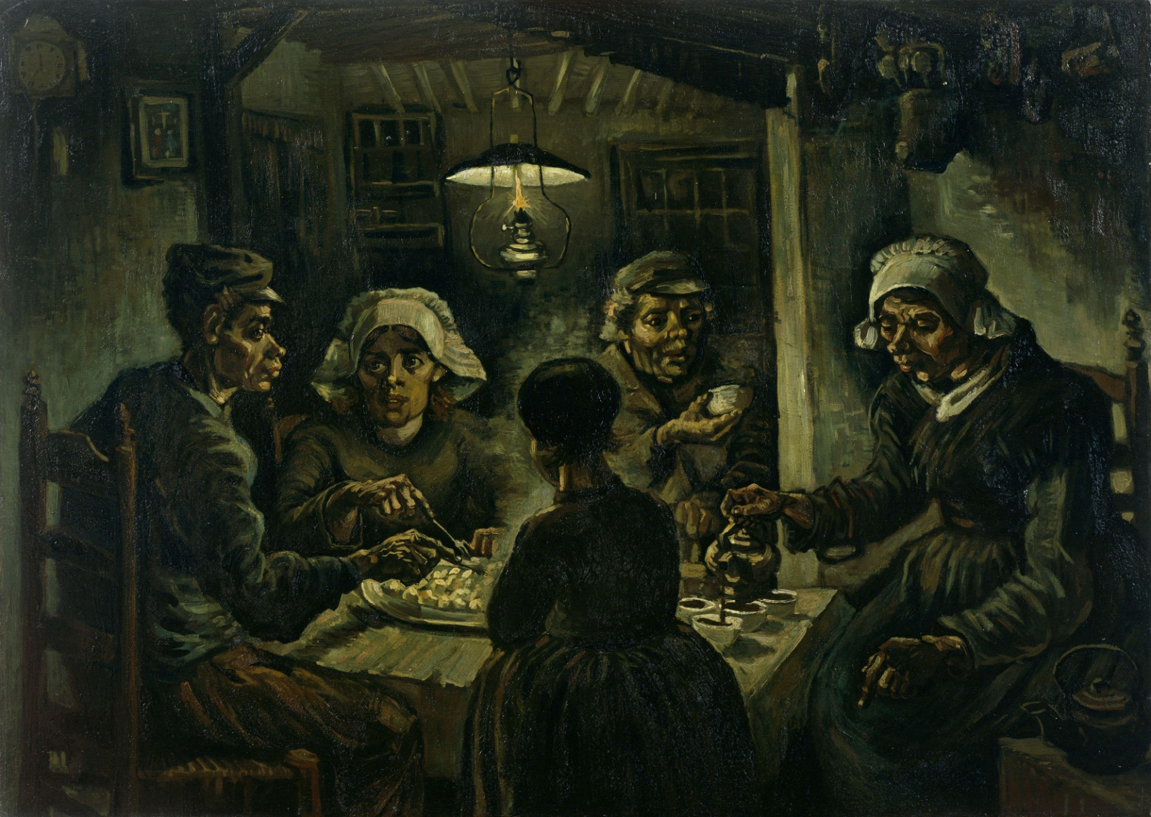
GREECE

Slide 5
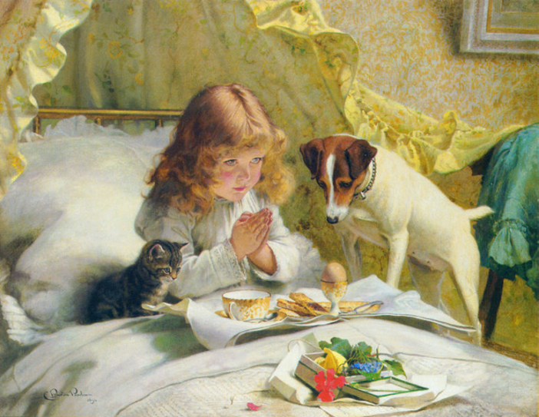

Slide 6
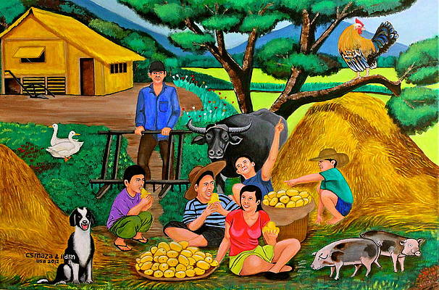
FRANCE

Slide 7
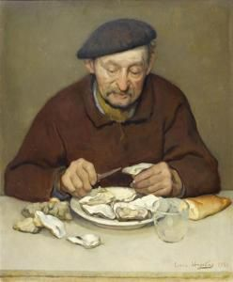

Slide 8
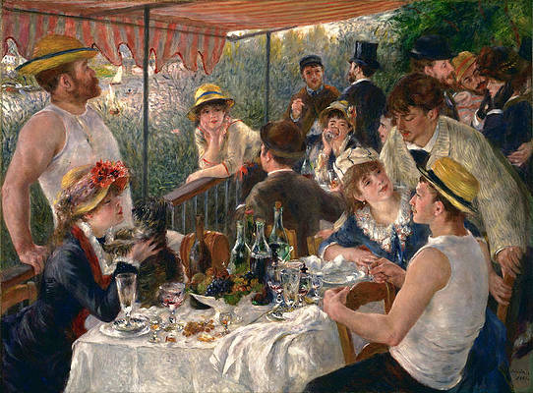
ROMANIA

Slide 9
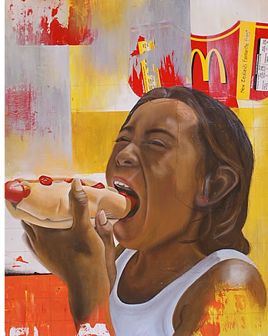
A hotdog? Lovin’ it
I have waited for a McDonald’s in my neighbourhood for a lifetime.
I can finally enjoy a fresh hotdog.
Thanks McDonald’s

Slide 10
The paintings we included and the artists who created them are as follows:
Henri Brispot – Gourmand
Bartolome Esteban – Boys Eating Grapes and Melons
Vincent van Gogh – The Potato Eaters
Charles Burton Barber – Suspense
Cyril Maza – Harvest Time
Louis Vergetas – Man Eating Oysters
Pierre-Auguste Renoir – Luncheon of the Boating Party
Bill Barminski – Fast Food Art (?)

