Slide 1
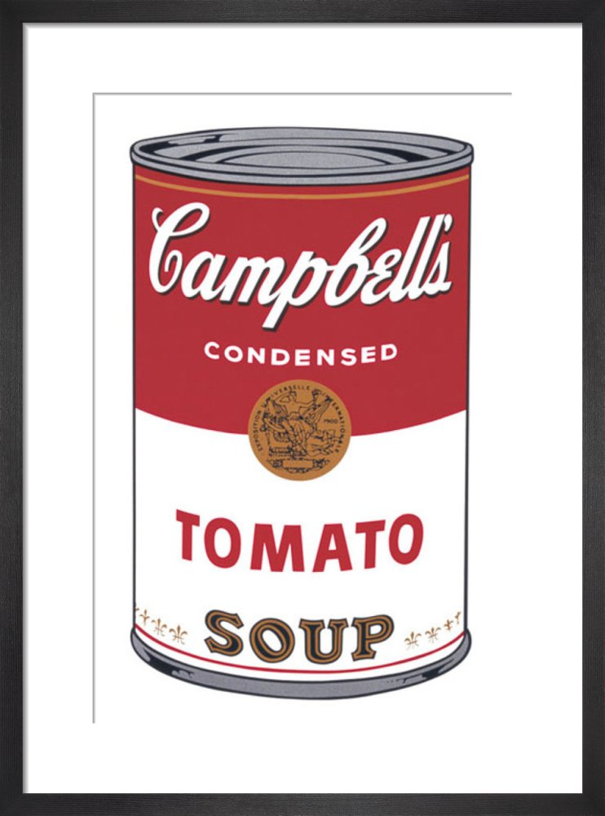
Art and Gastronomy

Slide 2
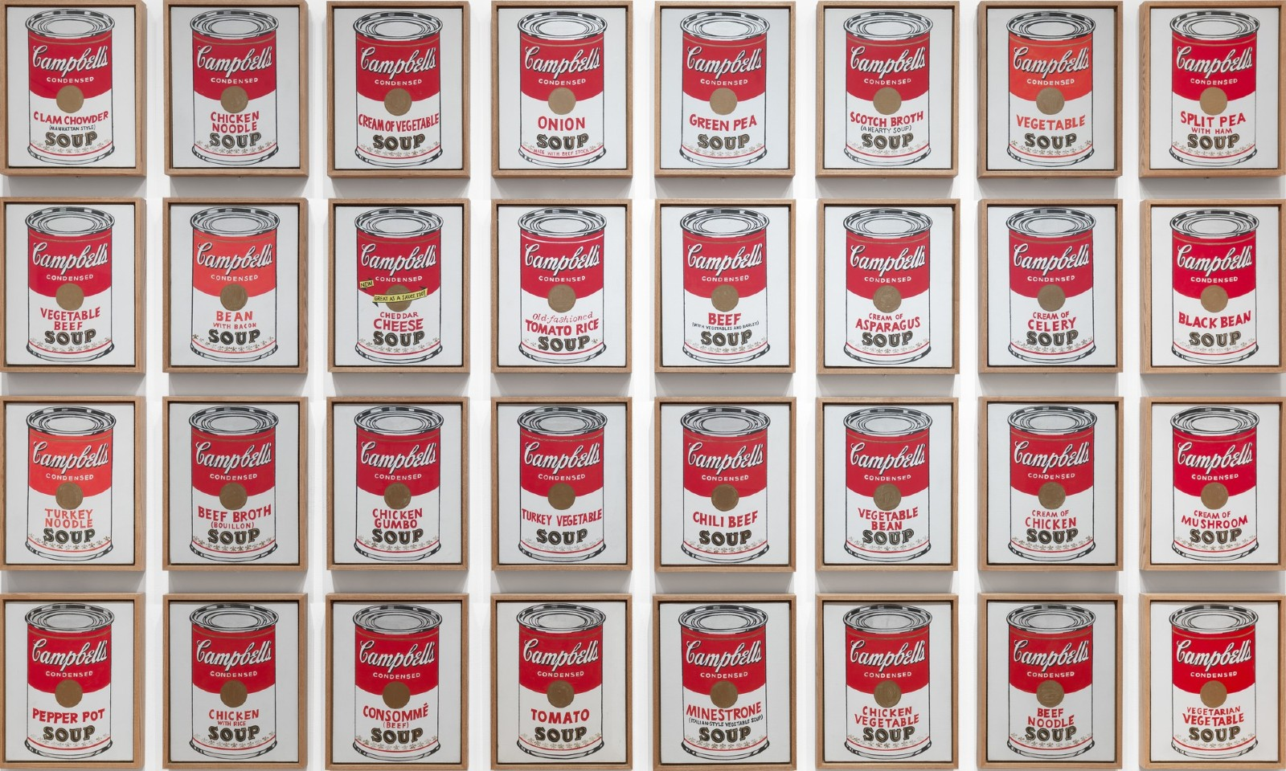
Andy Warhol

Slide 3
Art and Gastronomy
Campbell's Soup Cans (sometimes referred to as 32 Campbell's Soup Cans) is a work of art produced between November 1961 and March or April 1962, by American artist Andy Warhol. It consists of thirty-two canvases, each measuring 20 inches (51 cm) in height × 16 inches (41 cm) in width and each consisting of a painting of a Campbell’s Soup can—one of each of the canned soup varieties the company offered at the time.

Slide 4
Create your own masterpiece!

