Slide 1

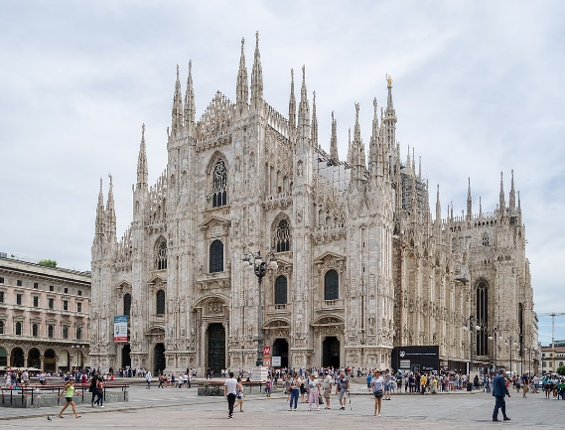
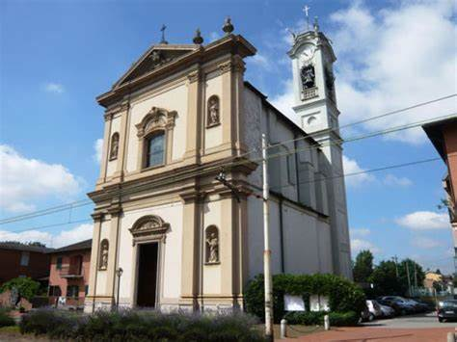
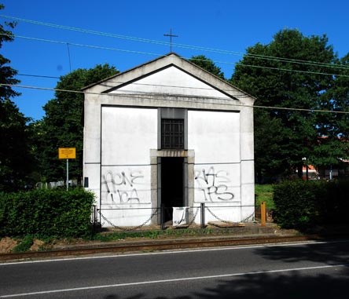

ITALY SECOND MOBILITY
This year we adopted one spire of the Duomo Cathedral in Milan and two unknown churches in Paderno Dugnano.
Our aim is to let these churches being recognised, because this is the most precious Italy.
IIS C.E. Gadda Paderno Dugnano Milan Italy

Slide 2
PILASTRELLO
Oratory of the Blessed Virgin Mary
7m x 6m
IIS C.E. Gadda Paderno Dugnano Milan Italy

Slide 3
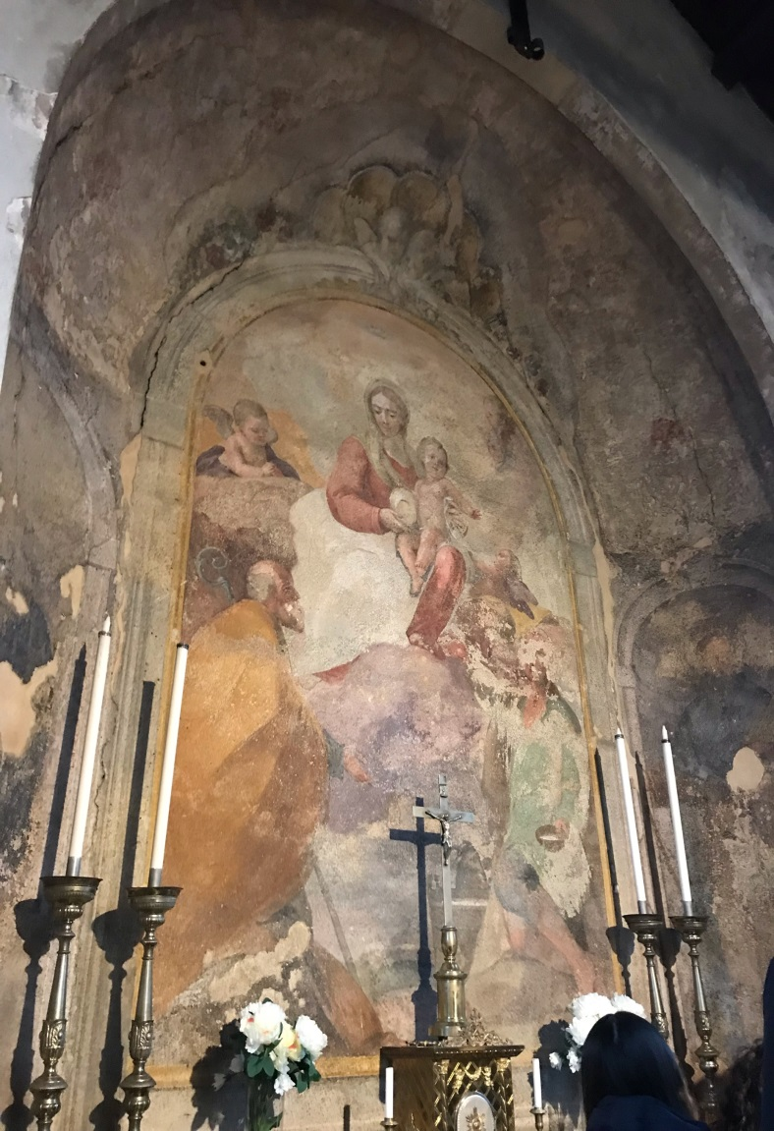
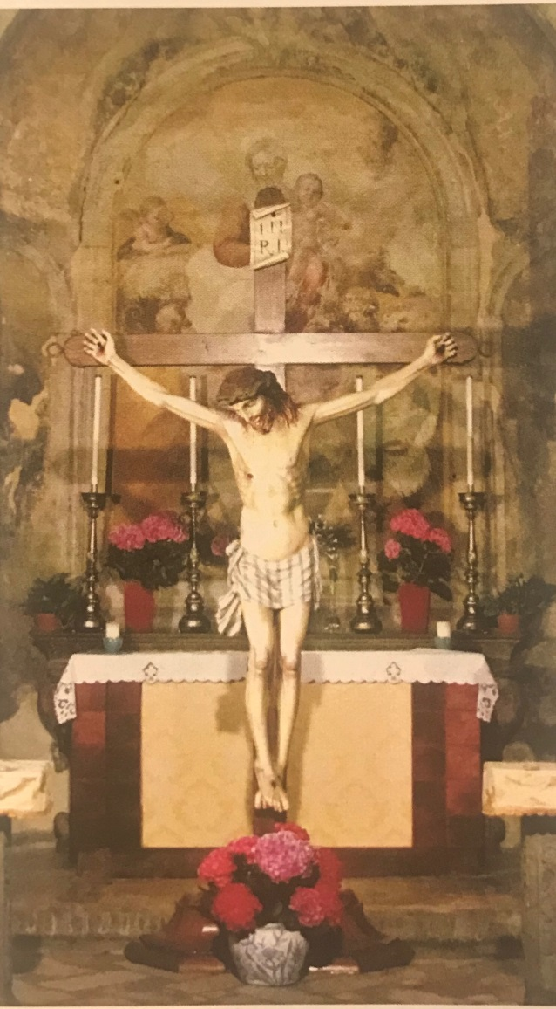
Fresco of Virgin Mary
1779 – Giambattista Gariboldi
Crucifix
1500 ca.
IIS C.E. Gadda Paderno Dugnano Milan Italy

Slide 4
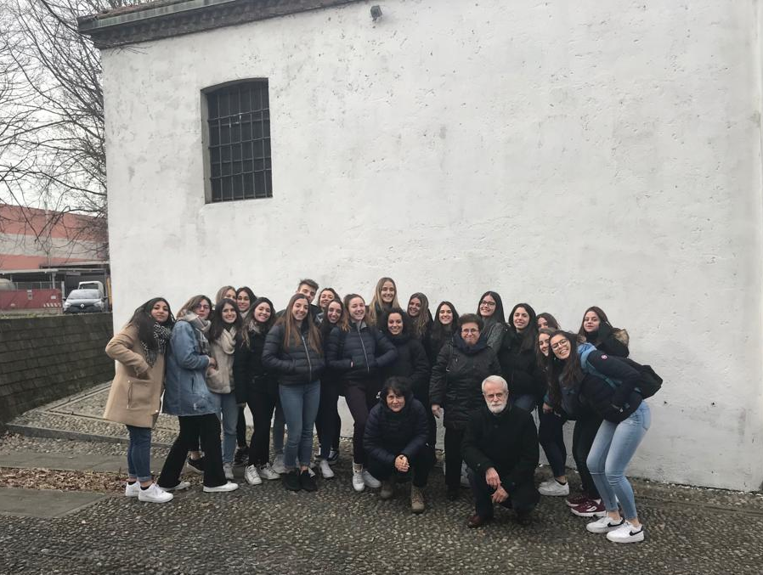
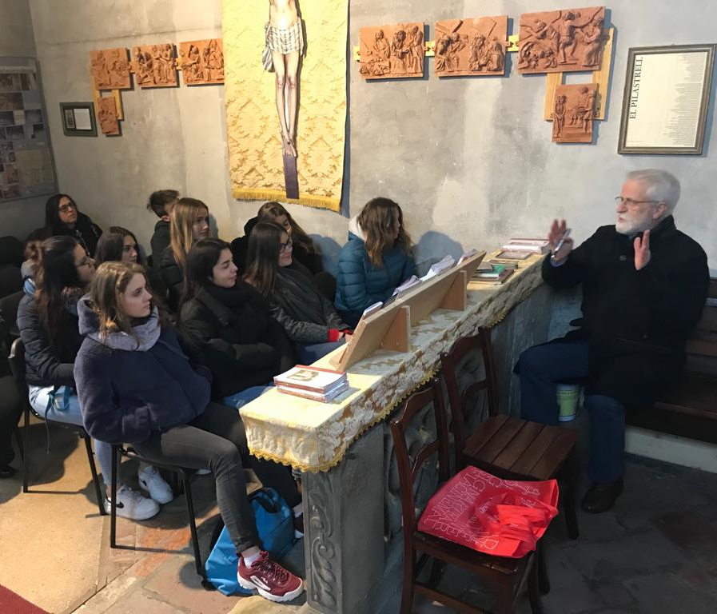
PILASTRELLO’S ASSOCIATION
They adopted the church in 2012…
and now we are working too!
IIS C.E. Gadda Paderno Dugnano Milan Italy

Slide 5
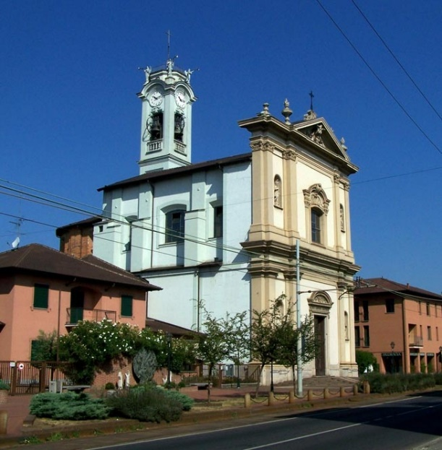
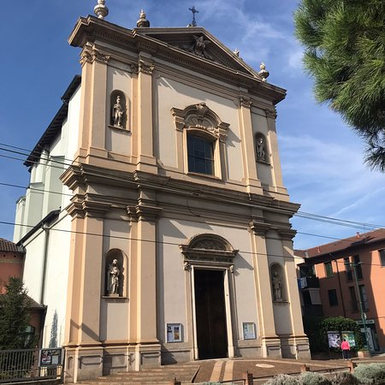
SAINT AMBROGIO CHURCH
It is a baroque church placed in Cassina Amata, in Paderno Dugnano.
It is dedicated to S.Ambrogio, patron of Milan.
It was founded in 1697 by the architect Filippo Cagnola.
The building of this church lasted more than 100 years and it has always been updated.
IIS C.E. Gadda Paderno Dugnano Milan Italy

Slide 6
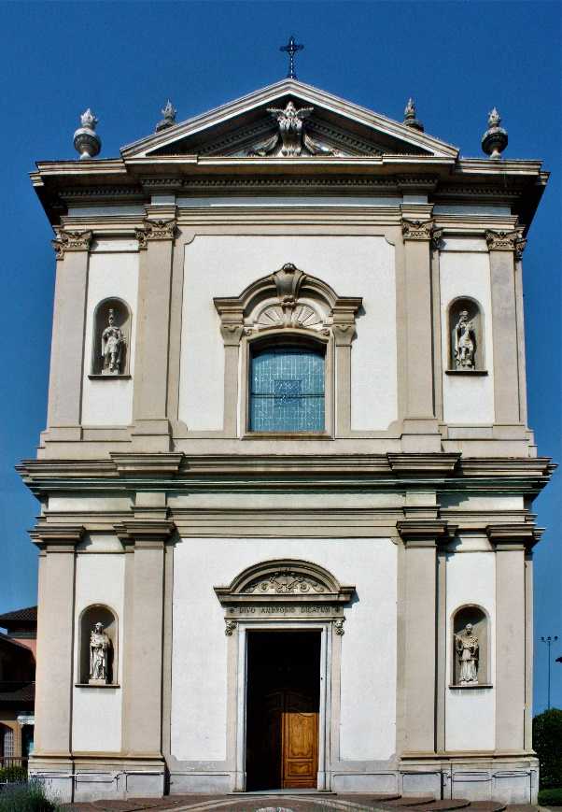
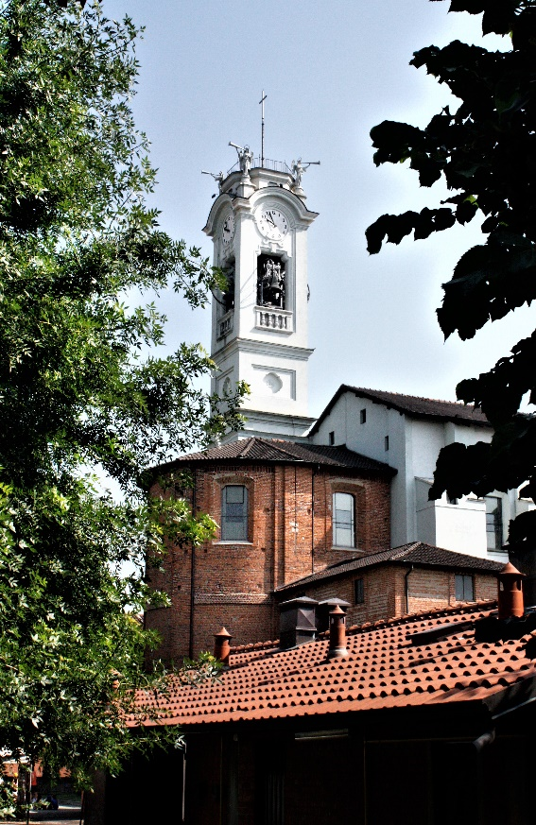
FRONT AND BELL TOWER
It is divided into 3 parts and it was finished in the XIX century.
There are also 4 niches with statues of saints.
It was made by Francesco Croce
There are 4 angels, facing the 4 cardinal directions.
IIS C.E. Gadda Paderno Dugnano Milan Italy

Slide 7
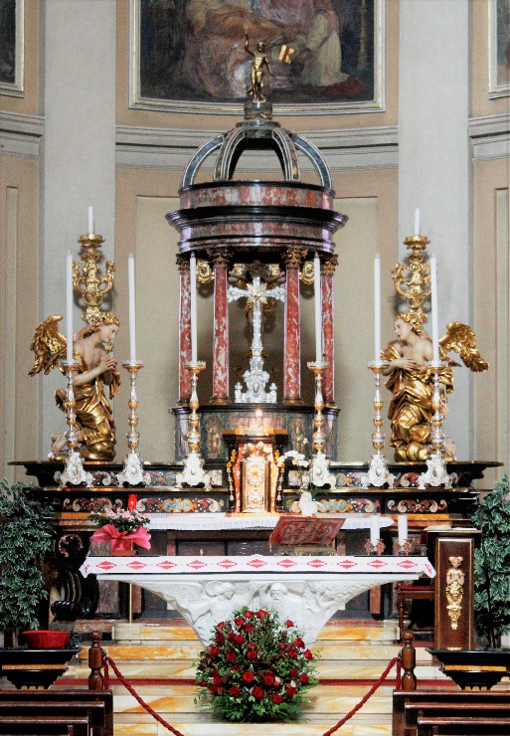
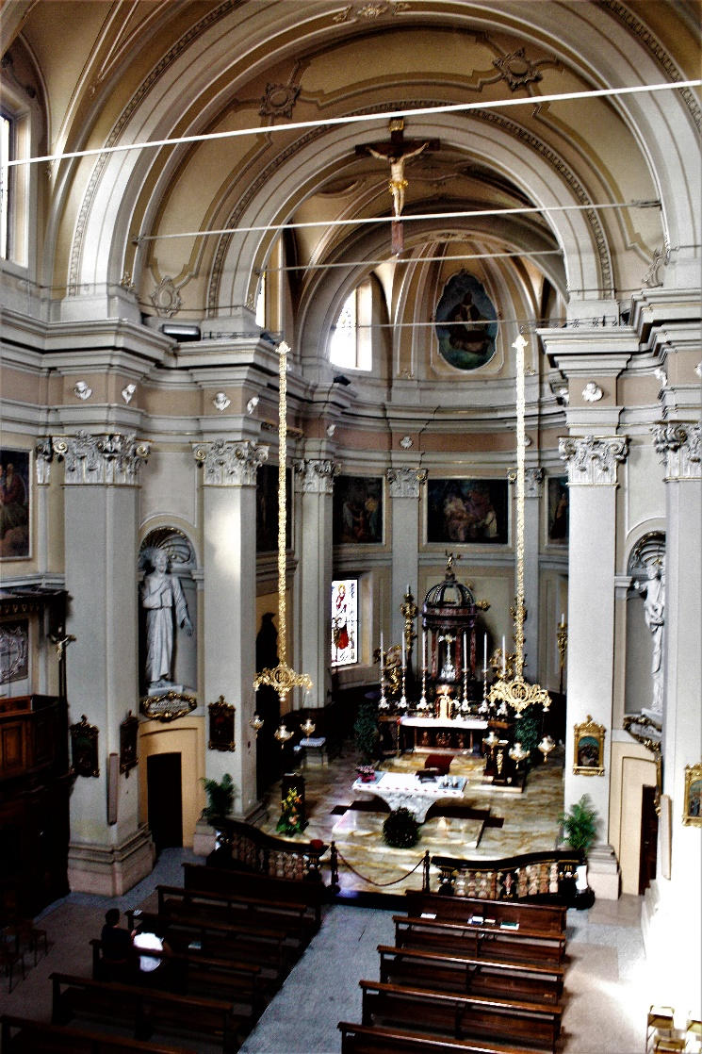
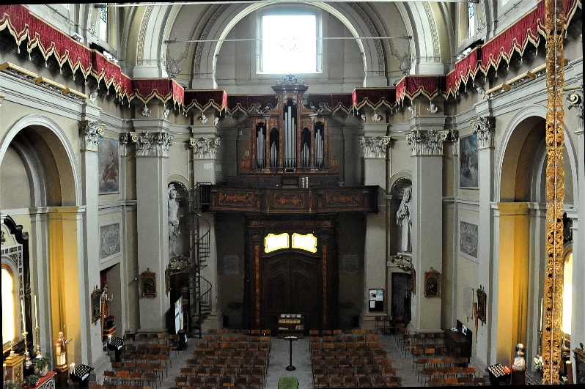
INNER
The church has a unique nave, rectangular, with two lateral chapels and a deep presbytery.
On the right of the entrance there is a statue of S.Ambrogio , made of wood.
In the back of the apse there is a circular temple called “a tholos”.
There’s an ancient organ.
IIS C.E. Gadda Paderno Dugnano Milan Italy

Slide 8
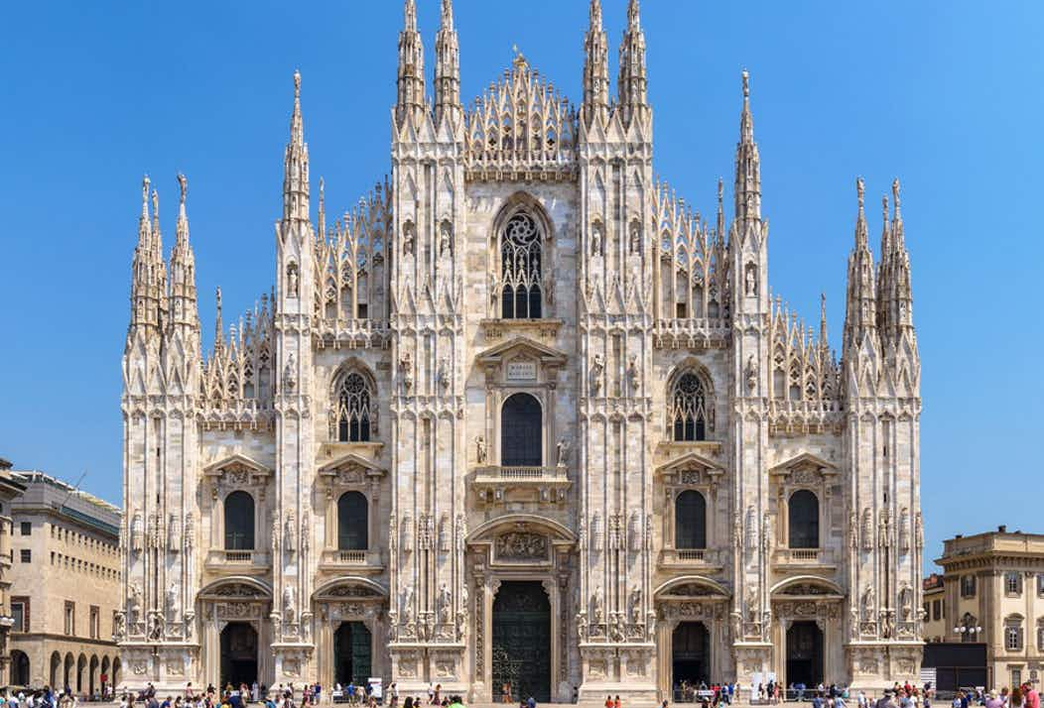
IIS C.E. Gadda Paderno Dugnano Milan Italy

Slide 9
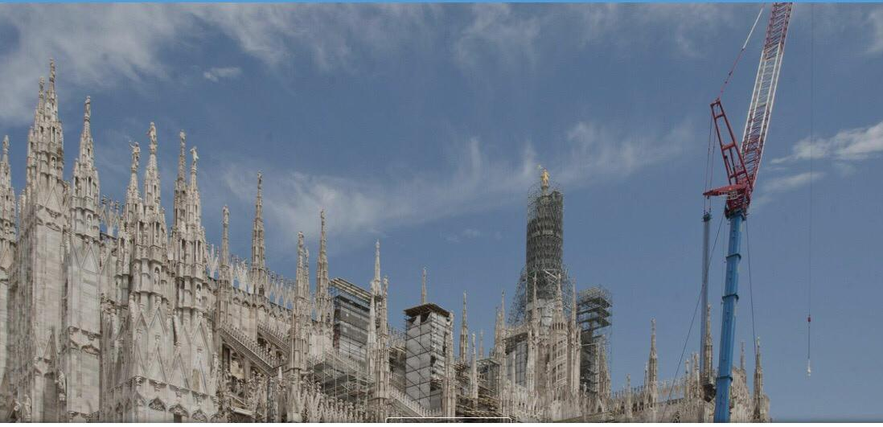
IIS C.E. Gadda Paderno Dugnano Milan Italy

Slide 10
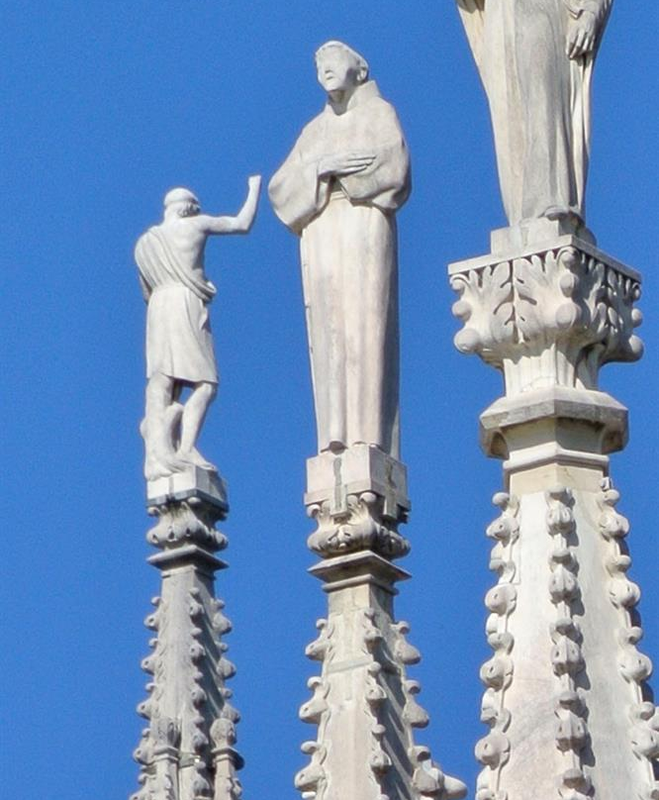
IIS C.E. Gadda Paderno Dugnano Milan Italy

Slide 11
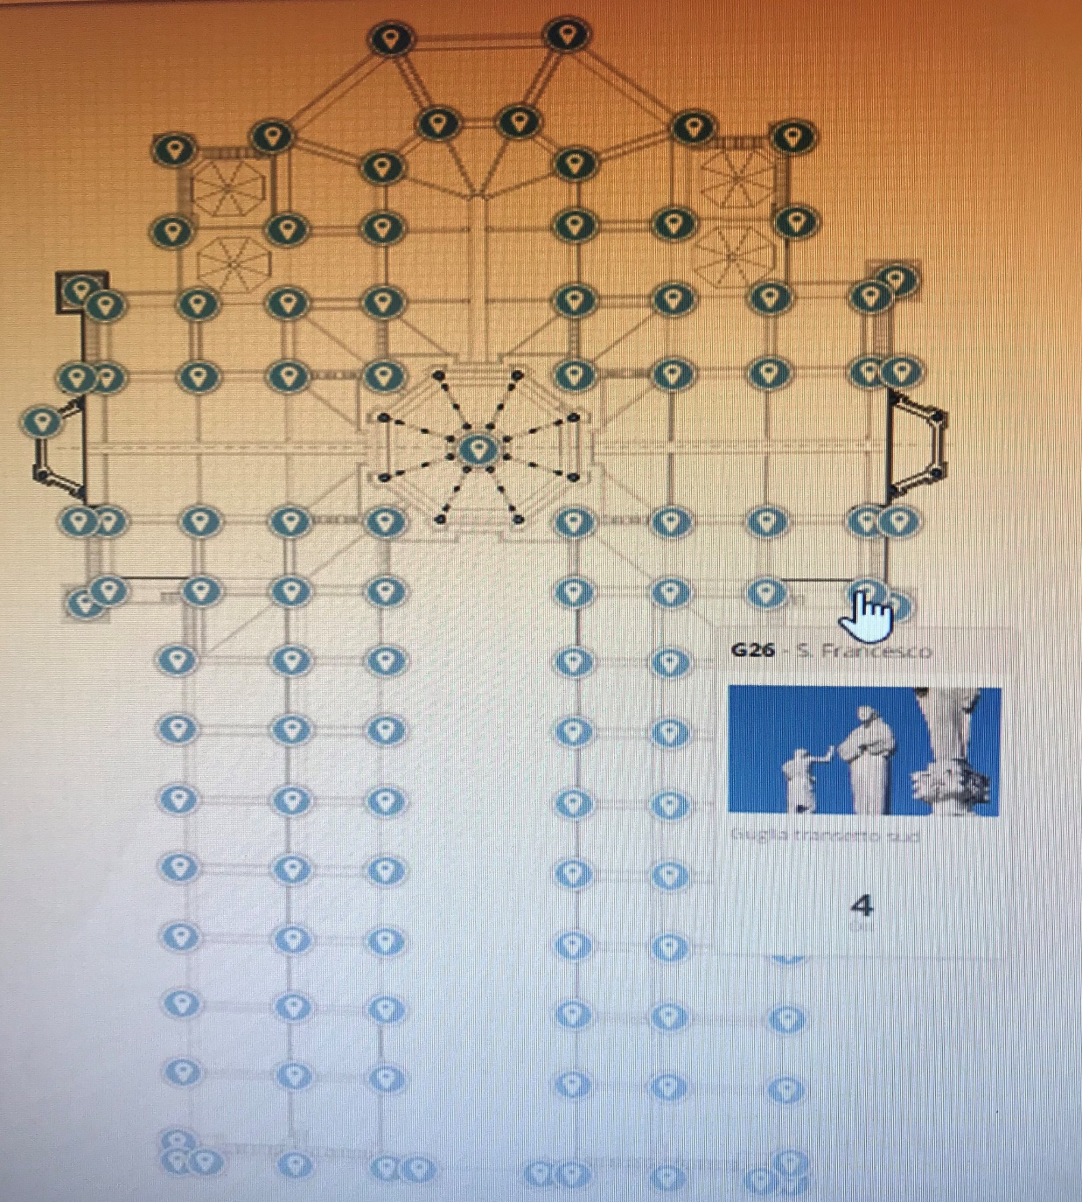
IIS C.E. Gadda Paderno Dugnano Milan Italy

Slide 12
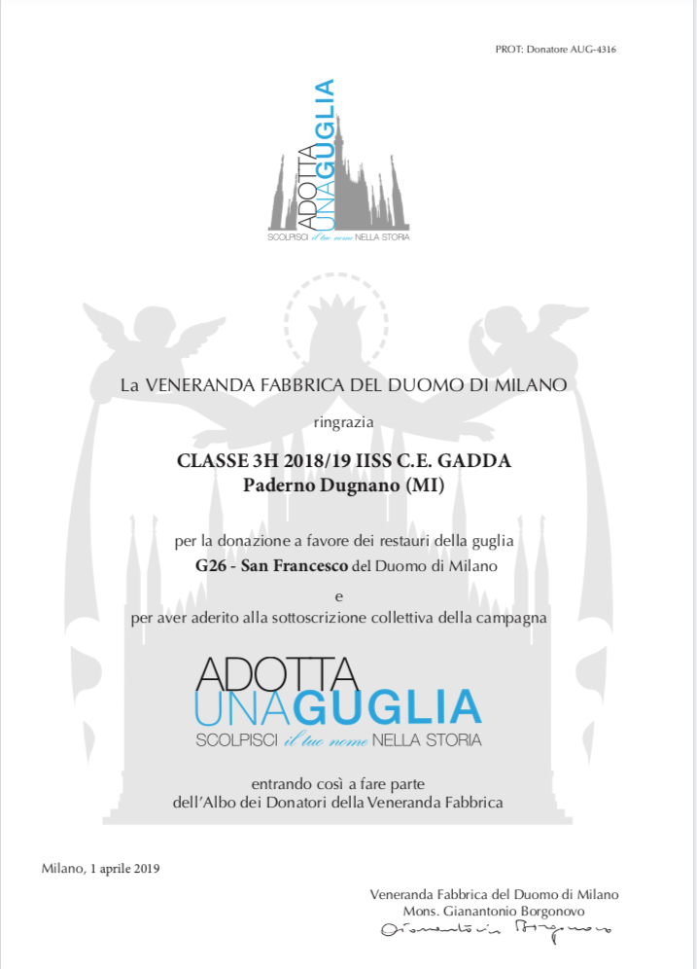
IIS C.E. Gadda Paderno Dugnano Milan Italy

