Slide 1

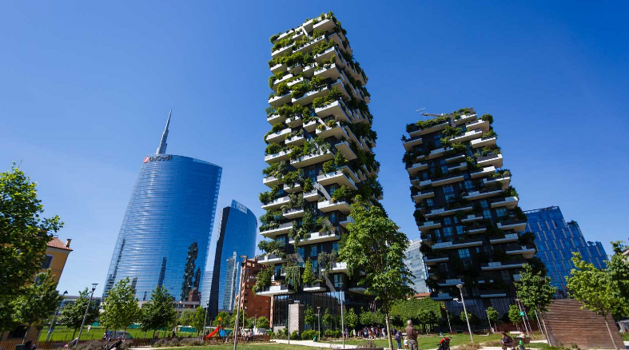

VERTICAL FOREST
IIS C.E. Gadda Paderno Dugnano Milan Italy

Slide 2

THE FIVE POINTS OF A MODERN ARCHITECTURE
IIS C.E. Gadda Paderno Dugnano Milan Italy

Slide 3
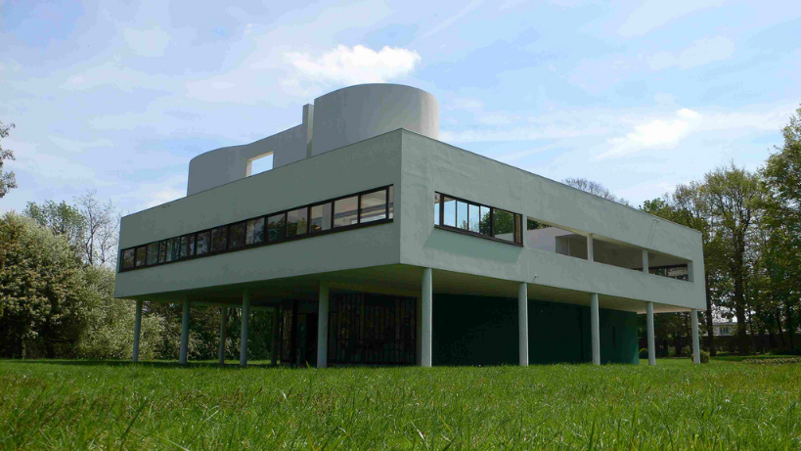
The PILOTIS (or Pylon)
IIS C.E. Gadda Paderno Dugnano Milan Italy

Slide 4
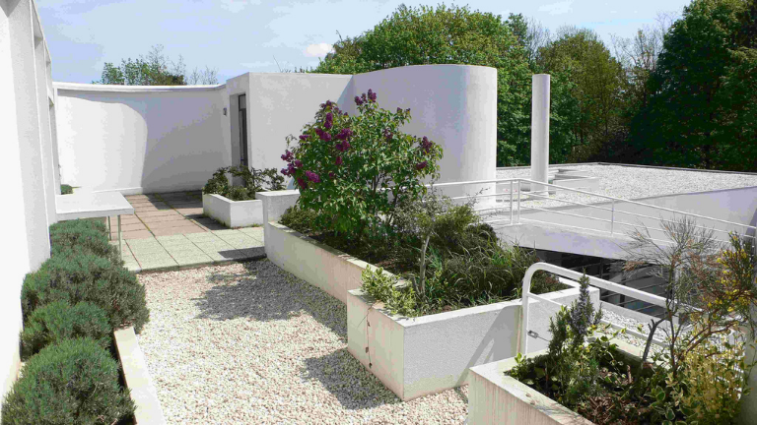
The ROOF TERRACE
IIS C.E. Gadda Paderno Dugnano Milan Italy

Slide 5
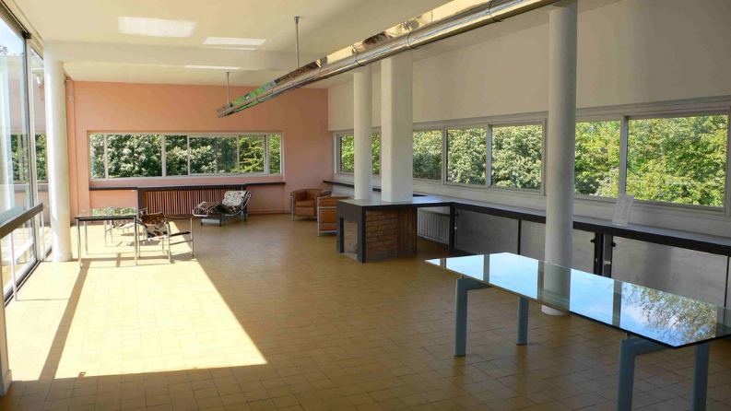
The FREE PLAN
IIS C.E. Gadda Paderno Dugnano Milan Italy

Slide 6
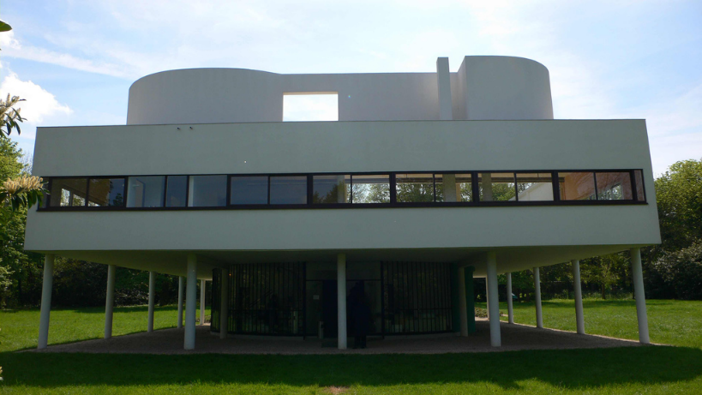
The RIBBON WINDOW
IIS C.E. Gadda Paderno Dugnano Milan Italy

Slide 7
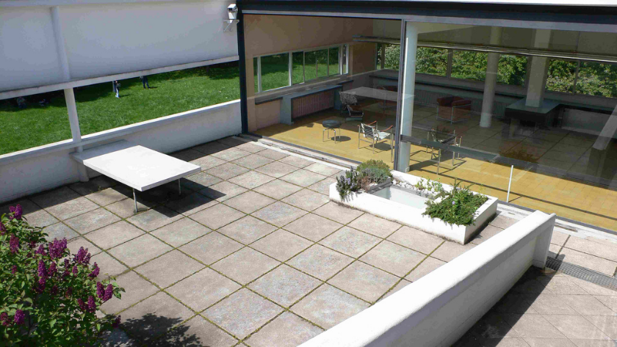
The FREE FAÇADE
IIS C.E. Gadda Paderno Dugnano Milan Italy

Slide 8
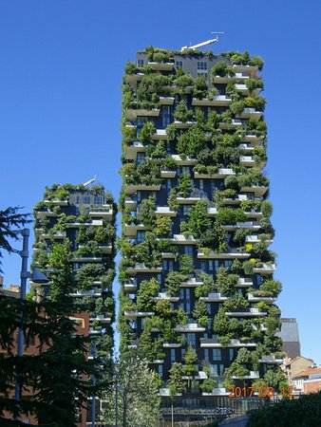
INTRODUCTION
Designed by BOERI STUDIO;
2 towers;
Milan’s Porta Nuova district;
800 Trees, 4.500 shrubs, 15.000 plants.
IIS C.E. Gadda Paderno Dugnano Milan Italy

Slide 9
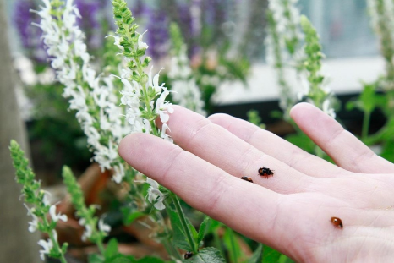
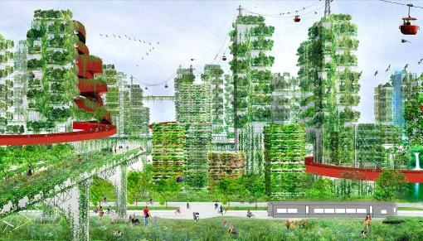
THE VEGETAL SYSTEM OF THE VERTICAL FOREST
The project of a city entirely green
Re-colonization of the city by vegetation and by animal life
https://www.youtube.com/watch?v=XSUPEdhEjUE
IIS C.E. Gadda Paderno Dugnano Milan Italy

Slide 10
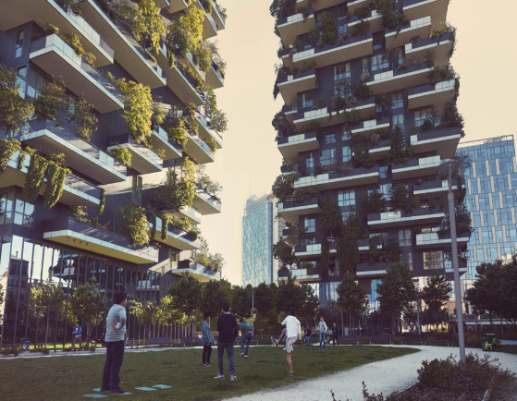
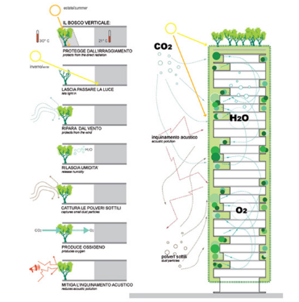
MITIGATIONS
The Vertical Forest contributes to the construction of a microclimate
IIS C.E. Gadda Paderno Dugnano Milan Italy

Slide 11
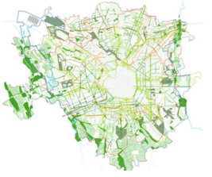
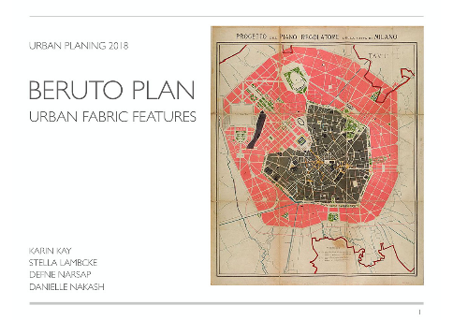
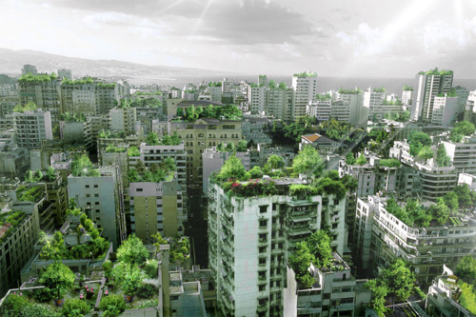
THE URBAN PLANNING OF MILAN
https://www.youtube.com/watch?v=PPfyShd50NQ&t=163s
IIS C.E. Gadda Paderno Dugnano Milan Italy

Slide 12
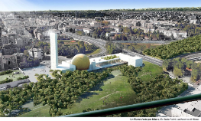
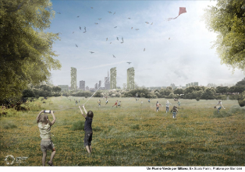
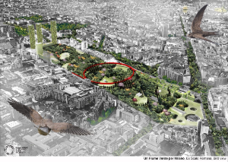
GREEN RIVER
Urban reforestation project;
Stefano Boeri;
Network of green areas linked together;
Support services;
Protection of urban biodiversity.
IIS C.E. Gadda Paderno Dugnano Milan Italy

Slide 13
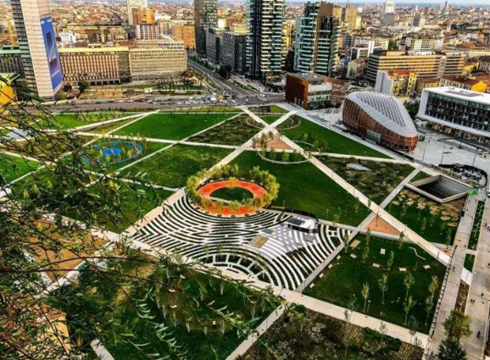
LIBRARY OF TREES
It is next to the Vertical Forest
It is the city’s third-largest urban green space
IIS C.E. Gadda Paderno Dugnano Milan Italy

Slide 14
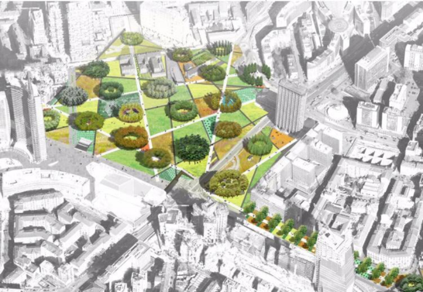
It contains over 135.000 of plants of 100 different species, and 500 trees.
IIS C.E. Gadda Paderno Dugnano Milan Italy

Slide 15
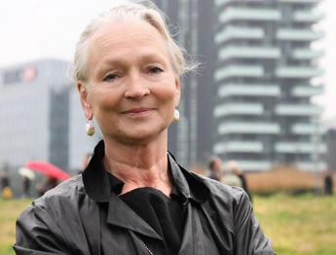
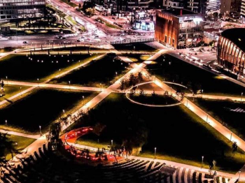
It was designed by the english designer Petra Blaisse;
The park has a completely open layout, with no gates marking its borders;
It has bike and pedestrian paths.
IIS C.E. Gadda Paderno Dugnano Milan Italy

Slide 16
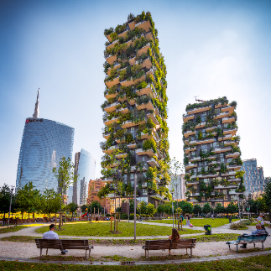
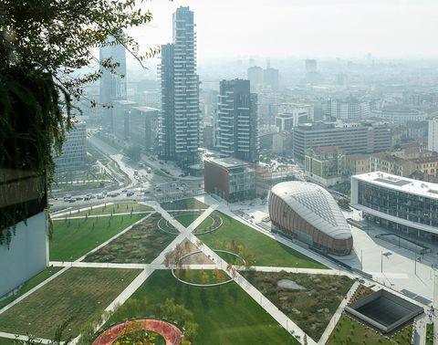
THANKS FOR YOUR ATTENTION
IIS C.E. Gadda Paderno Dugnano Milan Italy

