Slide 1

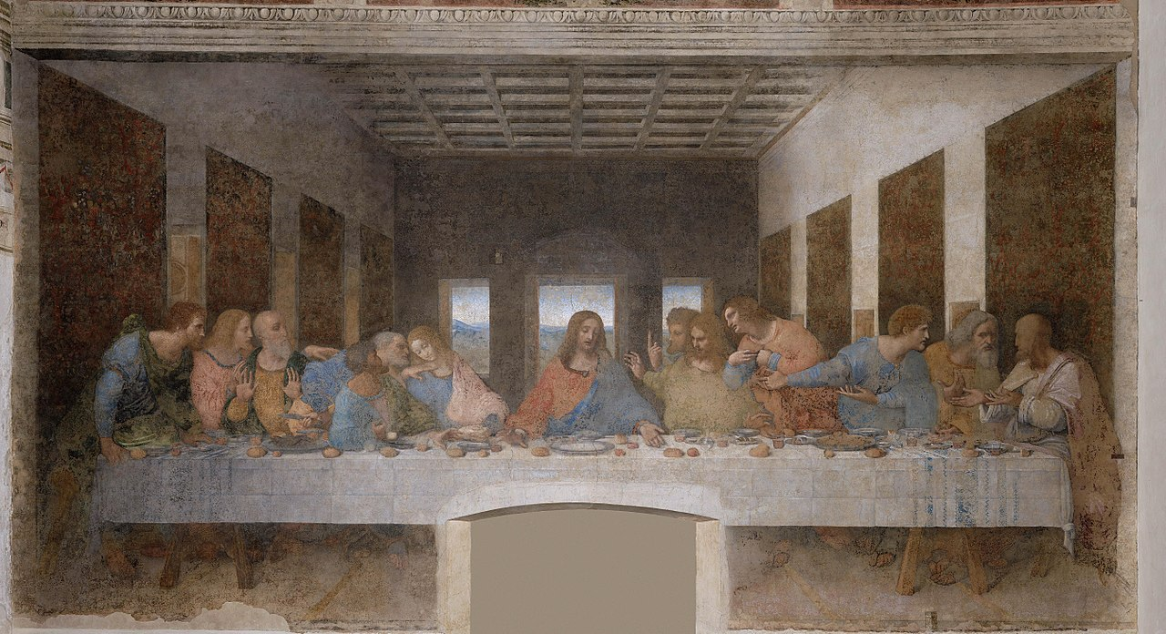

The restoration of Leonardo da Vinci’s
Last Supper
IIS C.E. Gadda Paderno Dugnano Milan Italy

Slide 2

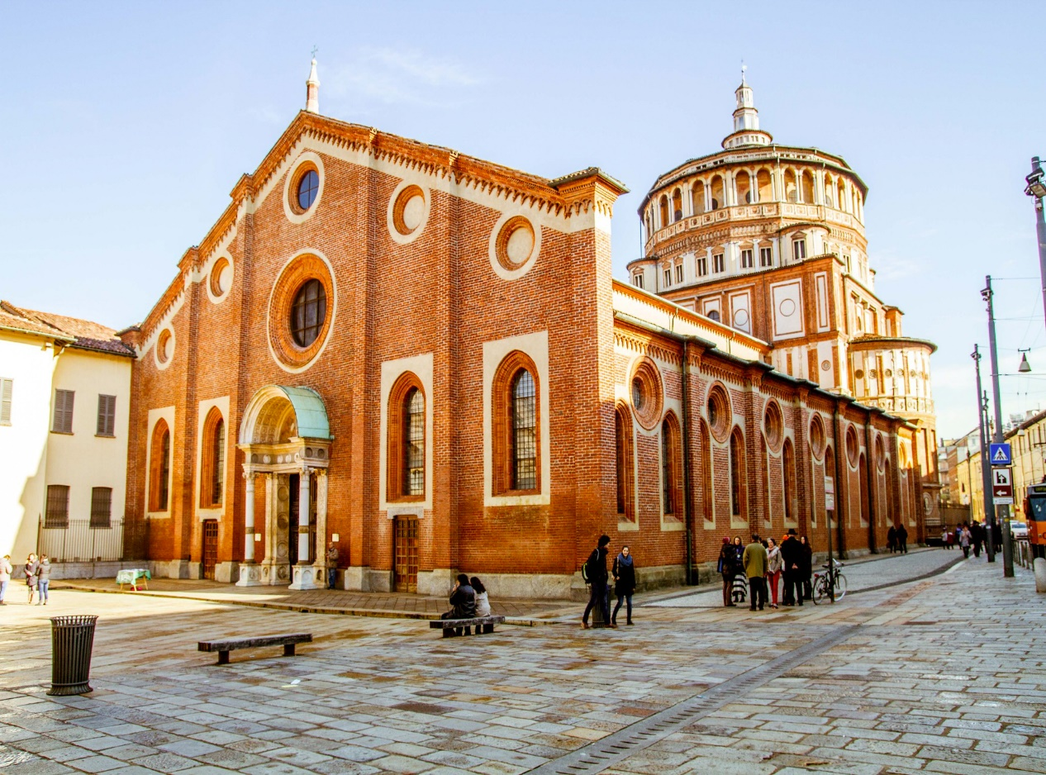
Leonardo da Vinci decorated the refectory of the Convent of Santa Maria delle Grazie, called Cenacolo. He began The Last Supper
( Cenacolo) in 1495 and went on until 1498.
Leonardo used an experimental technique combining the "tempera” technique with the oil color which was the main cause of the ruin of the painting.
The tradition says that the first restorer of the masterpiece was Leonardo Da Vinci himself, at the beginning of the '500.
Then, in the next centuries, several actions were made by painters and restorers.
IIS C.E. Gadda Paderno Dugnano Milan Italy

Slide 3
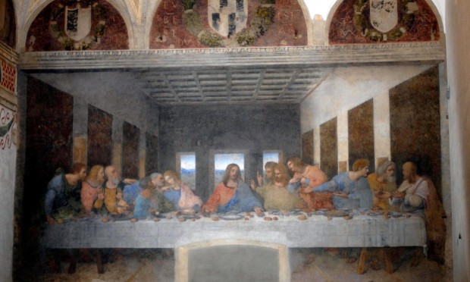
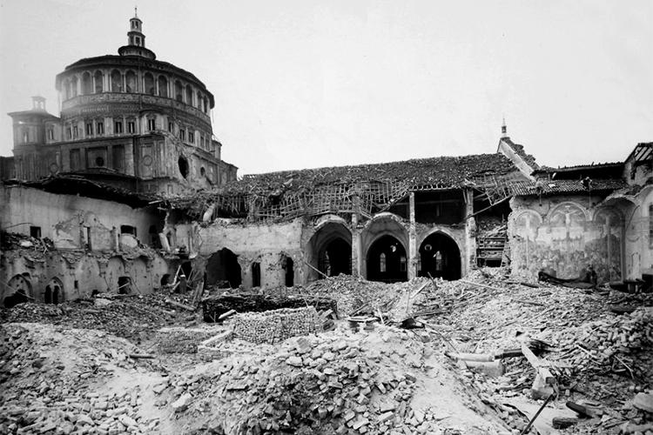
The damages to the masterpiece occurred in centuries are of different types:
falls and cracks on colored parts
humidity on the wall
dust, candle smoke, braziers
quakes caused by the 1943 bombing
smog
IIS C.E. Gadda Paderno Dugnano Milan Italy

Slide 4
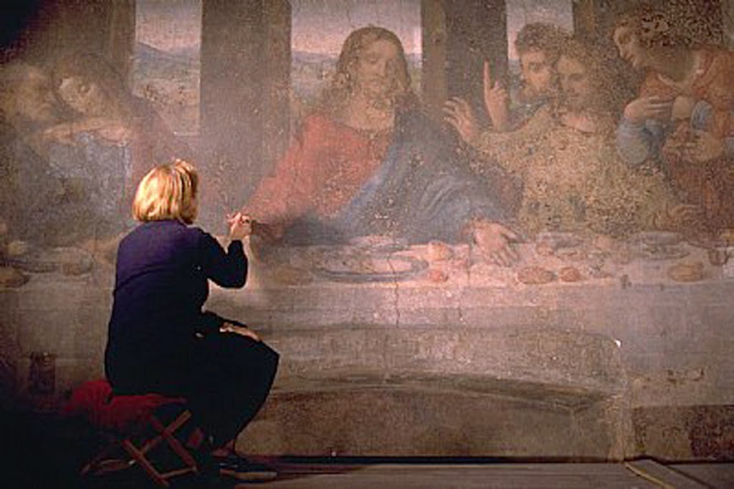
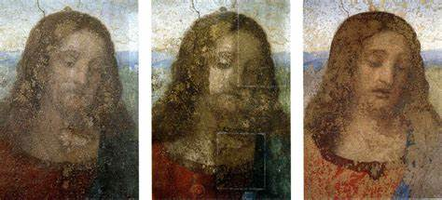
In 1999, the art restorer Ms. Pinin Brambilla and her staff concluded the restoring that took more that 20 years.
Now the fresco has to be kept in a strictly protected environment.
IIS C.E. Gadda Paderno Dugnano Milan Italy

