Slide 1
Fight for Freedom
Czech way

Slide 2
Scope
Work with the mind map
28. 10. 1918 - 100 years of the republic (the figure TGM and his PR capabilities)
30. 9. 1938 - the herald of the second world war Operation Anthropoid (preparation for the crypt)
1968/1969 Burning Bush - Palach wasn’t alone
17. 11. 1989 (mass excitement comparison with 1968)

Slide 3
FIGHT FOR FREEDOM - MIND MAP
What is freedom?
What types of freedom do you know?
How can we fight for freedom?

Slide 4
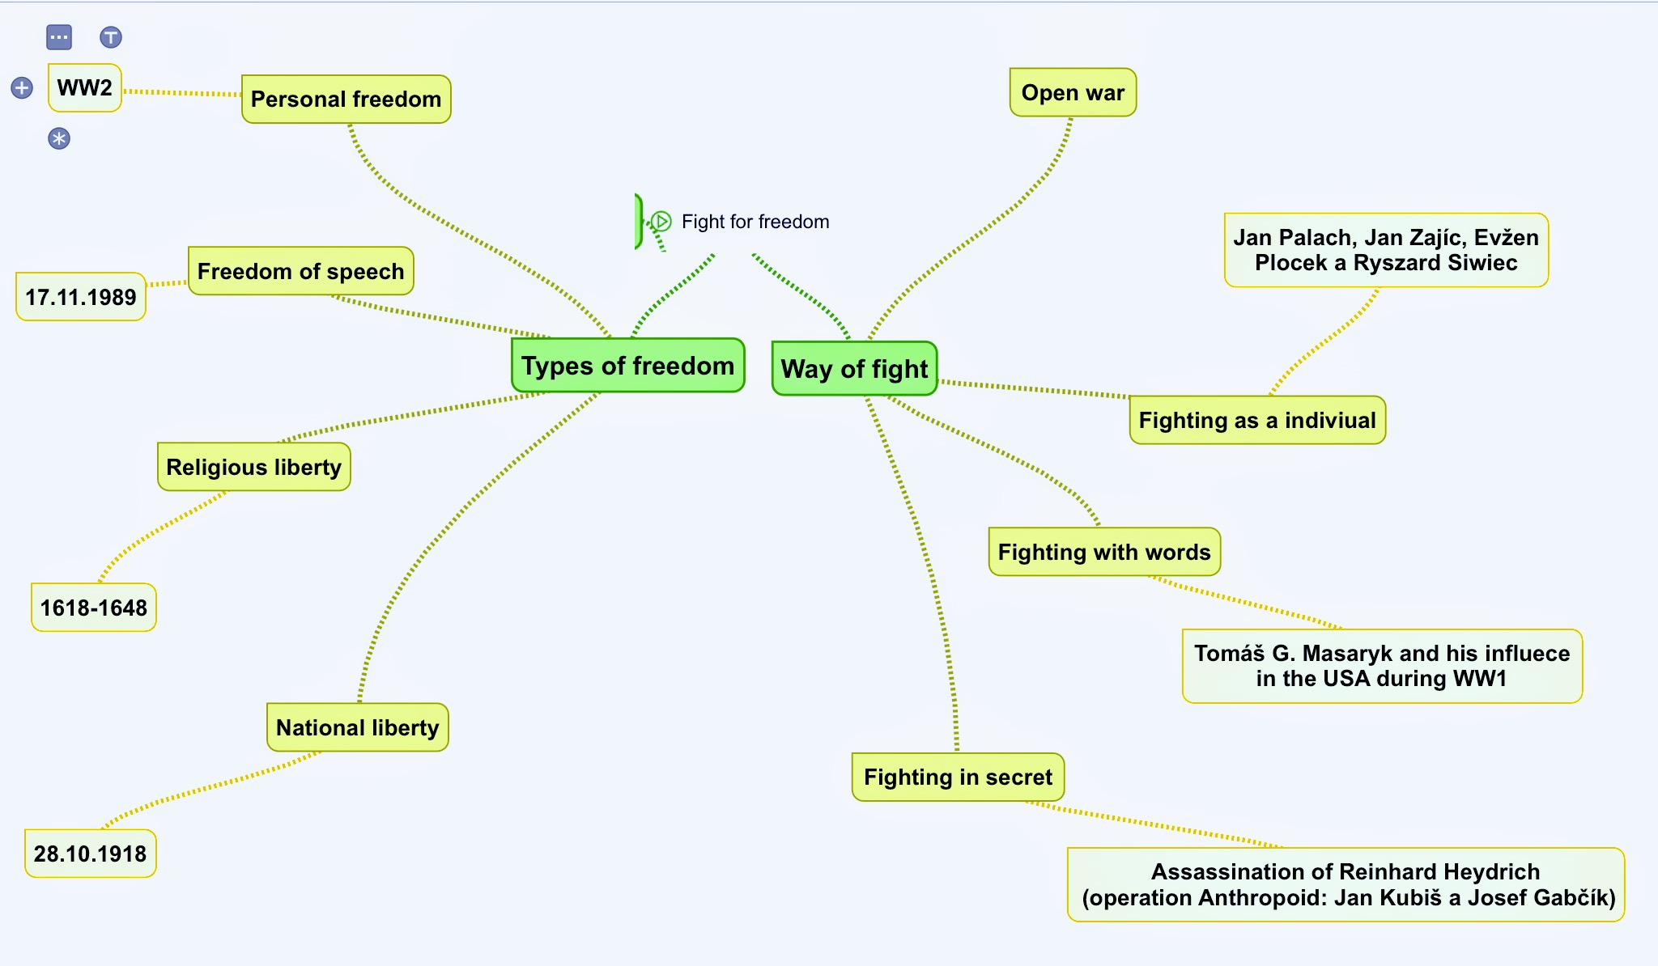

Slide 5
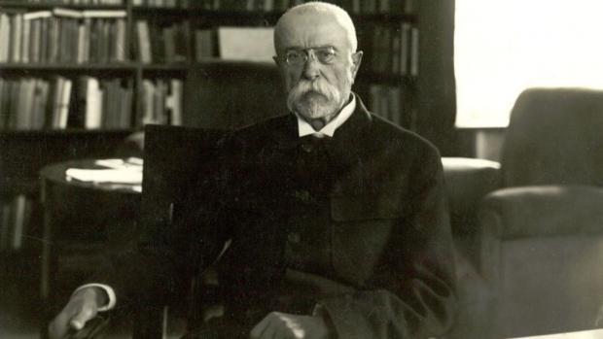
28.10.1918 - THE CREATION OF CZECHOSLOVAKIA

Slide 6
28.10.1918 - THE CREATION OF CZECHOSLOVAKIA
- republic announced before the official end WW1
- Tomáš Garrigue Masaryk elected president in his absence
- habsburg monarchy fell, although Karl I. wanted it to become a federation (Masaryk was faster)
- creation was supported by the world powers (especially USA and France)
How is it possible?

Slide 7
28.10.1918 - THE CREATION OF CZECHOSLOVAKIA
=> PR activities of Masaryk and his collaborators
regular articles in The New York Times
shows on BBC
diplomatic talks with US president (W. Wilson)
=> creation of legions (became legitimate armies)
=> regulated requests
=> attempts at limiting the influence of the House of Habsburg
=> system of Versailles

Slide 8
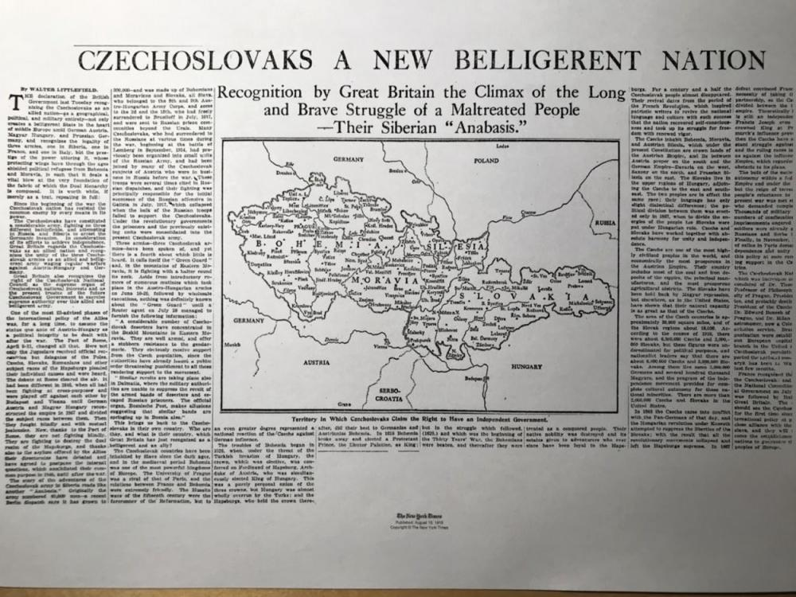
Deník New York Times před sto lety, v srpnu 1918, věnoval myšlence československého státu titulní článek středečního vydání, později v týdnu pak ještě dva dlouhé texty a otiskl i velkou mapu Československa. | Foto: Jan Kaliba | Zdroj: Český rozhlas

Slide 9
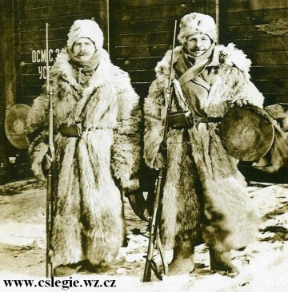
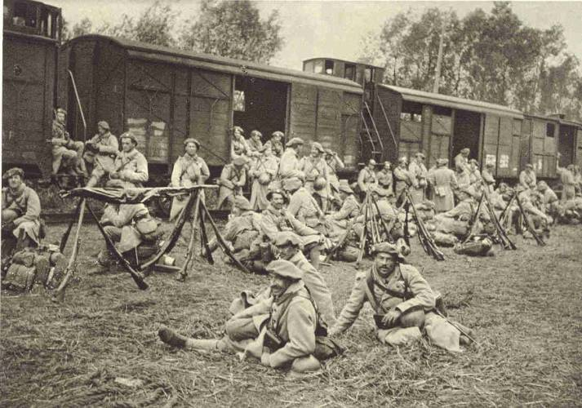
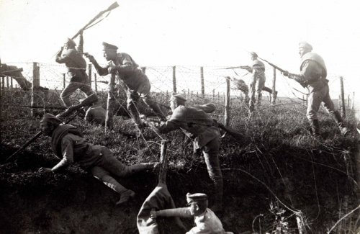

Slide 10
28.10.1918 - THE CREATION OF CZECHOSLOVAKIA
What should you do, if a state is created from the fall of an empire?
publish constitution (definitive from 2/1920)
reform the currency
reform the estates
foreign relations (CSR was part of Little Entente and a member of the League of Nations)

Slide 11
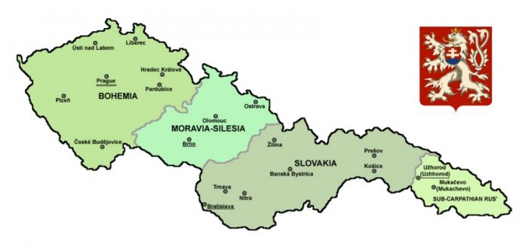

Slide 12
28.10.1918 - THE CREATION OF CZECHOSLOVAKIA
ISSUES:
MINORITIES - the constitution mentions czechoslovak people, not germans, hungarians or rusyns => exploited by Hitler during his negotiations at the Munich Agreement

Slide 13
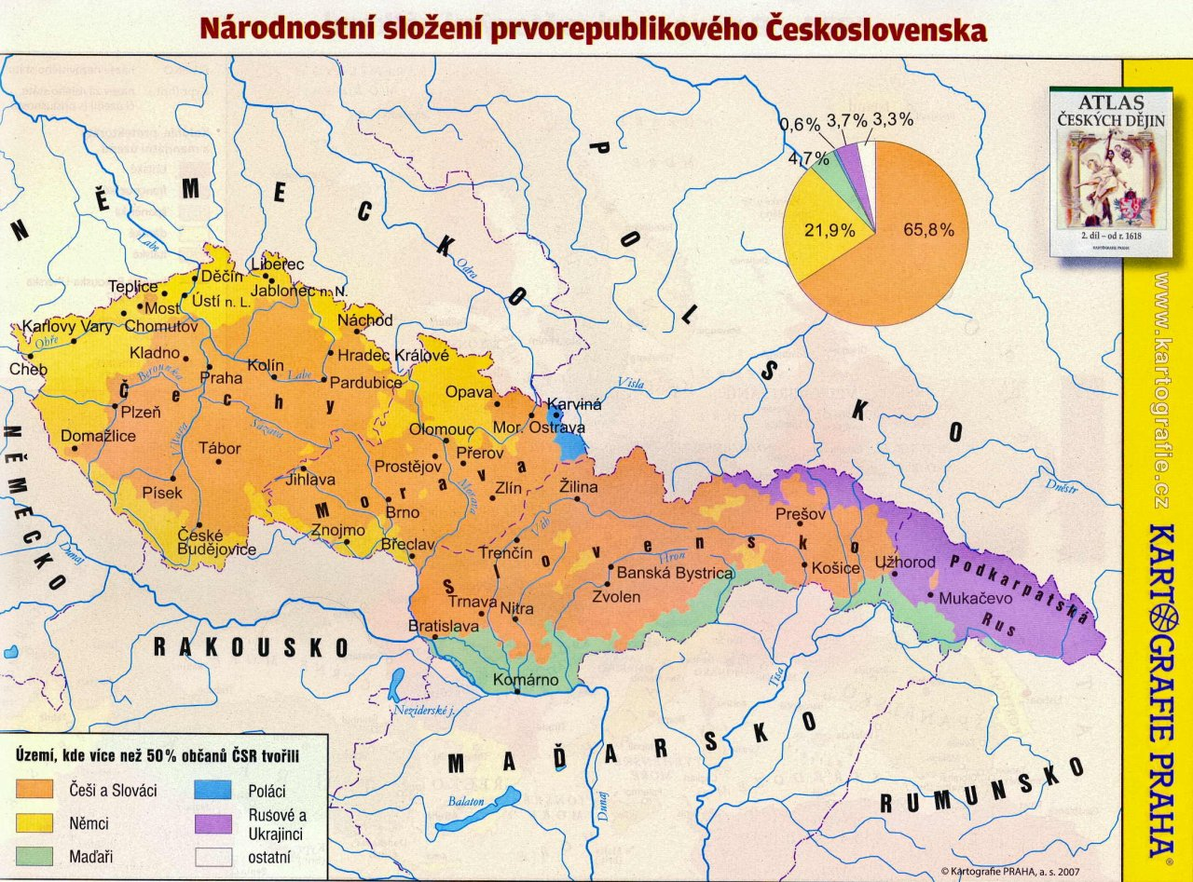

Slide 14
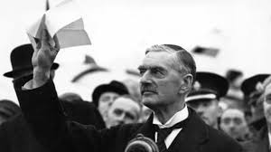
30. 9. 1938 - Munich Agreement
THE DAY WHEN WE WERE NOT FIGHTING
29.-30.9. 1938 conference of world powers in Munich -> Neville Chamberlain (UK) -> Édouard Daladier (FRA) -> Benito Mussolini (ITA) -> Adolf Hitler (D)
agreement on the cession of CSR borderlands to Germany; an example of appeasement

Slide 15
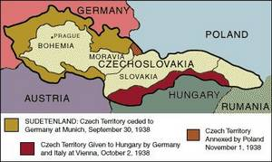
30. 9. 1938 - MNICHOVSKÁ DOHODA
THE DAY WHEN WE WERE NOT FIGHTING
WHY DIDN’T WE FIGHT?
WOULD YOU FIGHT?
CONSEQUENCES: - loss of territory, abolition of democracy, later creation of the Protectorate of Bohemia and Moravia - psychic damage, still present

Slide 16
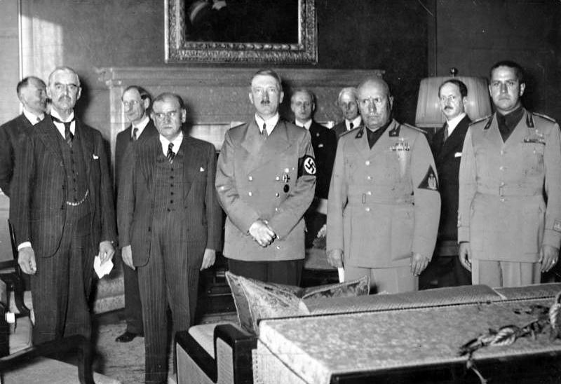

Slide 17
OPERATION ANTHROPOID (27. MAY 1942)
paratroopers trained in UK (J. Gabčík and J. Kubiš)
GOAL: assassination of Reinhard Heydrich ("the man with the iron heart", Hitler)
REVENGE: -> paratroopers found and kill -> exterminations of Lidice and Ležáky and frequent executions -> elevated prestige of CSR between the alliance

Slide 18
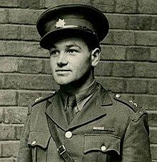
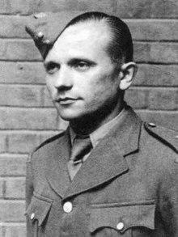
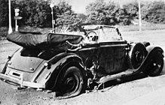
Jan Kubiš Jozef Gabčík

Slide 19
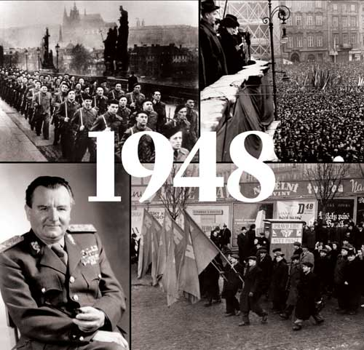
2/1948
the communist revolt
beginning of communist totality

Slide 20
21. 8. 1968 - Spring is over
60’s were times of political and cultural release
The period of the Prague Spring
The idyl ended in 21. 8. 1968
invasion of the Warsaw pact’s armies

Slide 21
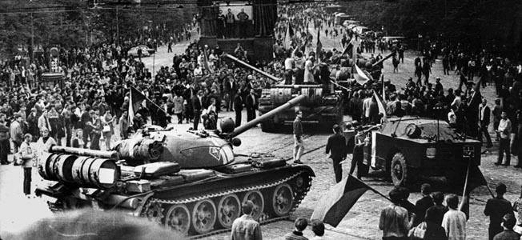
More than 130 civilians were killed when the Soviet Union sent tanks and troops into Prague in 1968

Slide 22
21. 8. 1968 - Spring is over
The people first riot and express their disagreement en masse, but they fall into apathy and conciliate with the situation
=> normalization in the 70’s, 80’s

Slide 23
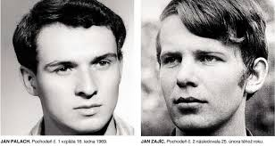
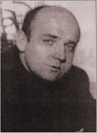
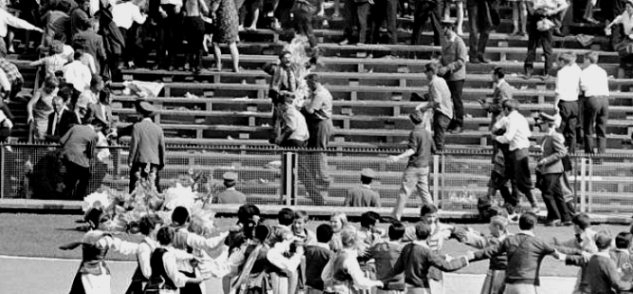
1968/1968 - PALACH WAS NOT ALONE
Jan Palach
Jan Zajíc
Evžen Plocek
Ryszard Siwiec

Slide 24
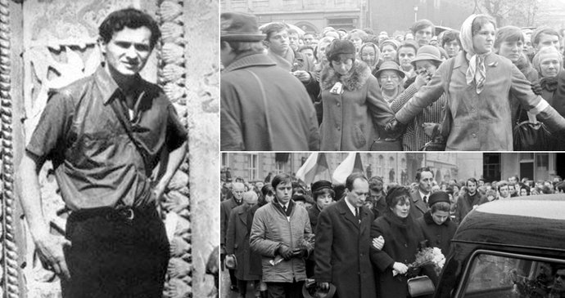
1968/1969 - PALACH WAS NOT ALONE
BURNING BUSH

Slide 25
17. 11. 1989 - VELVET REVOLUTION
velvet => taking over without a fight
very spontaneous
the students started it
the end of communist totality
a return to democracy·
separation from Slovakia later (1993)
president Václav Havel

Slide 26
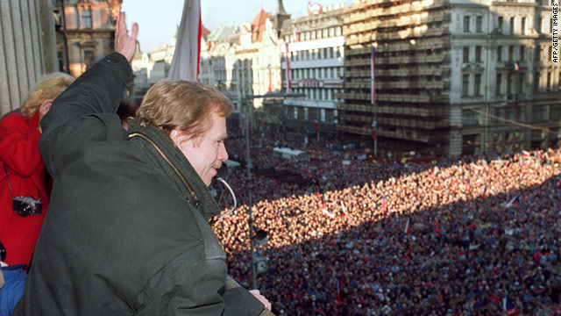
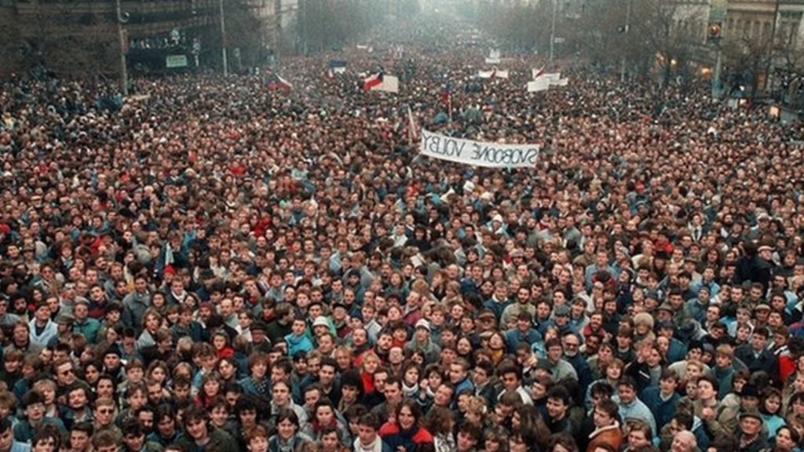
17. 11. 1989 - VELVET REVOLUTION

Slide 27
Thank you for your attention.

Slide 28
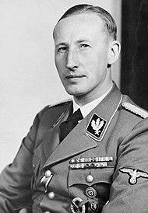
Reinhard Heydrich
main architect of the Holocaust
SS-Obergruppenführer and General of Polizei
Deputy Reich-Protector of Bohemia and Moravia
he lead the January 1942 Wannsee Conference (Final Solution to the Jewish Question)
many historians regard him as the darkest figure within the Nazi elite

Slide 29
Images: link
https://goo.gl/images/CgY6hs
www.cslegie.wz.cz
https://commons.wikimedia.org/wiki/File:Czechoslovakia_I.png
https://goo.gl/images/DKYKaV
https://goo.gl/images/jzsbUR
https://goo.gl/images/zeA3HC
https://goo.gl/images/wtEuaR
https://goo.gl/images/N3aeM9
https://goo.gl/images/P77GmS

Slide 30
Images: link
https://goo.gl/images/KyPKNj. https://goo.gl/images/ut5WNu
https://goo.gl/images/53xo2W. https://goo.gl/images/kx8qdB
https://goo.gl/images/46Lsi5. https://goo.gl/images/HaxMyE
https://goo.gl/images/5vhr9o. https://goo.gl/images/ffzpbQ
https://goo.gl/images/WhVKFU. https://goo.gl/images/4yeHuD

