Slide 1
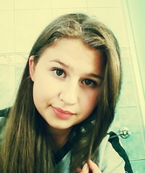
My name is Ola. I'm 14 years old. I'm from Grybów in Poland. I have one brother. His name is Kacper I have dog and fish. I have a friend, Gabi. My favourite colours are black, grey and dark purple. I like play volleyball with Gabi

Slide 2
Look at : voki - http://www.voki.com/pickup.php?scid=11880268&height=267&width=200

