Slide 1
1st Experimental High School of Thessaloniki, Greece
“Manolis Andronikos”
Maro Tsivou
Ifigeneia Fardi
Georgia Vasilikou
Lefteris Xenokratis
Stavros Theocharidis
Lazaros Konstantinidis

Slide 2
Our school
TOPICS:
¨Facilities
¨Daily program- How we spend our day at school
¨Events and contests
¨”Recreate your school” program
¨School clubs
¨Occupation with Erasmus+

Slide 3
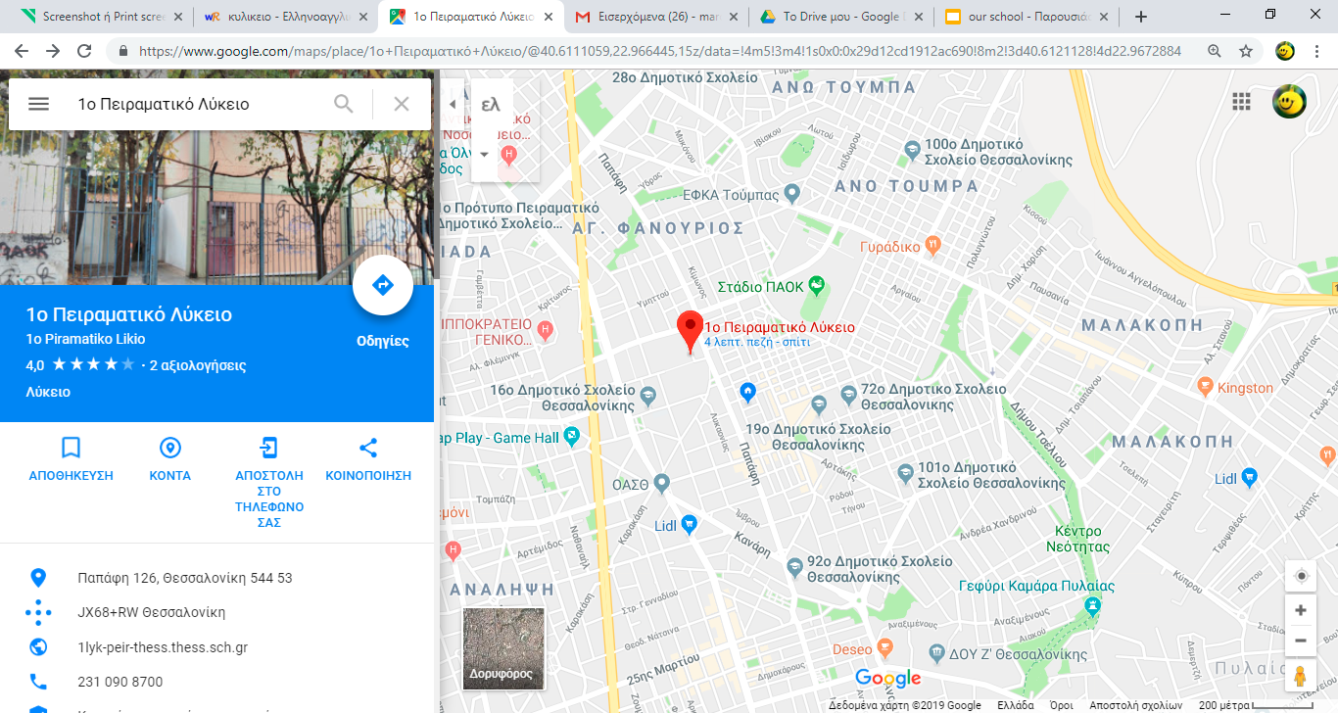
Our school
Our school is consisted of:
7 teaching classrooms
The teachers’ office
The principal’s office
Our gym
Our venue
Our Canteen
A library

Slide 4
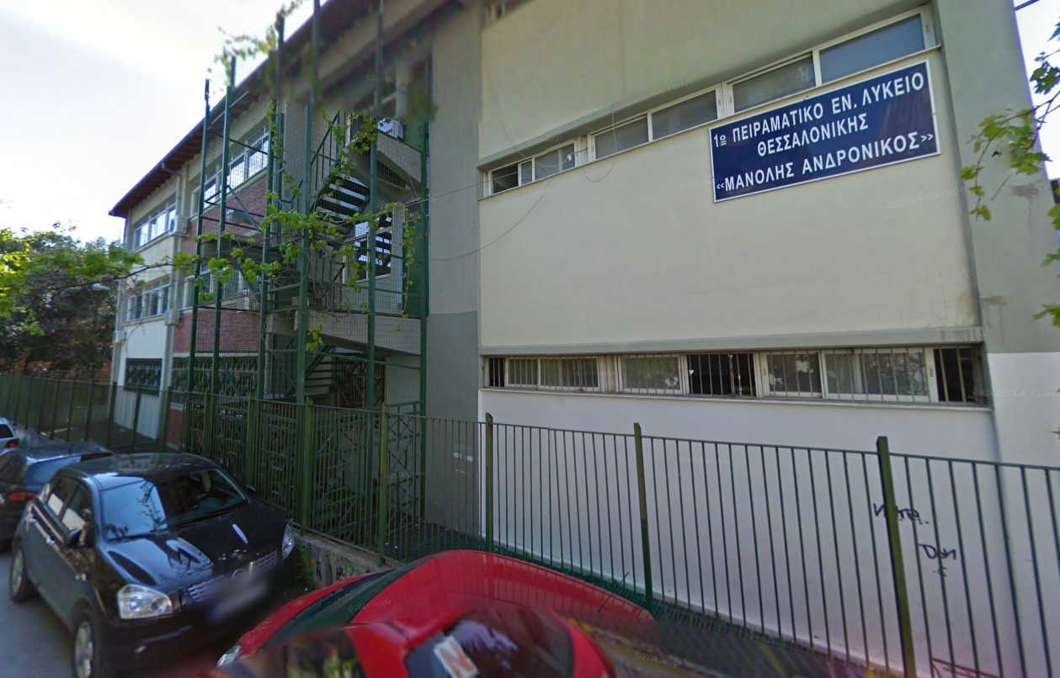
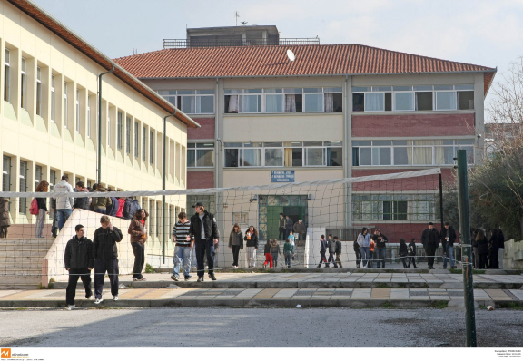

Slide 5
Daily Program
The bell rings at 8:15 AM. All students have to be there in order to meet and follow our schedule properly.
The classes start. Our education includes:
Ancient Greek,Greek Literature, History, Foreign Languages (English, German, French), New Greek, Philosophy
Maths (Algebra and Geometry) , Physics, Chemistry, Biology
Physical Education
Religion Education
The breaks between our classes last 5-10 minutes.
School program ends at 2:10 AM.

Slide 6
School organized competitions
Throughout the years our school has played a significant role when it comes to organizing events and contests.
For example during the last three years the Ancient Greek competition has been really successful among the schools of the Municipality of Thessaloniki.
Another really interesting contest that takes place every year at our school is LOGIGAME which is a logic competition.
Some years ago a social sciences contest also took place.
This year it’s the first time that some of our classmates took the initiative to organize a photography contest among the schools of Thessaloniki.

Slide 7
Events
Every year at the Panhellenic Day of Sports our school organizes sport matches between its 6 classes in order to promote the good sportsmanship.
Of course we cannot forget events which are associated with Erasmus+. There are parties in order to welcome our guests and show them our beautiful city and culture.
Our school has also been organizing a Theology Conference for the past 5 years for every greek school around the country.

Slide 8
Events
We take part in other conferences and contests about science, including the biggest technology contest around the world called “F1 in schools”.
Last but not least, we organize some parties in order to celebrate the end of high school for our graduates in the end of each school year.

Slide 9
An innovative project with perspective...
This year we are trying to function on a new model of school administration. We call this project “Community of Democracy and Responsibility”. This name practically means that both students and teachers have the biggest equality possible as for the decisions that have to do with issues which pertain to school.

Slide 10
An innovative project with perspective...
The implementation of this specific project aims to prove that a school should and can function based on the absolute meaning of equality and democracy. Our main means to achieve our goal is a list of rules that someone should follow in order to have a constructive conversation and by extension to come to a decision that can improve the way that our school works.

Slide 11
School Clubs
One of our advantages as an Experimental School, a property which gives us the opportunity to execute a different way of teaching, is that after our daily program there are many school clubs that anyone can attend. Some examples are:
Rhetoric club (debating club)
Club for “future archaeologists”
“Music Lab”
Tennis club
Experiments and innovation club (Science club)
Mathematics Club
Model United Nations club (MUN club)
Theater club

Slide 12
Erasmus+
Our school has been participating in programs such as Erasmus+ for many years, thus giving us the opportunity to:
communicate
create team spirit
learn things about other cultures
visit countries
broaden our horizons in general.
We, as students, are more than happy to participate in such programs and gain different experiences which will probably be really useful for our lives later.

Slide 13
Thank you for your attention

