Slide 1
GREECE

Slide 2
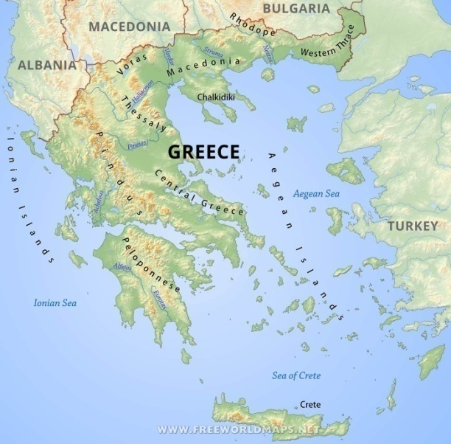
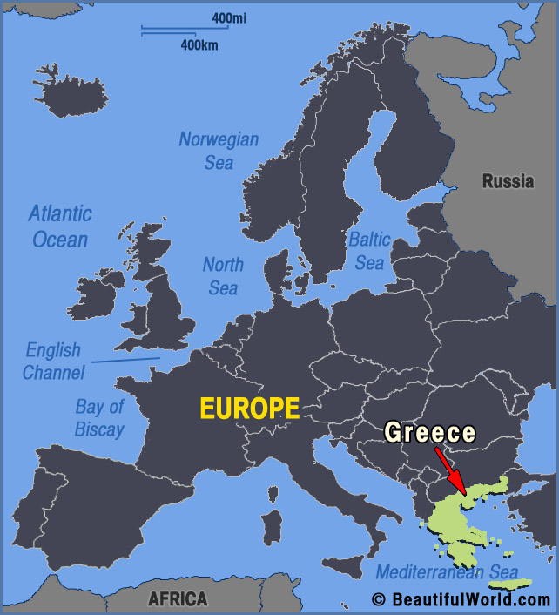
Religion: Eastern Orthodoxy
Independence declared from the Ottoman Empire: 25 March 1821 (traditional starting date of the Greek War of Independence), 15 January 1822 (official declaration).
Current constitution: 11 June 1975
Population: Approximately 10.800.000
Eighty percent of Greece is mountainous, with Mount Olympus being the highest peak at 2,918 metres.

Slide 4
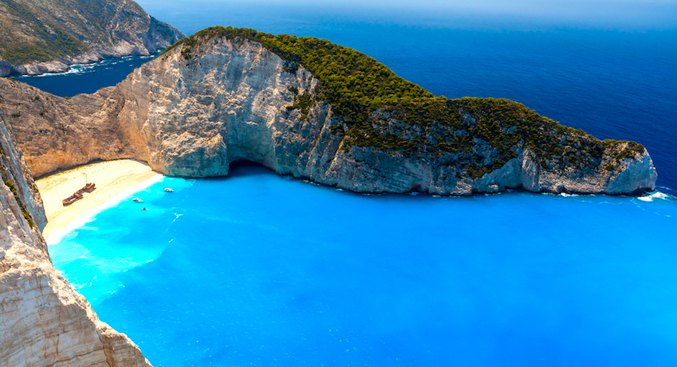
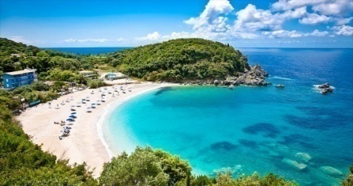
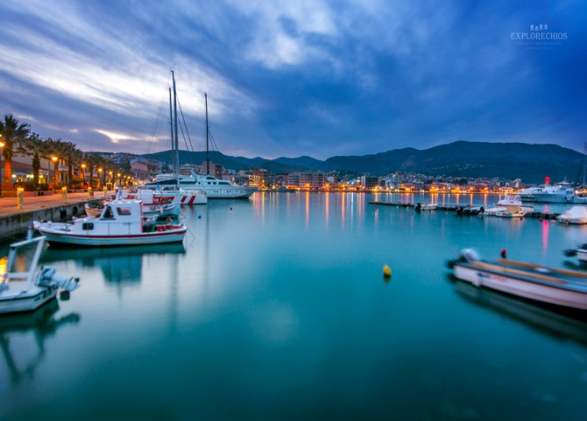
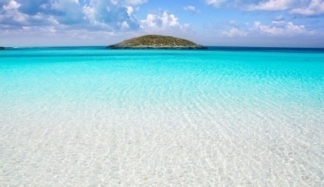
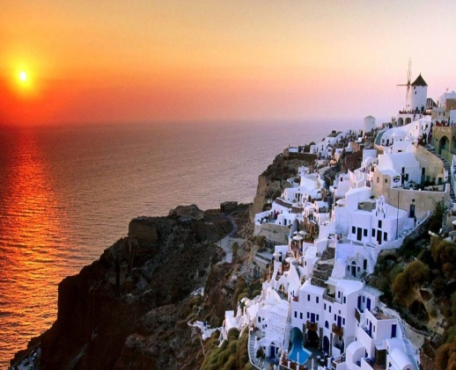
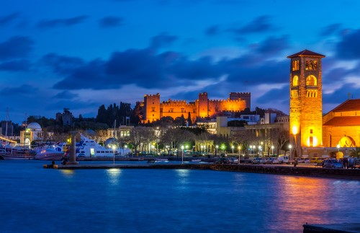
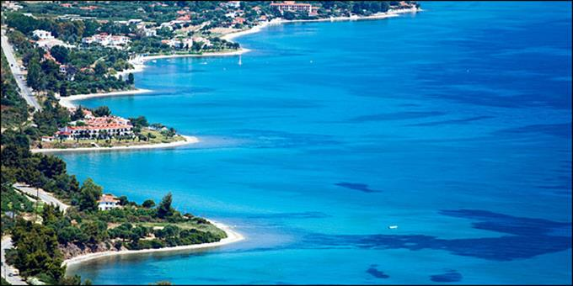
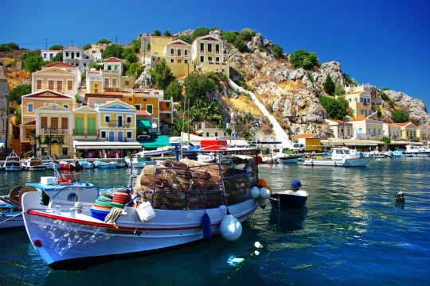
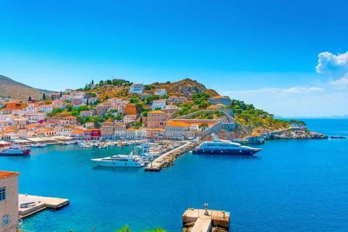
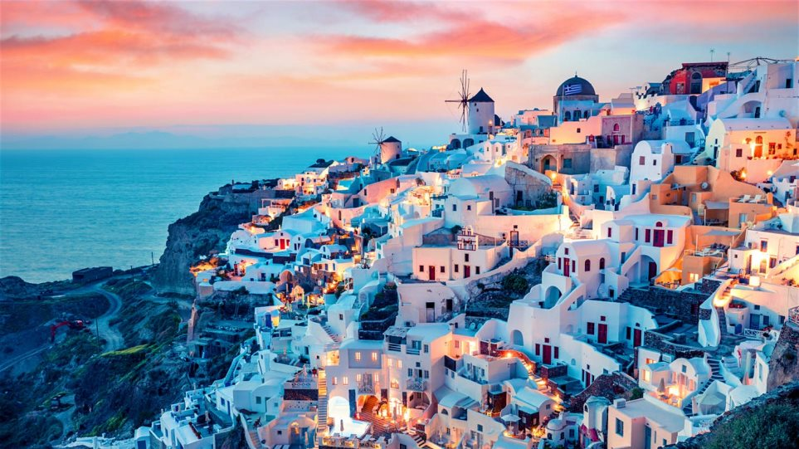
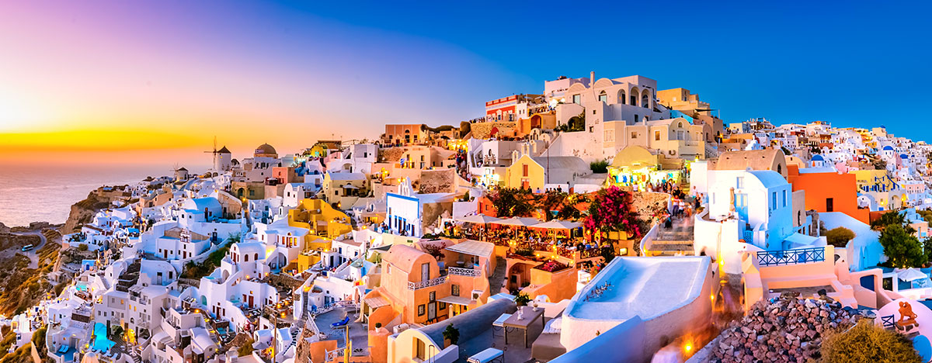
Tourism in Greece has been a key element of the economic activity in the country, and is one of the country's most important sectors. Greece has been a major tourist destination and attraction in Europe since antiquity, for its rich culture and history. Greece attracted more than 33 million visitors in 2018.

Slide 5
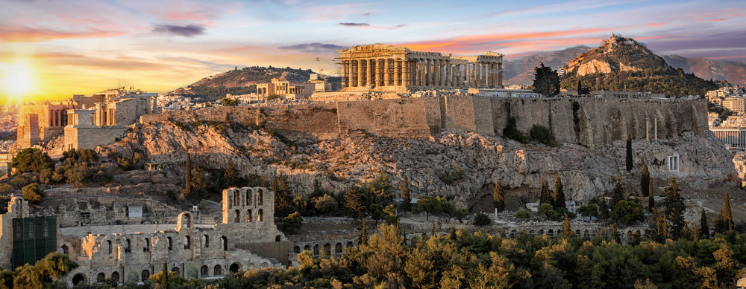
ANCIENT GREEK MONUMENTS
Greece is known for its fascinating and glorious past. The numerous historical monuments that have been preserved up to this day date from all me periods, from the Mycenaean and the Classical times. All the Medieval and Modern Era. The following is a list of some of the most important ancient sights.

Slide 6
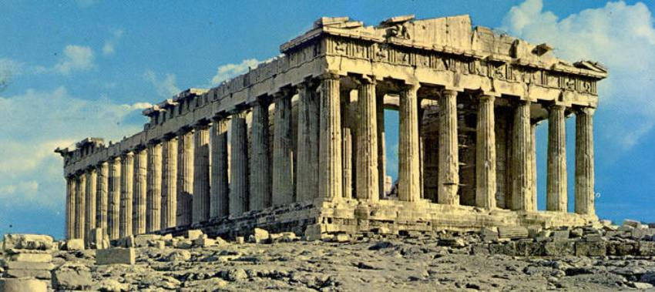
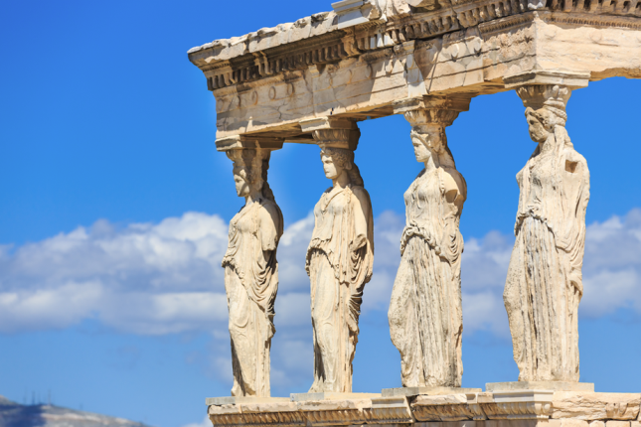
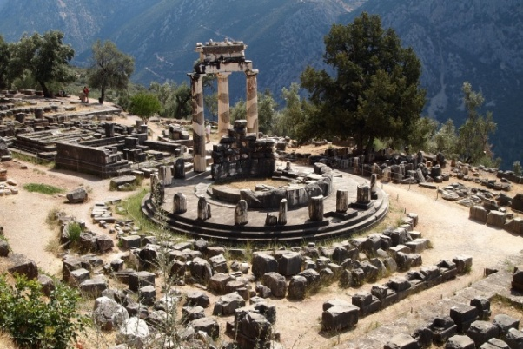
Acropolis of Athens
The Acropolis of Athens is the most famous historical monument of Greece. It was constructed during the Golden Century of Athens, by the best craftsmen of the era. It includes various impressive buildings, out of which the most famous is the Parthenon.
Oracles: Ancient Delphi and Ancient Dodona

Slide 7
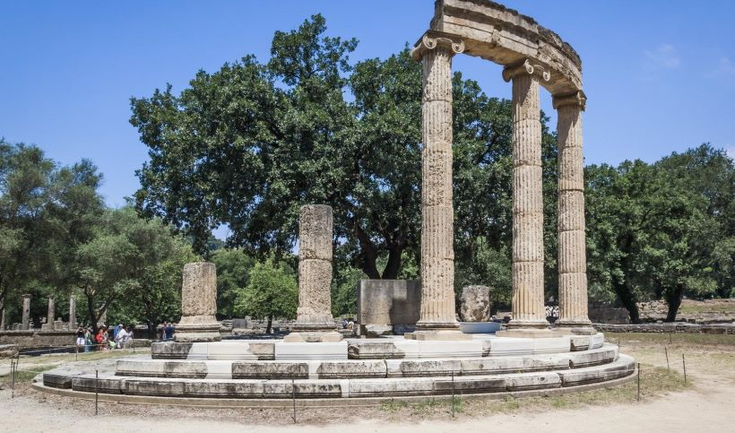
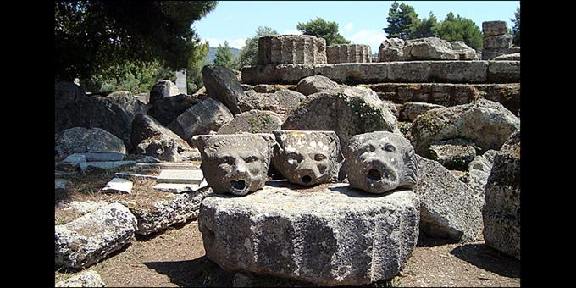
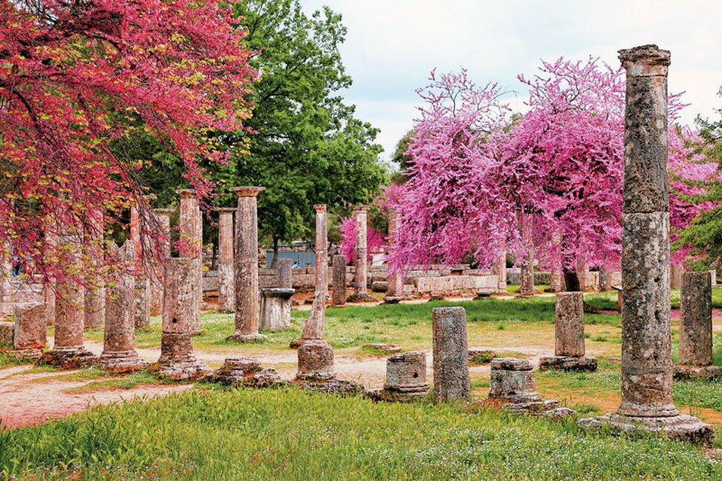
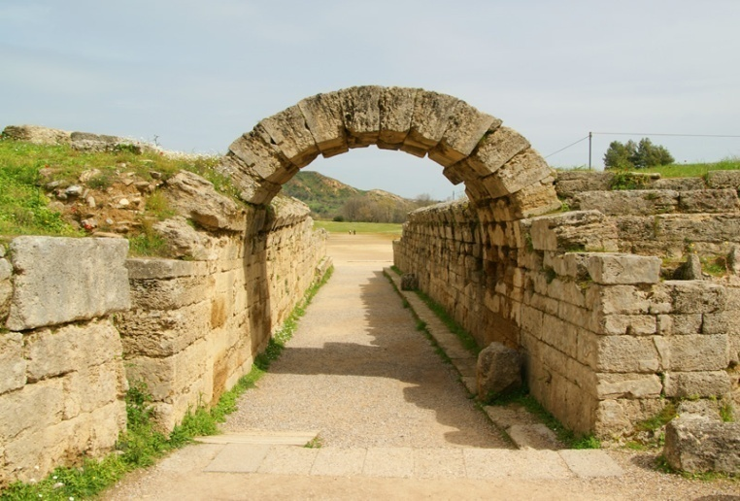
Ancient Olympia
Ancient Greeks are the pioneers of the Olympic Games and Olympia is the place where this competition
took place, once every 4 years. Today the most important sights in Ancient Olympia are the temples of
Zeus and Hera and the Ancient Stadium.

Slide 8
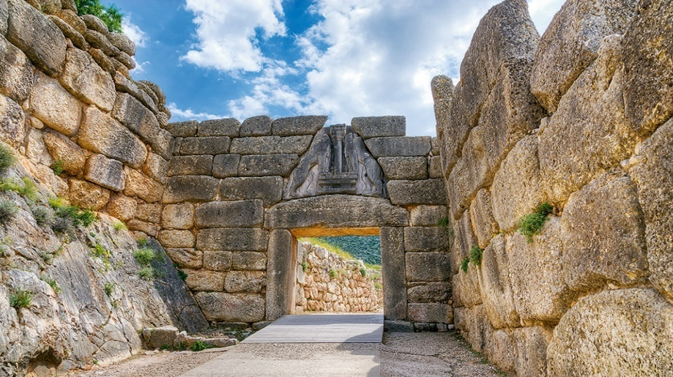
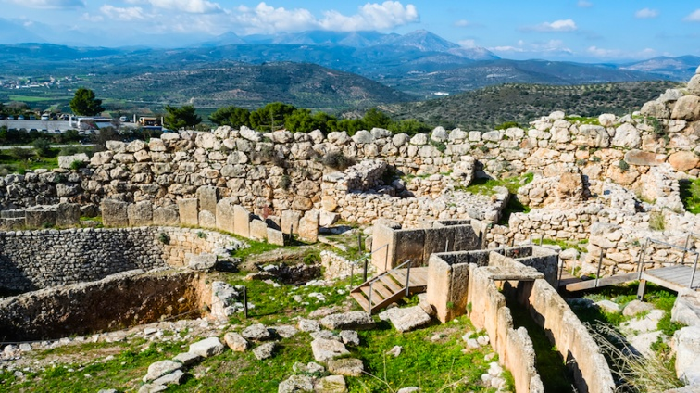
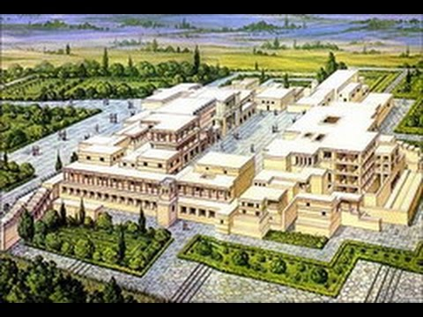
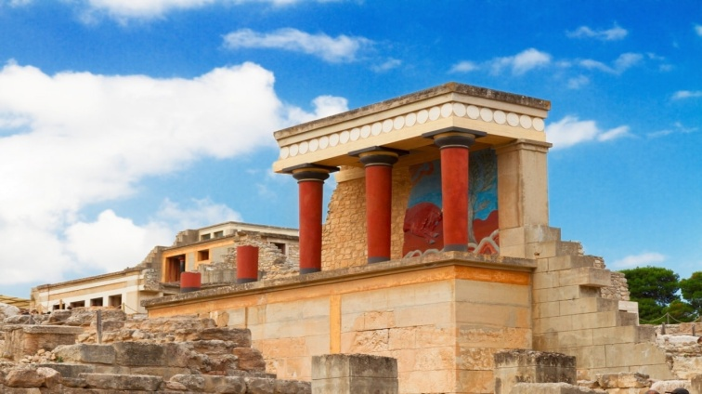
Mycenae
Minoan Palace of Knossos

Slide 9
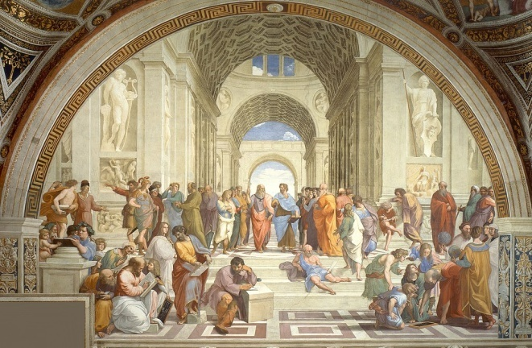
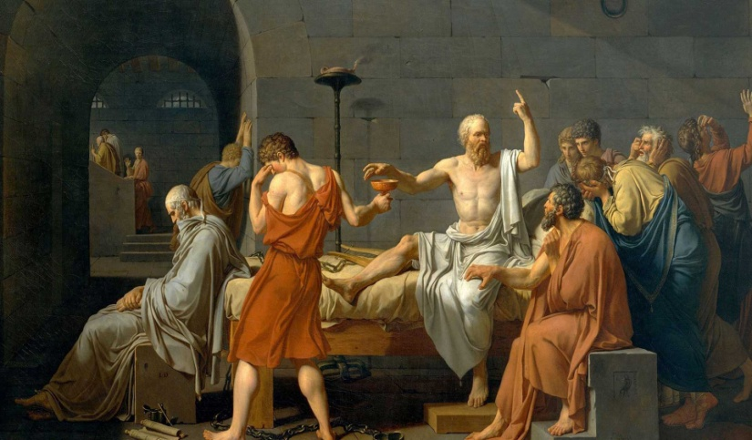
Ancient Epidaurus
.# 
 

Ancient Epidaurus
.# 
 

Ancient Epidaurus
.# 
 

Ancient Epidaurus
.# 
 

GREEK PHILOSOPHY
Ancient Greek philosophy arose in the 6th century BC and was used to make sense out of the world in a non-religious way. The most famous Greek philosophers are Socrates, Plato and Aristotle.Their words of wisdom inspired a variety of people in Ancient Greece, but they often caused controversy among the society, as philosophers had both followers and doubters.

Slide 10
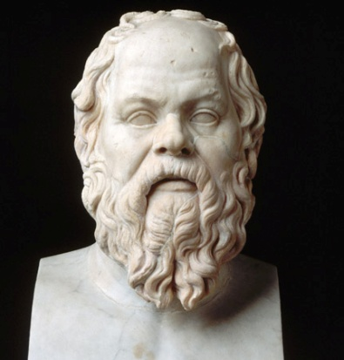
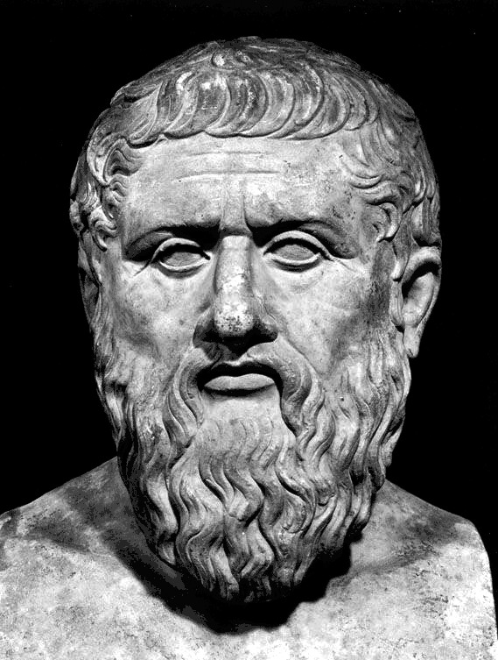
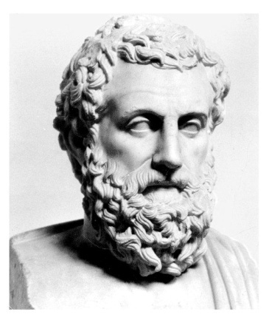
Socrates:
“One thing I know, that I know nothing.
This is the source of my wisdom.”
Plato:
“Good people do not need laws to tell them to act responsibly, while bad people will find a way around the laws.”
Aristotle:
“Anybody can become angry - that is easy, but to be angry with the right person and to the right degree and at the right time and for the right purpose, and in the right way - that is not within everybody's power and is not easy.”

Slide 11
Maro Tsivou
Ifigeneia Fardi
Georgia Vasilikou
Lefteris Xenokratis
Stavros Theocharidis
Lazaros Konstantinidis

